Slide 1
In search of best practices.
Beyond accuracy: why and how we use nonprobability samples and how we (should) report about them.
J. Kappelhof & S. Steijn

Slide 2
Overview
Why are we here?
The function and position of the Netherlands Institute for Social Research/SCP within the Netherlands
The golden standard for the SCP with respect to representation
Examples of deviations from the golden standard
Why do we sometimes deviate at the SCP?
Reflections on previous presentations from the SCP perspective
In search of best practices: questions and (proposed) guidelines
Notes:
Ad 1) Listened to all your presentations with great interest, but from a slightly different perspective

Slide 3
The Netherlands Institute for Social Research/SCP
Independent government research institute
Conducts research on sociocultural aspects of Dutch society
(Aims) to put relevant sociocultural developments on the governmental agenda and attempts to monitor and evaluate government policies (on request and on own initiative) using scientifically sound methodology
Government
SCP
Politics (stakeholders)
Science

Slide 4
The golden standard for the SCP with respect to representation
Golden standard (GS): surveys using probability based samples
          originating from a sample frame covering the entire target population
          and obtaining high and balanced response rates
Notes:
So , a clear definition of who belongs to our target population, complete coverage, no panel or convenience samples of any kind, no substitution, no low and possibly selective response.

Slide 5
Examples of deviations
Health care
Gender & Sexuality
Media usage
Non-registered migrants
Monitoring Vox Populi
Complex policy reforms
Notes:
Next we will provide a number of examples of where we decided or were forced to deviate from our GS aim. They have a wide range in topics and also in types of target population and challenges. We will discuss them briefly only highlighting the particular challenges with respect to these surveys causing us not to adhere to our GS aim.

Slide 6

Surveys among people requesting long term health care assistance, their caregivers and people responsible for assessing the health care request
Notes:
on the first of January 2015 several significant law reforms were introduced with respect to long term health care, one of which is the ‘devolution’ to local government (municipalities) of the responsibility to provide long term health care.
Aim: ascertain the impact and effectiveness of the revised health care system among people with perceived health care needs that request assistance, their caregivers and health care workers in municipality tasked with assessing/evaluating the health care needs.
No GS possible due to coverage and frame issues (hidden populations), cognitive challenges, but also extremely low response rates were expected due to being oversurveyed
For example, in the case of the survey among persons requesting care assistance we first needed to develop a sample frame in which every member of the target population would be listed. This meant asking the municipalities to provide us with a list of persons who had requested health care assistance for the first time in a certain time period (2015). However, many municipalities refused out right to provide/compile such a list, or did not have/record or could not provide a complete listing of anyone who had requested a form of care assistance for the first time in that time period. So, the target population was hidden. We tried other avenues such as to opt for a multistage sample design (PSU municipalities, SSU persons) using the population size of the elderly within a municipality as a proxy, but high refusal rates led to us asking every municipality to participate, but response was low and selective.
in case of persons working in a municipality and tasked with assessing people’s health care needs or request the fact that each municipality organised it differently caused major problems in getting the ‘right’ person or persons to ask the question.

Slide 7
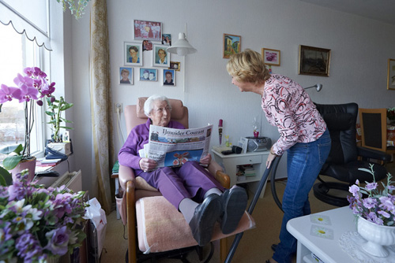
Surveys among elderly living in institutions for the elderly
Notes:
Aim: to obtain information regarding their health, leisure time, mobility, social network, but also the size and quality of the provided care.
No GS possible due to coverage/eligibility issues (there are many types of care facilities and living communities where elderly live on a (semi-)permanent basis and to what degree could they be considered institutions for the elderly, what to do with temporary residents), multiple layers of permission/potential for nonresponse (director of retirement home, person themselves or , in the case of proxies the nurse or family member and also cognitive challenges, excerbating the potential for nonresponse bias (i.e., some home only board the more serious patients (dementia, etc.) in which case directors or staff more easily refuse the survey participation request),
In this case we allowed replacement institutions and also proxy interviews for part of the questionnaire (nurse of family member), the remainder of the questionnaire was not completed.

Slide 8

        Surveys among LGBT community in the Netherlands
Notes:
Aim: gain insight in the socio-economic position of LGBT’s (several surveys), perceptions of tolerance, safety, etc.
No GS possible due to the fact most of them are a hidden population, but also in the case of transgenders a clear definition of who belongs to the target population.
For example, in case of the T we developed and implemented a WebRDS which didn’t work out and eventually we had to add respondents from an online convenience sample.
LGB also used online convenience samples

Slide 9
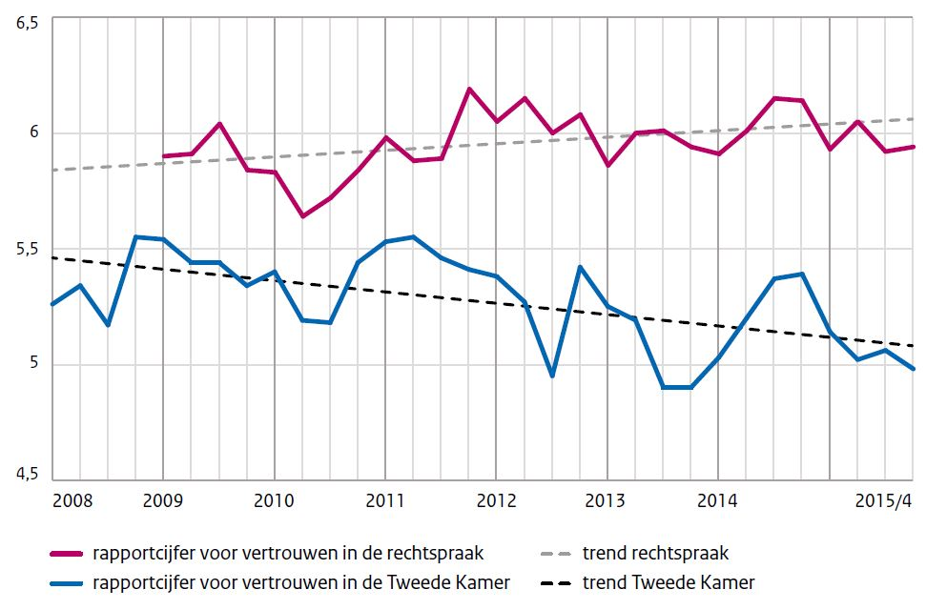
        Continuously monitoring the perspectives of Dutch citizens
Notes:
Aim is to map the opinions of Dutch citizens on a variety of topics relevant in todays society. In particular it aims to find out their main concerns on topics such as climate change, immigration, health care, etc., what is considered important, their general wellbeing, and the their opinions on society as a whole and politics. (thermometer)
No GS possible due to request for timeliness and budget. There is an update every three months.
In this instance we allowed for the use of a panel.

Slide 10
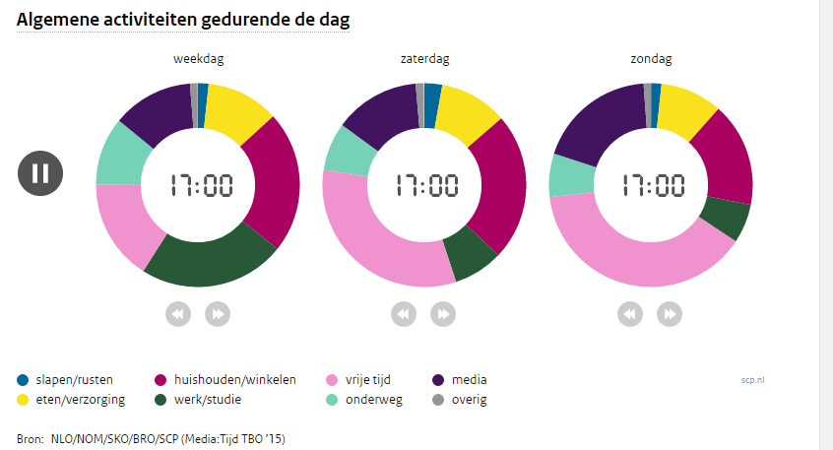
Time Use Survey
Notes:
Aim: Monitoring (digital and analogue) media use of Dutch population in a more sophisticated manner than the ordinary Time Use Survey
No GS possible due to commercial partners in combination with a low budget, but also hard-to-survey subgroups
Low net response rate (recruted under people who already filled in a survey on reading newspapers and who were willing to be part of more research)

Slide 11

Survey on the perceptions of Dutch citizens regarding solidarity in pensions
Notes:
Context: discussion in Dutch politics about the future of national pension funds and scheme’s.
Aim: to find out the support of solidarity in (supplementary) pension scheme's: Trying to answer questions such as if people still want to pay into the same pension fund as a society? Can relevant societal trends be found and be related to this? To which degree do people prefer collective over individual pension arrangements, etc.
No GS possible due to knowledge based challenges but also money issues. A feasibility study learned that people have great difficulty understanding the questions and usually do not have a lot of knowlegde regarding this topic.
As a result a panel was used. This panel – the Dutch national bank panel- consists of people with a great interest in economic topics and they were thought to be more knowledgable on the topic.

Slide 12

Survey among parents of Polish, Bulgarian and Romanian children living in the Netherlands.
Notes:
Aim: to ascertain their socio-economic living conditions, health and well being. Are their educational challenges that need to be addressed, is it easy for them to learn Dutch, do they have a difficult time adjusting/transitioning/coping with living in the Netherlands, etc.
No GS possible due to coverage and frame issues (hidden populations) and budget
Eventually a random sample was drawn of registered Polish, Bulgarian and Romanian parents (with or without a Dutch partner). However, the target population was broader and also included Polish, Bulgarian en Romanian children of parents residing in the Netherlands but who are not officially registered (such as seasonal workers, labourers who have their children come over only for limited periods in the year, etc.)

Slide 13
        Why do we sometimes deviate at the SCP if no GS is possible?
Total survey quality (TSQ): Considers the ‘fitness for use’ or ‘fitness for purpose’ of an estimate.
      Not only accuracy, but also other quality dimensions: timeliness, accesibility, usability, relevance, clarity, comparability, coherence, etc. (see for example Eurostat’s Quality Assurance Framework (2011) , Biemer (2010) or OECD (2011))
      Of course, some of the more qualitative dimensions are hard to quantify, but this is closer to the SCP context
          The SCP is mostly commissioned by government departments because the question is politically relevant
      In our examples the choice to deviate were the result of relevance and completeness, timeliness and punctuality, coherence, and comparability
Notes:
Relevance: The degree to which it meets the real needs of clients. Available statistics should reflect the needs and priorities expressed by the users (completeness).
Accuracy : The closeness between the estimated value and the (unknown) true value. Difference can be systematic (bias) or random (variance).
Timeliness : (and punctuality): How quickly data becomes available (and on time at pre-established dates).
Accessibility (and clarity): Are the data easily accessible by users and available in the forms users desire (and adequately documented- metadata).
Comparability: The extent to which differences between statistics from different geographical areas, non-geographical domains, or over time, can be attributed to differences between the true values of the statistics.
Coherence: The degree to which the data from a single data set (survey), and data brought together across data sets, are logically connected and complete. Statistics are coherent in so far as they are based on common definitions, classifications and methodological standard.

Slide 14
Reflections on presentations from SCP perspective
What have we learned
Our perspective

Slide 15
In search of best practices: guidelines
Judge how to report on a case by case basis
General guidelines we currently provide:
    Don’t report point estimates: ico lack of sample frame
    Do practice transparency and report openly about the use of a non-probability sample and its (potential) implications
    Do examine underlying dimensions, correlations and trends in the data
    Examine the coherence of the results with qualitative research using triangulation (if possible)

Slide 16
In search of best practices: additional guidelines?
Don’t report point estimates i.c.o. (very) low response rate?
BE very conservative with null hypothesis (use higher DEFF or lower alpha) and in visualising trends.

Slide 17
In search of best practices: questions
      How to deal with literature/information sources based on nonprobability samples when interpreting your own results?
      How to best report about the uncertainty when presenting results based on a sample with unknown inclusion probabilities?

Slide 18
References
Biemer, P.P. (2010). Total Survey Error. Design, Implementation, and Evaluation. Public Opinion Quarterly, 74, 5, 817 – 848.
Eurostat (2011). Quality Assurance Framework (QAF). Eurostat.
OECD (2011). Quality dimensions, core values for OECD Statistics and procedures for planning and evaluating statistical activities. OECD.

