Slide 1
An Empirical Process for Using Nonprobability Surveys for Inference
Robert Tortora
Ronaldo Iachan
ICF
Prepared for Paris Conference on Inference from Non Probability Samples
17 March 2017
Contact: Robert.Tortora@icf.com

Slide 2
An Empirical Process to Establish Usability of Nonprobability Surveys for Inference
Overview
Motivation behind method moving to Non-Probability Survey (NPS) for inference
Probability Survey (PS)
Increasingly more expensive
Increasing nonresponse rates
Current State
Comparisons to PS
How to push beyond comparisons with PS, deciding on a priori decision rule
Comparison – illustrate how to do it
At later time how can NPS stand alone, another a priori decision rule
Further research

Slide 3
An Empirical Process to Establish Usability of Nonprobability Surveys for Inference
NPS
Qualitative
Not Inferential - Accepted in market research, no accepted statistical theory
Fast (500 interviews, nationwide, with parents in hh with 19 – 35 month old children in 24 hours, 200 interviews in NYC for correlational study in 12 hours)
Low cost, relatively, even when paying an incentive
Hard to reach to survey (19 – 35 month children)

Slide 4
The CHINTS Pilot: A Comparison of national estimates with site level data
The most recent time you looked for information about health or medical topics, where did you go first?
Notes:
Module: Looking for Health Information
Question: A2 The most recent time you looked for information about health or medical topics, where did you go first?
Responses: 12 options. Graph restricted to the TOP FIVE most reported in HINTS

Slide 5
Compare 2 NPS designs to PS (the Kott situation)
Telephone Probability Survey
LA BRFSS
n = 1,000
Spanish Language interviewing
2 years earlier then NPS surveys
Non-probability Web Panel Surveys – no Spanish language questionnaire, some wording differences
NPS quota design based on panel firm survey method – start with hardest to fill quota cells – called Quota, n = 689 (an aside – inverse sampling with its different estimators for proportions and sampling error)
2. NPS based on random sample selected before fielding, based on census demos – called Census – select large enough initial sample to allow for reminders and obtained finalize sample size, n = 553

Slide 6
An Empirical Method to Establish Usability of Nonprobability Surveys for Inference
This is a proposed method to push beyond just comparing NPS to PS and to allow for use of NPS for inference, i.e., in manner of a PS
1) Motivated by risk tolerance as in design based surveys where we design a survey and select a sample with the risk α (generally = 0.05) of getting a bad sample, that is, in 1 out of 20 surveys, using predefined (a priori) decision rule and 2) motivated by Statistics Sweden Aspire system (Bergdahl, H., Biemer, P. and Trewin, D. (2014)).
Assumes NPS from a panel “quota sample” (NOT a river sample, or other convenience sample), a sample design that is repeatable
Dropping the PS
Assuming successful comparison to PS on the first occasion the NPS stands alone at later times if 1) panel demos only change marginally (user decides acceptable level of change) and 2) the same quota sample design is used
Continue on with NPS until panel demos change too much

Slide 7
Method
The organization that is responsible for making these estimates, selects the level of risk they are willing to accept by deciding on what to compare
Make overall population estimates, PE, or
Make sub-population estimates, SPE, or
Conduct multivariate analysis, MA
Include post stratification adjustment, PSW
If the organization
only want overall estimates then a rule using comparisons at the overall level and defined a priori.
wants overall estimates and sub-population estimates then a rule covering overall comparisons and sub-population comparisons and defined a priori.
wants overall estimates, sub-population estimates and multivariate relationships then a rule covering overall estimate comparisons, sub-population comparisons and “correlational” comparisons and defined a priori.
Considers the overall impact of adjusting – how much

Slide 8
Method
Rules are developed in the form of indices I_{k}, k = PE,SPE, MA and PSW
I_{k} is calculated based on comparisons where a “good” comparison results in a 0 added to the index and a “bad” comparison results in some positive number added to the index.
Since the rule is defined a priori the organization knows in advance the maximum possible “bad” score, say I_{MAX} and can assign the level of risk at some cutoff, say I_{C} , where if I_{k} <= I_{C} the NPS is acceptable for inference.
The organization is free to decide on the risk that is acceptable, if I_{C} near 0 then the organization is not willing to tolerate much risk and when I_{C} nears I_{MAX} the organization is wiling to tolerate more risk.
Determining level of risk may include factoring in mode differences, timing, etc. This may increase the level of risk willing to tolerate

Slide 9
Decision Rules
Points assign as individual comparisons within the predefined rule(s)
Create index(s) and every time a comparison fails add to the index. If the index score is over a predefined acceptable level of risk the comparison of the NPS to the PS is not successful
Assume data user chooses rules based on:
comparing ever asthma, ever diabetes, ever cancer, ever smoker, current smoker, excellent/very good health, flu shot last year and visited doctor in past year
1. overall, 95% confidence intervals (Stephan and McCarty (1958), Sudman (1966))
adding 1 for each unsuccessful comparison
2. by gender, 95% confidence intervals
adding 1 for each unsuccessful comparison
3. ratio of cv of post-stratification weights, if ≤ 1.2, 0 added to index, if ≥ 1.21 added 1 to index
Max score for index is 25 if add 1 for each failed comparisons, user decides a priori cut off - if I_{C} > k NPS not acceptable

Slide 10
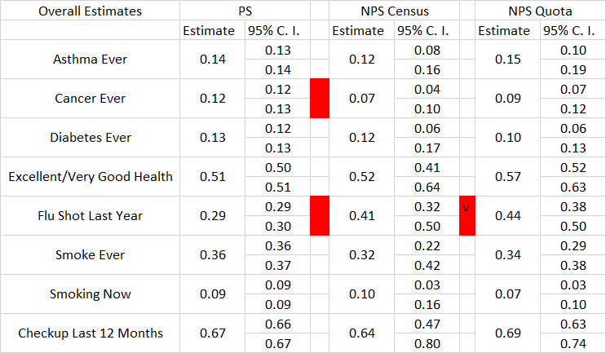
Overall Comparisons to PS

Slide 11
Example of a scoring method
Sub-population estimates by gender: Census NPS and Quota NPS both have total score of 4 out of 16.
Census NPS
Male Flu Shots
Female Flu shoots
Male ever cancer
Male smoker ever
Quota NPS
Male Flu Shots
Female Flu shoots
Male ever cancer
Female ever diabetes

Slide 12
Example of a scoring method
Ratio of cv of post-stratification weights
Census NPS/PS - 0.03, add 0 to index
Quota NPS/PS - 2.54, add 1 to index

Slide 13
An Empirical Method to Establish Usability of Nonprobability Surveys for Inference
Index score for Quota NPS and Census NPS is 6 (1 + 4 + 1) and (2 + 4 + 0), respectively
1. For later occasions compare panel demos from time 1 based on a priori decision rule
2. If not substantial change, again user determined, no need to have a comparison PS, conduct NPS using same quota sample design – data is acceptable for use
3. For even later use repeat 1 and 2.
4. When panel demos change too much repeat NPS and PS comparison.

Slide 14
Moving On
Remove differences
use self-administered mode for PS and NPS
conduct same time
eliminate question wording differences
Combine comparisons
Large urban health department deciding on rule and cutoff
April/May 2017 fielding
assuming successful comparison
Compare panel demos in April 2018 and conduct NPS alone

Slide 15
Thank You
Robert.Tortora@icf.com

