Slide 1

  The perils of non-probability sampling
Jelke Bethlehem
Leiden University, The Netherlands

Slide 2
The perils of non-probability sampling
Overview
  The rise of survey sampling.
  The fundamental principles of probability sampling.
  Case 1: Nonresponse in surveys based on random sampling.
  Case 2: Self-selection in online surveys.
  Some examples of self-selection.
  A random sample + nonresponse, or a self-selection sample.
  Conclusion.

Slide 3
Surveys, polls, …
Different terms for the same type of research
  Investigation of a group of people (the population).
  Measurement by means of asking questions.
  Observation of only a small selection from the population (the sample).
  Generalisation of the outcomes from the sample to the population.
Does this work?
  Yes, if it is a good survey.
  No, if it is a bad survey.
  What is a good survey?
Generalisation
Population
Conclusions
Sample
Selection

Slide 4
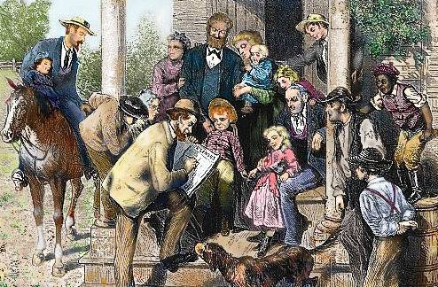
The rise of sample surveys
Until 1895: complete enumeration (censuses)
  New France (Canada): 1666, Jean Talon (intendant), 3215 people.
  Sweden: 1748, Denmark: 1769.
  Netherlands: 1795, new system of electoral constituencies.
  Standardized questionnaires.
  Legal obligation to participate.
No sampling
  It was considered not proper to replace people by computations. Sampling is discrimination.
  No reliable conclusions possible based on sample data. Data are required on all people.

Slide 5
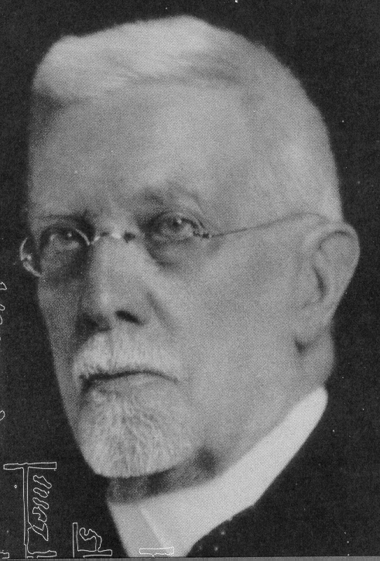
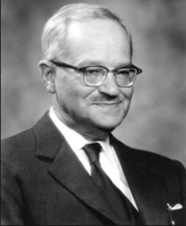
The rise of sample surveys
Developments
  1895: Anders Kiaer proposes his ‘Representative Method’. A kind of quota sampling. Create a miniature of the population. Accuracy of estimates cannot be computed.
  1906: Arthur Bowley shows the importance of random sampling. Probability Theory can be applied. Estimates have a normal distribution. Variances can be computed.
  1934: Jerzy Neyman introduces the confidence interval. He also shows that quota sampling does not work.

Slide 6

The rise of sample surveys
The fundamental principles of survey sampling
  Samples must be selected by means of probability sampling.
  Every person must have a positive probability of selection.
  All selection probabilities must be known.
Consequences
  It is always possible to construct an unbiased (valid) estimator.
  Estimators often have a (approximately) normal distribution.
  Accuracy of estimators can be computed (confidence intervals).
Warning
  For other forms of sampling (e.g. quota sampling, or self-selection ), it is not clear how reliable and accurate the outcomes are.

Slide 7
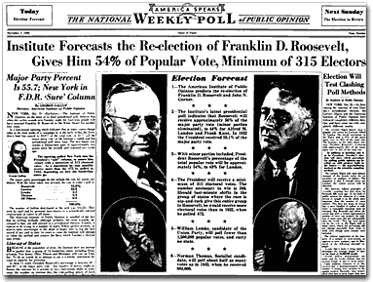
Bad example: the presidential elections in the U.S. in 1936
The Literary Digest poll
  Sample: Lists of car owners and telephone directories.
  Sample size: 2,400,000.
  Prediction: Alf Landon (Republican) will win.
The George Gallup poll
  Quota sample (gender, age, socioeconomic class, region). on quota.
  Sample size: 50,000.
  Hundreds of interviewers spread over the country.
  Prediction: Franklin Roosevelt (Democrat) will win.

Slide 8
Bad example: the presidential elections in the U.S. in 1936
Result
  Prediction of Literary Digest was wrong.
  Prediction of Gallup was right.
Conclusion
  Sample of Literary Digest was not representative.
  Sample contained too many middle and upper class people. They tend to vote Republican.
  A large sample does not help if it lacks representativity.
Candidate | Prediction by Literary Digest | Prediction by Gallup | Election result
Roosevelt (Dem) Landon (Rep) | 43% 57% | 56% 44% | 61% 37%

Slide 9
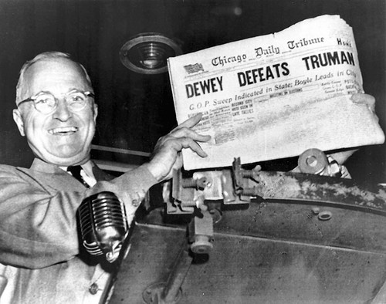
Bad example: the presidential elections in the U.S. in 1948
The Gallup Poll
  Thomas Dewey (Republican) vs Harry Truman (Democrat).
  Prediction: Dewey will win.
  Newspapers did not wait for final results.
  Harry Truman turned out to be the winner.

Slide 10
Example: the presidential elections in the U.S. in 1948
The result
Causes
  Quota sampling instead of probability sampling.
  Over-representation of Republicans in quota samples.
  Poll stopped too early (two weeks before the elections).
  Consequence
  Gallup replaced quota sampling by random sampling.
Candidate | Prediction by Gallup | Election result
Truman (Dem) Dewey (Rep) | 44% 50% | 50% 45%

Slide 11
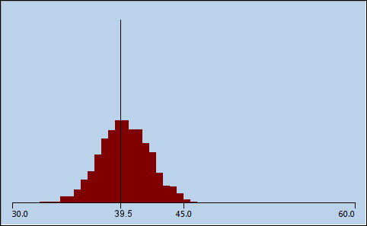
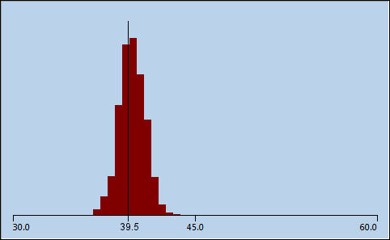
Random sampling really works …
Simulation: election survey in the town of Rhinewood
  Population of 30,000 voters.
  Estimate percentage voting for the New Internet Party (NIP).
  True population percentage: 39.5%.
  Repeat sample selection a large number of times.
  Samples of size 500 Samples of size 2,000

Slide 12
Problems
Increased costs
  Interviewer-assisted surveys (CAPI, CATI) is becoming too expensive.
  Can we change to online surveys without sacrificing quality?
Sampling issues
  There are no proper sampling frames for online surveys.
  It becomes difficult to select a sample for a telephone survey.
Increasing nonresponse problems
  Response rates < 10% for telephone surveys (RDD).
  Response rates < 40% for online surveys.
  Do the principles of probability sampling still apply?
Notes:
Now, let’s have a look at the current situation in general. Then there are a number of issues.

Slide 13
The nonresponse problem
Nonresponse in surveys
  Persons who are selected in the sample (and who belong to the target population) do not provide the requested information.
Main causes of nonresponse
  Non-contact.
  Refusal.
  Not-able.
Consequences of nonresponse
  Estimators are less precise due to fewer observations.
  Representativity is affected, because nonresponse is selective.
  Therefore, estimators can be biased.

Slide 14
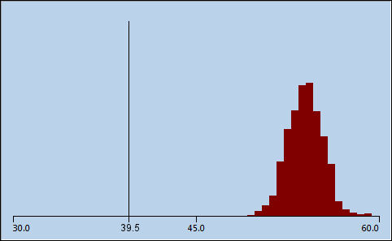
The nonresponse problem
Simulation: election survey in the town of Rhinewood
  Estimate percentage voting for the New Internet Party (NIP).
  True population percentage: 39.5%.
  People with internet respond more than those without.
  Repeat sample selection a large number of times.
  Samples of size 2,000 Samples of size 2,000
  Full response 61% response

Slide 15
The nonresponse problem
Modelling nonresponse
  Each person k has an unknown probability ρ_{k} to respond.
  Simple random sample.
  The response percentage is a biased estimator of the population percentage.
  The bias is of the estimator is equal to
Bias depends on
  Correlation R_{ρY} between target variable and response probabilities.
  The standard deviation S_{ρ} of the response probabilities.
  Mean response probability.

Slide 16
The nonresponse bias
The bias due to nonresponse:

Slide 17
The nonresponse bias
The bias due to nonresponse:
Correlation between response probabilities and survey variable

Slide 18
The nonresponse bias
The bias due to nonresponse:
Correlation between response probabilities and survey variable
Variation of response probabilities

Slide 19
The nonresponse bias
The bias due to nonresponse:
Correlation between response probabilities and survey variable
Variation of response probabilities
Response rate

Slide 20
The nonresponse bias
The bias due to nonresponse:
  Note: Increasing the sample size does not help to reduce the bias.
Correlation between response probabilities and survey variable
Variation of response probabilities
Response rate

Slide 21
Solving the nonresponse problem
Solution 1: reduction of the nonresponse
  Reduce nonresponse in the field as much as possible.
  For example: more training for interviewers, more reminders, use of incentives.
  This is expensive and time-consuming.
  There will always remain nonresponse.
Solution 2: correction for the effects of non-response
  Is the usual approach.
  Attempt to reduce the bias of estimators.
  Apply correction technique: adjustment weighting.

Slide 22
Solving the nonresponse problem
What is adjustment weighting?
  Assignment of weights to responding persons.
  Use of weighted values to compute estimates.
  People in over-represented groups get weight smaller than 1.
  People in under-represented groups get weight larger than 1.
Ingredients: auxiliary variables
  Individual values must be measured in the survey.
  Distribution in population must be available.
Weighting is only effective, if
  There is strong correlation with target variables of the survey.
  There is strong correlation with response behaviour in the survey.

Slide 23
Solving the nonresponse problem
Weighting techniques (1)
  Make the response representative with respect to auxiliary variables.
  Post-stratification (simple weighting).
  Generalized regression estimation (linear weighting).
  Raking ratio estimation (multiplicative weighting).
Weighting techniques (2)
  Based on estimated response probabilities (response propensities).
  Adapt Horvitz-Thompson estimator by including estimated response probabilities.
  Post-stratification based on estimated response probabilities.
Problem
  Insufficient effective auxiliary variables.

Slide 24






Online surveys
Online survey
  Rapidly became very popular.
  Simple access to large group of potential respondents.
  Fast data collection. One can do a survey in a day.
  Cheap: no interviewers, no printing costs, no mailing costs.
  Attractive: use of video, audio, pictures, and animation.
  Everyone can do it!
Problem
  How to select a sample for an online survey.

Slide 25
Online surveys
Selection of a random sample for an online survey
  A sampling frame is required for a probability sample.
  There is often no sampling frame containing e-mail addresses.
  So it is not possible to send an e-mail with a link to the questionnaire website.
Alternative 1: survey with different recruitment mode
  Draw a random sample from a population register, or an address list, and send a letter (with a link) to each selected address.
  Draw a random sample of telephone numbers, call the selected people, and give them a link.
  Disadvantages: more cumbersome, not so fast, more expensive.

Slide 26




Online surveys
Alternative 2: set up an online panel
  Recruit members with a random sample.
  Recruitment mode: mail or CATI.
  Only setup is time-consuming and expensive.
  Surveys based on random sample from the panel
Bad alternative
  Rely on self-selection (opt-in) of respondents.
  Self-selection sampling = non-probability sampling.

Slide 27
Online surveys, self-selection problems
Self-selection
  No probability sampling is applied.
  Participants are people that happen to see the invitation, have internet, and spontaneously decide to participate.
  It is a cheap and fast way to collect a lot of data.
  However, the sample is not representative.
Problems
  Also people outside the target population of the survey can respond.
  Often people can respond more than once (on the same, or on a different computer).
  Groups of people may attempt to manipulate the outcomes of the web survey.

Slide 28

Online surveys, self-selection problems
Example 1 of self-selection
  2005 Book of the Year Award.
  High profile literary prize in the Netherlands.
  A self-selection survey was carried out to select the best book.
  One could vote for one of nominated books, or suggest another book.
  Number of participants: 92,000.
  72% voted for a non-nominated book: the new Bible translation.
  Result of a campaign by Bible societies, a Christian TV-channel, and a Christian newspaper.

Slide 29
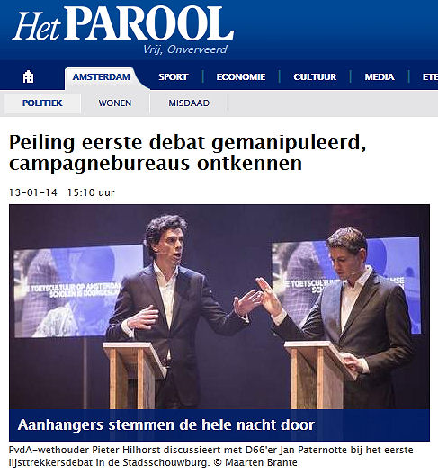
Online surveys, self-selection problems
Example 2 of self-selection
  Local elections in Amsterdam in 2014.
  Debate between local party leaders.
  Online poll: who was the best?
  Two campaign teams discovered one could vote more than once.
  They voted all night. Results:
  The poll was cancelled.
Party | Votes
D66 SP PvdA GL VVD | 3,890 3,816 1,121 852 214

Slide 30
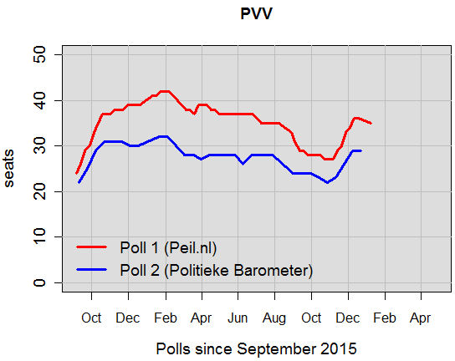
Online surveys, self-selection problems
Example 3 of self-selection
  Two major Dutch election polls.
  Both based on self-selection online panels.
  Estimates for largest party (right-wing, populist PVV).
  Systematic difference of 8-10 seats (on a total of 150 seats).

Slide 31
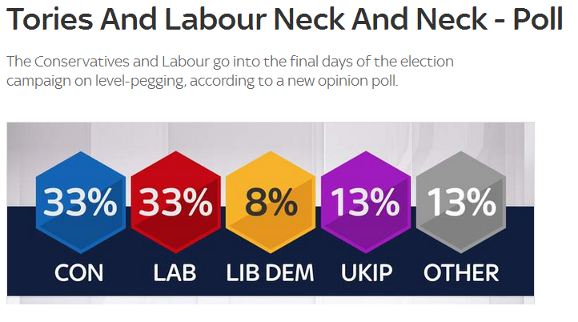
Online surveys, self-selection problems
Example 4: The UK Polling Disaster
  General election of 7 May 2015 in the United Kingdom.
  There were many polls (telephone and online).
  All predicted a neck-to-neck race between the Conservative Party and the Labour Party, likely leading to a ‘hung parliament’.
  They were all wrong: the Conservatives got a comfortable majority of 6.5 percentage points.
Sky News
4 May 2015

Slide 32
Online surveys, self-selection problems
Example 4: The UK Polling Disaster
  Difference between Conservatives and Labour.
  Difference in election: 6.5%
Poll | Mode | Sample | Difference
Populus YouGov Survation PanelBase Opinium TNS BMG Ipsos MORI ComRes ICM Lord Askcroft | web panel web panel web panel web panel web panel web panel web panel telephone telephone telephone telephone | 3,917 10,307 4,088 3,019 2,916 1,185 1,009 1,186 1,007 2,023 3,028 | 0% 0% 0% -2% 1% 1% 0% 1% 1% -1% 0%

Slide 33
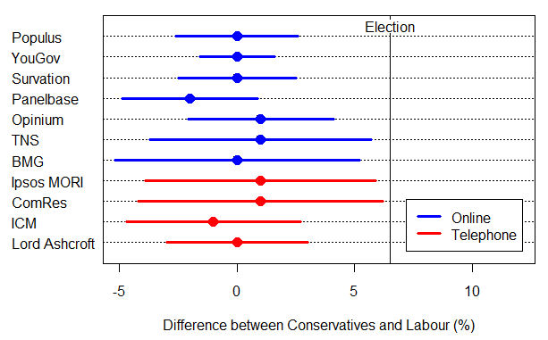
Online surveys, self-selection problems
Example 4: The UK Polling Disaster
  Variable: the difference between Conservatives and Labour.
  There are significant differences between polls and election result.

Slide 34
Online surveys, self-selection problems
Example 4: The UK Polling Disaster
  There was no ‘Shy Tory Factor’.
  There was no ‘Late Swing’.
  ‘Herding’ could not be excluded completely.
Conclusions
  The web surveys were not representative because they were based on self-selection web panels.
  The telephone surveys were not representative because they suffered from very low response rates (20%).
  The weighting adjustment techniques used, were not effective. They were not able to reduce the bias.

Slide 35
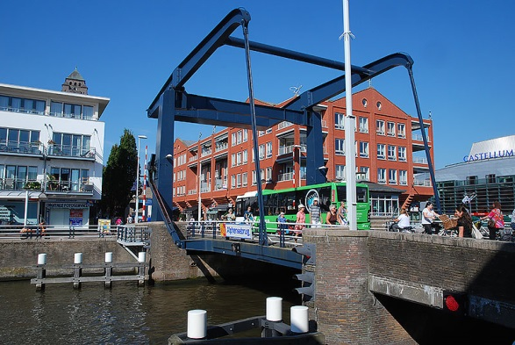
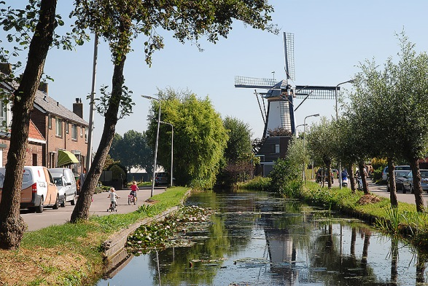
Online surveys, self-selection problems
Example 5: Shopping Sundays in a municipality
  Urban town Alphen (70,000 people)
  Seven rural villages: Aarlanderveen, Benthuizen, Boskoop. Hazerswoude-Dorp, Hazerswoude-Rijndijk, Koudekerk, Zwammerdam (together 30,000 people).
Alphen Benthuizen

Slide 36
Online surveys, self-selection problems
Example 5: Shopping Sundays in a municipality
  Should the shops be open on Sunday?
  Liberal parties in favour, Christian parties opposed.
Three surveys at the same time
  Face-to-face interviews by members of political parties in shopping centres on one Saturday afternoon. 754 interviews.
  Citizen panel, based on random sample from population register. 857 interviews. Response: 54%.
  Self-selection web survey, to give everyone the possibility to express an opinion. 1550 interviews.
Note
  Appeal by churches to their members to vote.

Slide 37
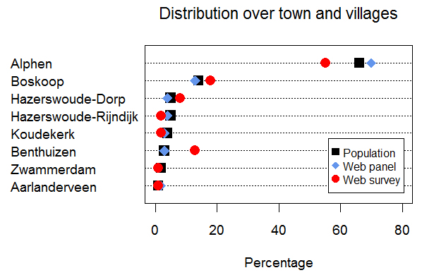
Online surveys, self-selection problems
Example 5: Shopping Sundays in a municipality
  Distribution of the response over town and villages.
  Small Christian villages are over-represented

Slide 38
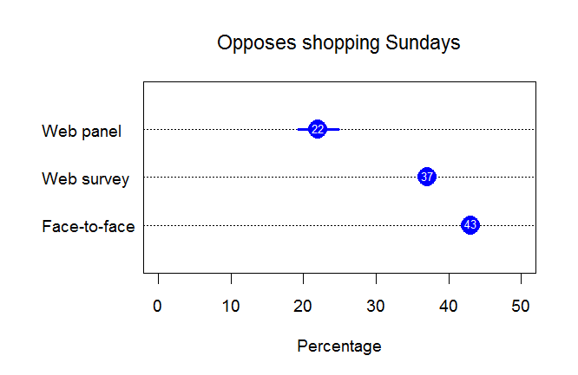
Online surveys, self-selection problems
Example 5: Shopping Sundays in a municipality
  Results of the surveys
  Large differences between surveys!. Which one is correct?

Slide 39
Self-selection problems
Self-selection bias
  Respondents are people that have internet, happen to see the invitation, and spontaneously decide to participate.
  Each person k has unknown probability π_{k} to participate.
  The bias of the estimator is equal to
Bias depends on
  Correlation R_{πY} between target variable and participation probabilities.
  The standard deviation S_{π} of the participation probabilities.
  Mean participation probability.

Slide 40
Self-selection problems
Question
  Isn’t a random sample with a low response rate just as bad as a self-selection sample?
  The expressions for the bias look similar.
  However, the response probabilities are much larger than the participation probabilities.
Worst case: maximum absolute bias
  Random sample + nonresponse:
  Self-selection sample:

Slide 41
Self-selection problems
Examples
  CAPI survey, random sample, response rate = 60%:
  Telephone survey, random sample (RDD), response rate = 10%:
  Self-selection survey. Population = 12 million, response = 120,000, participation rate = 1%.

Slide 42
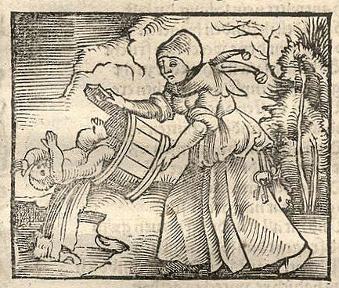
Conclusions
Random sampling or self-selection?
  The worst case bias of a large self-selection sample is much larger than a random sample with a very low response rate.
  Use random sampling. Do not throw out the baby with the bath water.
  But
  Improve the quality of web panels .
  Work on better weighting adjustment techniques.

