Slide 1
A Comparison of Two Nonprobability Samples with Probability Samples
Elizabeth S Zack
Department of Sociology
John M Kennedy
Center for Survey Research
Indiana University Bloomington

Slide 2
Research Questions:
Under what conditions can nonprobability online panels be used for social science research?
Are multivariate models generated from online panels comparable to similar models generated from gold standard surveys?
Should social science researchers use nonprobability samples?

Slide 3
Appropriate use of online panels
Experiments
Online nonprobability samples produce high quality experimental data (e.g., Berinsky et al. 2012; Leeper & Mullinix 2014; Mullinix et al. 2013; Weinberg et al. 2014)
Point estimates
With appropriate selection procedures and statistical controls, the online panels do reasonably well. Some procedures are better than others (Pew, 2016)

Slide 4
MTurk
Amazon product; workers paid for generally small tasks performed online
No control on participant characteristics
Conducted spring 2015
N = 250 to 350
Notes:
.
.

Slide 5
Qualtrics Panel
Qualtrics aggregates participants from opt-in panels
Requested demographic controls for age, gender, and region
Conducted summer 2015
N = 450 to 550

Slide 6
2014 General Social Survey
random sample of US noninstitutionalized population
Conducted in-person; April - October
n = 1,000 to 2,300
Response rate – 69%

Slide 7
2013 American National Election Reconnect Study
Online follow-up of ANES 2012 Time Series internet sample
Conducted July 2013
n = 1663
Response rate – 2% (estimated)

Slide 8
Study Focus
Compare GSS and ANES with Mturk and Qualtrics Panel
Using GSS/ANES instead of Census or other demographic controls
Use similar methods to most social science researchers
Not using methods used by survey researchers to evaluate sample quality or develop point estimates
Comparison of multivariate models

Slide 9
Survey Questions
Dependent Variables
Health and Well Being
Science
Education
Family
Government
Policy Preferences
Racial Attitudes
Independent Variables
Demographics age, gender, region, race & ethnicity, education, marital status, political ideology, party id, income

Slide 10
Data Analysis
Frequency distributions
Demographics
Outcome variables
Bivariate associations
Multivariate models using demographics with public opinion items
Examine effects of sample type on multivariate models
Limited number of dependent variables for the models

Slide 11
Age
ANES
GSS
MTURK
QUALTRICS

Slide 12
Education
ANES
GSS
MTURK
QUALTRICS

Slide 13
Demographic Comparisons
Mturk vs GSS
more males and whites than GSS
MTurk workers have more education, are younger, have lower incomes, are more liberal, are less likely to identify as Republican, and are more likely to have never been married than GSS
Mturk vs ANES
MTurk sample has marginally more whites
MTurk workers have significantly more education, are younger, have lower incomes, are more liberal, are less likely to identify as Republican, and are more likely to be living with a partner or to have never been married than ANES

Slide 14
Demographic Comparisons
Qualtrics vs GSS
The Qualtrics sample has marginally more males, and significantly more whites.
Qualtrics respondents have more education, are younger, have lower income, are less politically moderate, are less likely to identify as Independent, and are more likely to never have been married than GSS
Qualtrics vs ANES
Qualtrics sample have significantly more education, are younger, have lower income, are more liberal, and are more likely to be living with a partner or to never have been married
Qualtrics closer match on demographics

Slide 15
Should government make it easier or more difficult to buy guns?
Should government do more to solve country’s problems or should this be left to private businesses?
ANES
GSS
MTURK
MTURK
QUALTRICS
QUALTRICS

Slide 16
Is life exciting or dull?
Science research should be supported by the federal government.
GSS
GSS
MTURK
MTURK
QUALTRICS
QUALTRICS

Slide 17
Do the poor have more or less money than they deserve?
If certain groups stayed in their place, we would have fewer problems
ANES
ANES
MTURK
MTURK
QUALTRICS
QUALTRICS

Slide 18
Outcome Variable Distributions - Summary
MTurk distributions differed significantly from ANES distributions on all four ANES variables
Qualtrics differed significantly on three of the four variables
MTurk distributions differed significantly from GSS on 19 of the 22 GSS variables
Qualtrics significantly differed from GSS on 11 of the 22 variables

Slide 19
Bivariate Analysis
Selected questions and demographics presented
Use one category of outcome variables to make comparisons easier
Illustrative rather than significance testing

Slide 20
Science makes our way of life change too fast (% strongly agree)
Age |  | GSS | Mturk | Qualtrics
18 - 29 |  | 8% | 22% | 13%
30 - 49 |  | 4% | 18% | 6%
50-64 |  | 7% | 12% | 5%
65+ |  | 6% | 0% | 7%
Gender
Male |  | 5% | 19% | 7%
Female |  | 6% | 18% | 8%
Ideology
Extremely Liberal |  | 26% | 31% | 13%
Liberal |  | 8% | 15% | 9%
Slightly Liberal |  | 5% | 17% | 3%
Moderate |  | 5% | 19% | 7%
Slightly Conservative |  | 5% | 23% | 7%
Conservative |  | 5% | 3% | 7%
Extremely Conservative |  | 4% | 19% | 6%

Slide 21
People get ahead mostly through hard work, luck, or both equally? % hard work
Age |  | GSS | Mturk | Qualtrics
18 - 29 |  | 69% | 34% | 48%
30 - 49 |  | 73% | 43% | 48%
50-64 |  | 70% | 41% | 46%
65+ |  | 64% | 29% | 43%
Gender
Male |  | 66% | 43% | 47%
Female |  | 73% | 34% | 46%
Ideology
Extremely Liberal |  | 52% | 19% | 49%
Liberal |  | 57% | 35% | 36%
Slightly Liberal |  | 65% | 31% | 40%
Moderate |  | 72% | 48% | 36%
Slightly Conservative |  | 74% | 51% | 53%
Conservative |  | 80% | 73% | 63%
Extremely Conservative |  | 76% | 50% | 68%

Slide 22
Should a woman be able to have an abortion for any reason? % yes
Age |  | GSS | Mturk | Qualtrics
18 - 29 |  | 48% | 83% | 69%
30 - 49 |  | 46% | 71% | 57%
50-64 |  | 48% | 63% | 53%
65+ |  | 37% | 43% | 56%
Gender
Male |  | 46% | 72% | 55%
Female |  | 44% | 78% | 62%
Ideology
Extremely Liberal |  | 81% | 95% | 85%
Liberal |  | 69% | 92% | 79%
Slightly Liberal |  | 63% | 79% | 68%
Moderate |  | 43% | 62% | 62%
Slightly Conservative |  | 40% | 54% | 46%
Conservative |  | 21% | 36% | 41%
Extremely Conservative |  | 24% | 13% | 17%

Slide 23
Should the government do more to help the poor, or should people do more % people should do more
Age |  | GSS | Mturk | Qualtrics
18 - 29 |  | 7% | 6% | 8%
30 - 49 |  | 11% | 11% | 11%
50-64 |  | 12% | 13% | 13%
65+ |  | 23% | 0% | 22%
Gender
Male |  | 16% | 10% | 14%
Female |  | 11% | 8% | 12%
Ideology
Extremely Liberal |  | 6% | 5% | 11%
Liberal |  | 4% | 0% | 4%
Slightly Liberal |  | 7% | 4% | 5%
Moderate |  | 10% | 12% | 9%
Slightly Conservative |  | 13% | 17% | 15%
Conservative |  | 28% | 30% | 19%
Extremely Conservative |  | 40% | 50% | 37%

Slide 24
Blacks should work their way up without special favors. % Strongly agree
Age |  | GSS | Mturk | Qualtrics
18 - 29 |  | 32% | 16% | 34%
30 - 49 |  | 37% | 20% | 36%
50-64 |  | 43% | 27% | 42%
65+ |  | 39% | 0% | 48%
Gender
Male |  | 39% | 18% | 41%
Female |  | 38% | 20% | 38%
Ideology
Extremely Liberal |  | 32% | 4% | 43%
Liberal |  | 25% | 6% | 22%
Slightly Liberal |  | 24% | 15% | 17%
Moderate |  | 38% | 21% | 39%
Slightly Conservative |  | 39% | 34% | 44%
Conservative |  | 52% | 45% | 56%
Extremely Conservative |  | 70% | 69% | 64%

Slide 25
Bivariate Associations Summary
Overall, the associations are what would be expected from previous research
Substantial evidence of sample effects
Qualtrics is relatively close to GSS
Mturk is different from GSS

Slide 26
Multivariate Analysis
Ordinal logistic regressions presented
Mix of categorical and continuous variables
Omitted categories are male, non-white, not South, married, Protestant, and Democrat
Larger analysis uses logistic and multinomial regressions

Slide 27
OLR - Blacks should work their way up without special favors
 | GSS (N=1480) |  | MTurk (N=350) |  | Qualtrics (N=512)
 | β | Std. Error | β | Std. Error | β | Std. Error
Gender
Female | -0.151 | (0.099) | 0.037 | 0.214 | -0.069 | 0.171
Race
White | 0.431*** | (0.113) | 0.375 | 0.248 | 0.428* | 0.203
Education | -0.286*** | (0.043) | -0.258* | 0.118 | -0.052 | 0.100
Age | 0.026 | (0.060) | -0.368* | 0.157 | 0.068 | 0.102
Region
South | 0.481*** | (0.105) | 0.018 | 0.213 | -0.103 | 0.173
Marital Status
Widowed | -0.102 | (0.201) | -0.069 | 1.036 | 1.336* | 0.584
Divorced | 0.090 | (0.147) | -0.078 | 0.491 | 0.307 | 0.289
Separated | -0.313 | (0.287) | -2.228* | 0.948 | -0.648 | 0.633
Never married | -0.155 | (0.138) | -0.389 | 0.245 | -0.190 | 0.220
Family Income | 0.001 | (0.027) | 0.127* | 0.061 | 0.037 | 0.054
Religion
Christian (non-Protestant) | 0.377** | (0.119) | -0.017 | 0.337 | 0.573** | 0.217
Other | -0.269* | (0.129) | -0.170 | 0.320 | 0.234 | 0.241
Political Ideology | 0.251*** | (0.042) | 0.680*** | 0.096 | 0.245*** | 0.063
Party ID
Republican | 0.496** | (0.156) | -0.052 | 0.433 | 0.895** | 0.263
Independent | 0.431*** | (0.117) | -0.030 | 0.268 | 0.513* | 0.221
Other | 0.014 | (0.290) | 0.595 | 0.470 | -0.347 | 0.353

Slide 28
OLR - How much of the time can you trust the federal government to do what is right?
 | ANES (N=761) |  | MTurk (N=350) |  | Qualtrics (N=514)
 | β | Std. Error | β | Std. Error | β | Std. Error
Gender
Female | 0.106 | 0.208 | 0.414 | 0.270 | 0.376⁺ | 0.215
Race
White | 0.066 | 0.232 | -0.051 | 0.301 | 0.551* | 0.237
Education | 0.069 | 0.105 | 0.114 | 0.146 | 0.133 | 0.124
Age | 0.261* | 0.121 | 0.049 | 0.199 | 0.370** | 0.129
Region
South | 0.010 | 0.213 | -0.387 | 0.259 | 0.040 | 0.213
Marital Status
Widowed | -0.350 | 0.392 | 0.054 | 0.647 | 0.524 | 0.414
Divorced | -0.036 | 0.326 | -0.409 | 1.221 | -1.184* | 0.603
Separated | -0.154 | 0.725 | -1.537 | 1.048 | -1.354⁺ | 0.733
Never married | 0.649* | 0.318 | -0.406 | 0.331 | 0.108 | 0.286
Family Income | 1.075⁺ | 0.581 | 0.069 | 0.395 | 0.351 | 0.392
Religion | 0.077 | 0.063 | -0.059 | 0.077 | -0.165* | 0.068
Christian (non-Protestant) | 0.229** | 0.075 | -0.100 | 0.115 | 0.412*** | 0.078
Other
Political Ideology | 0.539⁺ | 0.318 | 0.933⁺ | 0.562 | -0.451 | 0.323
Party ID | 0.725** | 0.263 | 1.109** | 0.353 | 0.010 | 0.272
Republican | 1.302* | 0.636 | 1.716* | 0.797 | -0.035 | 0.472

Slide 29
Regressions with sample type as variable
Second step of analysis
Samples pooled to allow sample type to be included as a variable
Measures impact of sample type net of other variables
Indicates the differences between nonprobability and probability samples

Slide 30
OLR - Blacks should work their way up without special favors with sample variable
 | β | Std. Error
Survey Type
Qualtrics | 0.120 | 0.098
MTurk | -0.665*** | 0.119
Family Income | 0.020 | 0.022
Marital Status
Widowed | 0.029 | 0.183
Divorced | 0.094 | 0.125
Separated | -0.355 | 0.247
Never Married | -0.245* | 0.103
Age | 0.007 | 0.048
Female | -0.095 | 0.078
Region
Midwest | -0.123 | 0.120
South | 0.168 | 0.112
West | -0.111 | 0.121
White | 0.308*** | 0.090
Education | -0.262*** | 0.037
Political Ideology | 0.329*** | 0.031
Party ID
Republican | 0.544*** | 0.126
Independent | 0.368*** | 0.094
Other | -0.051 | 0.199

Slide 31
OLR - Should birth control be available to teens without parental approval with sample variable
 | β | Std. Error
Survey Type
Qualtrics | -0.039 | 0.097
MTurk | 0.406*** | 0.123
Family Income | 0.003 | 0.022
Marital Status
Widowed | -0.166 | 0.182
Divorced | 0.168 | 0.123
Separated | 0.466⁺ | 0.255
Never Married | 0.161 | 0.104
Age | -0.352*** | 0.048
Female | 0.158* | 0.078
Region
Midwest | -0.034 | 0.124
South | -0.156 | 0.113
West | 0.253* | 0.124
White | 0.370*** | 0.091
Education | 0.006 | 0.038
Political Ideology | -0.374*** | 0.031
Party ID
Republican | -0.442*** | 0.125
Independent | -0.113 | 0.095
Other | 0.009 | 0.212

Slide 32
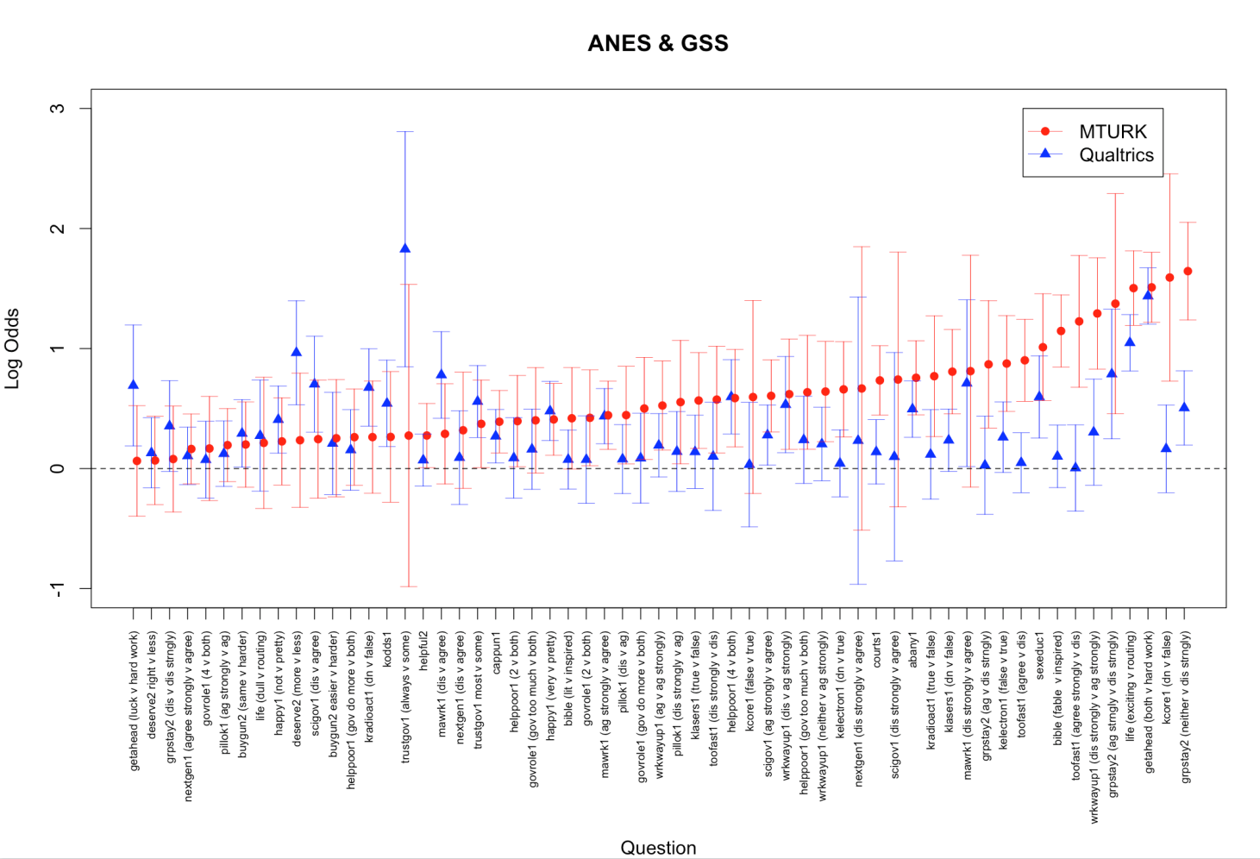
Response Comparisons

Slide 33
Regression Summary (tentative)
Ordinal logistic regression - the outcome variables with basic demographics (age, race, etc.)
For the most part, the variables performed as expected across the nonprobability and probability samples. The expected explanatory variables are in the right direction
Qualtrics appears to be closer to probability samples than Mturk
However, the relationships between basic demographic variables and outcome variables differ by sample type

Slide 34
Regression Summary (tentative)
When the sample variable is introduced, the Mturk variable is significantly different, even when controlling for demographic variables
A fuller analysis indicates that for some items, both Qualtrics and Mturk reasonably well but for many, the differences are substantial
Mturk is generally further from the probability sample than Qualtrics

Slide 35
Summary (so far)
The samples differ by demographic characteristics, including differences between ANES and GSS
Mturk is younger, more educated, more male, and liberal than the other samples
The Mturk differences are noted in the bivariate analysis
The OLR models generally predict as expected but Mturk differs somewhat
When the samples are combined, the Mturk sample has an independent effect in the model

Slide 36
Limitations
Probability samples are much larger
The analysis does not control for:
Possible differences from 2013 - 2015
Mode effects for GSS
Question order
Limited analysis for this presentation, e.g., we think that samples are similar for some kinds of questions
Random variation

Slide 37
Thank You!
Contact Information:
Elizabeth Zack
Email: eszack@indiana.edu
John Kennedy
Email: kennedyj@indiana.edu

