Slide 1
Expanding the toolbox:
Inference from non-probability samples using machine learning
Joep Burger, Bart Buelens, Jan van de Brakel
Statistics Netherlands
INPS, 16–17 March 2017, Paris

Slide 2
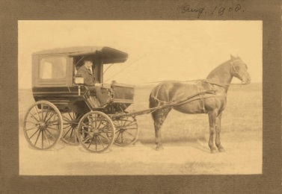
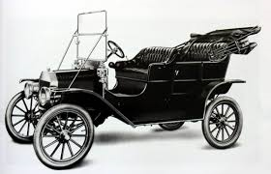







Disruptive technologies
Big picture
Transport
Light
Music

Slide 3
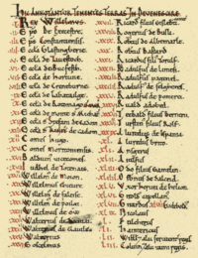
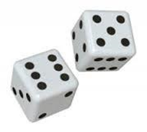

Disruptive technologies
Big picture
Official statistics

Slide 4




Big data
Human-sourced data
  social media
  internet search
Process-mediated data
  scanners
  electronic funds transfers
Machine-generated data
  GPS
  sensors
UNECE 2013

Slide 5

Potential
Timelier
Higher frequency
More detail
Higher precision (≠ more accurate)
Lower measurement bias
Cheaper
Less burden

Slide 6
Challenges
Representation
  big data sample ≠ population of interest
  non-probability samples
Others
  measurement (data ≠ information)
  processing
  privacy
  continuity
Notes:
similarities with register data
searching for ‘flu’ ≠ having flu; not calling ≠ being at home; reflectance spectrum ≠ crop production

Slide 7

Street Bump App
Automatic pothole mapping
Selection bias
  wealthier, younger neighborhoods

Slide 8



INPS
Inference: generalize from sample to population
Predict missing values
  Pseudo-design-based
  Model-based
  Algorithmic
Auxiliary information
  Known for all units in the population
$$x$$
$$y$$
$$\hat{y}$$
sample
population
remainder

Slide 9




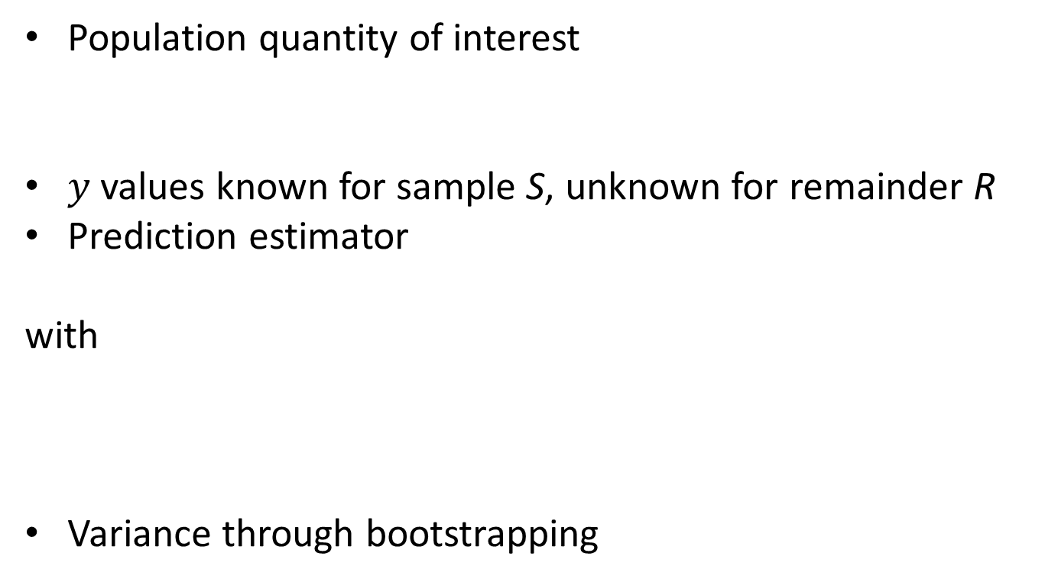
Formal
Population quantity of interest
$y$ values known for sample S, unknown for remainder R
Prediction estimator
with
Variance through bootstrapping

Slide 10
Methods
Sample mean (SAM)
Pseudo-design-based (PDB)
Generalized linear model (GLM)
k-Nearest neighbors (KNN)
Artificial neural network (ANN)
Regression tree (RTR)
Support vector machine (SVM)

Slide 11

Sample mean (SAM)
Mean of observed units
$${\hat{y}}_{j}=\overline{y}=\frac{1}{n}\sum_{i∈S}{y_{i}}$$

Slide 12
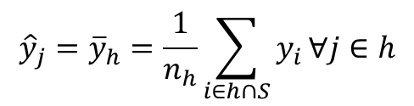
Pseudo-design-based (PDB)
Mean of observed units within stratum
  Use auxiliary variables
$${\hat{y}}_{j}={\overline{y}}_{h}=\frac{1}{n_{h}}\sum_{i∈h∩S}{y_{i}}∀j∈h$$

Slide 13


Generalized linear model (GLM)
Generalized combination of auxiliary variables
$$g(E\left(Y_{i}\right))=βx_{i}$$
$${\hat{y}}_{j}=g^{−1}(\hat{β}x_{j})$$

Slide 14





k-Nearest neighbors (KNN)
Mean of $k$ observed units closest in $x$ space
  Distance measure
$${\hat{y}}_{j}=\frac{1}{k}\sum_{a∈A_{j}}{y_{a}}$$
$$x_{2}$$
$$y$$
?
$$x_{1}$$

Slide 15
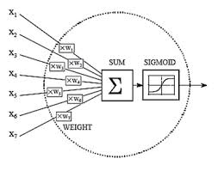
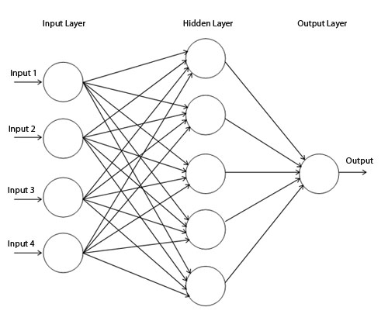

Artificial neural network (ANN)
Artificial neuron
Network of artificial neurons
$${\hat{y}}_{j}=ANN(x_{j},\hat{β})$$
Koné Mamadou Tadiou

Slide 16



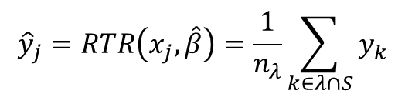



Regression tree (RTR)
Construct binary tree
  Maximize between variance
  Stopping criterion
Mean of observed units within leaf
Algorithmic version of PDB
$$x_{1}≤a$$
$$x_{1}>a$$
$$x_{1}≤b$$
$$x_{1}>b$$
$$x_{2}≤c$$
$$x_{2}>c$$
$${\hat{y}}_{j}=RTR\left(x_{j},\hat{β}\right)=\frac{1}{n_{λ}}\sum_{k∈λ∩S}{y_{k}}$$

Slide 17
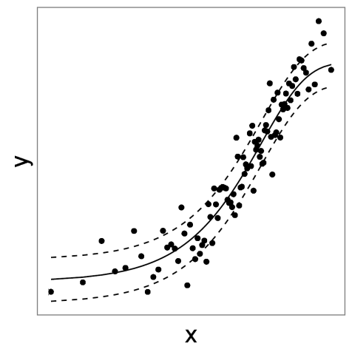
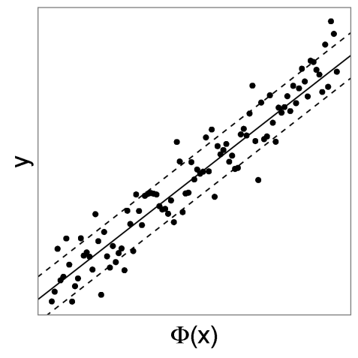



Support vector machine (SVM)
Linear separation in $ℝ^{M>N}$ ($Φ\left(x\right)$)
Learn in $ℝ^{N}$(Kernel trick)
Original space ℝ^{N}
Higher-dimensional space ℝ^{M}
$$K\left(x_{i},x_{j}\right)={\left\langle Φ\left(x_{i}\right),Φ\left(x_{j}\right)\right\rangle }_{M>N}$$
$${\hat{y}}_{j}=\sum_{i}{{\hat{α}}_{i}K\left(x_{i},x_{j}\right)}$$
Notes:
Kernel trick: no need to know mapping function phi explicitly
Measure of similarity: pairwise dot-products

Slide 18
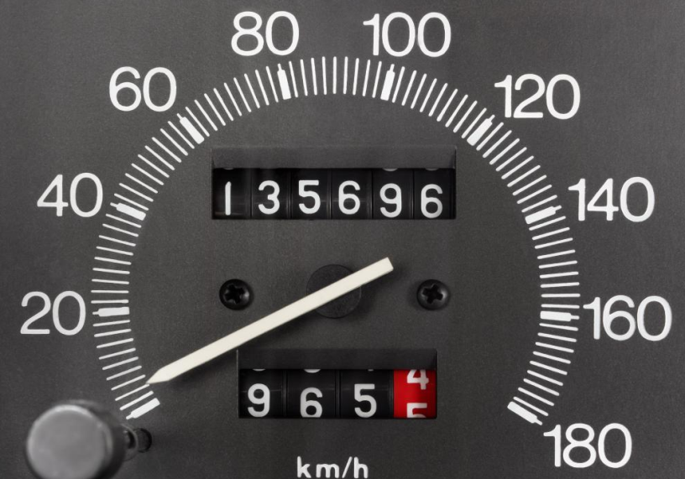
Case study
Online Kilometer Registration
  6,7 mln privately owned cars
  Mileage readings → annual mileage
Auxiliary variables
  Registration year
  Weight
  Fuel type
  Owner’s age

Slide 19
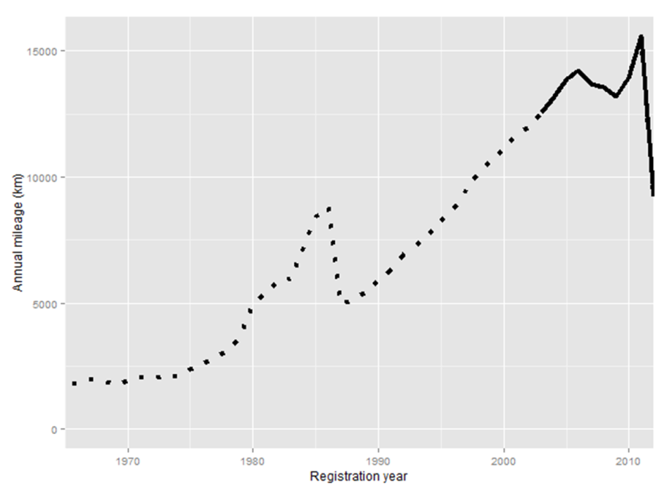

Non-probability sample
Only data about young cars
Inference: ${\hat{G}}_{Y}=G\left({\left\{y_{i}\right\}}_{i∈S}∪{\left\{{\hat{y}}_{i}\right\}}_{i∈R}\right)$

Slide 20
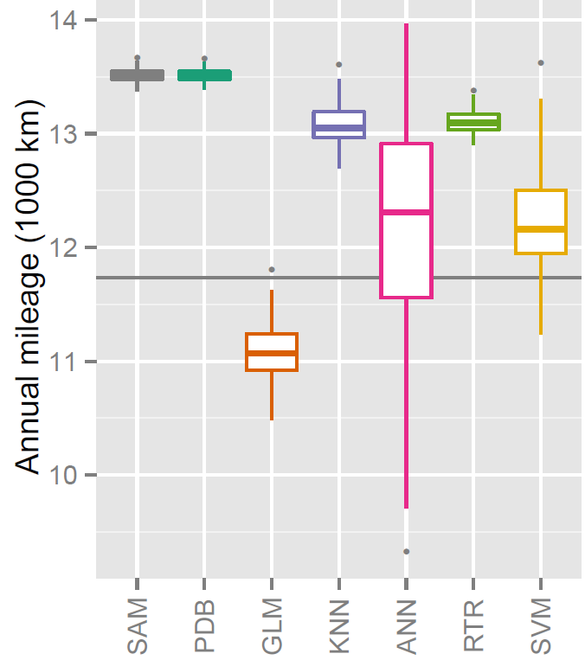
Inference

Slide 21
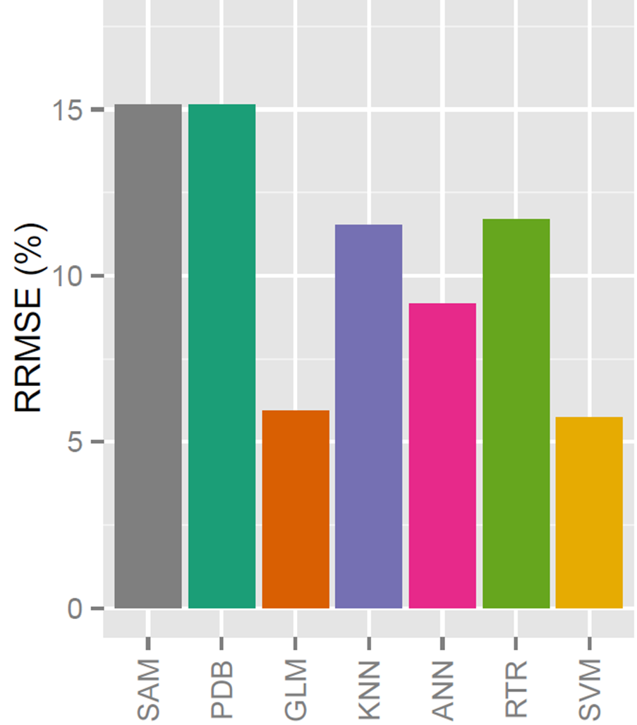
Accuracy

Slide 22
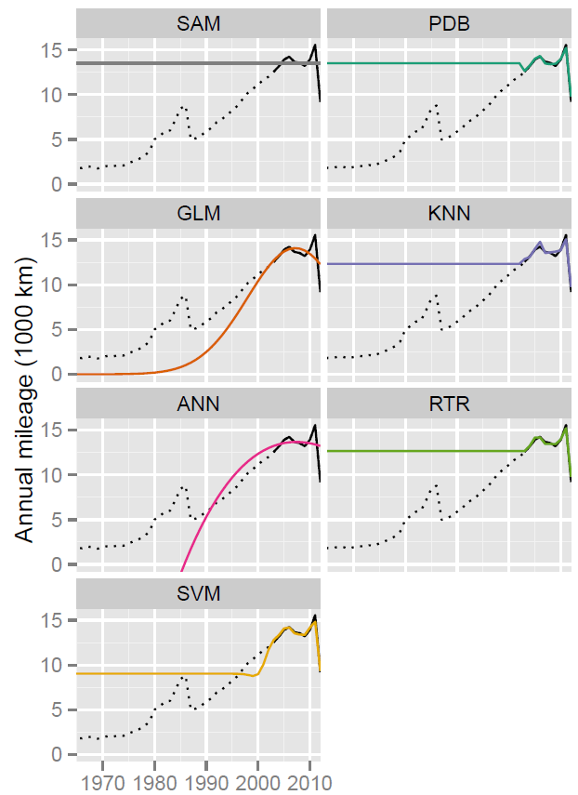

Slide 23
Conclusions
Both PS and NPS may suffer from selection bias
Beyond pseudo-design-based methods
  Model-based
  Algorithmic
(Many, continuous) auxiliary variables crucial
  Registers
  Paradata
  Profiling

Slide 24
Working paper
https://www.cbs.nl/nl-nl/achtergrond/2015/44/predictive-inference-for-non-probability-samples
Contact
j.burger@cbs.nl

