Slide 1
Nonprobability sampling as model construction
Andrew W. Mercer
Senior Research Methodologist
PhD Candidate, JPSM

Slide 2
How do we avoid selection bias in survey estimates?

Slide 3
The ideal: perfect randomization
Random selection…
from the entire population…
with known probabilities of selection…
and 100% response…
…implies that for any variable we measure (and those that we don’t measure), the sample distribution will match the population on average.
Depends only on what know about the process. Not what we know about the population.
No need for models or strong assumptions.

Slide 4
None of these things apply to nonprobability surveys...
Selection is not random by definition.
You do not have access to the whole population.
There are no known inclusion probabilities.
You probably don’t have complete response.
The sample is only sure to match the population on those dimensions where it is fixed by design (e.g. quotas).
We can only evaluate the sample based on what we know about the population. Nothing intrinsic to the process that guarantees anything.
Entirely dependent on models and strong assumptions.

Slide 5
…but we act as if they should.
Two main study designs for evaluating nonprobability surveys:
A) Compare one or more nonprobability samples on a wide array of arbitrary variables where benchmarks are available:
  e.g. Kennedy et al 2016; Gittelman et al 2015; Yeager et al 2011
B) Compare a probability sample to a nonprobability sample and look for similar estimates:
  e.g. Pasek 2015; Ansolabehere and Schaffner 2014; Chang and Krosnick 2009
Usually the same weighting and estimation procedures applied to all comparison samples.
Notes:
Implicit in this formulation is that we are looking for a standard process that yields accurate estimates for an arbitrary range of variables.

Slide 6
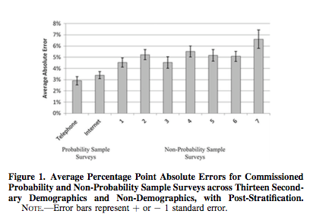
In 2004-2005, samples varied in accuracy
Source: Yeager, David S., Jon a. Krosnick, Linchiat Chang, Harold S. Javitz, Matthew S. Levendusky, Alberto Simpser, and Rui Wang. 2011. “Comparing the Accuracy of RDD Telephone Surveys and Internet Surveys Conducted with Probability and Non-Probability Samples.” Public Opinion Quarterly 75 (4): 709–47.

Slide 7
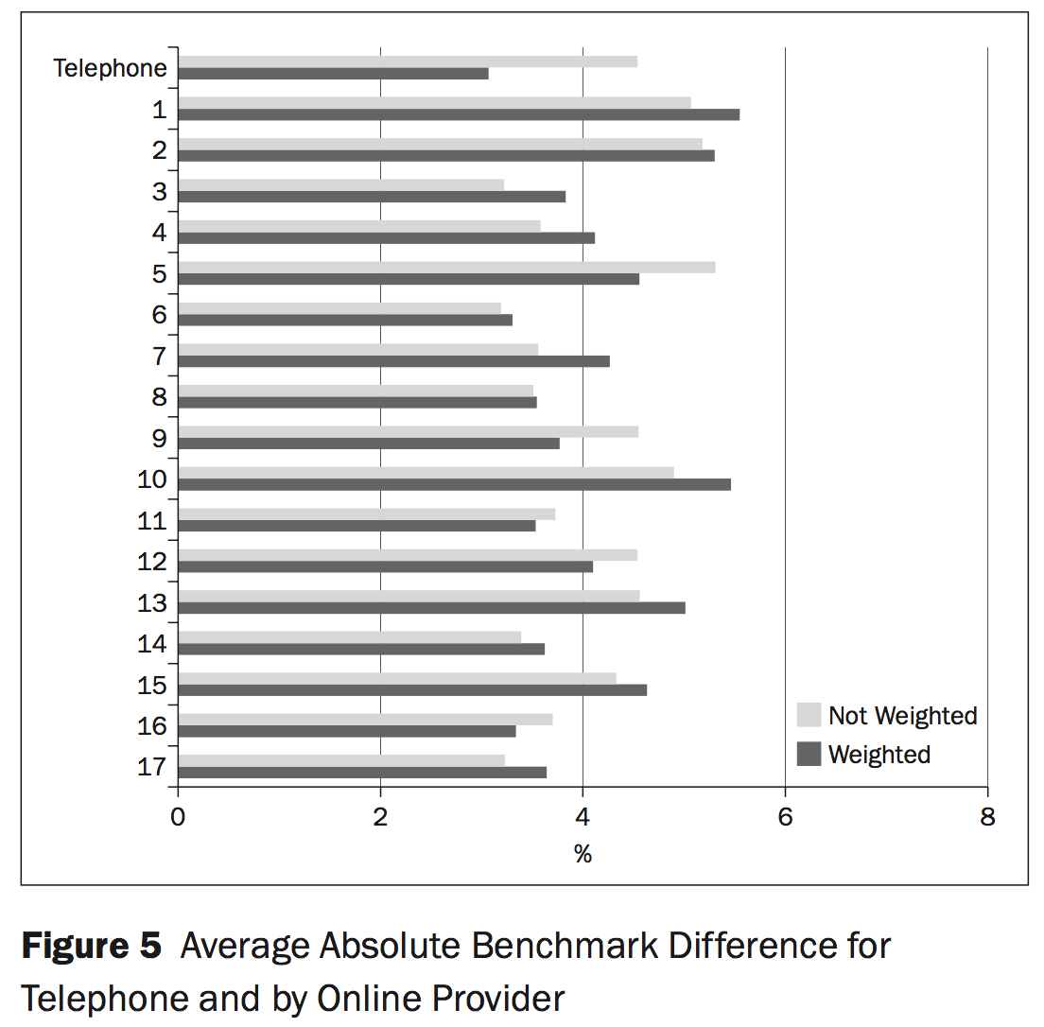
Still true in 2013
Source: Gittelman, Steven H., Randall K. Thomas, Paul J. Lavrakas, and Victor Lange. 2015. “Quota Controls in Survey Research: A Test of Accuracy and Intersource Reliability in Online Samples.” Journal of Advertising Research 55 (4): 368–79.

Slide 8
In 2016 we added color…
Source: Kennedy, Courtney, Andrew Mercer, Scott Keeter, Nick Hatley, Kyley Mcgeeney, and Alejandra Gimenez. 2016. “Evaluating Online Nonprobability Surveys.” Pew Research Center.
Notes:
Note ATP
Note Sample F on Civic and Non-Civic

Slide 9
Current TSE formulation doesn’t fit well
How would we characterize the errors observed in these studies?
For probability surveys, the Total Survey Error (TSE) framework provides useful concepts for describing flaws in the sampling and data collection process.
  Undercoverage
  Nonresponse
Not well defined for many nonprobability surveys
  No frame
  Often no discrete sample (routers)
Concepts describe how a survey process deviates from randomization.
Notes:
Hypotheticals: suppose you had perfect coverage and response but no random selection.

Slide 10
Where does this leave us?
Estimates still vary considerably across samples.
Hard to generalize beyond the samples and questions at hand.
Benchmarks are not usually the outcomes we want to study.
What do we do when we don’t already have the right answer?

Slide 11
We are not the first people to have this problem

Slide 12


Parallels Between Experiments and Surveys
Randomized experiment
Probability-based survey
Trt B
$${\overline{y}}_{B}$$
Trt B
𝑦 ̅_𝐵
Trt A
$${\overline{y}}_{A}$$
Trt A
𝑦 ̅_𝐴
Not Samp
$${\overline{y}}_{NS}$$
Not Samp
𝑦 ̅_𝑁𝑆
Samp
$${\overline{y}}_{S}$$
Samp
𝑦 ̅_𝑆
$${θ=\overline{y}}_{A}−{\overline{y}}_{B}$$
$${\overline{y}}_{Pop}={\overline{y}}_{S}={\overline{y}}_{NS}$$

Slide 13
Causal Inference and Survey Inference
Causal inference and survey inference both recognize the utility of randomization.
  Probability-based surveys
  Randomized experiments
  For causal inference, there has been a long recognition that learning from non-experimental data is valid and necessary while recognizing the limitations.
  Fields like political science, economics, epidemiology, sociology all use observational data.
  Decades of research developing methods for non-experimental data.
  The conditions that permit causal inference from observational data are the same conditions that permit survey estimates from non-probability samples.

Slide 14
What needs to be true to avoid selection bias?
Exchangeability (aka ignorability, unconfoundedness):
We know and have measured all of the confounding variables that are correlated with both inclusion in the sample and the outcome of interest.
Positivity (aka common support):
There are no kinds of unit with distinct values of the outcome variable that are systematically missing from the sample.
Composition:
The distribution of potentially confounding variables in the sample matches the distribution in the population.
Notes:
Note that it’s possible to have exchangeability and positivity without knowing the right composition.
Also note that we do know about these issues, but there is a lot more work in this area in causal inference.

Slide 15
More formally
Selection bias implies that:
Which parts of this equation don’t match the between sample and population?

Slide 16
Sample design as part of modeling
Sample is a scaled down representation of the population with respect to X.
Inferences about Y are justified based on model of Y | X.
Exchangeability
Means selecting the right combination of X covariates for use in quotas, weighting or other modeling.
Positivity
Selecting a data collection protocol that is capable of reaching all levels of X in the sufficient numbers.
Composition
Availability of distributional information for quota targets, raking parameters, post-strata for MRP
Notes:
You can think of a sample itself as a scale model of a population. Design reflects beliefs about distribution of X and relationship between X and Y.

Slide 17
How good is the model?
With ”gold-standard” microdata representing the population, we can estimate the relative contribution of each of these problems to the total selection bias.
For each sample:
Estimate a propensity model predicting sample membership:
Estimate a response surface model for the outcome:
Estimate counterfactual scenarios

Slide 18
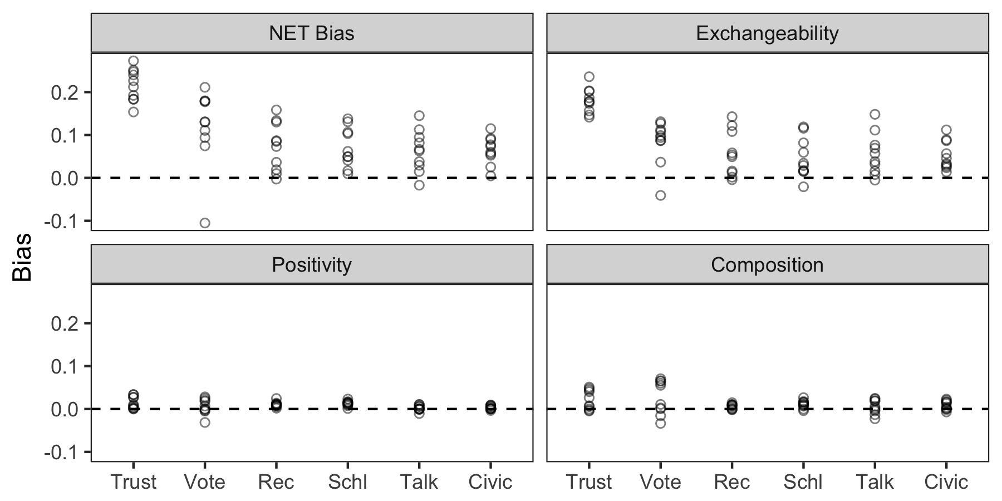
2013 CPS Civic Engagement vs. Pew Nonprob Samples
BART models conditional on age, sex, race and Hispanic ethnicity, and education.

Slide 19
Why do some methods work better?

Slide 20
Revisiting Sample I
For each sample, we requested weights from vendors and also created our own. Used the weights that gave the lowest average error.
Sample I
Consistently lower error than other samples.
Only vendor provided weights that were used for analysis.
What’s different?
Exchangeability
Selection on more than just demographic variables (party, religious attitudes, etc…).
Positivity
Match to a synthetic population on chosen covariates.
Composition:
Combination of matching for selection, propensity score weighting and calibration.

Slide 21
The Xbox Study and MRP
Wang et al (2014)
Panel survey of Xbox users in the days leading up to the 2012 presidential election.
Closer to the national vote than the 2012 Pollster.com average, and very accurate on state level estimates or Obama vote share (mean error 2.5%).
93% Male and 65% 18-29 years old. 1% of 65+.
Exchangeability
Powerful covariates for predicting vote preference (i.e. party id).
Positivity
Very large sample size. 750k interviews, 345k respondents.
1% is still ~3400 observations.
Composition:
2008 exit poll for poststratification gives composition of party. Not usually available.
MRP regularization allows more dimensions and more granularity

Slide 22
Going forward

Slide 23
A research agenda
Variable selection methods
Tradeoffs between estimation approaches
  e.g. Raking vs. MRP
Combining compositional microdata from different sources
Move away from benchmarks
Methods for testing models
Variance!

Slide 24
Some principles
Accept necessity of assumptions and work to make sure they are justifiable
Design with modeling assumptions in mind
Design with model testing in mind
Covariate selection is probably more important than anything else
Achieving the requirements may be difficult or impossible for some areas of research.
This does not make them any less required.

Slide 25
Thank you!
Andrew W. Mercer
Senior Research Methodologist
amercer@pewresearch.org

