Slide 1
FAIRness of (Linked) Social Media Data
Janez Štebe, ADP [Arhiv Družboslovnih Podatkov], University of Ljubljana
ESRA 8th Conference Zagreb, Croatia, from 15th to 19th July 2019

Slide 2
Slovenian Social Science Data Archives (ADP-Arhiv Družboslovnih Podatkov)
About ADP
Founded in 1997
Slovenian national research data centre for social sciences
600 social science studies data accessible in a data catalogue + 150 metadata only
Mainly survey data (from 1960‘s on), few qualitative, social networks and social media
member of CESSDA ERIC
obtained CoreTrustSeal in beginning of 2018
involved in EU, CESSDA and national projects

Slide 3
ADP involvement in SERISS project
Linked third party CESSDA partner in SERISS
Involved in Task 1 and 3, WP6: New forms of data – legal, ethical and quality issues
Task 1 address: Legal and ethical etc. challenges of Social Media (SM) Data
Results: Workshops, reports, guides
Tasks partners: NSD (WP and T1 Lead), UKDA (T3 Lead), ČSDA, ADP, (GESIS)
In this presentation : Special attention about the data service aspects of dealing with SM data:
Appraisal and selection, Curation, Archiving, Sharing, Disseminating and Re-using SM data
Notes:
But we mainly talk about twitter data

Slide 4
Why is discussing about sharing SM data important?
SM research: becomes established source of data for research (complementing, substituting other sources/methods, including surveys- see Kleiner 2015, Callegaro 2018)
SM data can be reused for the benefits of new research
Journals, funders request data sharing for transparency and reproducibility of research (under FAIR principles)
Data sharing principles are (still) in flux (we need to discuss and re-evaluate, establish standards) (Mannheimer and Hull 2017)
CESSDA: only a handful of SP is accepting/ curating SM data (see appendix of SERISS 6.3 report)
Notes:
: there is a need to establish practice, if possible, based on a common principles.
Opportunities of SM data FORS_WPS_2015-02_Kleiner.pdf
Sometimes presented as a goldmine of what people are thinking (Brid-Aine Parnell, 2014), such data are seen as offering unprecedented opportunities for the collection of experimental and observational data. In particular, they provide the ability to observe the online behaviour of hundreds of millions of people in almost real time, and therefore to measure small effect sizes that may otherwise have gone unnoticed (Golder and Macy, 2014; Khoury and Ioannidis, 2014). This led Golder and Macy (2014) to describe the scale as being both massive and microscopic at the same time. 10 Not only have researchers access to the most recent data available (Khoury and Ioannidis, 2014), but social media data also offer information on what people do and say “in the wild” (Tinati et al., 2014), rather than retrospectively. By capturing “everything” within a particular field of a particular platform (Tinati et al., 2014) they also open up new research venues, making it possible to study behaviours that were unsolicited and unprompted by the researcher in the first place (McCormick et al., 2013). Social media data may also be used to inform traditional research, for example by uncovering new associations that may be further tested, or may serve as a pre-test to see whether behaviours or attitudes not currently in a survey are evident among the larger population.

Slide 5
Issues about (sharing) SM data
Compared to survey data: this are ‚organic‘ data, found and not generated with research purpose in mind
Issues about data quality (Japec et al. 2015; Callegaro 2018)
Complexity of Big Data (size, structure,…)
Ethical issues
Consent (when it‘s necessary, if practical, and how to obtain)
Public or private communication
Confidentiality: Anonymization, sensitive content, vulnerable population
Legal issues
Terms of Services (changing, limiting use, when to and when not to follow)
Licences and permissions of use (Controlled access to sensitive data, evaluating purpose of use to balance the risks)
GDPR (rules and exceptions for research)

Slide 6
Paradigmatic cases of (non)sharing SM data
The following categories of cases:
Establishing best practice: Transparent arguments about principles and decisions taken that lead to archived and accessible SM data (Kinder-Kurlanda et al. 2017)
Typical for certain group of cases: e.g. sharing for replication purpose in a self-archiving repository by disclaimer (Chukwuemeka and Abdul 2017)
Exceptional: resolving conflicts of principles showing an exception from the typical rules (Mannheimer, Hull 2017)
Problematic: reach attention as cases that cross the boundary of acceptable (e.g. public vs. private consideration in Tastes, Ties, and Time Dataverse)
Range of solutions we can observe:
Users / depositors responsibility vs. curator responsibility
Comparison of general repositories vs. disciplinary data centres

Slide 7
Aspirational FAIR sharing framework
Original FAIR Guiding Principles (https://doi.org/10.1038/sdata.2016.18 ):
‚The intent is that these may act as a guideline for those wishing to enhance the reusability of their data holdings.‘
Attributes of metadata and data to qualify as Findable, Accessible, Interoperable and Reusable
Discussions and misconceptions about FAIR :
Not new, just make it more visible some of the long standing principles around open research data (OECD, Royal society, …)
Oriented towards Machine- computer automatic assessment
Overlap with some other principles: regarding data citation (Force11), Core Trust Seal (more focus on repositories, while FAIR is data centric)
FAIR is not equal Open (there are various degrees of openness that are legitimate reasons for not completely open depending on data characteristics; there are degrees of FAIRness that are appropriate for the type of data in specific case)
Notes:
Framework is better then theory, it‘s a set of boxes of principles; Aspirational because it‘s presented as a goal not a prescription, and it depends on the type of data and community of users and curatiors…

Slide 8
Selection from existing FAIR maturity metrics for the purpose of evaluating SM data sharing
Different emphasis on some of the aspects depending on discipline established requirements, type of data and purpose of evaluation…
including a discussion about what is perhaps missing from usual FAIR criteria:
data quality assessment,
and costs of keeping and curating data
What we will do:
elaborate FAIR criteria and Map to Attributes of cases of SM data shared (and repositories)

Slide 9
Sources of existing metrics for FAIR
ANDS-NECTAR-RDS-FAIR data assessment tool | ARDC
DANS-Fairdata | DANS
DANS-Fair enough? | DANS
The CSIRO 5-star Data Rating tool | CSIRO
FAIR Metrics Questionnaire | The FAIR Metrics Group
Stewardship Maturity Mix | NOAA's CICS-NC, NOAA's NCDC
FAIR Evaluator | GO FAIR, LUMC CBGP, IDS, RDA FAIRsharing, IQSS
Data Stewardship Wizard | ELIXIR NL/CZ
Checklist for Evaluation of Dataset Fitness for Use | Assessment of Data Fitness for Use WG (WDS/RDA)
RDA-SHARC Evaluation | SHARC IG (RDA)
WMO-Wide Stewardship Maturity Matrix for Climate Data | The SMM-CD WG
Data Use and Services Maturity Matrix | The MM-Serv WG
Taken from: RDA Fair Maturity Assessment

Slide 10
To be Findable: F1. (meta)data are assigned a globally unique and persistent identifier
Possible criteria (relevant for SM data, but could be quite general) selected from the list of existing proposals (see RDA Fair Maturity Assessment):
Citation exists, including authorship, year, comprehensive title, persistent identifier (e.g. DOI)
Persistent identification of the dataset and related work (related literature and data, authors, projects, terms)
Related SM Data issues:
Are the data, literature and code and project etc. PID-s present? Or linked in a persistent way.
Is it possible to cite data using required elements? Is the data cited by the related article?

Slide 11
Example cases
Data deposited ✔ in the disciplinary data archives:
Kaczmirek, Lars; Mayr, Philipp (2015): German Bundestag Elections 2013: Twitter usage by electoral candidates. GESIS Data Archive, Cologne. ZA5973 Data file Version 1.0.0, http://dx.doi.org/10.4232/1.12319 ✔
SM data linked to survey data not ✘(yet) archived, related to:
Sloan, L., Jessop, C., Al Baghal, T., & Williams, M. (2019). Linking Survey and Twitter Data: Informed Consent, Disclosure, Security, and Archiving. Journal of Empirical Research on Human Research Ethics. https://doi.org/10.1177/1556264619853447 ✘
„(…)none have gone through a formal archiving process and been accessed by researchers working independently of the original research team. Although we have identified what we think may be key issues and how they may be overcome, it will only be through actually archiving and providing access to these data that we might fully understand the challenges and whether or not the measures we have outlined will address them.“ (Sloan et al. 2019: 10)
Notes:
preveri consent text če dovoli arhiviranje: pomemnbo je načrtovati

Slide 12
Remaining F… aspects
F2. Is data described with rich metadata
F3. Metadata clearly and explicitly include the identifier of the data it describes
SM (meta)data criteria:
Extent of descriptive information in metadata
Standard disciplinary metadata used, cross walked to general repository metadata systems
Searchable on the institutional, disciplinary, and/or general catalogue…
SM Cases:
Informal sharing, sharing ‘upon request’, sharing on website, GitHub: ✘
that lack the availability of search, insufficient documentation, and poor response to request access (mentioned in Weller and Kinder-Kurlanda 2016)

Slide 13
To be Accessible: A1. (meta)data are retrievable by their identifier using a standardized communications protocol
A1.1 the protocol is open, free, and universally implementable
A1.2 the protocol allows for an authentication and authorization procedure, where necessary
Example criteria: Data not available publicly; Person-to-person contact needed.
Basic online services available for data access (e.g. FTP/HTTP direct download).
Non-standard data services.
Standard-based interoperability data services.
Previous + Full capability of sub-setting, aggregation and visualization.
Example criteria: Please provide a IRI that resolves to a description of the process to obtain access to restricted content In case of a non legal restricted access, is the restriction properly justified by the researcher ?

Slide 14
Example cases
SM (meta)data criteria:
Establishing existence of metadata describing access conditions…and reasons for not completely open access…
SM Cases:
GESIS example:
Kinder-Kurlanda et al. (2017) arguing that it‘s possible to re-identify individuals based on rehydrated twits.
No consent was obtained.
Location can be reconstructed
As a consequence:
‚Each access request is decided on individually based on the information provided in the application (e.g., research topic, methods, etc.)‘. ✔ (Kinder-Kurlanda et al. 2017)

Slide 15
A2. metadata are accessible, even when the data are no longer available
Example criteria:
Metadata persistence policy / guarantee
Comment: based on repository having a plan (CTS)…
SM (meta)data test:
Access to metadata and code (even if data is not publicly accessible)?
E.g. ID of Twits: full metadata is searchable and accessible… even if ‘deidentified’ /modified data only is accessible.
Problematic:
Persistence of content (if post behind the ID – lost),

Slide 16
Example cases
NSD full metadata without data:
Social Media During and After the Terrorist Attacks (Hornmoen, H., 2017). https://doi.org/10.18712/nsd-nsd2434-v1
Availability Status / Restrictions
For further information please contact the principal investigator.
Tastes, Ties, and Time Dataverse: https://dataverse.harvard.edu/dataverse/t3 )
DataVerse landing page: denoting non-existence…
– Fulfilment of only one of requirements: Persistent DataVerse identifier (internet location) that lead to a note:
UPDATE (10/13/10): The T3 dataset is still offline as we take further steps to ensure the privacy of students in the dataset. Please check back later at this site for additional updates- a notice will be posted when the distribution process has resumed.
No metadata about past existing data ✘
If the comprehensive metadata would exist, this could serve as an intermediate substitute for data

Slide 17
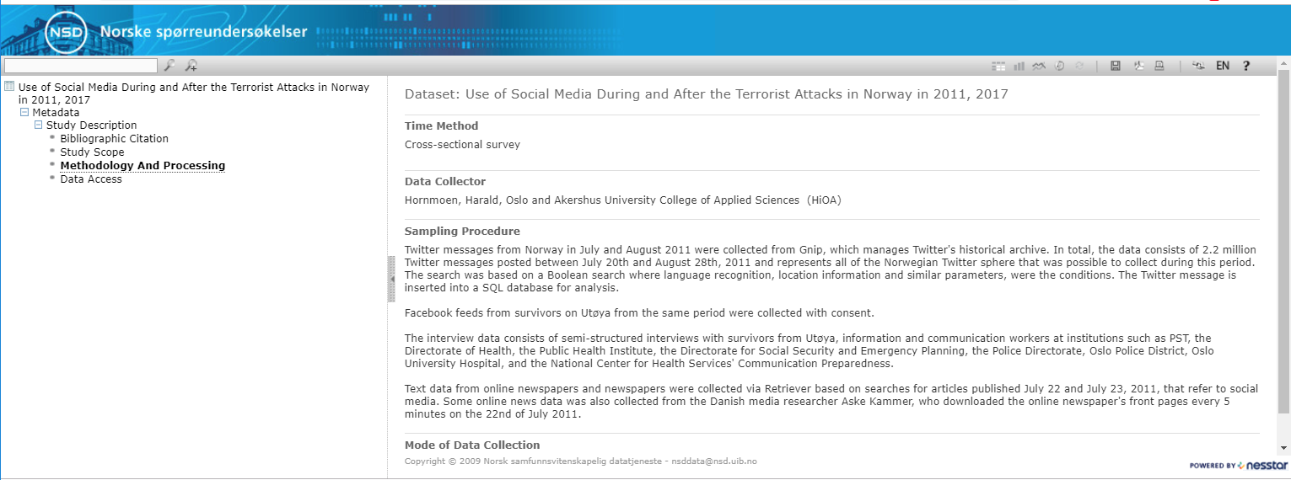
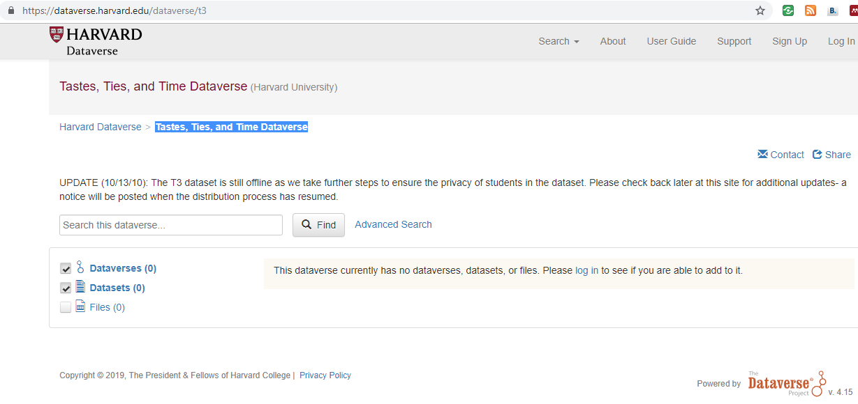

Slide 18
To be Interoperable:
I1. (meta)data use a formal, accessible, shared, and broadly applicable language for knowledge representation.
I2. (meta)data use vocabularies that follow FAIR principles
SM (meta)data criteria:
added value processing: standard variables/attributes annotation…
SM case:
Ljubešić, Nikola; Erjavec, Tomaž and Fišer, Darja, 2017, Twitter corpus Janes-Tweet 1.0, Slovenian language resource repository CLARIN.SI, http://hdl.handle.net/11356/1142.
linguistic annotation (normalised and lemmatised, TEI encoding), gender, author type, sentiment

Slide 19
I3. (meta)data include qualified references to other (meta)data
Not specific to SM data:
Reach context information for related information about project, publications etc...
global journal related repositories are favourites there…
But specific is:
links to code, perhaps anonymised versions of data, … in particular when access to data is limited.

Slide 20
To be Reusable: R1. meta(data) are richly described with a plurality of accurate and relevant attributes
Example criteria:
Database has users guide
Is there extensive metadata and rich additional documentation available (for others to understand and reuse your data)?
Content of the dataset agrees with description of the dataset content
Which relevant actions have been undertaken by the researcher to enhance the data reuse potential
Does the researcher provide information on methods and tools that permit the understanding, integrity, value and readability of data intended to be kept on the long-term ? (e.g. versioning, archival and long term reuse issue for protocols, softwares, required methods and contexts to create, read and understand data)

Slide 21
Cases
SM Case of extended documentation and data use suggestions:
International Conference on Web and Social Media (ICWSM) dedicated Data papers section. E.g.:
- Brena, 2019a: News Sharing Users Behaviour on Twitter: A Comprehensive Data Collection of News Articles and Social Interactions
- The data referred to is available at one of the dedicated repositories, in this case it is at the Harvard Dataverse (Brena, 2019). The code is published on GitHub.
SM Case: Hemphill et al (2018): Developing a Social Media Archive at ICPSR:
ICPSR Jupiter notebook feature plan of SM archive to enhance the replicability…

Slide 22
R1.1. (meta)data are released with a clear and accessible data usage license
Example criteria:
Terms of usage (licenses, other conditions of reuse, data protection, ethical issues)
Do the data reuse control and data sharing arrangements meet the data protection and local/national ethics requirements?
Legal reuse restriction properly justified?

Slide 23
Example case
Chukwuemeka , David and Abdul, Adeniyi (2017) GE_Readme.docx:
It is noted that we only upload a subset of the collected Tweets (1499,999 Tweets) to comply with Clause F.2 of the Twitter Developer Policy (effective June 18 2017).
Disclaimer
The published Data are for non-commercial research purposes only, and the use of the data is subject to all of the other provisions and rules of the Twitter Developer Policy and Agreement.
Data contained within each tweet sample are copyright by the Tweet's authors and are subject to all copyright law. The creator of the dataset makes no assertion of rights related to the content of each tweet. The dataset is provided 'as is' without warranty or any representation of accuracy, timeliness or completeness.
Please follow Twitter Term of Service and related policies when accessing the above files and using the data contained in these files. We take no responsibility for any inappropriate/illegal use of the data by any third party.
Notes:
No responsibility ?! (disclaimer)…: !!! see examples of data sets: ukda disclaimer text… vs standard text…
https://zenodo.org/record/1995646#.XA-wpXRKg2w%C2%A0 Sharc evaluation…
Simmilar case mentioned by One case mentioned by Weller and Kinder-Kurlanda is The Twitter Project Page at MPI-SWS as an example of discontinuity of access to full content dataset, in this case based on explicit request from Twitter Company. E.g. The network datasets announced to be publicly available at: https://github.com/srayandatta/Reddit
http://twitter.mpi-sws.org/

Slide 24
R1.2. (meta)data are associated with detailed provenance R1.3. (meta)data meet domain-relevant community standards
Description of methods used to create this dataset are appropriate for the context and discipline
SM Case typical observation:
Hemphill et al (2019): How can we save social media data?:
‚Researchers then rarely describe the particulars of those collection methods or the transformations they perform on the data to prepare it for analysis. The inability to judge the quality or understand the provenance of a single research group’s effort presents additional challenges for other research groups to reuse the data.‘

Slide 25
Cost considerations
Discussion
Not all data need to be shared /
Not all data need to be open (only as open as it‘s reasonable and fair)
Creator (author) or repository (data archive): the data archive intensity of curation follows the appraisal and selection criteria of collection: only reference data sets deserve highest intensive level of curation
Trade of between usability and access: anonymization can be time consuming and costly; or even not possible for SM content (and related survey data);
Controlled access perhaps better solution? (but views differ)
Appraisal and Selection for new type of data
Repositories poses general-purpose disciplinary knowledge of the data and curation best practice:
Compared to researchers specific knowledge of study design, data collection and analysis.
Notes:
Data managment training and DMP are important here!

Slide 26
Conclusion
FAIR is less a matter of the data itself than it is of the data’s metadata:
having “FAIR metadata is of very high value in its own right” (FORCE11).
The data itself might not be accessible, but to find information about the data and its access conditions is already part of FAIRness. (http://blog.ukdataservice.ac.uk/its-not-such-a-fair-way-off/)
We lack metadata and documentation standards for Social Media Datasets (Hemphill et al. 2019)

Slide 27
Data resources mentioned
Brena, G., Marco Brambilla, Stefano Ceri, Marco Di Giovanni, Francesco Pierri, Giorgia Ramponi (2019a). News Sharing Users Behaviour on Twitter: A Comprehensive Data Collection of News Articles and Social Interactions. https://aaai.org/ojs/index.php/ICWSM/article/view/3256/3124.
Brena, Giovanni; Brambilla, Marco; Ceri, Stefano; Di Giovanni, Marco; Pierri, Francesco; Ramponi, Giorgia, 2019b, "News Sharing User Behaviour on Twitter: A Comprehensive Data Collection of News Articles and Social Interactions", https://doi.org/10.7910/DVN/5XRZLH, Harvard Dataverse, V3.
Chukwuemeka , David and Abdul, Adeniyi (2017). The UK 2015 General Election, Twitter data. [Data Collection]. Colchester, Essex: UK Data Archive. Doi: 10.5255/UKDA-SN-852772
https://github.com/DataSciencePolimi/NewsAnalyzer
GE_Readme.docx (http://reshare.ukdataservice.ac.uk/852772/14/GE_Readme.docx)
Hornmoen, H. (2017). Use of Social Media During and After the Terrorist Attacks in Norway in 2011, 2017 [Data set]. NSD – Norwegian Centre for Research Data. https://doi.org/10.18712/nsd-nsd2434-v1
Ljubešić, N.; Erjavec, T. and Fišer, D., 2017, Twitter corpus Janes-Tweet 1.0, Slovenian language resource repository CLARIN.SI, http://hdl.handle.net/11356/1142.

Slide 28
References
Callegaro M., Yang Y. (2018) The Role of Surveys in the Era of “Big Data”. In: Vannette D., Krosnick J. (eds) The Palgrave Handbook of Survey Research. Palgrave Macmillan, Cham. https://doi.org/10.1007/978-3-319-54395-6_23
Hemphill, L., Hedstrom, M., Leonard, S. (2019) How can we save social media data? Retrieved from http://hdl.handle.net/2027.42/149013
L’Hours et al (2018) Appraisal/Selection Requirements for New Forms of Data. Deliverable 6.9 of the SERISS project funded under the European Union’s Horizon 2020 research and innovation programme GA No: 654221. https://doi.org/10.5281/zenodo.1406926 . Available at: www.seriss.eu/resources/deliverables
RDA Fair Maturity Assessment WG. https://www.rd-alliance.org/groups/fair-data-maturity-model-wg
Japec, L., F. Kreuter, M. Berg, P. P. Biemer, P. Decker, C. Lampe, J. Lane, C. O’Neil, and A. Usher. 2015. “Big Data in Survey Research. AAPOR Task Force Report.” Public Opinion Quarterly 79(4): 839–80. doi: 10.1093/poq/nfv039.
Kinder-Kurlanda K, Weller K, Zenk-Möltgen W, et al. (2017) Archiving information from geotagged tweets to promote reproducibility and comparability in social media research. Big Data & Society. DOI: 10.1177/2053951717736336
Kleiner, B., A. Stam and N. Pekari (2015): Big data for the social sciences. FORS Working Papers. https://forscenter.ch/wp-content/uploads/2018/07/fors_wps_2015-02_kleiner.pdf
Mannheimer, S., and Hull, E.A (2017) Sharing Selves: Developing an Ethical Framework for Curating Social Media Data, International Journal of Digital Curation, 2017, Vol. 12, Iss. 2, 196–209.
Weller, K., and Kinder-Kurlanda, K. (2016) A Manifesto of Data Sharing in Social Media Research. DOI: http://dx.doi.org/10.1145/2908131.2908172

Slide 29
Questions?
Comments?!
Sugesstions!
Thank you!

