Slide 1
Using Machine Learning Models to Predict Costs under Alternative Designs in a Responsive Design Framework
James Wagner^{1,2}, Michael Elliott^{1,2,3}, Brady T. West^{1,2}, Stephanie Coffey^{2,3}
¹ Survey Research Center, Institute for Social Research, Univ. of MI-Ann Arbor
² Joint Program in Survey Methodology, Univ. of MD-College Park
³ U.S. Census Bureau
ESRA
July 18, 2019

Slide 2
Acknowledgements / Disclaimers
This work was supported by a grant from the National Institutes for Health (#1R01AG058599-01; PI: Wagner)
The National Survey of Family Growth (NSFG) is conducted by the Centers for Disease Control and Prevention's (CDC’s) National Center for Health Statistics (NCHS), under contract # 200‐2010‐33976 with University of Michigan’s Institute for Social Research with funding from several agencies of the U.S. Department of Health and Human Services, including CDC/NCHS, the National Institute of Child Health and Human Development (NICHD), the Office of Population Affairs (OPA), and others listed on the NSFG webpage (see http://www.cdc.gov/nchs/nsfg/). The views expressed here do not represent those of NCHS or the other funding agencies.

Slide 3
Overview
Background
  Responsive Survey Design
  Monitoring incoming data from the field
Problem
  Need predictions of costs under alternative designs
NSFG
  Current design
  Data
Methods
  Multilevel Regression Models
  Bayesian Additive Regression Trees (BART)
Results
Conclusions

Slide 4
Responsive Survey Design (RSD)
Uncertainty has become an issue in survey design
RSD makes use of incoming data from the field to address this uncertainty
  Groves and Heeringa (2006)
Develop indicators of cost and error
Planned interventions when costs increase or errors stabilize/increase

Slide 5
Problem
Costs and errors vary over time
RSD has used proxy indicators
  Costs: call attempts
  Nonresponse error: stabilized estimates, “phase capacity”
Inaccurate indicators may lead to inefficient designs
Can we improve the accuracy of cost predictions?

Slide 6
NSFG
Continuous data collection
  A new sample is released every quarter
Two-stage data collection:
  Screener interview to identify eligible persons
  Main interview of selected person
Two phases of data collection:
  Phase 1: 10 week data collection
  Phase 2: Subsample remaining cases
    Oversample higher likelihood of interview cases and eligible/likely eligible cases
    Reduce interviewer workload by 2/3
    Change data collection model: added interview token of appreciation, interviewer behavior change
  Combine data and response rates from two phases using weights

Slide 7
NSFG: Data
We use the data available at the time the predictions would be made
  Paradata: highly correlated with interviewer hours (Wagner, 2019)
  Paradata and other characteristics of the sample for the future time periods we are predicting are not available at time of prediction
Use lagged values: the values from two weeks prior to the time period being predicted

Slide 8
NSFG: Data
Data include:
  Interviewer ID
  Phase (i.e. the design change)
  Lagged values of the following:
    Area characteristics: Census Division, Population eligibility rate, urbanicity, etc.
    Interviewer observations: access problems, safety concerns, etc.
    Commercial data: Age of first person, etc.
    Paradata: Number of screened interviews, number of trips, number of active lines, etc.

Slide 9
NSFG: Data
Variables are summarized to the interviewer-week level
  Call attempts have sample characteristics, interviewer observations, etc.
  Categorical variables: Mode
    EXAMPLE: Modal urbanicity from cases that were attempted two weeks prior to the week being predicted
  Continuous variables: Mean
    EXAMPLE: Mean population eligibility rate from cases that were attempted two weeks prior
  Paradata: Sums
    EXAMPLE: Number of completed screening interviews two weeks prior to the week being predicted
    EXAMPLE: Number of active sampled units (“lines”) two weeks prior

Slide 10
NSFG: Data
Use data from previous quarters and current quarter phase one to predict phase two costs
  Predictions for Q22-Q27
Outcome variable: phase two interviewer hours
  This is the major cost driver of the phase
Secondary costs: incentives
  Not predicted in these models
  Some are prepaid, i.e. known
  Postpaid incentive more readily predicted from propensity models

Slide 11
Method
Two methods of prediction:
  Multilevel regression models
    Random intercept for each interviewer
    All covariates described earlier included in the model
  Bayesian Additive Regression Trees (BART, Chipman, et al., 2010)
    Sum of trees method
    Priors constrain the inclusion of predictors
    Possible to examine how frequently each predictor is included

Slide 12
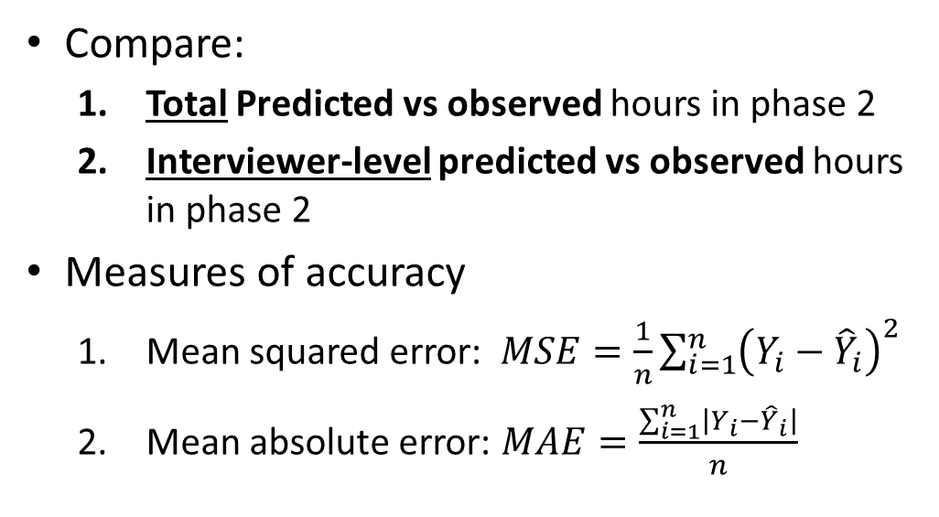
Method
Compare:
  Total Predicted vs observed hours in phase 2
  Interviewer-level predicted vs observed hours in phase 2
Measures of accuracy
  Mean squared error:$MSE=\frac{1}{n}{\sum_{i=1}^{n}{\left(Y_{i}−{\hat{Y}}_{i}\right)}}^{2}$
  Mean absolute error: $MAE=\frac{\sum_{i=1}^{n}{\left|Y_{i}−{\hat{Y}}_{i}\right|}}{n}$

Slide 13
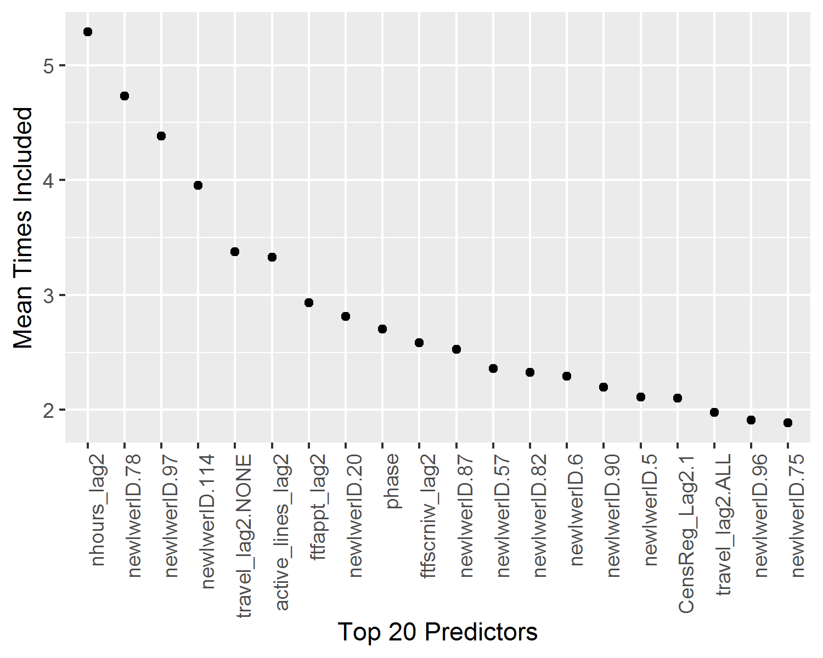
Results: Interviewers are consistent
MLM models: ICC:0.21-0.25
BART models: 20 most frequently included variables
  11 are interviewer IDs

Slide 14
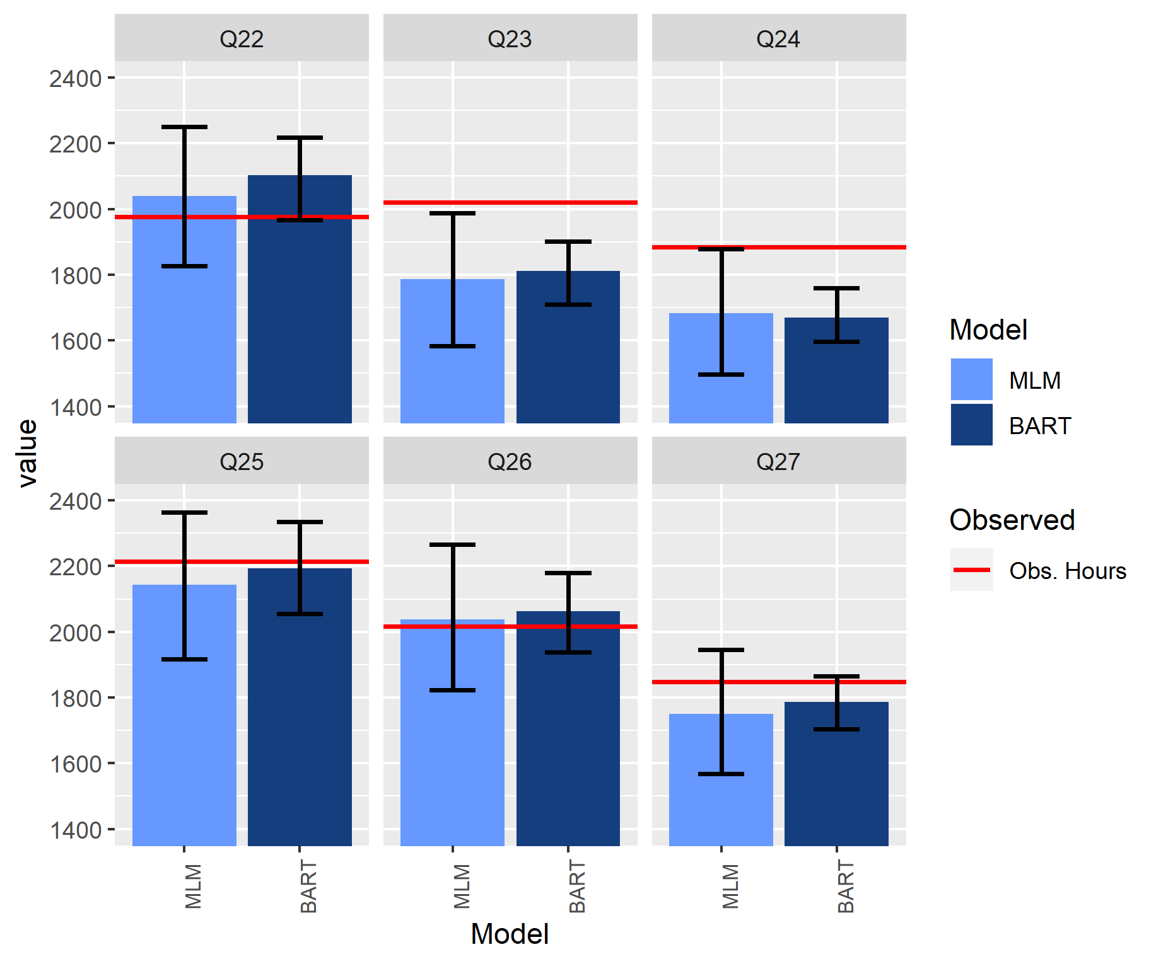
Results: Predictive Accuracy – Total Ph2 Hours

Slide 15
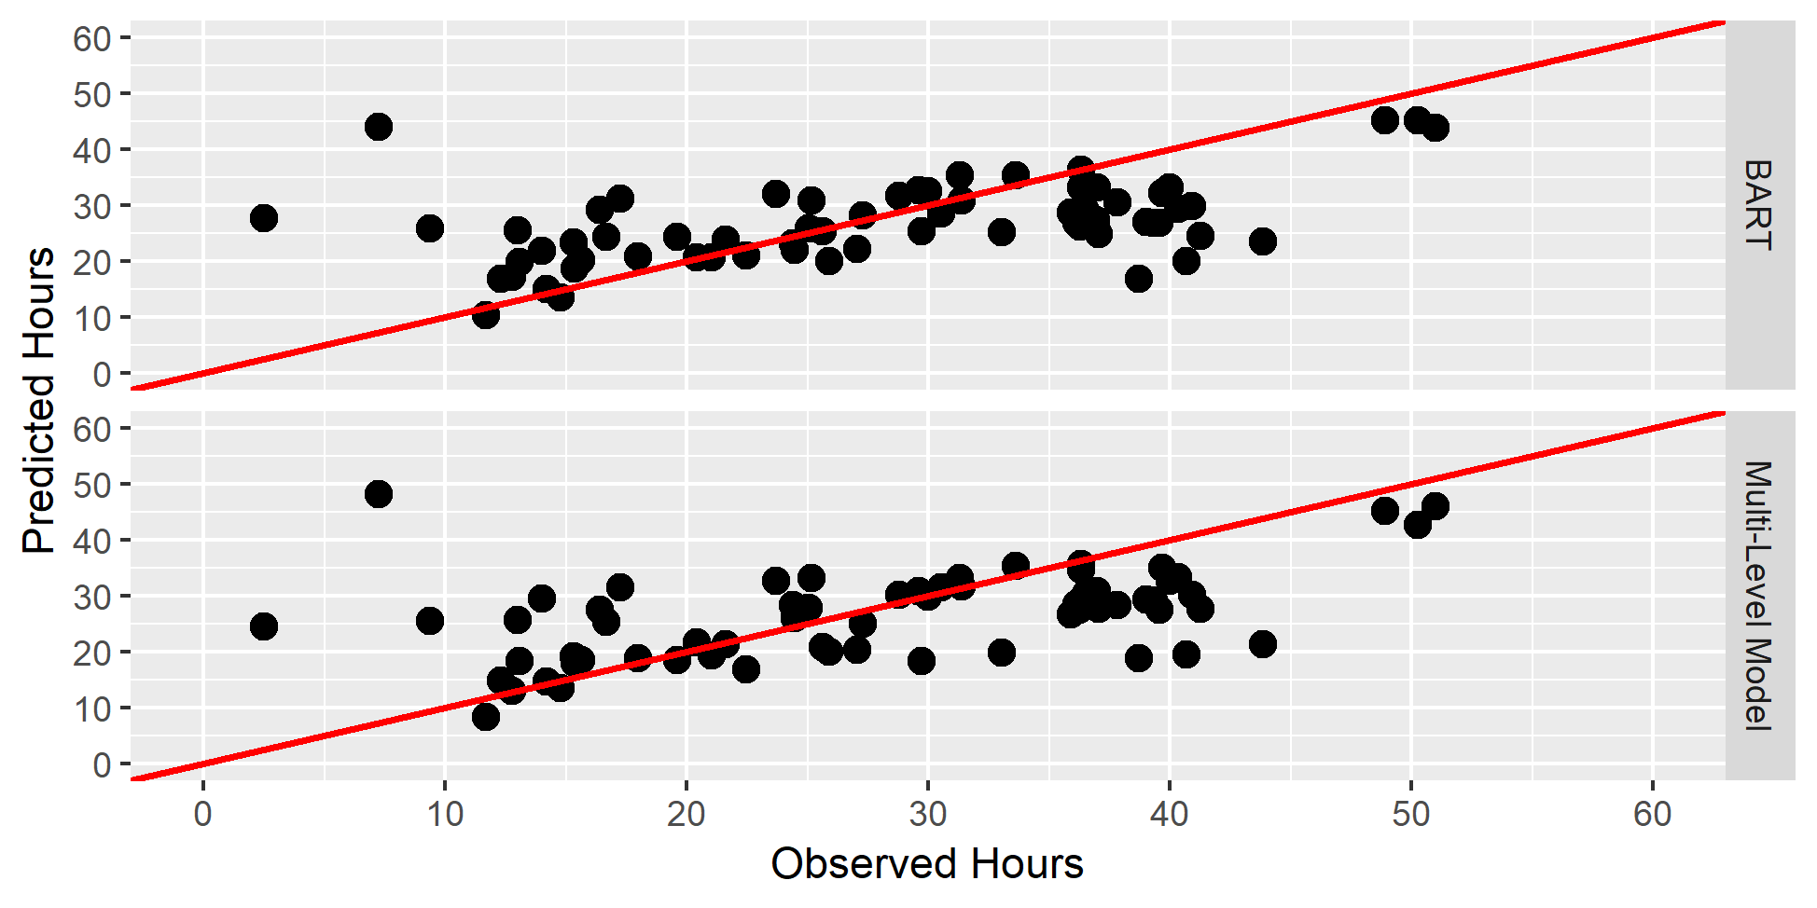
Results: Predictive Accuracy – Interviewers (Q27)

Slide 16
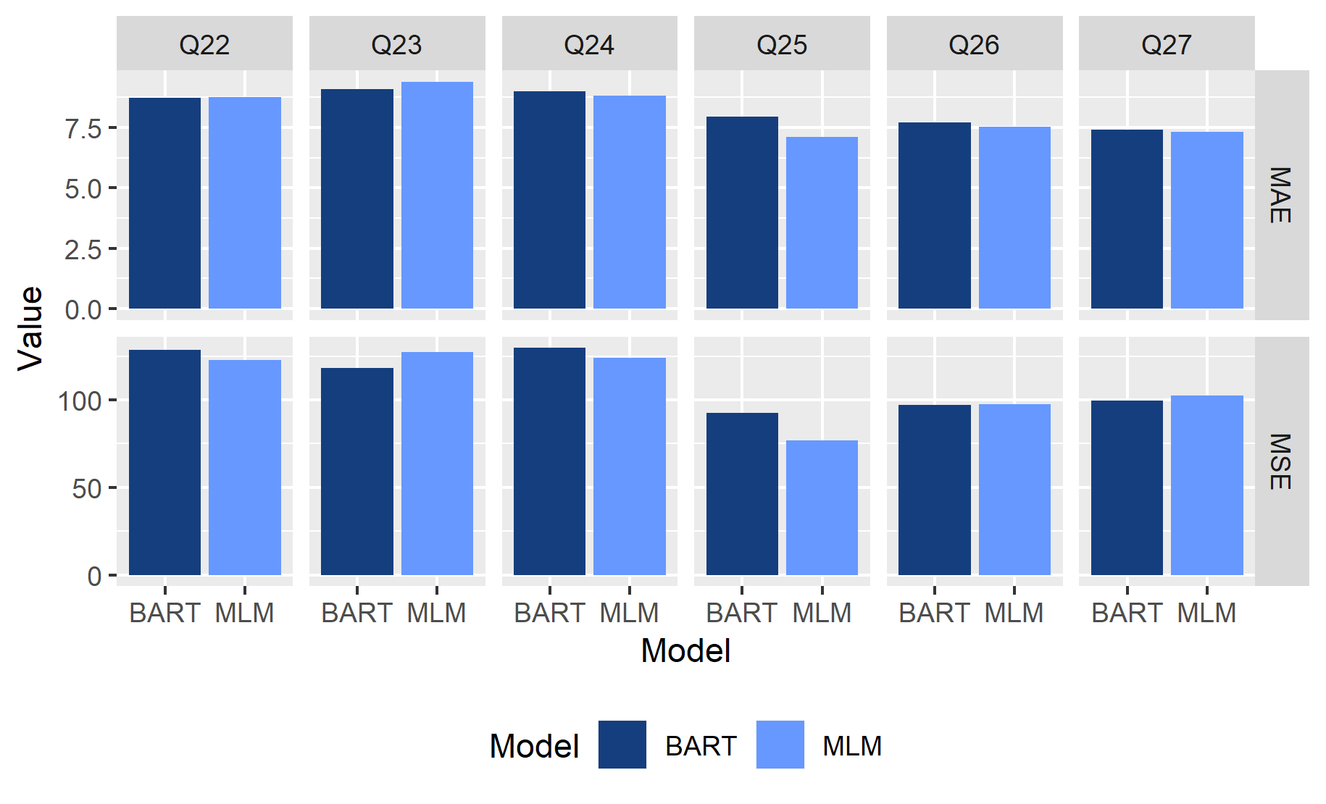
Predictive Accuracy – Interviewers (2)

Slide 17
Conclusions
Cost prediction is an interesting problem
Existing methods for prediction can be used
In this problem, knowing the interviewer is very useful since their behavior is consistent
For this problem, MLM and BART models produce comparable predictive accuracy

Slide 18
Thank You!
Email: jameswag@umich.edu

Slide 19
References
Chipman, H. A., E. I. George and R. E. McCulloch (2010). "BART: Bayesian additive regression trees." The Annals of Applied Statistics 4(1): 266-298.
Groves, R. M. and S. G. Heeringa (2006). "Responsive design for household surveys: tools for actively controlling survey errors and costs." Journal of the Royal Statistical Society: Series A (Statistics in Society) 169(3): 439-457.
Wagner, J. (2019). "Estimation of Survey Cost Parameters Using Paradata." Survey Practice 12(1): 1-10.

Slide 20
Data
Source | Predictor | Description
 | newIwerID | Interviewer ID Number
Timesheets | NHOURS_LAG2 | Number of hours worked by the interviewer in the week two weeks prior to the current week
 | travel_LAG2 | How much did the interviewer participate in overnight travel in the week two weeks prior to the current week: NONE, SOME, or ALL week.
 | DAYS_WORKED_LAG2 | The number of days worked (i.e. days with an entry in the timesheet) in the week two weeks prior to the current week
Sampling Frame | Qtr | The quarter of production (Q1-Q27)
 | year | The calendar year of production (2011-2018)
 | census_div_Mode_Lag2 | The modal Census Division of the lines attempted by an interviewer in the week two weeks prior to the current week
 | cens_reg_Mode _LAG2 | The modal Census Region of the lines attempted by an interviewer in the week two weeks prior to the current week
 | est_elig_rate_Mean_LAG2 | This is the mean of the Census Block Group level data about the estimated eligibility rate. The data are at the Block Group level, but the value here is the average over all contact attempts for the week that is two weeks prior to the current week.
 | est_elig_15_49_ACS_Mean_LAG2 | The mean of the estimated eligibility rate for the Census Block Group reported in the American Community Survey. The data are at the Block Group level, but the value here is the average over all contact attempts for the week that is two weeks prior to the current week.
 | elig_never_pct_Mean_LAG2 | This is the percentage of eligible persons living in the Census Tract who have never been married. The data are at the Tract level, but the value here is the average over all contact attempts for the week that is two weeks prior to the current week.
 | occ_rate_Mean_LAG2 | This is the Census Block Group level occupancy rate. The data are at the Block Group level, but the value here is the average over all contact attempts for the week that is two weeks prior to the current week.
 | domain_Mode_LAG2 | The domain is set at the Census Block Group (BG) level and assigned to housing units within each BG. All BGs are assigned to a domain based upon the following definitions: 1) <10% of Block Group African-American and <10% Hispanic, 2) >=10% of Block Group African-American and <10% Hispanic, 3) <10% of Block Group African-American and >=10% Hispanic, and 4) >=10% of Block Group African-American and >=10% Hispanic. The mode is for the domain of the lines that are attempted in the week two weeks prior to the current week
 | urban_Mode_LAG2 | The mode of the urbanicity (assigned at the case level) of the attempts made during the week that is two weeks prior to the current week, where 1=Major Metropolitan Area, 2=Minor Metropolitan Area, 3=Non-Metropolitan Area, 4=Remote Area.

Slide 21
Data
Source | Predictor | Description
Interviewer Observations | Structure_Type_Mode _LAG2 | The mode of the structure type variable of the cases that were attempted in the week that is two weeks prior to the current week . 1=Single family home, 2=Structure with 2 to 9 units, 3=Structure with 10+ units,4= Mobile home, 5=Other.
 | blAccess_Gated_Mean_LAG2 | The mean of an area segment-level observation about whether there is a gated community in the area segment. This is observed at the segment level but the value here is average over all contact attempts for the week that is two weeks prior to the current week.
 | blAccess_Seasonal_Hazard_Mean_LAG2 | The mean of an area segment-level observation about whether there is a potential seasonal hazard preventing access to the area segment (e.g. unplowed roads). This is observed at the segment level but the value here is average over all contact attempts for the week that is two weeks prior to the current week.
 | blAccess_Unimproved_Roads_Mean_LAG2 | The mean of an area segment-level observation about whether there are unimproved roads limiting access to the area segment. This is observed at the segment level but the value here is average over all contact attempts for the week that is two weeks prior to the current week.
 | blAccess_Other_Mean | The mean of an area segment-level observation about whether there other (i.e. not gated, seasonal hazards, or unimproved roads) factors limiting access to the area segment. This is observed at the segment level but the value here is average over all contact attempts for the week that is two weeks prior to the current week.
 | Lresidential_Mean | The mean of an area segment-level observation about whether the area is completely residential or also includes some commercial structures. This is observed at the segment level but the value here is average over all contact attempts for the week that is two weeks prior to the current week.
 | iNon_English_Speakers_Mean_LAG2 | The mean of an area segment-level observation about whether the area has evidence of non-English speakers. This is observed at the segment level but the value here is average over all contact attempts for the week that is two weeks prior to the current week
 | blNon_English_Lang_Spanis_Mean_LAG2 | The mean of an area segment-level observation about whether the area has evidence of Spanish speakers. This is observed at the segment level but the value here is average over all contact attempts for the week that is two weeks prior to the current week.
 | iSafety_Concerns_Mean_LAG2 | The mean of an area segment-level observation about whether the interviewer had concerns about their safety on the first visit. This is observed at the segment level but the value here is average over all contact attempts for the week that is two weeks prior to the current week.
 | Manyunits_Mean_LAg2 | The mean of an observation at the housing unit level indicating whether the sampled housing unit has 1=more than one unit, or 0=1 unit. This is observed at the housing unit level but the value here is average over all contact attempts for the week that is two weeks prior to the current week.
 | ChildrenUnder15_Mean_LAG2 | The mean of an observation at the housing unit level indicating whether the interviewer believes that there are children under the age of 15 living in the housing unit (1=Yes, 0=No). This is observed at the housing unit level but the value here is average over all contact attempts for the week that is two weeks prior to the current week.
 | AllAgeOver45_Mean_LAg2 | The mean of an observation at the housing unit level indicating whether the interviewer believes that persons living in the housing unit are all over the age of 45 (1=Yes, 0=No). This is observed at the housing unit level but the value here is average over all contact attempts for the week that is two weeks prior to the current week.

Slide 22
Data
Source | Predictor | Description
Commercial Data | MSG_MatchQuality_Mean_LAG2 | A variable indicating the estimated quality of the match of commercially-available data to the address (1-5). The data are at the case level, but the value here is the average over all contact attempts for the week that is two weeks prior to the current week.
 | MSG_Age_Mean_LAG2 | The mean age of the first person from the commercially-available data where those data are available. The data are at the case level, but the value here is the average over all contact attempts for the week that is two weeks prior to the current week
 | MSG_Income_Mean_LAG2 | The mean of the estimated household income for cases with a match to commercially-available data. The data are at the case level, but the value here is the average over all contact attempts for the week that is two weeks prior to the current week
Level of Effort Paradata | phaSE | The phase of the NSFG design (first phase occurs in weeks 1-10, phase 2 during weeks 11-12).
 | lag2.active_lines | The number of active lines from 2 weeks prior to the current week for each interviewer.
 | TRIPS_LAG2 | The total number of unique visits to an area segment (derived from call record data) from 2 weeks prior to the current week for each interviewer.
 | FTFNOCONTACT_LAG2 | The total number of Face-to-face contact attempts that resulted in no contact from 2 weeks prior to the current week for each interviewer.
 | FTFCONTACT_LAG2 | The total number of Face-to-face contact attempts that resulted in a contact with only agreement for a general callback from 2 weeks prior to the current week for each interviewer.
 | FTFAPPT_LAG2 | The total number of Face-to-face contact attempts that resulted in setting an appointment from 2 weeks prior to the current week for each interviewer.
 | MAINIW_LAG2 | The total number of main interviews (all main interviews are completed face-to-face) from 2 weeks prior to the current week for each interviewer.
 | FTFMAINRESISt_lag2 | The total number of Face-to-face contact attempts that resulted in the sampled person expressing concerns from 2 weeks prior to the current week for each interviewer.
 | FTFMAINNI_LAg2 | The total number of Face-to-face contact attempts that resulted in a final noninterview from 2 weeks prior to the current week for each interviewer.
 | FTFMAINNS_LAG2 | The total number of Face-to-face contact attempts that resulted in a final nonsample from 2 weeks prior to the current week for each interviewer.
 | FTFSCRNIW_LAG2 | The total number of Face-to-face contact attempts that resulted in a screening interview from 2 weeks prior to the current week for each interviewer.
 | FTFSCRNRESIST_LAG2 | The total number of Face-to-face contact attempts that resulted in the sampled housing unit expressing concerns prior to completing a screening interview from 2 weeks prior to the current week for each interviewer.
 | FTFSCRNNI_LAG2 | The total number of Face-to-face contact attempts that resulted in the sampled housing unit being finalized as a noninterview prior to completing a screening interview from 2 weeks prior to the current week for each interviewer.
 | FTFSCRNNS_LAG2 | The total number of Face-to-face contact attempts that resulted in the sampled housing unit being finalized as nonsample prior to completing a screening interview from 2 weeks prior to the current week for each interviewer.
 | FTF_MAINNS_INEL_LAG2 | The total number of Face-to-face contact attempts that resulted in the sampled person being finalized as ineligible prior to completing a screening interview from 2 weeks prior to the current week for each interviewer.
 | ACTIVE_LINES_LAG2 | The number of active sampled units two weeks prior to the current week for each interviewer.
 | TEL_ALL_LAG2 | The total number of telephone attempts made by each interviewer two weeks prior to the current week.

Slide 23
Predictive Accuracy – Interviewers (2)
 |  | MSE | MAE
Q22 | Multi-Level Model | *122.71 | 8.75
 | BART Model | 128.62 | *8.72
Q23 | Multi-Level Model | 127.14 | 9.40
 | BART | *118.03 | *9.09
Q24 | Multi-Level Model | *123.83 | *8.82
 | BART | 129.72 | 8.99
Q25 | Multi-Level Model | *77.03 | *7.11
 | BART | 92.38 | 7.96
Q26 | Multi-Level Model | 97.36 | *7.52
 | BART | *97.16 | 7.70
Q27 | Multi-Level Model | 102.45 | *7.31
 | BART Model | *99.46 | 7.40

