Slide 1
Comparable Measurement of Religiosity Across Different Religious Groups
Matthias Bluemke (GESIS, Mannheim, Germany)
Katharina Groskurth (GESIS, Mannheim, Germany)
ESRA 2019, Zagreb, July 16, 2019
Collaborators:
Jonathan Jong (Coventry & Oxford, UK)
Jamin Halberstadt (Otago, Dunedin, NZ)

Slide 2


Source: https://500questions.wordpress.com/2011/05/03/11-doesn%E2%80%99t-the-existence-of-many-religions-discredit-them-all/
Source: https://musingsofernie.files.wordpress.com/2014/07/religions.jpg

Slide 3
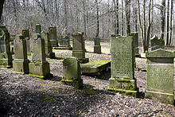

Comparing means or effect sizes across countries / cultures ?
Differences on construct level?
Differences due to measurement bias?
Correlation of Religiosity and Traumatic Events

Slide 4
Religion, Religiosity, Spirituality
“Religion is typically understood
to refer to communally held beliefs and practices
that are related to the sacred or transcendent.”
“Conversely, spirituality refers to an
individual’s subjective relationship with God,
or a sacred or transcendent dimension of existence.”
Hodge, Zidan, & Husain (2015), Psychological Assessment
Religiosity refers to an individual difference variable related to cognitive, affective and behavioral aspects based on religious beliefs and feelings as well as traditional and non-traditional expresssions thereof.

Slide 5
Assessment of Religiosity
Typical approaches:
Sociological tradition
  Member of a church/religious community? ________
  „Have you attended a place of worship or religious service within the last seven days? [yes/no]“
  „How often do you go to religious services?“
Psychological tradition
  “Do you consider yourself a religious person?” [1-5]
  “Are you a spiritual person?” [not at all – very much so]

Slide 6
Challenges
Challenges in assessment (Hill & Hood, 2009):
  Multidimensional instruments !
  Elusive concept: spirituality or supernatural belief ?
  Homogeneous samples !
  Targeting specific religious groups
  Question wording / presuppositions
  („How important is God in your life?“)
  Cross-cultural comparability questionnable?
    Language / translatability
    Religious backgrounds (theistic vs non-theistic)
Reliable and cross-culturally valid measure ?
  Measurement equivalence (invariance of factor structure)

Slide 7
Supernatural Belief Scale (SBS)
Measure of religious/supernatural beliefs
(Jong, Bluemke, & Halberstadt, 2013, EJP)
10 items
9 response options (agree-disagree)
Reliable, valid, but complex measurement model
  Dominant factor: Supernatural Belief
  One method factor for negative item content
  Five secondary factors …

Slide 8
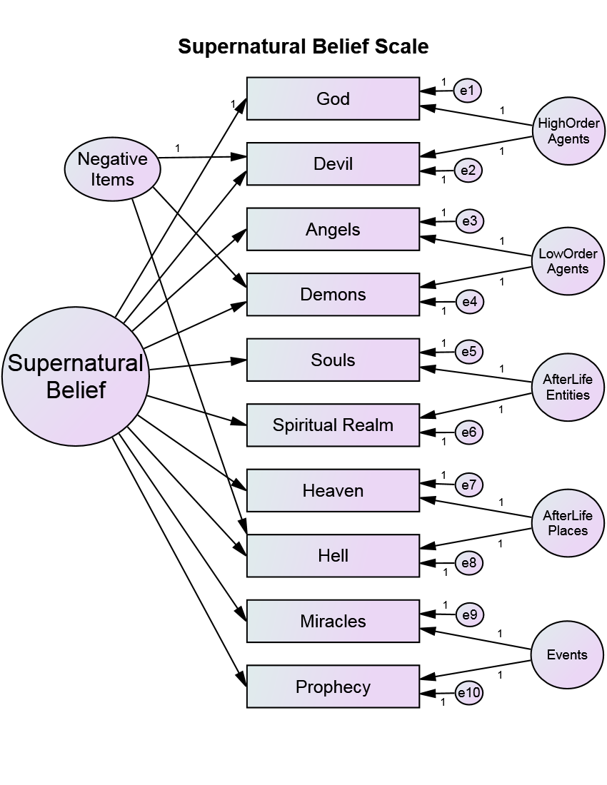
SBS-10 Measurement Model

Slide 9
Supernatural Belief Scale (SBS-6)
Measure of religious/supernatural beliefs
(Jong, Bluemke, & Halberstadt, 2013; Jong & Halberstadt, 2016)
6 items
9 response options (agree-disagree)
Reliable, valid, and simple measurement model
  Dominant factor: Supernatural Belief
  One minor residual correlation for specific item content
  Essence of precursor scale (SBS-10) is maintained

Slide 10
SBS-6: Short Scale with Six Items

Slide 11
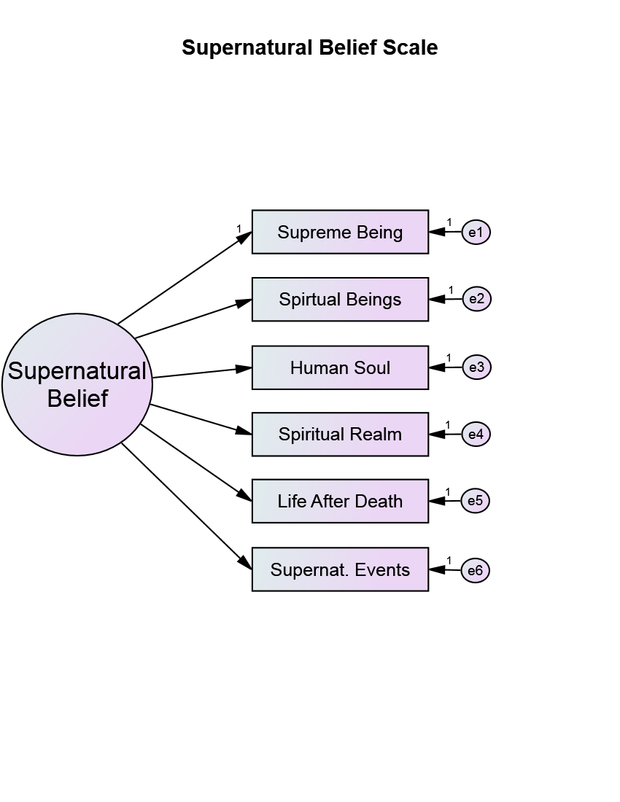
X_{i} = μ_{i} + λ_{i} η + ε_{i}
μ₁
λ₁
μ₂
λ₂
μ₃
λ₃
λ₄
μ₄
λ₅
μ₅
λ₆
μ₆
Researchers who study the hypotheses on the relationship between religiosity and other variables across several countries or religious groups
always face the statistical problem of measurement equivalence.

Slide 12

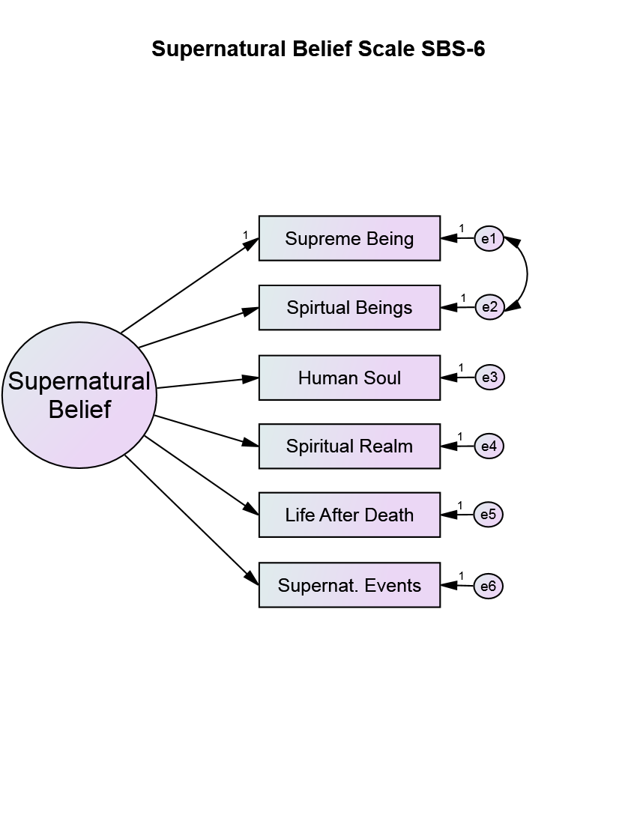
SBS-6 Short Scale
Facette:
SN-Agents
MGCFA | CFI | RMSEA | SRMR | AIC | BIC
1F | 0.948 | 0.109 | 0.037 | 87793 | 89145
1F + CE | 0.983 | 0.065 | 0.025 | 87148 | 88576

Slide 13
ISSP Religiosity Items (Short Scale)
Supernatural Belief: ISSP (2008-2009)
Heaven
Hell
Life after Death
Religious Miracles
MGCFA | CFI | RMSEA | SRMR | AIC | BIC
1F | 0.986 | 0.058 | 0.018 | 96036 | 96945

Slide 14
Method
Measurement Invariance (Equivalence)
  Multigroup confirmatory factor analysis (MGCFA)
  Estimator: „Robust Maximum Likelihood“ (MLR)
  Comparison of 12 countries for SBS-6
  (10 identical or similar countries for ISSP scale)
Levels of MI
  Configural invariance: comparability of factor form
    same factor form → comparable concept
  Metric invariance: comparability of factor loadings
    items have same weight on construct → same scale
  Scalar invariance: comparability of item intercepts
    items have same difficulties → factor means comparable

Slide 15

Samples: SBS-6 vs ISSP
        12 countries: N = 3,872
        Gender: 48% women
        Age: M = 36.0 yrs.
        (SD = 11.3)
        5 religions: n = 3,583
        Christian, None, Muslim,
        Buddhist, Hindu
        10 countries: N = 14,458
        Gender: 46% women
        Age: M = 43.8 yrs.
        (SD = 16.55)
        5 religions: n = 13,041
        Christian, Muslim, None,
        Buddhist, Hindu

Slide 16
Samples: SBS-6 vs ISSP
“International Death” – Study (IDS)
  Six countries (n₁₋₆ ≈ 200 – 800)
    U.S.A., Brazil, Russia, Philippines, Japan, Korea
    Online-Panel from Qualtrics;
    except for US (mTurk) & Japan (Lancer/mTurk equivalent)
“Affective Science of Religions“ – Study (ASR)
  Eight countries (n₁₋₈ ≈ 200 – 300)
    U.S.A., Brazil, Russia, China, India, Indonesia, Thailand, Turkey
“German Personality” – Study (GPS)
  One country (n₁ ≈ 400)
    Germany
    Respondi-Online-Panel / Quota-Sample (3 age groups, gender)

Slide 17
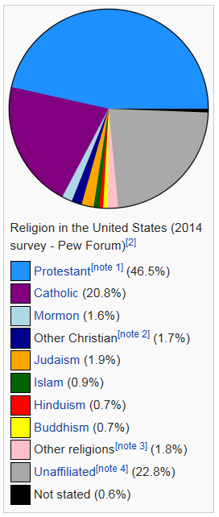
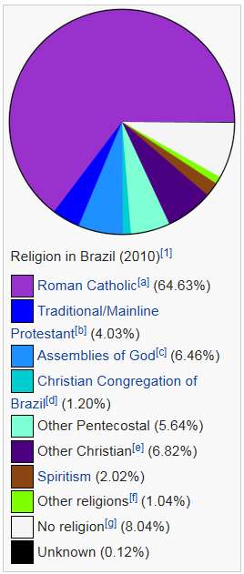
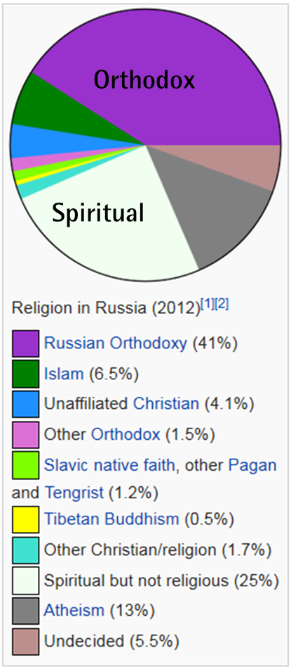
Religious Affiliations
U.S. Brazil Russia
Protestant
Roman Catholic
Roman Catholic
None

Slide 18
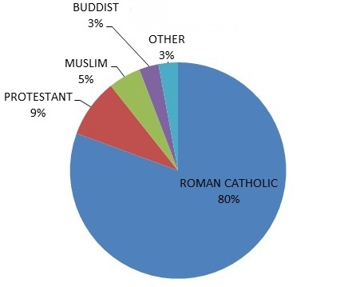
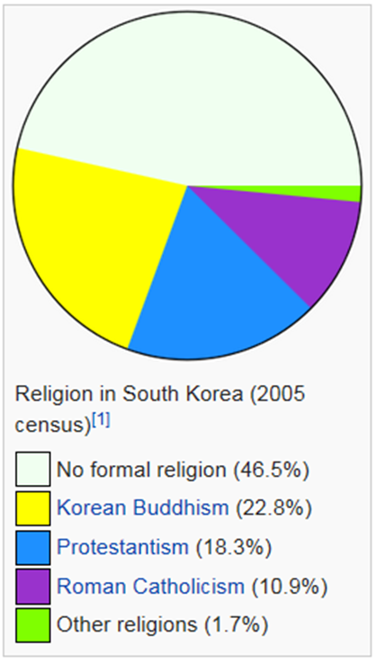
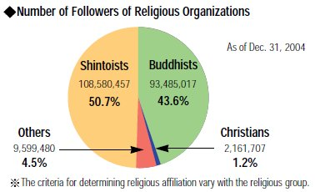
South Korea Philippines Japan
Philippines
None
Buddhist
Japan

Slide 19
Major Religious Backgrounds
SBS-6 |  | ISSP
USA | Christian / Protestant
Brazil | Christian / Roman Catholic | n.a.
Russia | Christian / Orthodox
Germany | Christian
Philippines | Christian
Thailand | Buddhist | Sri Lanka
Japan | Buddhists / None (Shintoists)
Turkey | Islam / Muslim
Indonesia | Islam / Muslim
India | Hindu | (Sri Lanka)
Korea | None / Christian
China | Atheist / None | Taiwan (Tao, Buddhists)

Slide 20
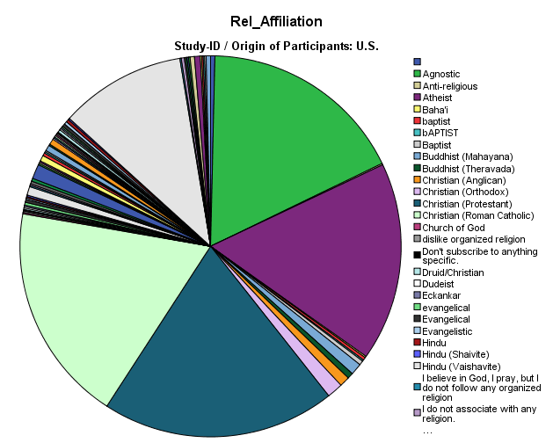
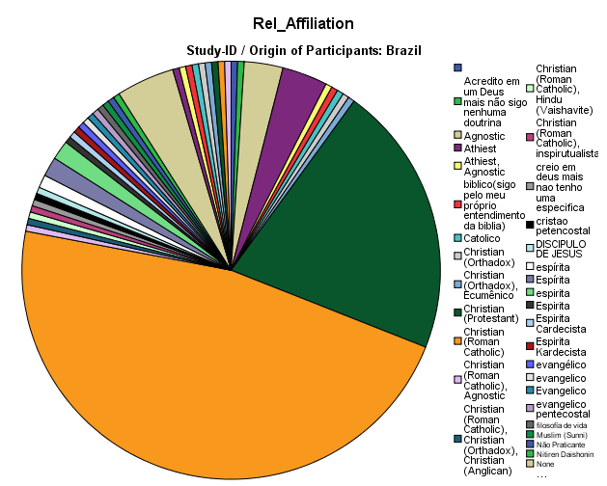
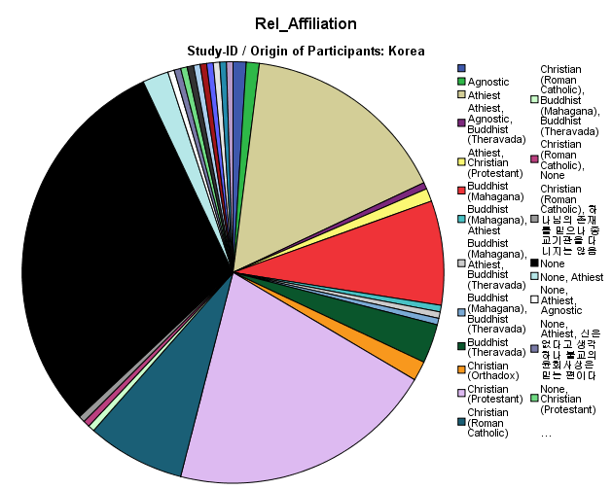
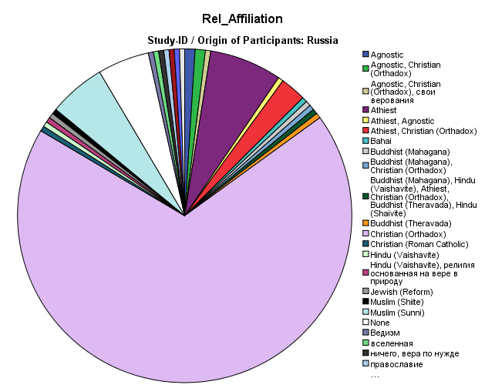
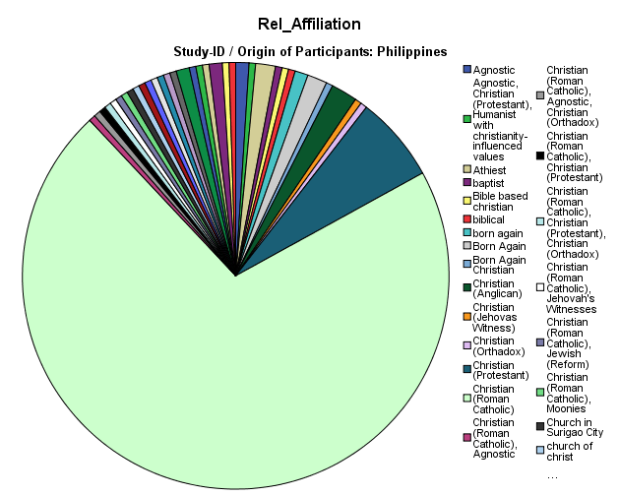
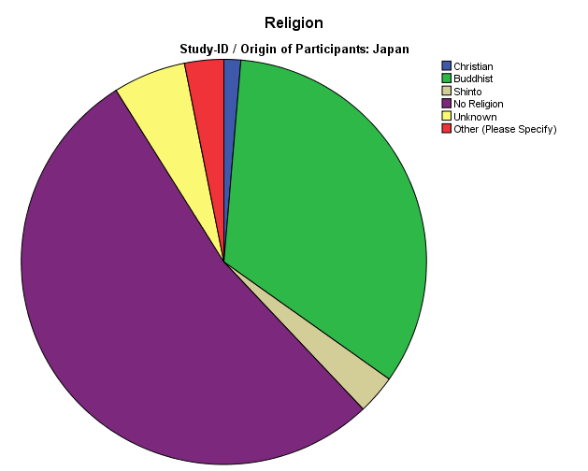
Composition of Samples
U.S.A.:
English
50% female
M(age) = 36 yrs
SD=11
Brazil:
Portuguese
36% female
M(age) = 36 yrs
SD=12
Korea:
Korean/Hangul
64% female
M(age) = 34 yrs
SD=11
Russia:
Russian
55% female
M(age) = 36 yrs
SD=10
Philippines:
Tagalog
57% female
M(age) = 35 yrs
SD=10
Japan:
Japanese
44% female
M(age) = 23 yrs
SD=9

Slide 21
SBS-6 Short Scale
Facette:
SN-Agents
MGCFA | CFI | RMSEA | SRMR | AIC | BIC
1F | 0.948 | 0.109 | 0.037 | 87793 | 89145
1F + CE | 0.983 | 0.065 | 0.025 | 87148 | 88576

Slide 22
SBS-6: Fit & Reliability for Countries
 | Goodness-of-fit (* MLR → SB-scaled) |  |  |  | Reliabilität
 | χ² (8) * | CFI * | RMSEA * | SRMR | Alpha | Omega | AVE
USA | 35.33*** | .990 | .055 | .009 | .97 | .96 | .85
Japan | 7.96 | 1.000 | .000 | .024 | .90 | .88 | .61
Korea | 26.20*** | .959 | .107 | .027 | .93 | .91 | .69
Russia | 14.66 | .990 | .046 | .020 | .91 | .89 | .62
Brazil | 49.67*** | .924 | .116 | .050 | .90 | .88 | .58
Philippines | 6.24 | 1.000 | .000 | .037 | .89 | .87 | .59
China | 17.50* | .980 | .078 | .024 | .92 | .92 | .69
India | 5.00 | 1.000 | .000 | .016 | .90 | .89 | .59
Indonesia | 19.09* | .946 | .085 | .032 | .87 | .86 | .52
Thailand | 12.38 | .983 | .055 | .026 | .88 | .86 | .56
Turkey | 19.58* | .973 | .086 | .023 | .96 | .94 | .78
Germany | 21.87** | .985 | .065 | .017 | .92 | .91 | .66

Slide 23
SBS-6: Equivalence across Countries?
 | Goodness-of-fit (* SB-scaled) |  |  |  | Model difference tests
 | χ² (df) * | CFI * | RMSEA * | BIC | Δχ²(Δdf) * | ΔCFI * | ΔRMSEA*
Configural (Factor form) | 228 *** (96) | .983 | .065 | 88576 | - | - | -
Metric (Loadings) | 381 *** (151) | .971 | .069 | 88321 | 167 *** (55) | .012 | .003
Scalar (Intercepts) | 1068 *** (206) | .892 | .114 | 88882 | 408 *** (55) | .079 | .054
Partial-scalar (#1, 2, 3, 6 free) | 442 *** (162) | .965 | .073 | 88316 | 245 *** (11) | .006 | .005
Factor-Means |  | .894 | .123 | 89241 |  | .071 | .050
P-Residual | partial scalar | 380 *** (113) | .941 | .088 | 41687 | 147 *** (30) | .030 | .021
On the basis of these findings we can conclude:
loading differences are only minor between statistical groups
the scale works well enough in terms of intercept differences
the scale works similarly in each of the involved countries
the construct is understood and assessed comparably across cultures
The SBS-6 is a cross-culturally invariant proxy of religiosity!
Hence, we might use the SBS-6 for hypothesis-tests across countries!

Slide 24
SBS-6: Equivalence across Religions?
 | Goodness-of-fit (* SB-scaled) |  |  |  | Model difference tests
 | χ² (df) * | CFI * | RMSEA * | BIC | Δχ²(Δdf) * | ΔCFI * | ΔRMSEA*
Configural (Factor form) | 112 *** (40) | .987 | .050 | 81279 | - | - | -
Metric (Loadings) | 178 *** (60) | .978 | .052 | 81211 | 69 *** (20) | .009 | .002
Scalar (Intercepts) | 511 *** (80) | .909 | .093 | 81668 | 499 *** (20) | .069 | .041
Partial-scalar (#1, 2 free) | 208 *** (72) | .975 | .051 | 81143 | 30 *** (12) | .003 | -.001
Factor-Means
P-Residual | partial scalar
On the basis of these findings we can conclude:
loading differences are only minor between statistical groups
the scale works well in terms of intercept differences
the scale works similarly in each of the involved religions
the construct is understood and assessed comparably across religious groups
The SBS-6 is a cross-culturally invariant proxy of religiosity!
Hence, we might use the SBS-6 for hypothesis-tests across religions!

Slide 25
ISSP: Equivalence across Countries?
 | Goodness-of-fit (* SB-scaled) |  |  |  | Model difference tests
 | χ² (df) * | CFI * | RMSEA * | BIC | Δχ²(Δdf) * | ΔCFI * | ΔRMSEA*
Configural (Factor form) | 118 *** (20) | .986 | .058 | 96945 | - | - | -
Metric (Loadings) | 486 *** (47) | .936 | .080 | 97287 | 399 *** (27) | .050 | .022
Partial-metric (#1, #4 free) | 170 *** (29) | .979 | .058 | 96929 | 52 *** (9) | .007 | .000
Scalar (Intercepts) | 993 *** (56) | .863 | .108 | 97899 | 973 *** (27) | .079 | .054
Partial-scalar (#3, #4 free) | 285 *** (38) | .964 | .067 | 97018 | 132 *** (9) | .015 | .009
On the basis of these findings we can conclude:
ISSP loading differences are non-negligible between statistical groups
the scale does not work well across countries
the scale does not work similarly in each of the involved countries
the construct is not understood and assessed comparably across cultures
The ISSP is not a cross-culturally invariant proxy of religiosity!
Hence, we cannot use the ISSP for hypothesis-tests across countries!

Slide 26
ISSP: Equivalence across Religions?
 | Goodness-of-fit (* SB-scaled) |  |  |  | Model difference tests
 | χ² (df) * | CFI * | RMSEA * | BIC | Δχ²(Δdf) * | ΔCFI * | ΔRMSEA*
Configural (Factor form) | 118 *** (11) | .981 | .061 | 95796 | - | - | -
Metric (Loadings) | 357 *** (23) | .941 | .075 | 96030 | 258 *** (12) | .040 | .014
Partial-metric (#1, #2 free) | 163 *** (15) | .974 | .062 | 95825 | 46*** (4) | .007 | .001
Scalar (Intercepts) | 516 *** (27) | .914 | .083 | 96337 | 347 *** (12) | .060 | .021
Partial-scalar (#2, #4 free) | 201 *** (19) | .968 | .061 | 95831 | 36*** (4) | .013 | .000
Factor-Means
On the basis of these findings we can conclude:
ISSP loading differences are non-negligible between statistical groups
the scale does not work well across religions
the scale does not work similarly in each of the involved religions
the construct is not understood and assessed comparably acorss religions
The ISSP is not a cross-culturally invariant proxy of religiosity!
Hence, we cannot use the ISSP for hypothesis-tests across religions!

Slide 27
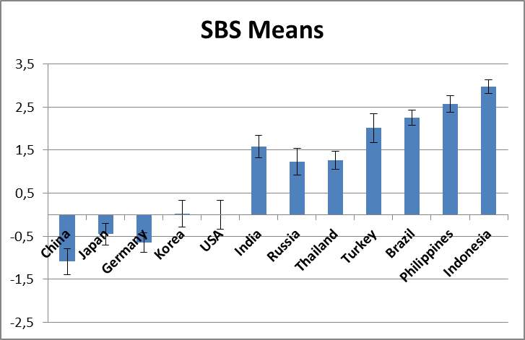
Cross-Cultural Supernatural Beliefs

Slide 28
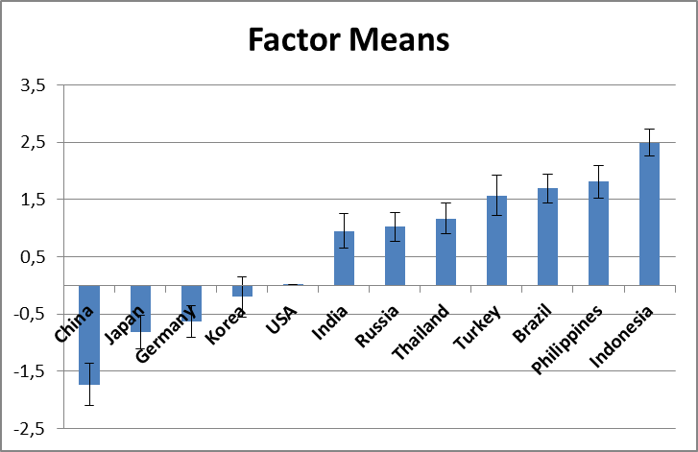
Cross-Cultural Supernatural Beliefs

Slide 29
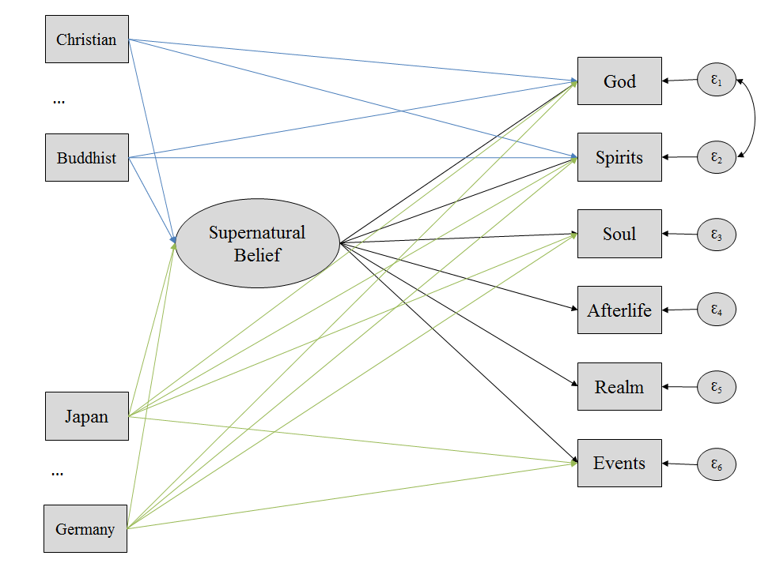
Cross-Cultural Supernatural Beliefs: MIMIC Model
MGCFA | CFI | RMSEA | SRMR | AIC | BIC
Baseline | 0.998 | 0.040 | 0.004 | 80311 | 80985
MIMIC | 0.992 | 0.038 | 0.008 | 80401 | 80933

Slide 30
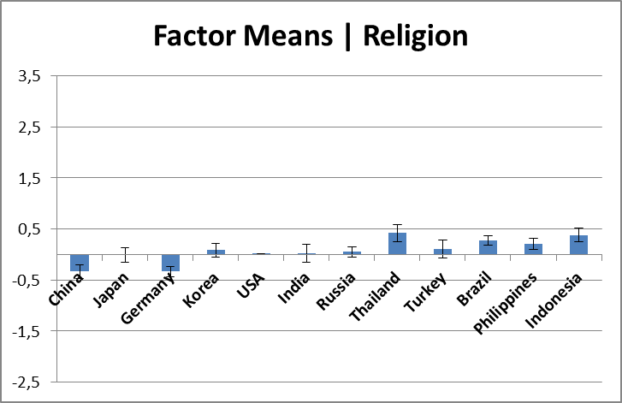
Cross-Cultural Supernatural Beliefs: MIMIC Model

Slide 31
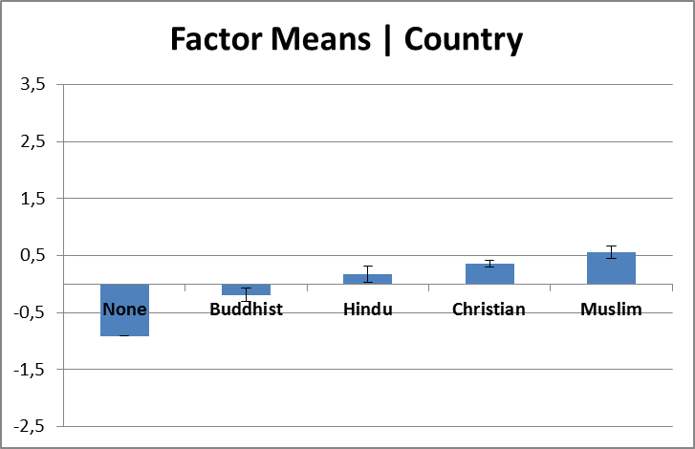





Cross-Cultural Supernatural Beliefs: MIMIC Model

Slide 32
Summary
Key findings for SBS-6 :
  Metric invariance → same construct, same metrics/scale
  Partial scalar invariance → some item difficulties differ
  Belief is measured highly reliably (in heterogeneous samples)
  ISSP scores are not a good approximation to (latent) religiosity
  SBS-6 is a quasi-standard for cross-cultural comparisons of religiosity in terms of supernatural belief

Slide 33
References
Jong, J., & Halberstadt, J. (2016). Death anxiety and religious belief: an existential psychology of religion. New York, NY: Bloomsbury Academic.
Religion pie charts from:
1) Wikipedia (thanks!!)
2) sites.google.com/site/rygalandjakesreligionish/countries-in-asia-with-other-religions
3) jalkeshijapan.weebly.com/uploads/2/3/8/5/23853705/9172960_orig.jpg

Slide 34
References: Data sources
Gendall, P. (2010). International Social Survey Programme: Study Monitoring 2008. Retrieved from https://dbk.gesis.org/dbksearch/download.asp?file=ZA4950_mr.pdf
GESIS (2015, April 10). ZA4950: International Social Survey Programme: Religion III - ISSP 2008: Errata & Versions. Retrieved from https://dbk.gesis.org//dbksearch/sdesc2.asp?no=4950&db=E&tab=3
ISSP Research Group (2007). ISSP 2008 – Religion III: Basic Questionnaire. Retrieved from https://dbk.gesis.org/dbksearch/file.asp?file=ZA4950_bq.pdf
ISSP Research Group (2012). International Social Survey Programme 2008: Religion III (2008) [ZA4950 Data file Version 2.2.0]. doi:10.4232/1.11334
ISSP Research Group (n.d.). Contents of ISSP 2008 module. Retrieved from https://dbk.gesis.org/dbksearch/file.asp?file=ZA4950_topics.pdf
ISSP Research Group, Saflianto, M., Omondi, P., Thavaraja, J., & Wanyama, E. (2013). Religion Around the World Study of the 2008 International Social Survey Programme (ISSP) [ZA5690 Data file Version 1.0.1]. doi:10.4232/1.11762
ISSP Research Group, Saflianto, M., Omondi, P., Thavaraja, J., & Wanyama, E. (n.d.). ZA5690: Religion Around the World Study of the 2008 International Social Survey Programme (ISSP): Methodology. Retrieved from https://dbk.gesis.org/dbksearch/sdesc2.asp?no=5690&search=International%20Social%20Survey%20Programme:%20Religion%20III%20ZA5690&search2=&field=all&field2=&DB=e&tab=0&notabs=&nf=1&af=&ll=10

Slide 35
Contact: matthias.bluemke@gesis.org jonathan.jong@anthro.ox.ac.uk jhalbers@psy.otago.ac.nz

Slide 36

From:
Monod et al. (2011).
Instruments measuring spirituality in clinical research: a systematic review.

Slide 37
Measurement Invariance = Equivalence
  „As proposed by Mellenbergh (1989),
  measurement invariance (MI) requires that
  the association between the items …
  and the latent factors … of individuals
  should not depend on group membership …”
  (van de Schoot et al., 2015)

Slide 38
CFI RMSEA SRMR AIC BIC
A 1_USA Uni 0.949 0.119 0.021 17904 17988
B 1_USA Uni+CE 0.983 0.074 0.011 17722 17812
C 2_Japan Uni 0.941 0.102 0.047 5305 5367
D 2_Japan Uni+CE 1 0 0.024 5261 5326
E 3_Korea Uni 0.87 0.18 0.053 4686 4745
F 3_Korea Uni+CE 0.959 0.107 0.027 4610 4673
G 4_Russia Uni 0.913 0.126 0.048 4779 4839
H 4_Russia Uni+CE 0.969 0.08 0.032 4747 4810
I 5_Brazil Uni 0.934 0.1 0.042 4574 4634
J 5_Brazil Uni+CE 0.977 0.063 0.034 4549 4611
K 6_Philippines Uni 0.906 0.094 0.058 4135 4194
L 6_Philippines Uni+CE 1 0 0.037 4061 4123

