Slide 1
Who Uses These Apps…
Marcelo Simas, Alexander Cates, Anthony Fucci
Presented at ESRA 2019

Slide 2
Historic Background
Historically Household Travel Surveys (HTS) have suffered trip underreporting
Starting in late 1990s GPS data loggers were used to collect trace data passively
Over time GPS derived travel data used in different ways
  Independent processing and comparison
  As a source for a prompted-recall interview
  Fully automated processing with attribute imputation
Then smartphones appeared…

Slide 3
Evolution of Smartphone Apps
Initially used as direct replacements of GPS loggers
  NuStats adapted CycleTracks for Portland HTS (2010), captured limited attributes
Connected to online instruments for prompted-recall
  MIT – Future Mobility Survey in Singapore (2014)
As a complete “in the moment” prompted-recall instrument (2015)
  RSG – rMove smartphone apps
Westat had internal prototypes as early as 2012
  Followed model from MIT in the beginning
  Switched to a full blown “in the moment” PR in 2016

Slide 4
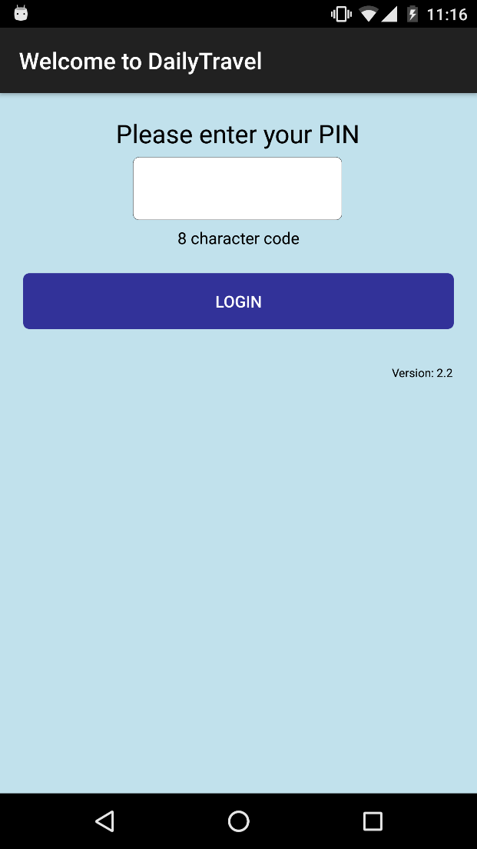
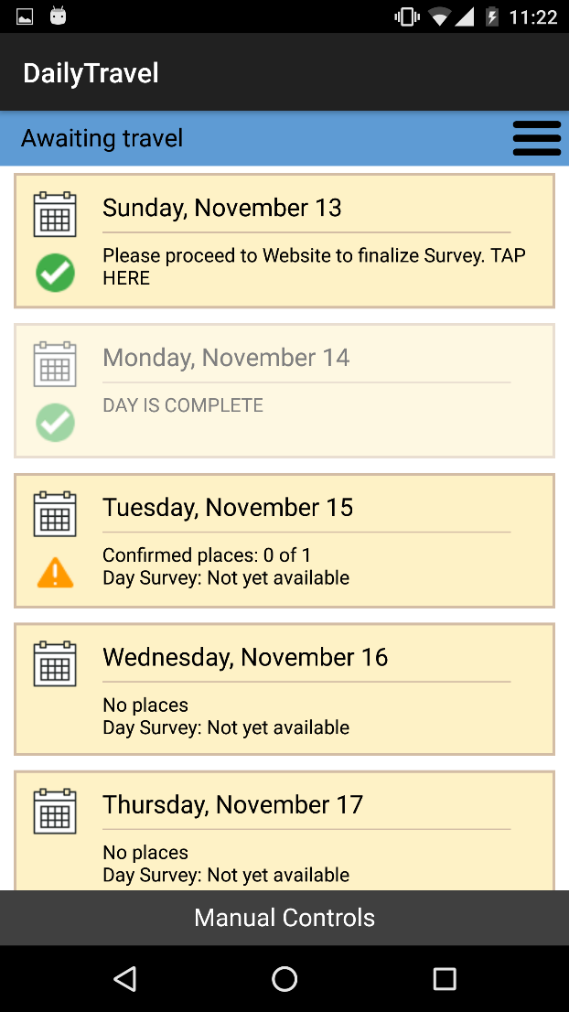
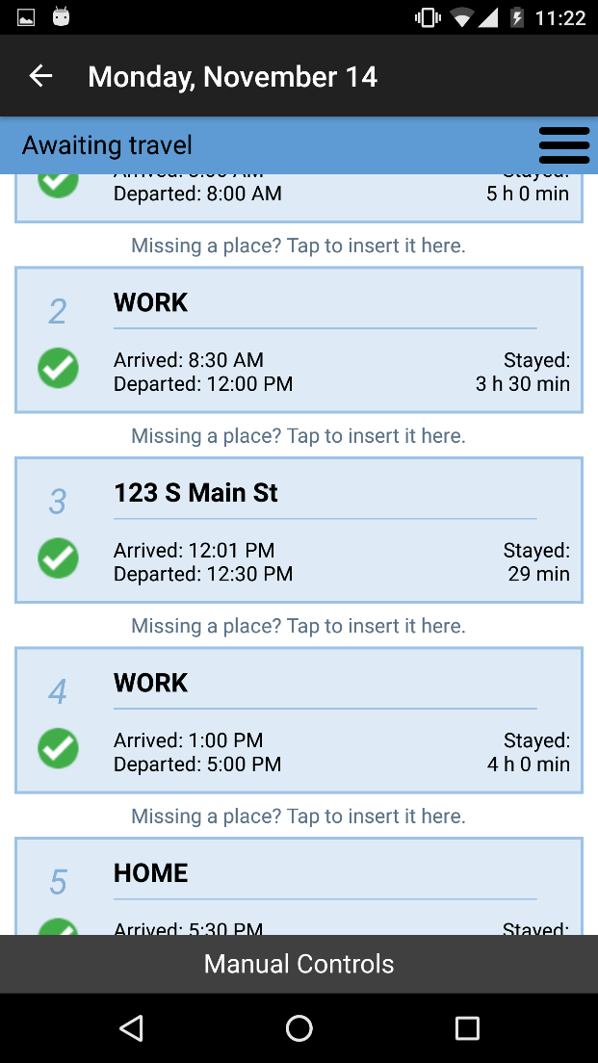
Examples of App Screenshots

Slide 5
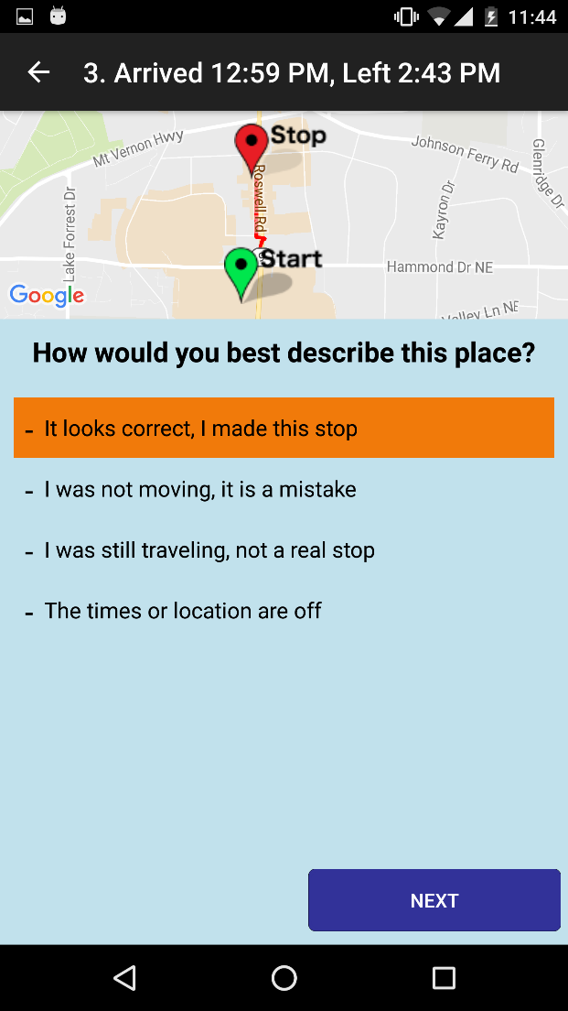
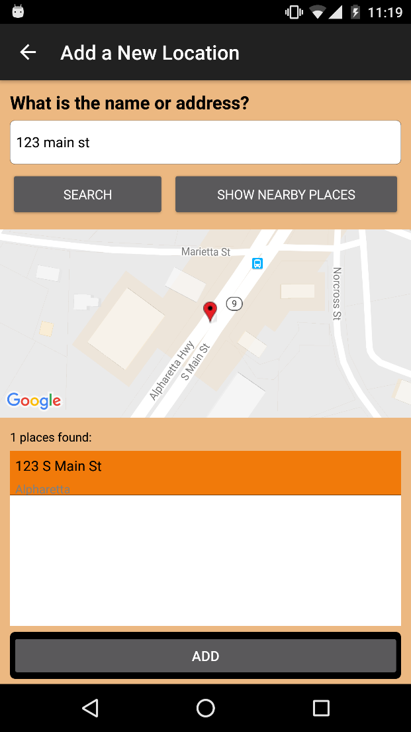
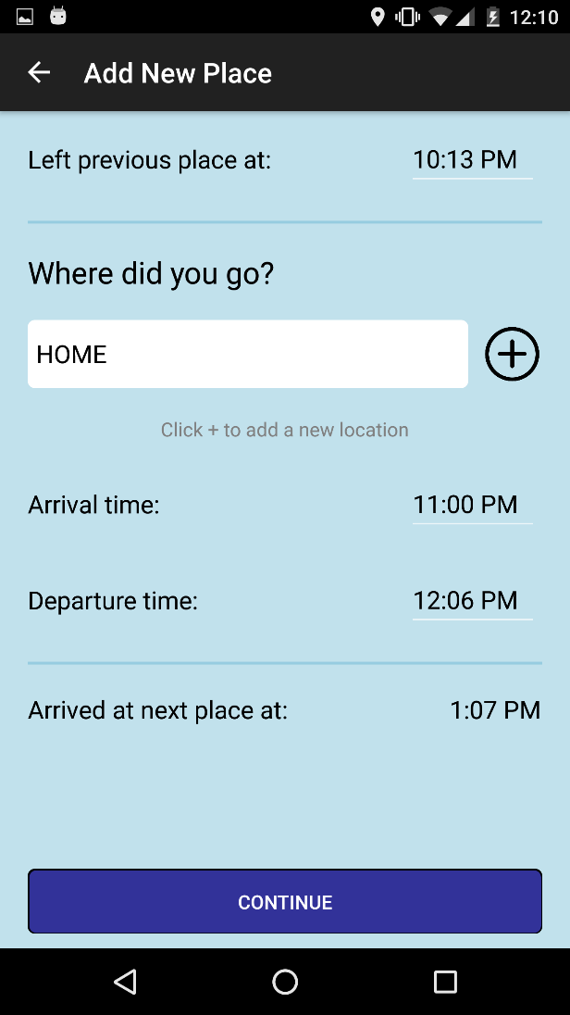
Example of App Screenshots

Slide 6
DailyTravel App – Background
Replace dedicated GPS logger devices
Implement state-of-the art features
  Support “in the moment” GPS-PR (limited place editing)
  Support for adding missed trips
  Integrate with TripBuilder Web (TBW)
  Multi-day support (week-long collection)
  Customizable instruments and time zones
  Connected to Google APIs
Full integration with other retrieval modes (Web, CATI)
  Possible to start on phone and end on Web or CATI

Slide 7

DailyTravel App at Westat
Westat started offering DailyTravel to all HTS participants age 13+ in 2016
  Initial deployment to a pilot in Hickory, NC
Following that Westat deployed apps to several HTS projects
  Billings (2017)
  Vancouver (Translink) with Ipsos (2017-2018)*
  CMAP – Chicago HTS (2018-2019)
  Maryland HTS (2018-2019)
  Laredo HTS (2018-2019)
  MARC – Kansas City HTS (2018-2019)

Slide 8
Research Questions
Examine sample percentages and socio-demographic characteristics of participants that use apps vs. those that do not
Review the characteristics of participants who start to use the app and fall into the following groups:
  complete reporting on the app,
  complete reporting on the web,
  or complete reporting over the phone.
Compare both the socio-demographic and travel aspects of complete households and persons who use the app versus those who don’t

Slide 9
Data Summary – Completes for Day 1
Project | Households | Persons (13+) | App Persons | Trips
Billings HTS | 1,059 | 1,950 | 633 | 7,728
CMAP HTS | 11,967 | 24,522 | 7,749 | 88,543
Laredo HTS | 1,007 | 2,406 | 354 | 9,598
MARC HTS | 3,788 | 7,090 | 548 | 27,987
Maryland HTS | 6,665 | 12,558 | 1,772 | 44,817
Total | 24,486 | 48,526 | 11,056 | 178,673

Slide 10
All GPS Points Collected Since 2016 (>60 million)

Slide 11
Socio-demographic characteristics
Household (Used App = At least one person used the app)
  Size
  Number of Vehicles
  Income
Persons
  Person type
  Age group
  Education

Slide 12
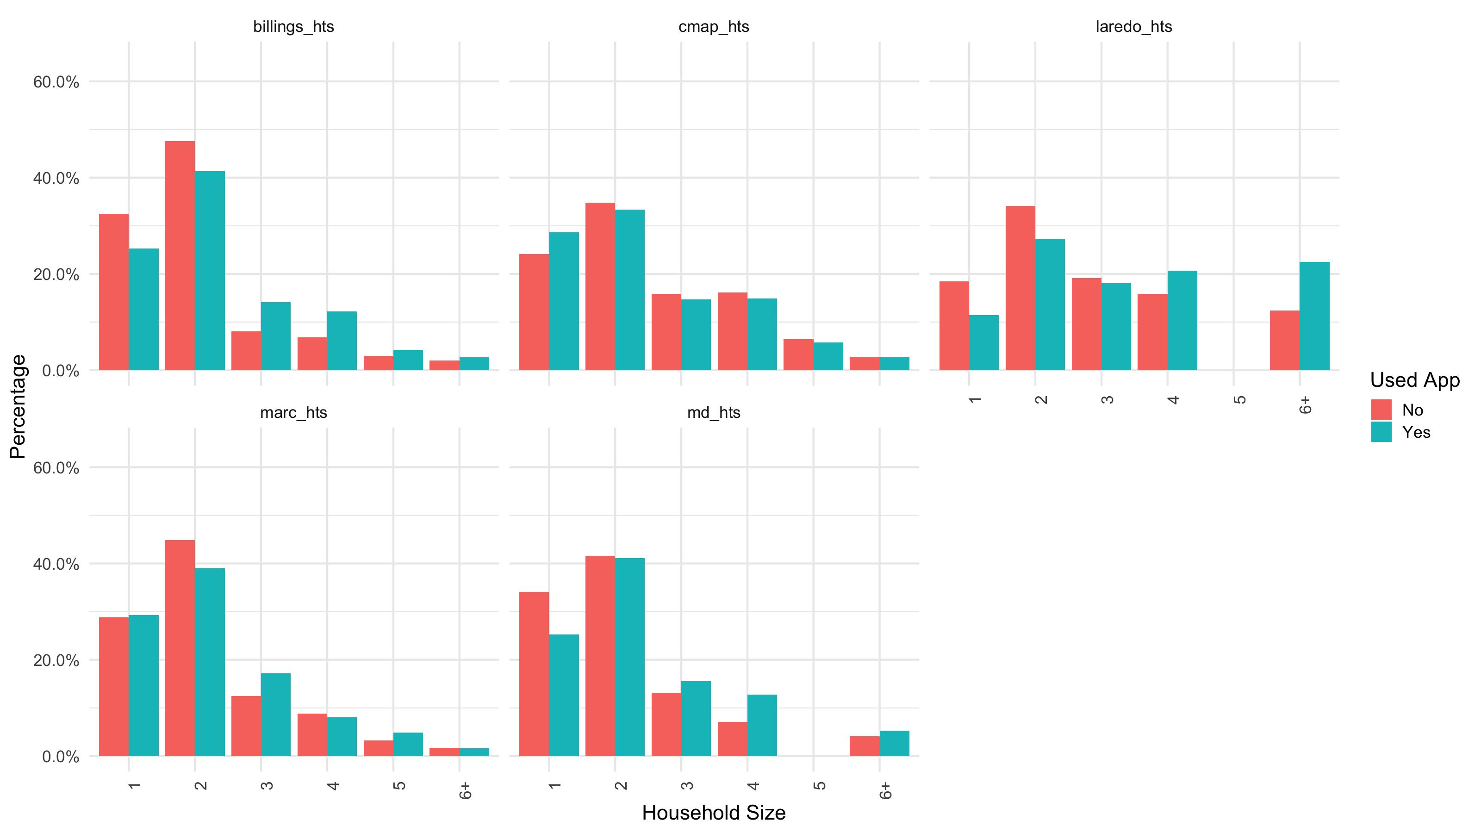
Household Size

Slide 13
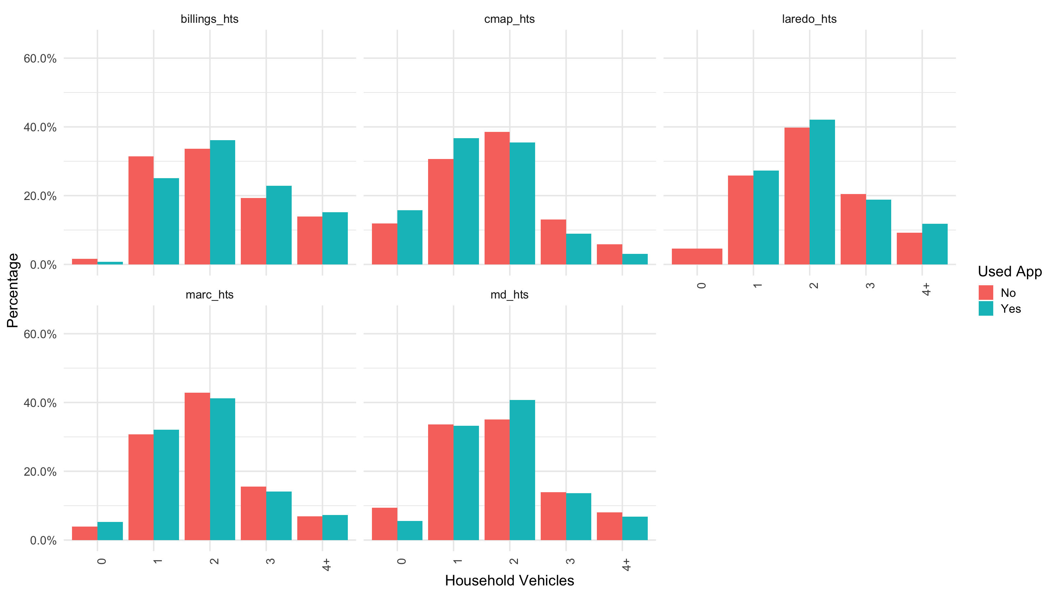
Vehicle Counts

Slide 14
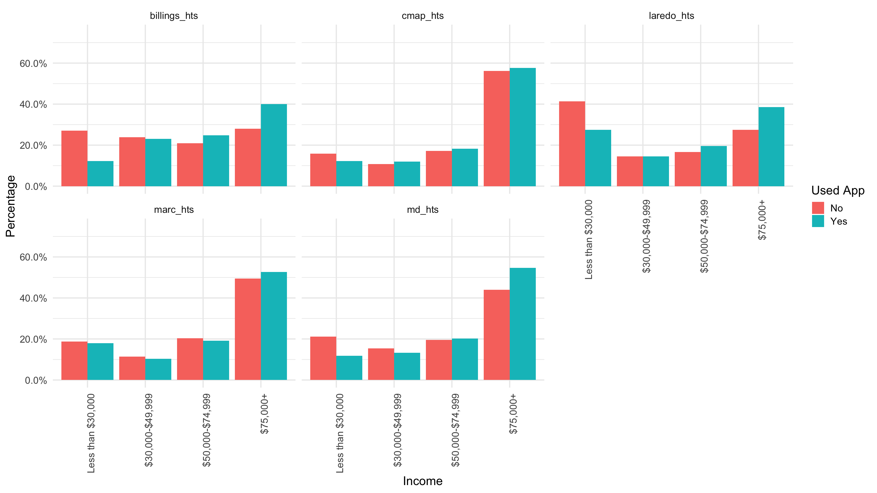
Income Groups

Slide 15
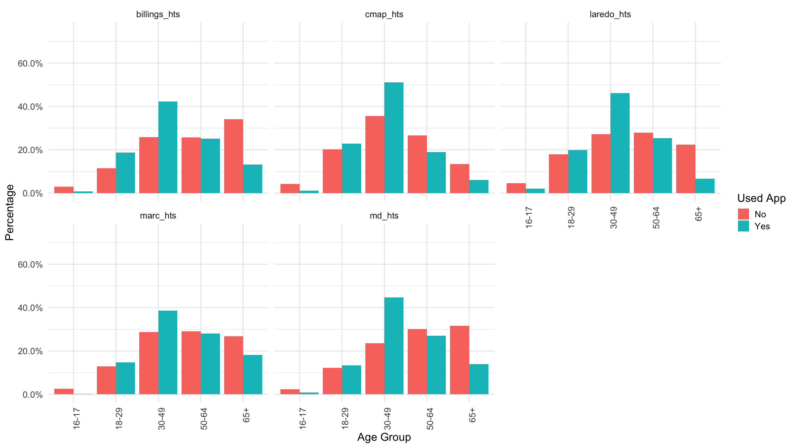
Person Age Groups

Slide 16
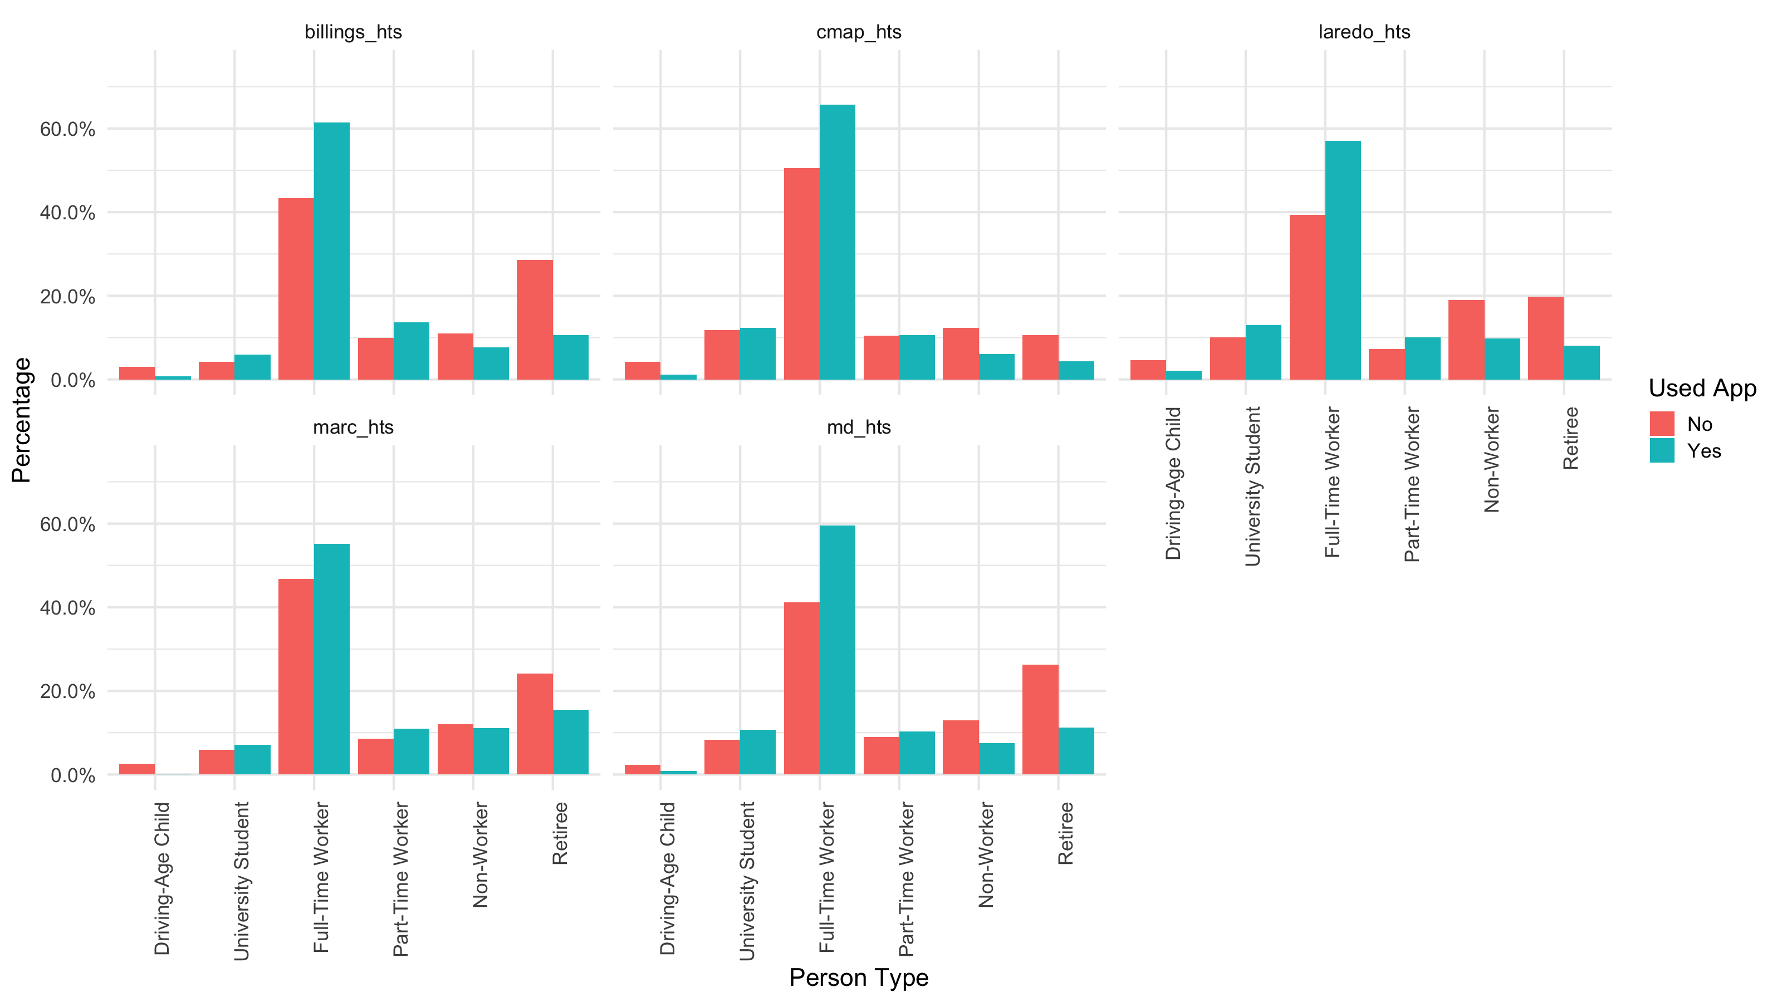
Person Types

Slide 17
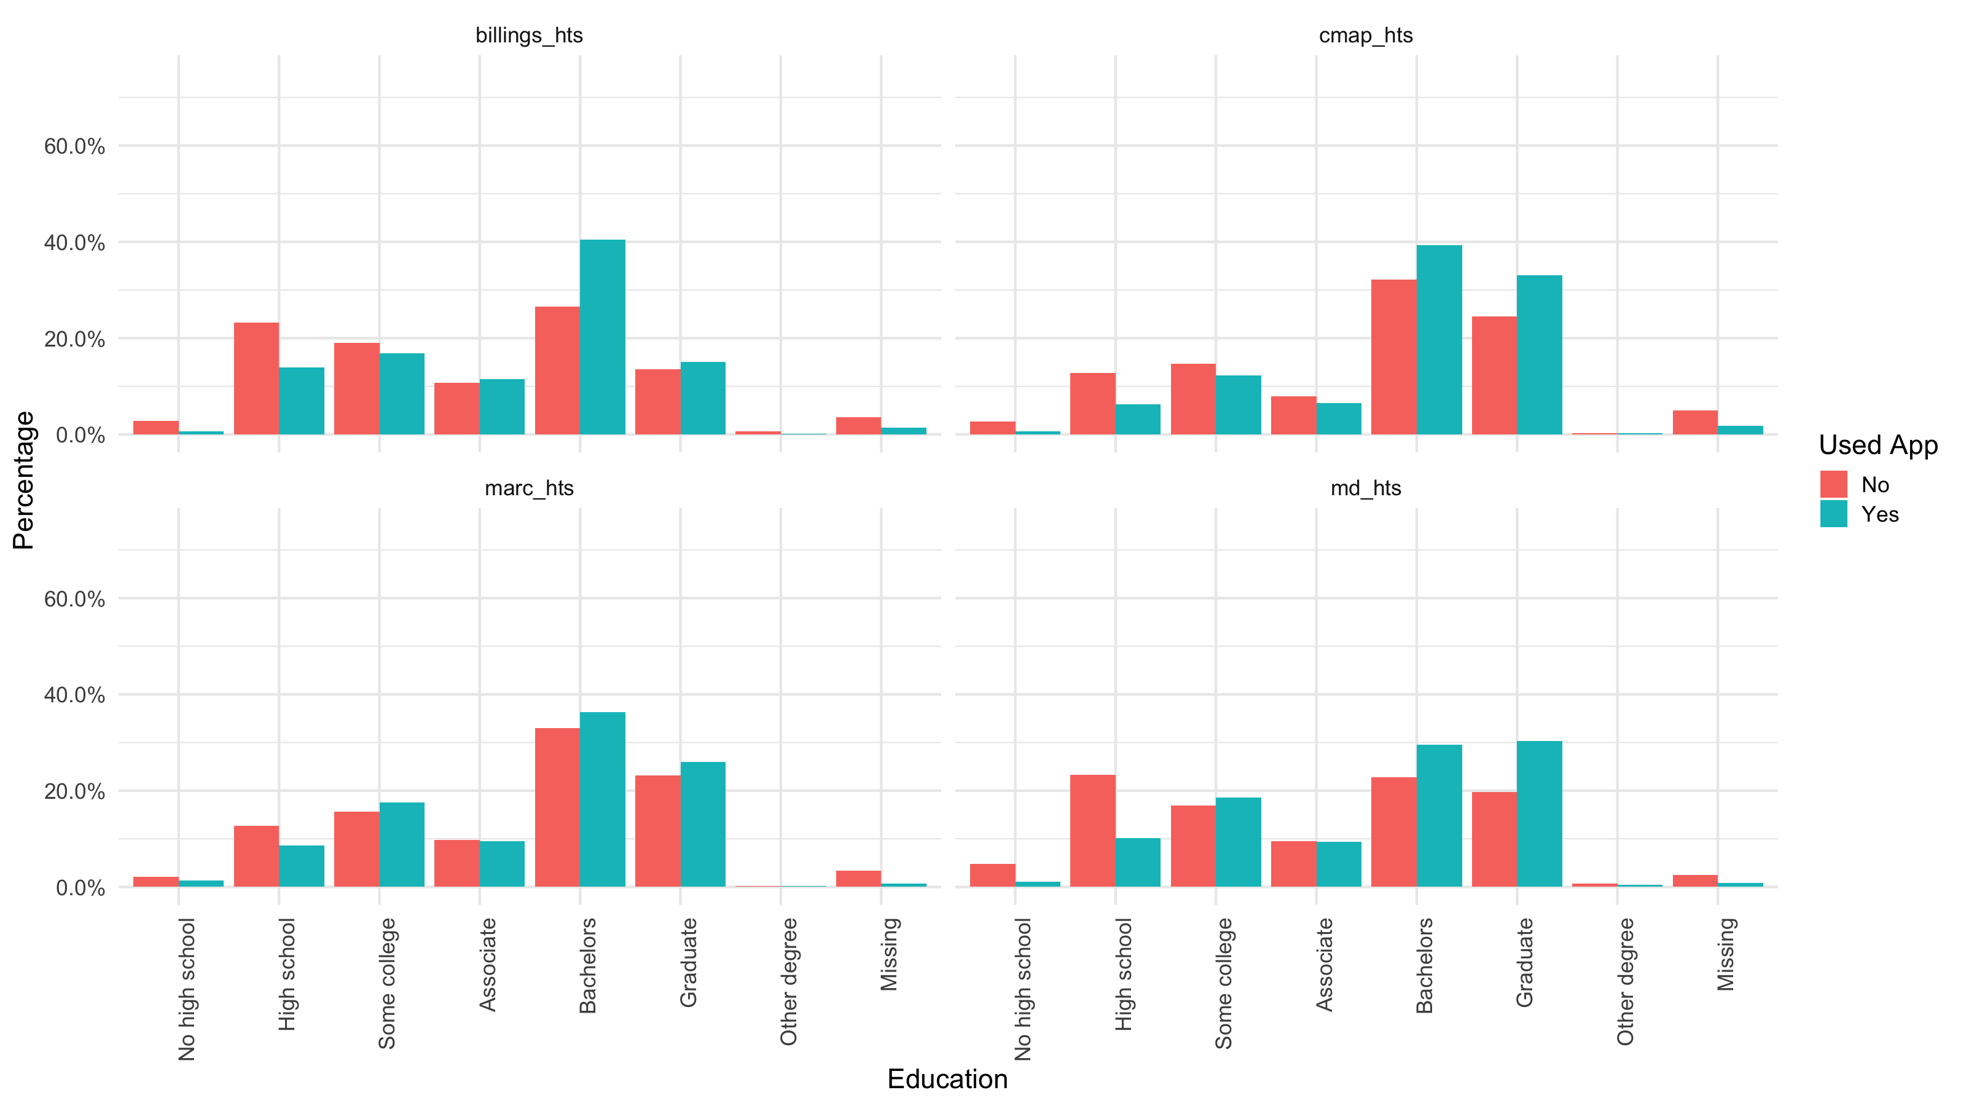
Education Levels

Slide 18
Travel Characteristics
Linked Trips
  Hourly departures
  Trip distances
  Trip travel time
  Trip rates by person type
  Trip rates by model purpose
Tours
  Tour rates
  Tour stop rates
Train Station
Lunch
2
4
Home
Work
3
1
Gym
5
6
Short Stop

Slide 19
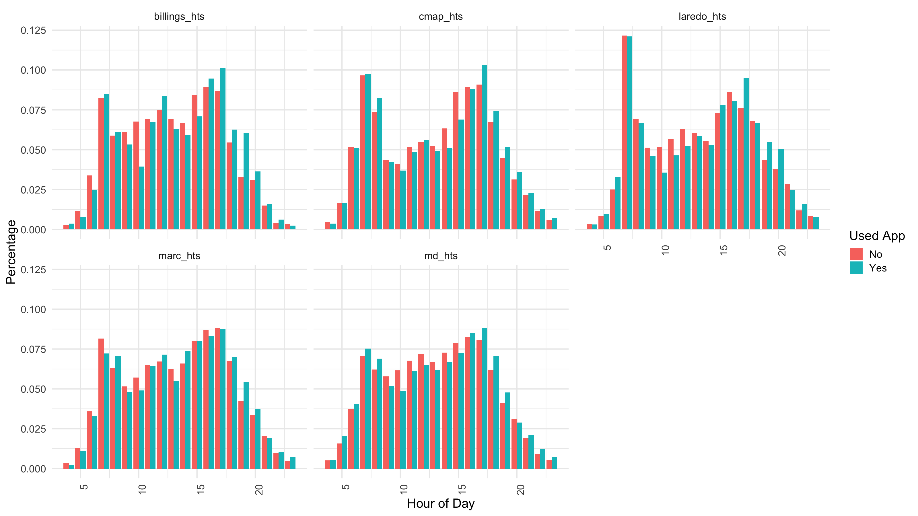
Hourly Linked Trip Departures

Slide 20
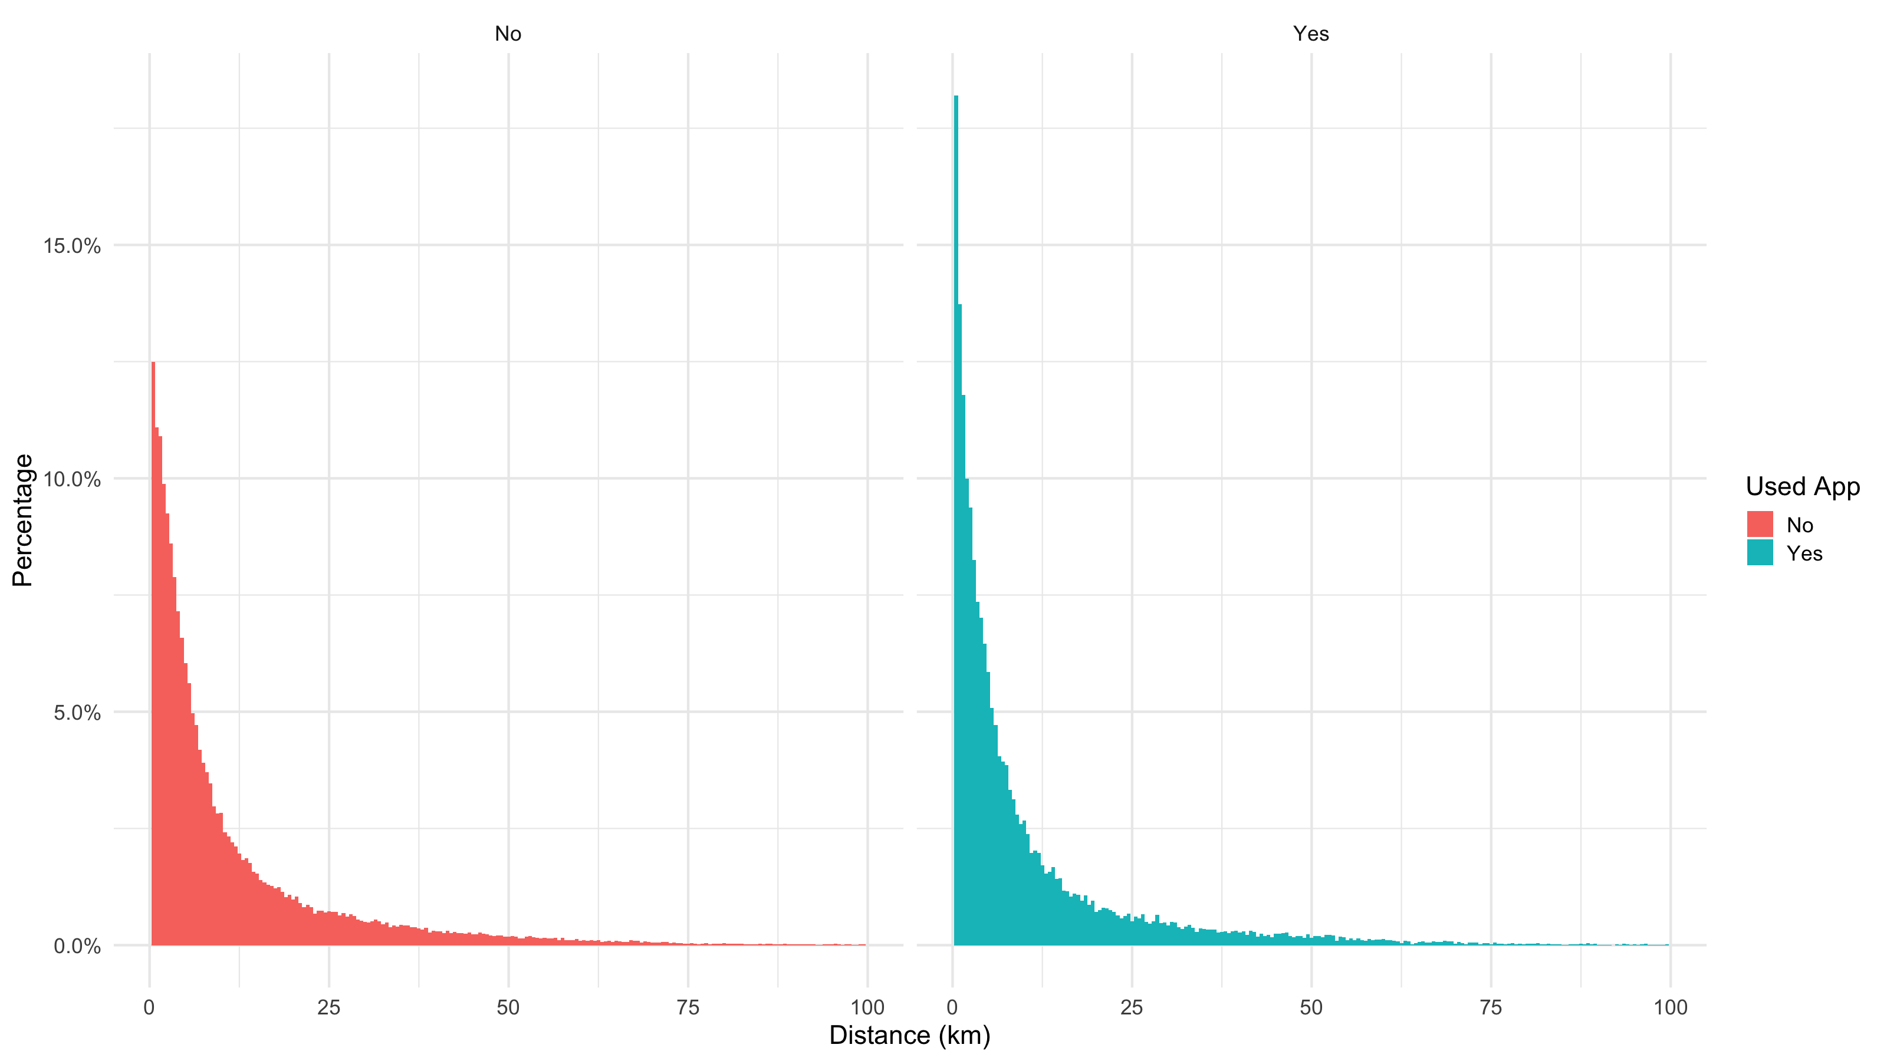
Linked Trip Distances

Slide 21
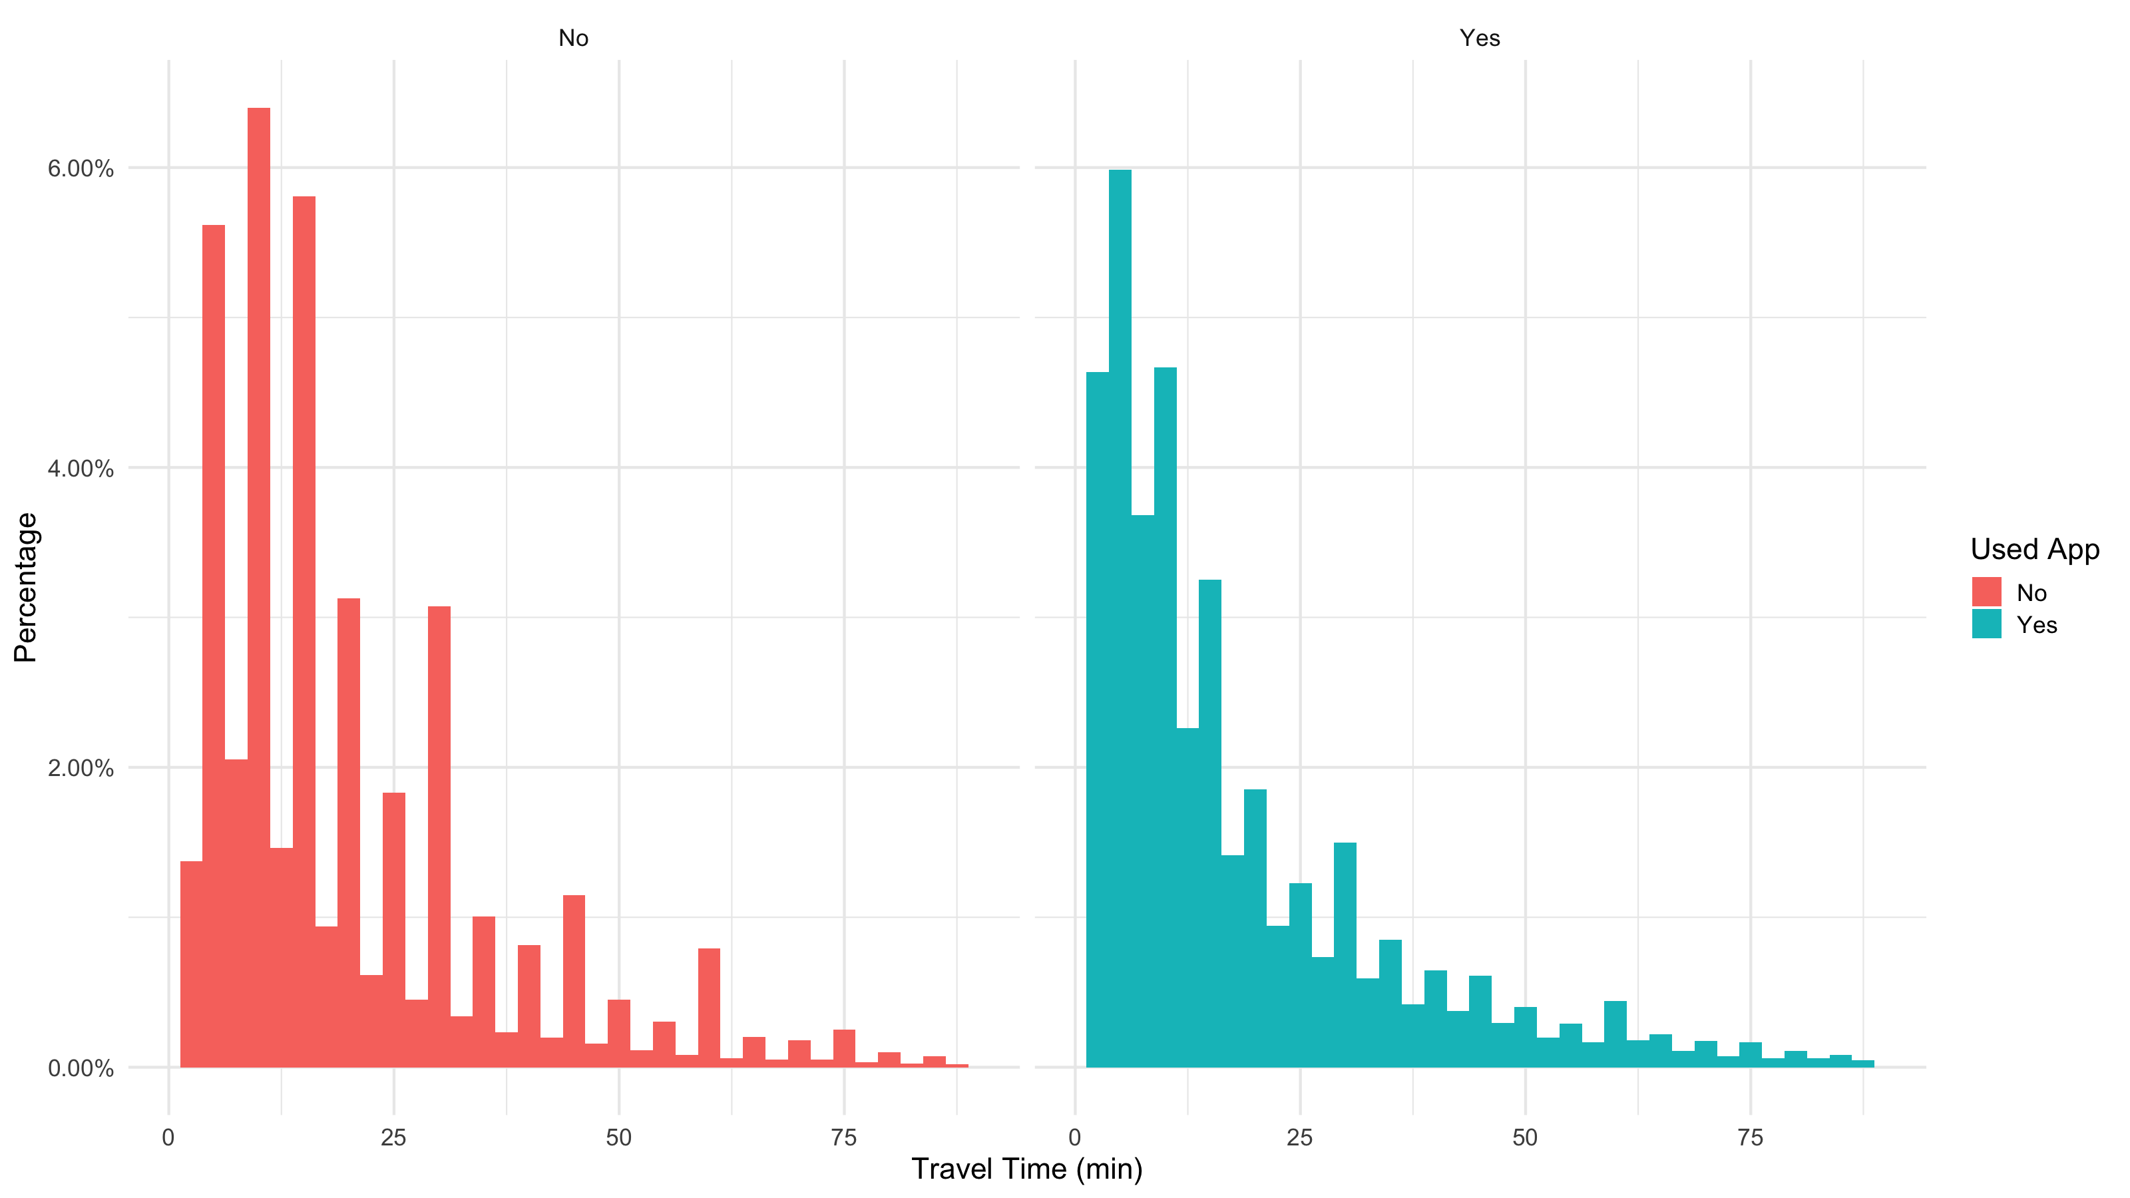
Travel Time

Slide 22
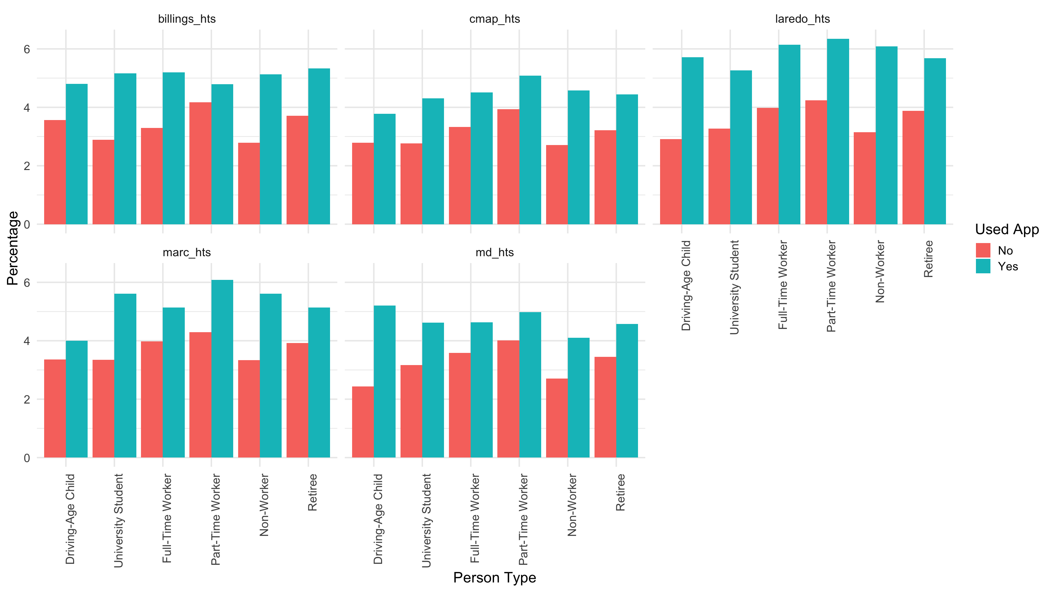
Trip Rates by Person Type

Slide 23
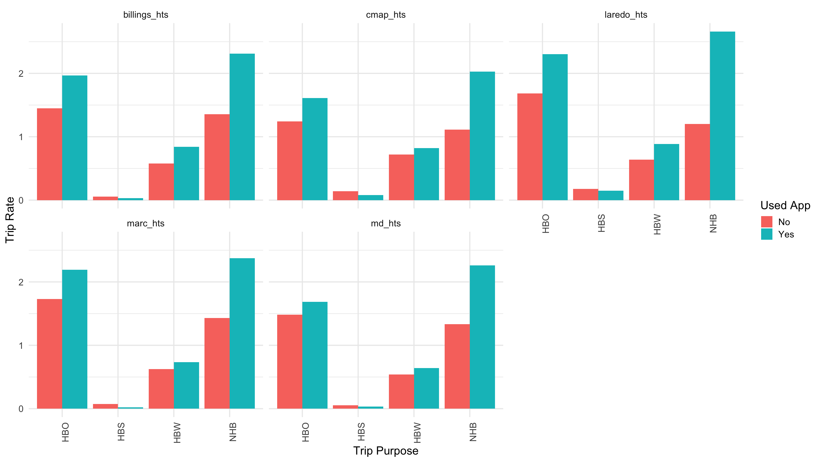
Linked Trip Rates by Model Purpose

Slide 24
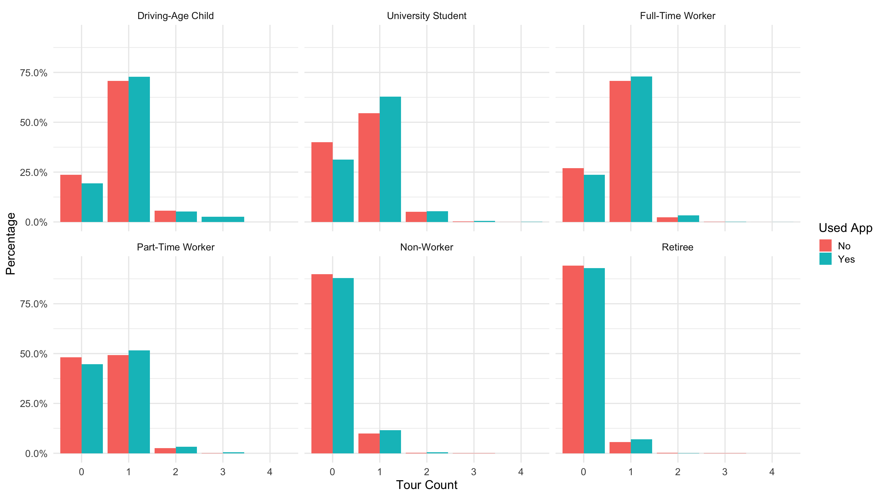
Mandatory Tour Rates by Person Type Across Projects

Slide 25
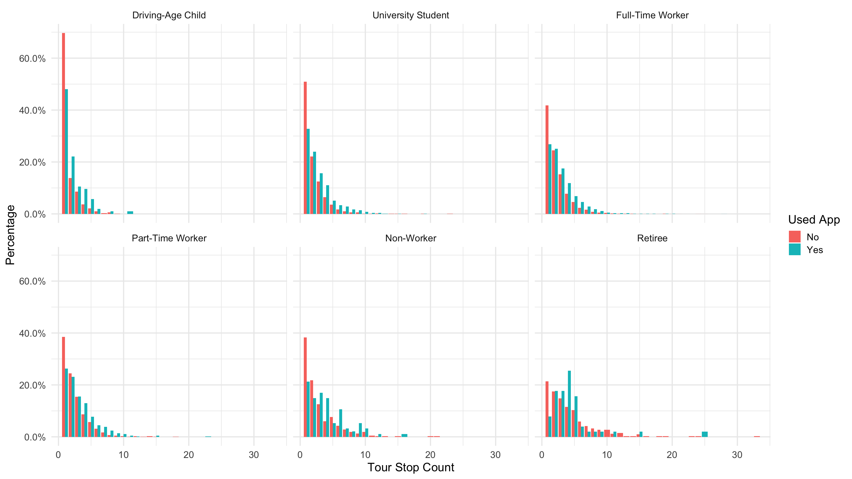
Mandatory Tour Stop Frequency by Person Type

Slide 26
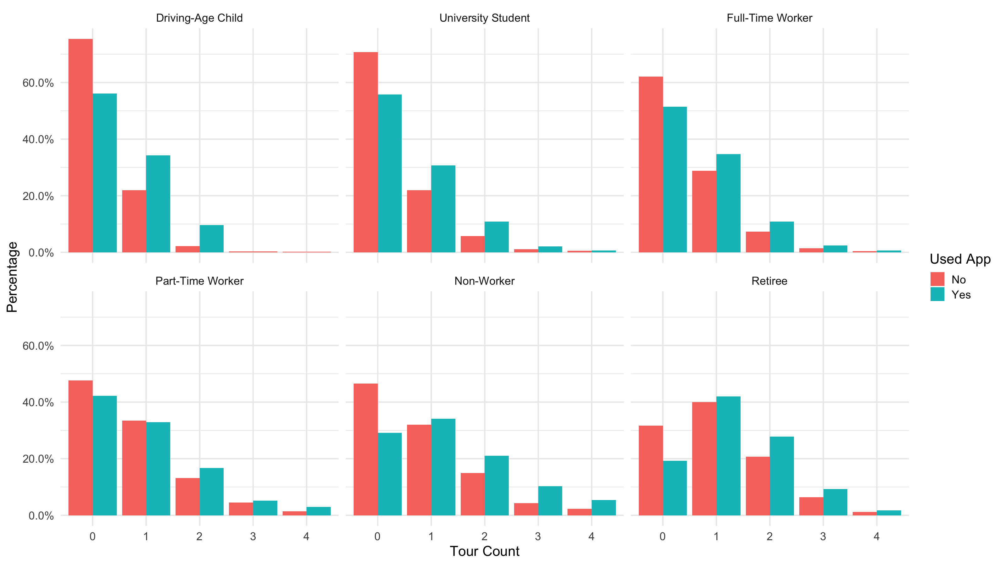
Non Mandatory Tour Rates by Person Type Across Projects

Slide 27
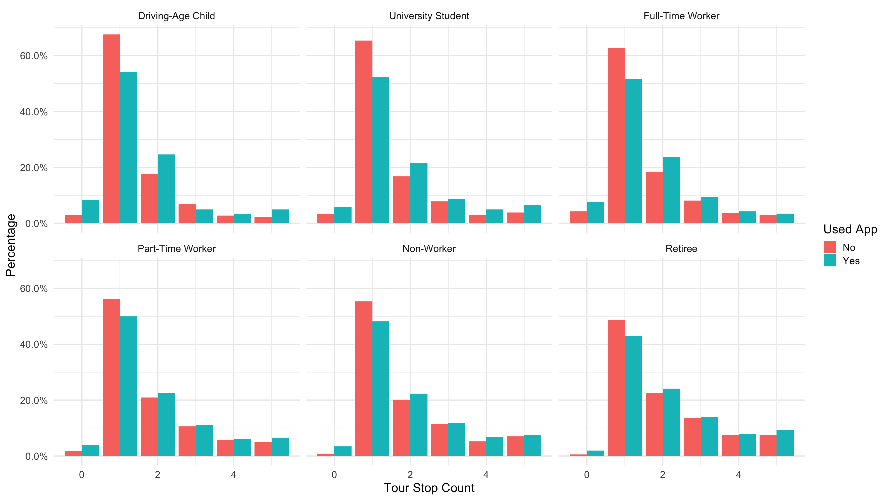
Non-Mandatory Tour Stop Frequency by Person Type

Slide 28
Completion Modes
Participants using apps can complete travel reporting via..
  App
  Web survey
  CATI (call into project hotline)

Slide 29
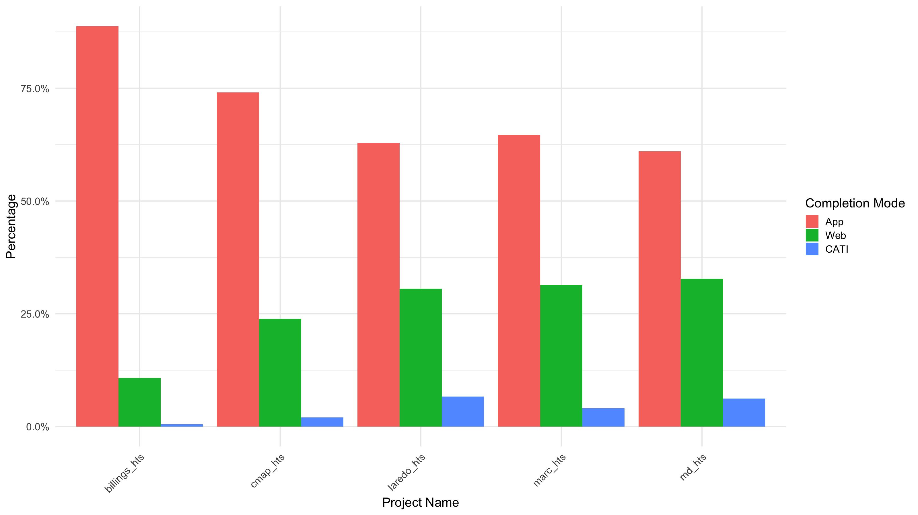
Final Completion Modes for App Users

Slide 30
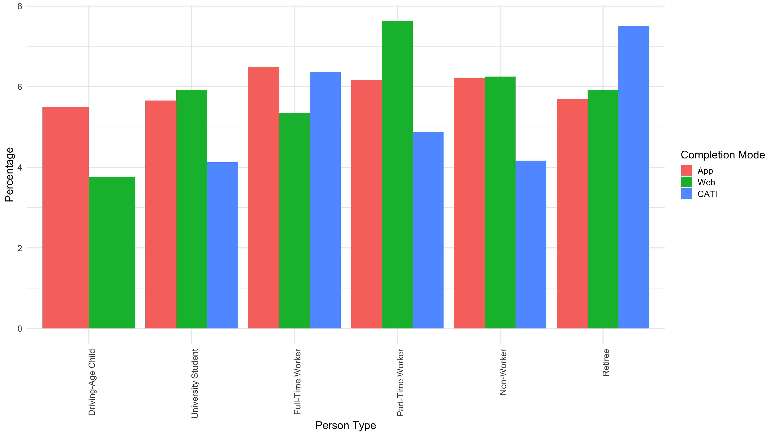
Linked Trip Rates by Final Completion Mode

Slide 31
Final Remarks
Smartphone apps are used across nearly all socio-dem dimensions but in a biased way
  Younger, more educated, wealthier
Using a smartphone app results in additional travel being captured and reported
  Impact is largest on non-mandatory travel, with higher tour and tour stop frequencies -> Matches expectations and other studies
Completion mode is highly related to person and household characteristics
  This shows the importance of providing smartphone app users alternative modes to complete – can reduce biases in final set

Slide 32
Thank You
For more information,
contact MarceloSimas@westat.com

