Slide 1
Moving Web Probing Forward: An Examination of Probe Type and Formatting
Paul Scanlon, PhD
8th European Survey Research Association Conference
Zagreb, Croatia
July 17, 2019

Slide 2
1. Web Probing
2. Previous Findings and Research Question
2. Methodology
3. Findings and Discussion

Slide 3
Web Probing
Growing method that uses set cognitive probes on web surveys to expand on findings from offline cognitive testing.
Two basic forms of web probing:
  Open-ended collects text data and provides primary qualitative data
  Close-ended collects quantitative data and relies on previous qualitative data
Overall, the goals of both forms is to:
  Collect meaningful data that assists in question evaluation
  Have a neutral impact on the survey response for the other items on the questionnaire.
Notes:
On the last point: so, we’re looking for things that aren’t 1) burdensome, 2) don’t cause drop-offs or item non-response, 3) don’t frame the respondent’s approach to upcoming survey items.

Slide 4
Previous Findings
Data from second round of NCHS’ Research and Development Survey (2016) was used to look at the impact of close-ended probes.
Using item nonresponse and drop-offs as the outcome, probes with
    Lots of answer categories
    Select-all-that-apply formatting
  appeared to perform worse that short, forced-choice probes.
In order to dig into this, we needed more metadata than we collected in 2016.

Slide 5
Research Question
Does probe type or content impact probe response?
  Cat. Selection vs Specific and Comprehension probes
Does probe formatting impact probe response?
  Impact on burden
  Impact on probe item response
  Impact on data quality
Notes:
Unfortunately, the research process being what it was, we had to drop this first question. The reasons were twofold: first as we saw yesterday there’s a lot of research—particularly from our colleagues here in Europe—on the impact of these types of probes. We came to realize that within the constraints of close-ended probing, category selection probes as defined by Dorothee, Katharina, Michael and Lars aren’t really that easy to construct. If one of the main points of category selection probes is to uncover ”silent misunderstandings,” then the researcher defining terms ahead of time is kind of beyond the point! Secondly, as I’m sure everyone in this room has experienced, we had to shift research direction as we were planning the survey. We use our RANDS survey as a testbed for the NHIS and NHANES, and had to use questionnaire real estate, degrees of freedom, and programming effort for other priorities…
So…

Slide 6
Research Question
Does probe type or content impact probe response?
  Cat. Selection vs Specific and Comprehension probes
Does probe formatting impact probe response?
  Impact on burden
  Impact on probe item response
  Impact on data quality
Notes:
Unfortunately, the research process being what it was, we had to drop this first question. The reasons were twofold:
FIRST as we saw yesterday there’s a lot of research—particularly from our colleagues here in Europe—on the impact of these types of probes. We came to realize that within the constraints of close-ended probing, category selection probes as defined by Dorothee, Katharina, Michael and Lars aren’t really that easy to construct. If one of the main points of category selection probes is to uncover ”silent misunderstandings,” then the researcher defining terms ahead of time is kind of beyond the point!
SECONDLY, as I’m sure everyone in this room has experienced, we had to shift research direction as we were planning the survey. We use our RANDS survey as a testbed for the NHIS and NHANES, and had to use questionnaire real estate, degrees of freedom, and programming effort for other priorities…
So…

Slide 7
Methodology
2019/Third Round of RANDS uses NORC’s Amerispeak Panel
  Statistically-sampled panel of Americans using an ABS frame with NRFU for recruitment.
  Survey limited to panel’s web respondents
Questionnaire included 98 questions, including 30 web probes
  Topics ranged from chronic conditions to health behaviors, injury, and affect.
Fielded in April of 2019, data received May;
2646 completes and 123 partials out of 4255 sampled panelists (62.19% Yield Rate)

Slide 8
Methodology
For Formatting Experiment, used three almost-identical probes on physical activity
  Following “Vigorous” and “Moderate” P.A. questions, and a stand-alone “content” probe at end of P.A. section.
  Each probe had 11 answer categories
  Half of sample saw probe as a “Multi-punch” select-all format; other half received a grid with individual Y/N questions.

Slide 9
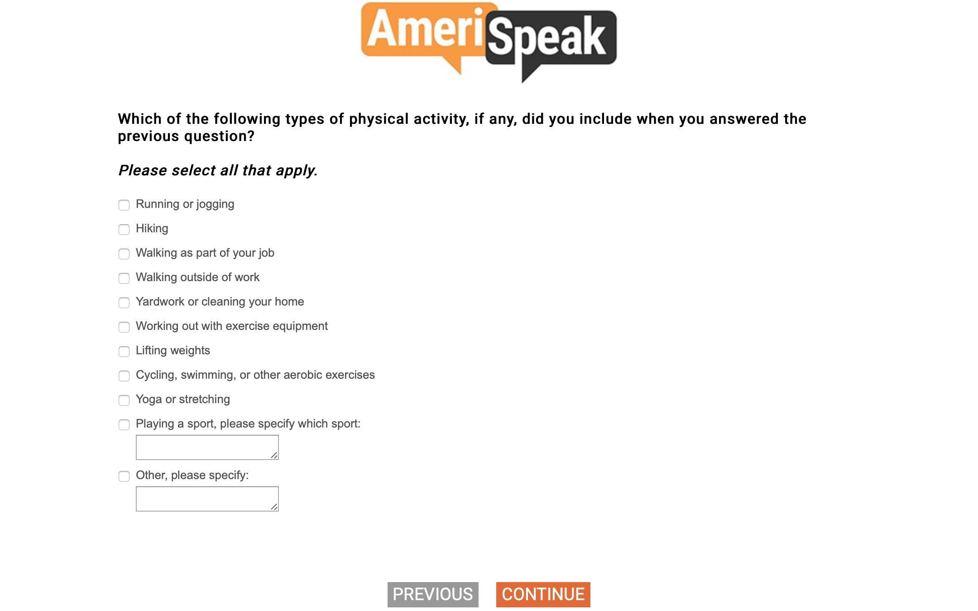
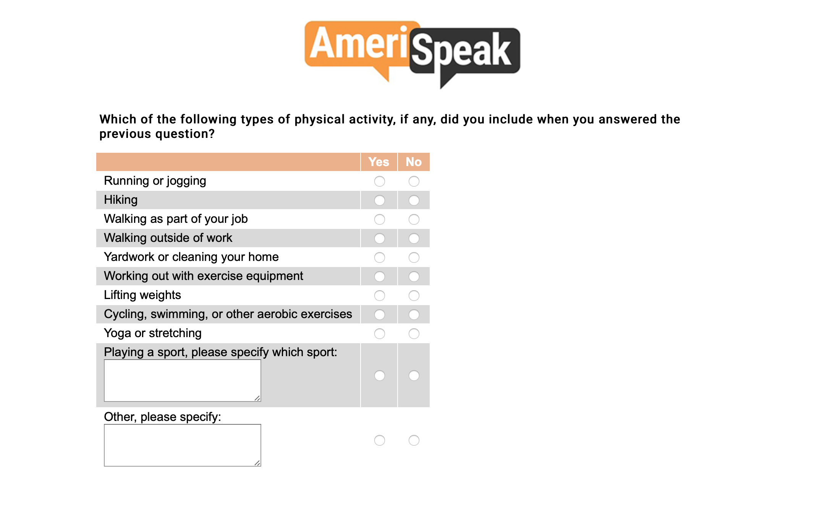

Slide 10
Findings
Impact on Burden:
  Topline Result: Forced Choice/Grid format took significantly more time than Select All/Multi-punch format

Slide 11
Notes:
Chart updated 6/28, data is UNWEIGHTED. Code at bottom of "Probe Experiment Notes.R"

Slide 12
Findings
Impact on Burden:
  Topline Result: Forced Choice/Grid format took significantly more time than Select All/Multi-punch format
  Two-way ANOVAs show that some interaction between Education, Age, Home Ownership, and Race/Ethnicity and probe time
Factor | Probe 20 | Probe 21 | Probe 22
Education |  |  | ***
Age | *** |  | ***
Home Owner | *** |  | ***
Race | *** |  | ***
Notes:
We ran regressions and found that even when controlling for all of these, however, the formatting was still significant for all three probes.
There is something going on with probe 21. Let’s keep that in mind.

Slide 13
Findings
Impact on Item Response
  Speeding: Using threshold of 215msec/word, and “adding” a Y/N to each line of the grid format.
    Threshold for Select All was 14.84 sec (rounded up to 15 sec)
    Threshold for Grid was 18.49 sec (rounded up to 19 sec)
  Too Long: Used same threshold as for removing outliers (Q3+3IQR) in time analysis
  Negative times were coded as NA
    Change in system time for some reason—since we don’t know why, they are excluded
Notes:
Conrad et al gives a threshold of 350, but notes that Rs with a college degree have been assigned a speed of 215. Used that because of panelists. NORC also suggests using a ratio of the response time to the median response time, and labeling all Rs with a ratio of .33 or less as speeders. Using all three of these thresholds, the results stay the same.

Slide 14
Notes:
Multipunch always had significantly more speeders than the grid format.

Slide 15
Findings
Impact on Response Quality
  Examined number of response categories captured by the two formats
  Cannot determine which is “better,” only if there’s a difference

Slide 17
Findings
Impact on Response Quality
  Examined number of response categories captured by the two formats
  Cannot determine which is “better,” only if there’s a difference
Again, see some subgroup interactions
  Two way ANOVA
Factor | Probe 20 | Probe 21 | Probe 22
Education | *** | ** | **
Age | *** | *** | ***
Survey Device |  | *** | ***
Speeder | *** | *** | ***

Slide 18
Findings
Impact on Response Quality
  Examined number of response categories captured by the two formats
  Cannot determine which is “better,” only if there’s a difference
What about “other” option (this is the closest we get to an open-ended probe on RANDS…)

Slide 20
Discussion
From this experiment, we’ve found that:
  A forced choice grid for probes takes more time to complete than a select-all/multipunch format.
  On the other hand, the select-all format appears to lead to more speeders and leads to fewer items selected
    Open question on who should count as a “speeder” and if more responses=better cognitive data
However, this experiment focused on a probe question w/ a long list of answer categories. The interaction between the response time and the format is probably affected by the number of categories
  Plans for next round include more diversity of probe lengths
Furthermore, we saw some indication of “learning” between the probes—with burden and speeding patterns differing between Probes 20 and 21 (which were identical). BUT, this did not appear to affect the number of items selected…

Slide 21

https://www.cdc.gov/nchs/CCQDER/
Q-Bank: https://wwwn.cdc.gov/qbank/
Got reports? qbank@cdc.gov
National Center for
Health Statistics

