Slide 1

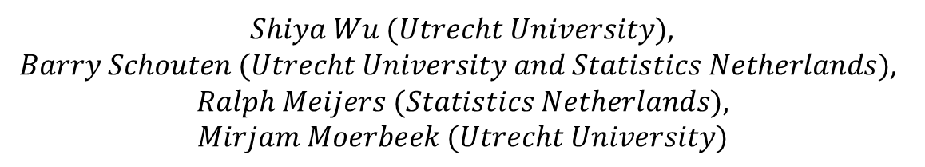
Expert Prior Elicitation in Bayesian Adaptive Survey Design: Two Case Studies
$Shiya Wu (Utrecht University)$,
$Barry Schouten (Utrecht University and Statistics Netherlands)$,
$$Ralph Meijers (Statistics Netherlands),$$
$$Mirjam Moerbeek (Utrecht University)$$

Slide 2
Outline
Why Bayesian analysis
Prior Elicitation
  General Methodology
  Similarity Criteria
  Criteria Importance
  Modelling
Application
  Energy Survey 2018
  SILC Survey 2016
Conclusion
1

Slide 3
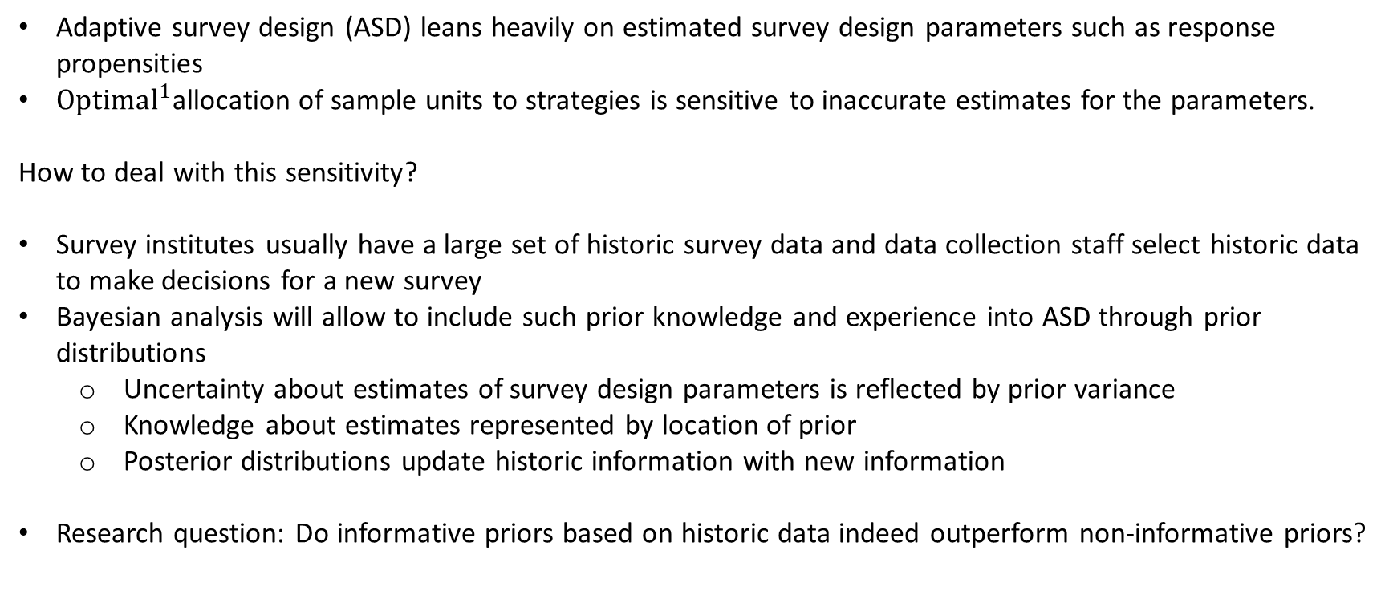
Why a Bayesian analysis?
Adaptive survey design (ASD) leans heavily on estimated survey design parameters such as response propensities
$Optimal^{1}$allocation of sample units to strategies is sensitive to inaccurate estimates for the parameters.
How to deal with this sensitivity?
Survey institutes usually have a large set of historic survey data and data collection staff select historic data to make decisions for a new survey
Bayesian analysis will allow to include such prior knowledge and experience into ASD through prior distributions
  Uncertainty about estimates of survey design parameters is reflected by prior variance
  Knowledge about estimates represented by location of prior
  Posterior distributions update historic information with new information
Research question: Do informative priors based on historic data indeed outperform non-informative priors?
1. Burger, J., Perryck, K., & Schouten, B. (2017). Robustness of adaptive survey designs to inaccuracy of design parameters. Journal of Official Statistics, 33(3), 687-708.
2

Slide 4
General Methodology
Selection:
  → identify historic surveys similar to the new survey
Translation:
  → incorporate historical survey responses in prior specification of the new survey
Evaluation:
  →assess informative prior against non-informative prior using cases studies
3

Slide 5
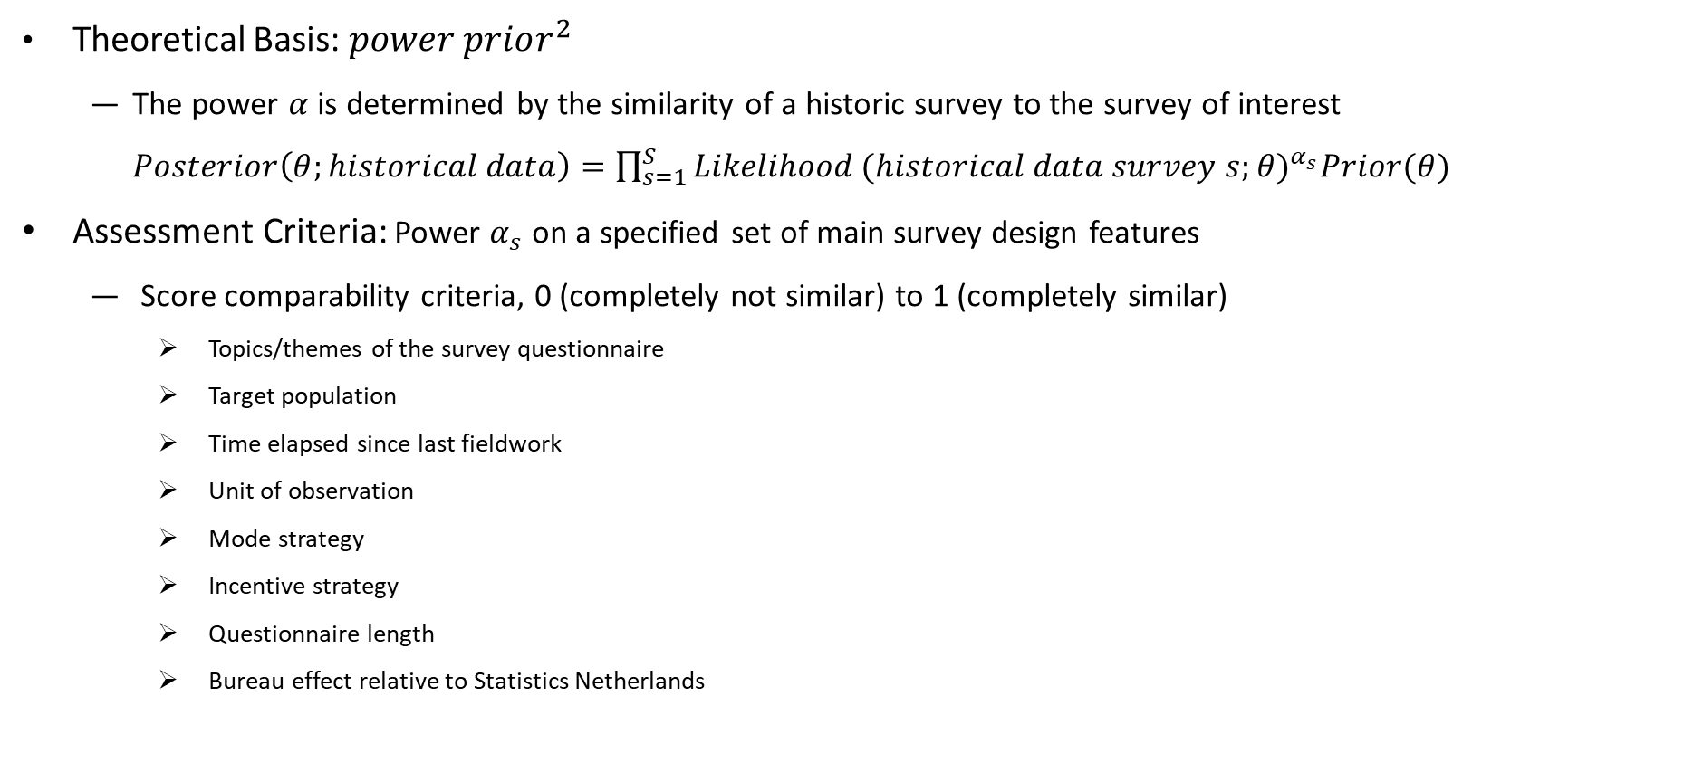
Similarity Criteria
Theoretical Basis: $power prior^{2}$
  The power $α$ is determined by the similarity of a historic survey to the survey of interest $Posterior\left(θ;historical data\right)=\prod_{s=1}^{S}{Likelihood}(historical data survey s;θ)^{α_{s}}Prior(θ)$
Assessment Criteria: Power $α_{s}$ on a specified set of main survey design features
  Score comparability criteria, 0 (completely not similar) to 1 (completely similar)
    Topics/themes of the survey questionnaire
    Target population
    Time elapsed since last fieldwork
    Unit of observation
    Mode strategy
    Incentive strategy
    Questionnaire length
    Bureau effect relative to Statistics Netherlands
2. Ibrahim, JG, & Chen, MH (2000). Power prior distributions for regression models. Statistical Science , 15 (1), 46-60.
4

Slide 6
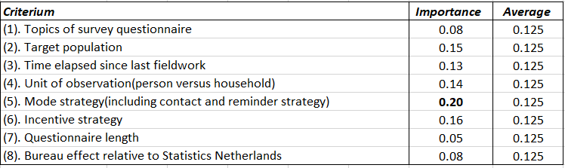
Criteria Importance
Weight Similarity Criteria
  Rank criteria importance
Sensitivity analysis
  Combine the historic strength over criteria
    Option 1: Average power
    Option 2: Weighted power
5

Slide 7
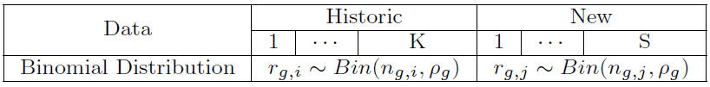
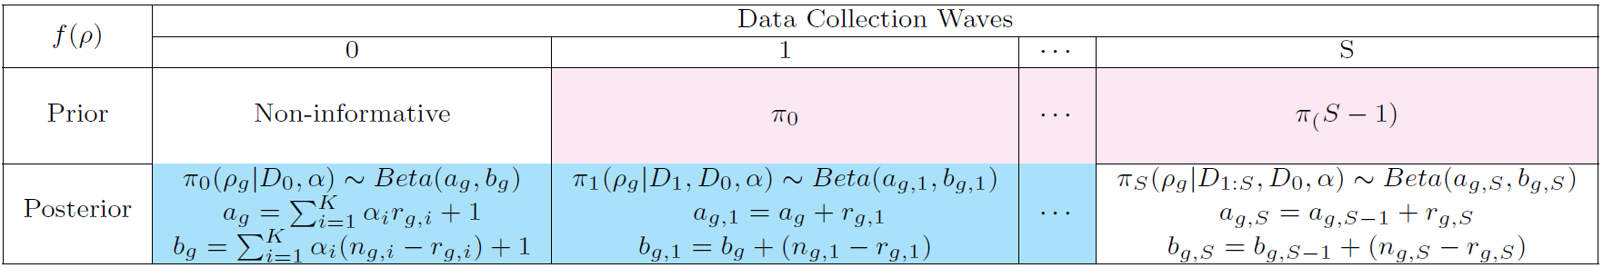
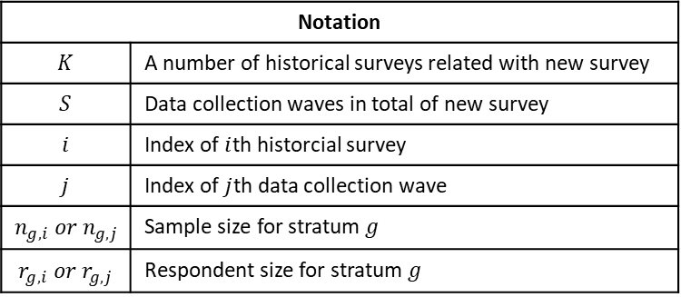

Modeling
Parameter: stratum response propensity, $ρ_{g}$
Data model:
Priors and Posterior:
Notation
$$K$$ | A number of historical surveys related with new survey
$$S$$ | Data collection waves in total of new survey
$$i$$ | Index of $i$th historcial survey
$$j$$ | Index of $j$th data collection wave
$$n_{g,i} or n_{g,j}$$ | Sample size for stratum $g$
$$r_{g,i} or r_{g,j}$$ | Respondent size for stratum $g$
6

Slide 8

Modeling
Weighted response rate (RR)
$$RR=Σ_{g=1}^{G}q_{g}ρ_{g}$$
Coefficient of Variation (CV)
$$CV=\frac{\sqrt{Σ_{g=1}^{G}q_{g}{\left(ρ_{g}−RR\right)}^{2}}}{RR}$$
Root mean square error (RMSE)
$$RMSE\left(\hat{θ};π\right)=\sqrt{{\left(\hat{θ}−E_{π}(θ)\right)}^{2}+Var_{π}(θ)}$$
7

Slide 9

Energy Module 2018
Description
  Population: follow-up survey for 2018 Housing Survey
  Strata: 30 strata by dwelling age, dwelling type and ownership type
  Strategy: mixed Cawi, Cati, and CawiCapi
Historical Surveys:
  Energy 2006,
  Energy 2012,
  Health Care Survey 2017,
  Housing Survey 2018.
Data collection: 15 waves
8

Slide 10
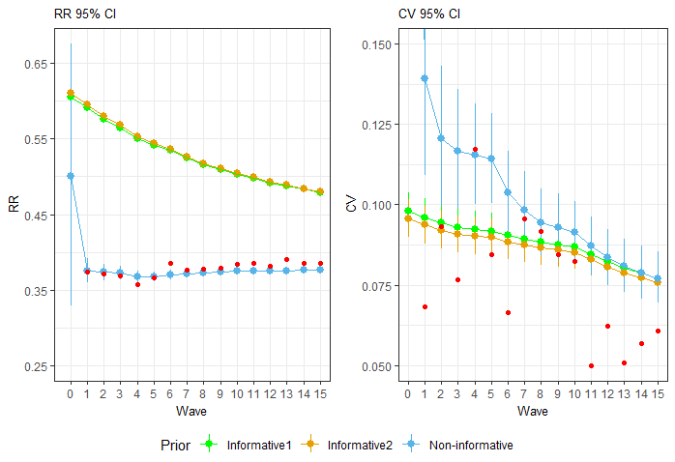
Energy Module 2018
95% Credible Intervals
Non-informative prior is superior for RR
Informative prior has smaller CI’s
CV is predicted better than RR for informative prior
RR and CV from informative prior converge more slowly due to historic information
9

Slide 11
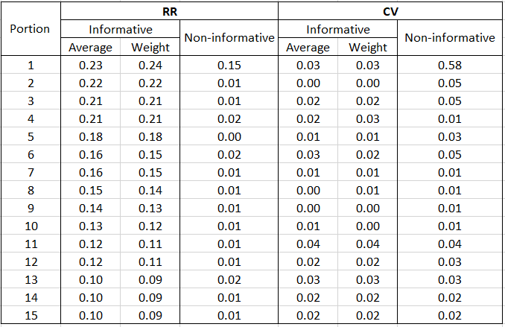
Energy Module 2018
RMSE
Informative prior outperforms non-informative prior
An exception: wave 4
CV from informative prior smaller than non-informative prior
Difference decreases between CV from informative prior and non-informative prior
Benefit from informative prior drops in time
Informative prior independent of the power combination
10

Slide 12

EU-SILC 2016
Description
  Population: a rotating panel with four groups with one new and three existing groups
  Strata: 20 strata are identified by crossing age, household size and income deciles
  Strategy:
    1st year: Web, then part of Web non-response by CATI
    With incentive
    No incentive
Historical Surveys:
  Household Budget Survey 2015,
  Labor Force Survey 2016.
Data collection: 3 waves
11

Slide 13
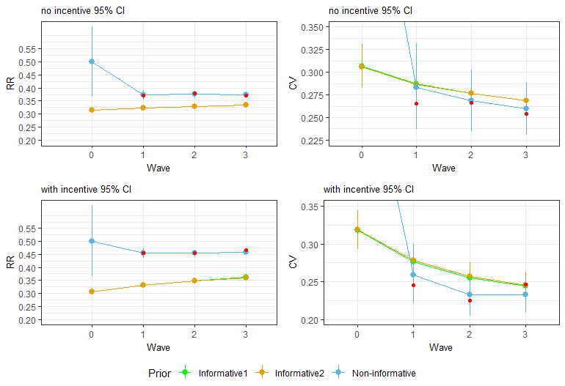
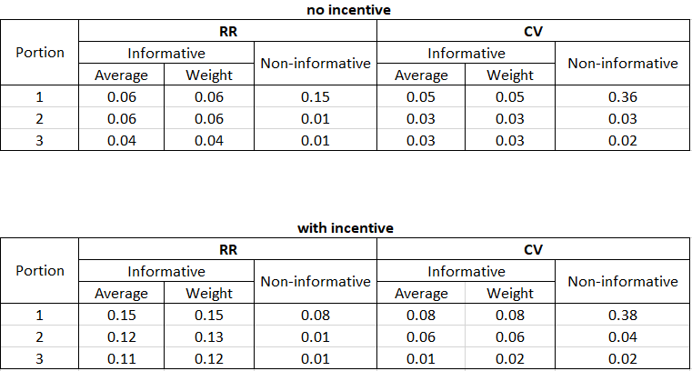
EU-SILC 2016
95% credible intervals
RMSE
12

Slide 14
Conclusions
Historic data and data collection experts add value when monitoring survey quality and will inform ASD
Prior elicitation for data collection staff is feasible, but may be refined
Informative prior outperforms non-informative for Energy 2018 and EU-SILC 2016
  For Energy 2018, the experts were right about the variation in response rates across strata but not about the level of response rates.
  For EU-SILC 2016, the experts were right about the levels and variations, but SILC waves are large and after one month their information is overwhelmed by observed data.
13

Slide 15
Thank you for your attention
Question?
14

