Slide 1
Fieldwork Monitoring Tool
ESRA 2019 Conference
Jamie Burnett

Slide 2
Problem
Evidence that quality of data collection varies by country despite harmonised training and standards.
Exasperated by
An emphasis on progress and back checking survey responses rather than data collection protocols.
Interviewers not recording all visits made to an address
Inaccessibility of information to monitor data collection
Capabilities and experience of the field management teams in each country to analysis this data

Slide 3
Solution
A central platform to monitor fieldwork within and across all countries
User friendly (visual, easy to navigate, understand and access data from)
(Restricted) Access for different user groups (country field teams, project managers, central support team and clients)
Real time monitoring
Harmonised set of metrics
A central team to support country field teams in training on tool and monitoring fieldwork
Accessible for Kantar and non-kantar companies
Raw data drawn directly from the individual country domains without any pre-processing

Slide 4
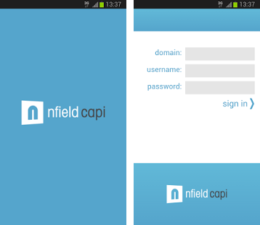

Fieldwork Monitoring Tool – How it works?
  Fieldwork management information is imported from individual country domains via the Nfield API (Application Programmer’s Interface)
  Information from survey responses, electronic contact sheets, sample frame and paradata (GPS, timestamps) all imported
  Pre-processing of survey and contact data done pre-fieldwork, some processing of data done on the fly when we import data (distance from address/start address).
  DAX functions in Power BI used to build metrics (automated process)
  Power BI dashboards & reports atomically generated and attached to a project
  Dashboards and reports published and accessible by all users
  Access restrictions to some reports
  Updated as many times as we want but generally set to once a day (overnight for specific country)
Survey Data
Contact & Para Data
Sample Data

Slide 5
Harmonised Metrics
Survey
Data
Contact & Para Data
Sample
Data
Progress
Performance
Quality

Slide 6
Progress
% interviews
% addresses visited at least once
% of nonfinal addresses
% of assignments started/finished
% of interviews backchecked
% of interviews removed (reason why)
Performance
Response, Contact, Refusal, Deadwood rates
% of interviews/contacts by time of day / day of week
% of addresses repeat visited within 2 hours (excluding appointments)
% of addresses with a ‘non-contact’ final outcome but less than required number of visits
% of interviews by demographics, strata variables (age, gender, education, urbanity, region)
Quality
% of interviews/contacts with GPS/network enabled
% of interviews/contacts conducted in wrong location (based on a distance threshold)
% of short interviews
Number of interviews done in one day
Short and consistent times between interviews
% of responses done at first visit of all addresses visited at least once
% of responses done at first visit of all interviews
Mismatch in gender/age between selected individual and respondent.

Slide 7
Fieldwork Monitoring Tool

Slide 8
Reporting Hierarchy
Country
Assignments
Addresses
Contacts
Interviewer
Interviews

Slide 9
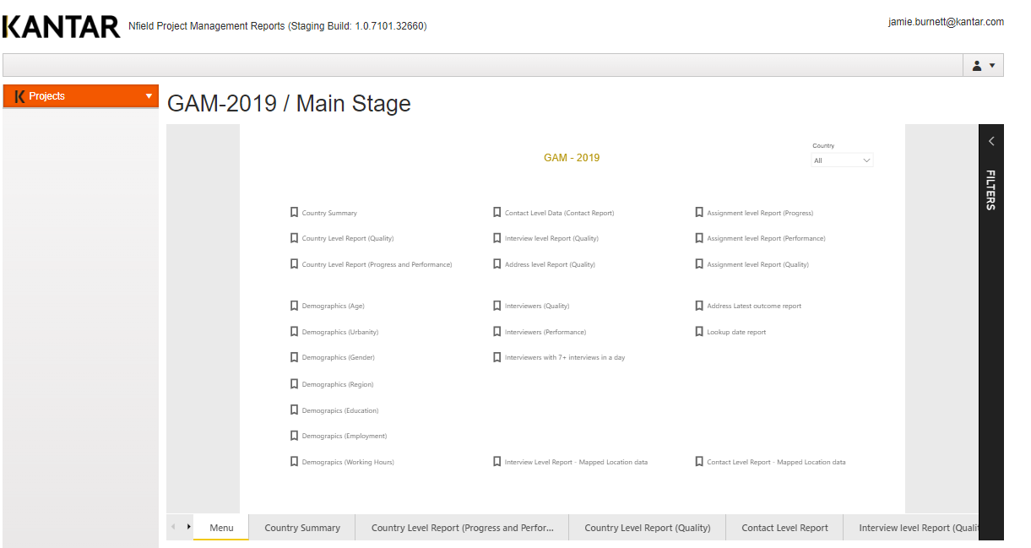

Slide 10
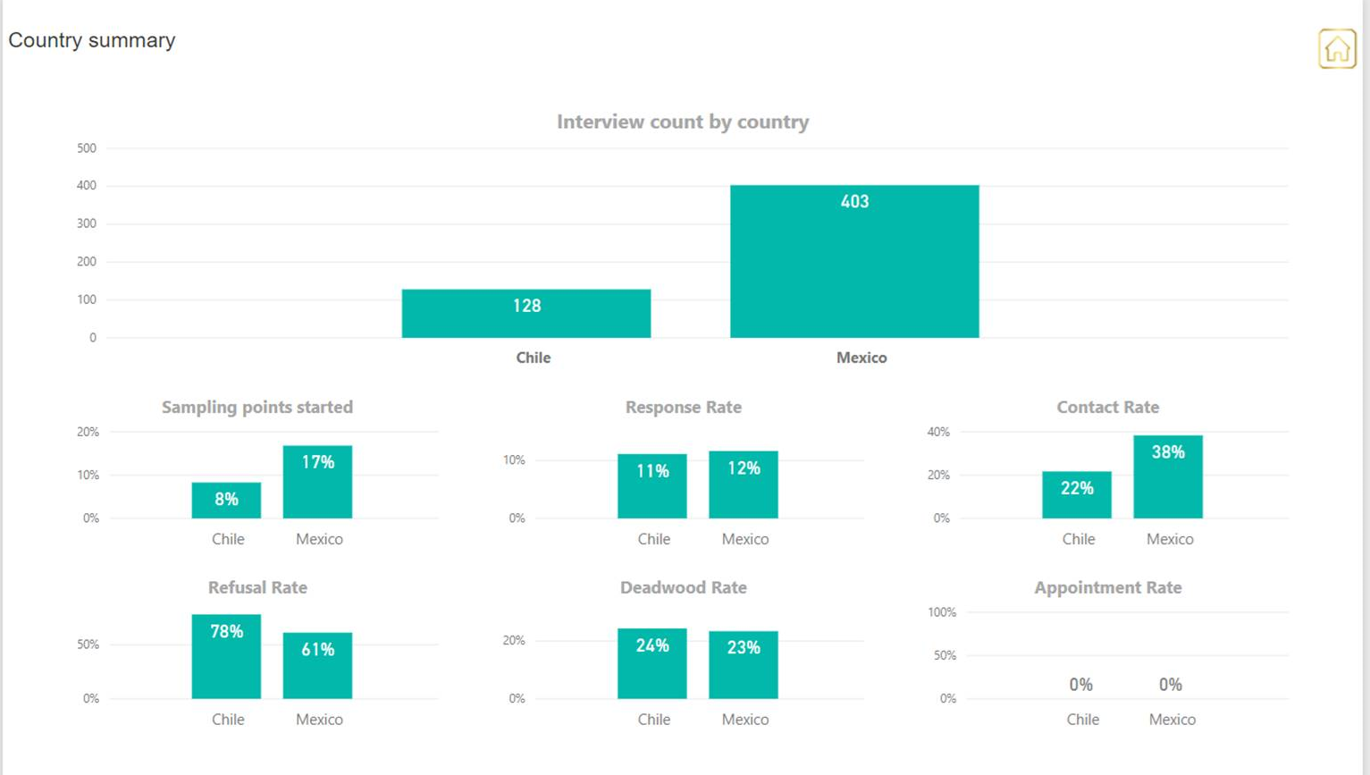

Slide 11
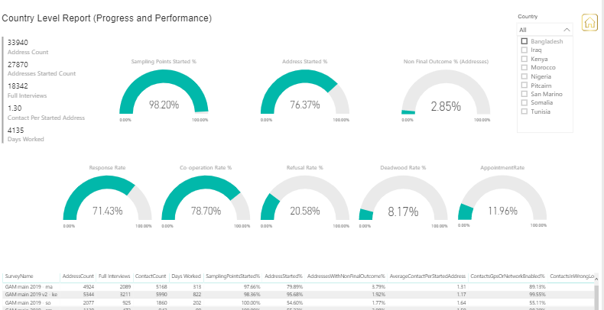

Slide 12
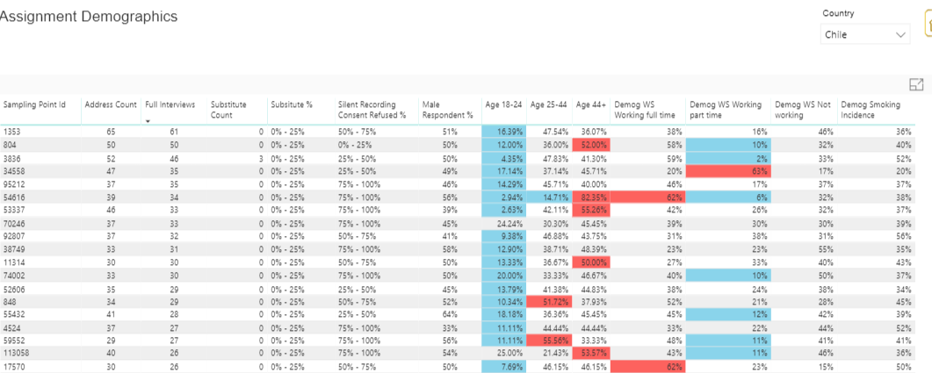

Slide 13
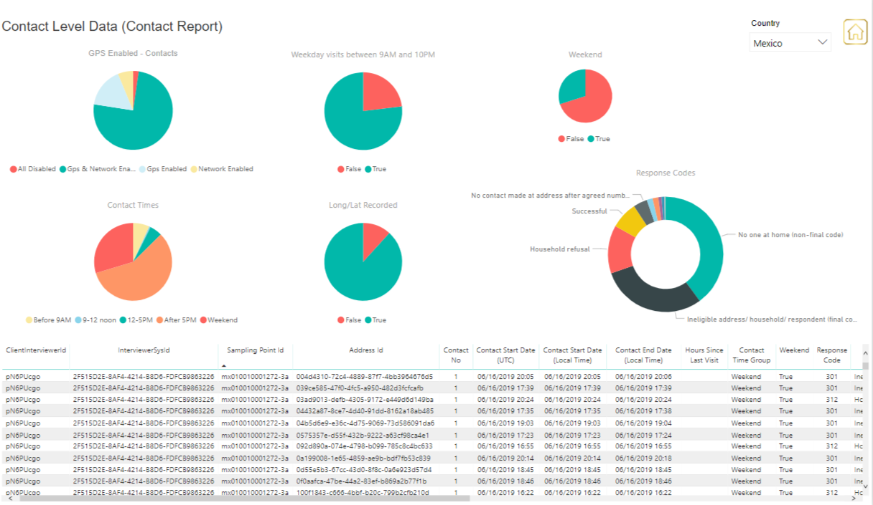

Slide 14
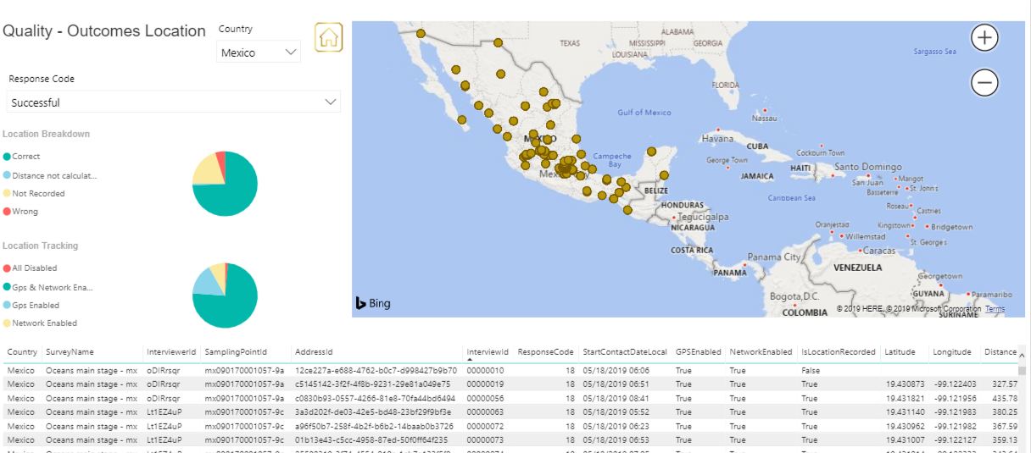

Slide 15
Learnings

Slide 16
What works well
Operationally
Streamlined process
Good user experience
Helpful metrics
Full transparency of fieldwork practices
Methodologically
Improved compliance with contact strategy
Early alert to quality issues (GPS turned off, wrong location, potential HH/Individual selection issues)
What needs improvement
Continuous improvements to look and feel
Further training
Consistency of use (not just on certain projects)
Information overload – rationalising the metrics (flagging system, 80:20 rule)
Clearer guidelines for fieldwork suppliers on what next based on metrics
    Prioritise metrics based on most/least important
    Provide guidance on next steps e.g. if interview done in wrong location? If high % of interviews done at first contact etc.

Slide 17
Interview in Wrong Location
Does GPS from other contacts show interviewer in right area on same date and time?
Yes
No
Unknown
KEEP INTERVIEW (assuming other details okay)
REMOVE INTERVIEW - FAILED QUALITY CHECK
Validate interview
Has interview passed validation?
Yes
No
KEEP INTERVIEW
REMOVE INTERVIEW - FAILED QUALITY CHECK

Slide 18
Examples from Europe and Asia

Slide 19
2016 vs 2017 - Europe
Metric | Greece | Hungary | Italy | Poland
Total addresses visited | 2,818 | 2,838 | 4,006 | 3,279
Total visits made | 3,505 | 3,945 | 4,617 | 5,107
Interviews at first contact | 80% | 86% | 83% | 72%
5+ interviews in 1 day | 23% | 6% | 8% | 5%
% assignments with exactly 10 ints | 91% | 79% | 87% | 85%
% of assignments completed in <=3 days | 79% | 45% | 43% | 36%
Compliance with 2nd visit | 52% | 74% | 39% | 82%
Compliance with 3rd visit | 59% | 76% | 82% | 86%
Compliance with 4th visit | 75% | 82% | 71% | 92%
Metric | Greece | Hungary | Italy | Poland
Total addresses visited | 5,704 (+2,886) | 2,717 (-121) | 4,617 (-126) | 4,900 (+1,621)
Total visits made | 10,701 (+7,196) | 4,938 (+993) | 5,205 (+558) | 8,846 (+3,739)
Interviews at first contact | 49% (-31) | 51% (-35) | 67% (-16) | 65% (-7)
5+ interviews in 1 day | 10% (-13) | 5% (-1) | 2% (-6) | 9% (+4)
% assignments with exactly 10 ints | 5% (-86) | 39% (-40) | 39% (-48) | 7% (-78)
% assignments completed in <= 3 days | 38% (-41) | 20% (-25) | 11% (-32) | 9% (-27)
Compliance with 2nd visit | 100% (+42) | 99% (+25) | 99% (+60) | 99% (+17)
Compliance with 3rd visit | 100% (+41) | 99% (+23) | 97% (+15) | 99% (+13)
Compliance with 4th visit | 100% (+25) | 100%(+18) | 89% (+18) | 99% (+7)
Notes:
9 steps taken to improve compliance post 2016 pre 2017
1) Developed tool to allow countries to access contact data information in almost real time
2) A greater emphasis on central monitoring of fieldwork compliance (not just progress) by PM team
3) Move Hungary and Poland to individual and address frames respectively (from random walk)
4) Restrict the number of addresses interviewers can visit on their random walk in Greece and Italy
5) Move away from a target number of interviews per assignment approach
6) Change Individual selection from next/last birthday to random selection within script
7) Central management/control over issuing of more addresses in any country/assignment
8) Review payment structure – was fixed rate per interview – incentivises non-compliance
9) Train, Train, Train – in depth training on how to operationalise a random probability approach in field

Slide 20
2017 vs 2018 - Asia
 | 2017 |  | 2018
 | Indonesia | Philippines | Indonesia | Philippines
Sample Size | 1114 | 1018 | 1142 | 1186
Total number of contacts made | 1612 | 1785 | 3946 | 6133
Total number of addresses visited | 1574 | 1594 | 2418 | 3747
Total interviewer days worked | 436 | 259 | 706 | 391
Days worked with at least 1 interview achieved | 408 | 246 | 471 | 310
Final Outcomes Achieved at first contact | 91% | 94% | 76% | 62%
Number of interviews at first visit to household | 998 | 986 | 842 | 840
% of interviews at first visit | 90% | 97% | 74% | 71%

Slide 21
2017 vs 2018 - Asia
 | 2017 |  | 2018
 | Indonesia | Philippines | Indonesia | Philippines
% of assignments where exact target number of interviews achieved | 100% | 87% | 69% | 67%
% of non-contact addresses with less than minimum number of visits | 0% | 0% | 2% | 1%
Time between repeat visits to same household under 2 hours (excluding appointments) | 89% | 66% | 28% | 16%
Time of day and day of week of contacts - % of assignments with <50% of contacts after 5pm weekday or weekend | 32% | 75% | 54% | 71%
Median time between interviews done on same day by same interviewer | 81 | 49 | 79 | 61

