Slide 1
Racial/Ethic Differences in the Associations between Verbal and Nonverbal Behavior Codes
Young Ik Cho
University of Wisconsin-Milwaukee
Timothy P. Johnson & Allyson Holbrook
University of Illinois at Chicago
ESRA Zagreb 2019

Slide 2
background
Behavior coding has been used to evaluate survey questions and to understand the survey interaction process.
We have used it to examine difficulties with specific cognitive processes involved in responding to survey questions, and to investigate cultural variability in respondent behaviors during interviews.

Slide 3
background
Previous studies were mostly based on verbal behavior codes.
The current study examined associations between verbal and nonverbal behavior codes, and ethnic variations in the relationships between the two.

Slide 4
Data collection
Standardized laboratory interviews
Adults 18+ recruited in Chicago, USA (n=403)
Questionnaire contents randomized
Subjects recruited via RDD
Interviews digitally audio & video recorded
$40 incentive

Slide 5
Data collection
Race/Ethnic Groups Sampled
African Americans (U.S.-born)
Mexican Americans
Primarily English speaking
Primarily Spanish speaking
Korean Americans
Primarily English speaking
Primarily Korean speaking
Non-Hispanic whites (U.S.-born)

Slide 6
Analyses
N = 358 respondent recordings
N = 47 survey questions examined
N = 13,808 responses coded
Multi-level cross-classified models

Slide 7
Verbal behavior codes
Comprehension Difficulties
Mapping Difficulties

Slide 8
Verbal behavior codes: Comprehension Difficulties
Clarification (unspecified): uncertainty about question, unclear if problem is related to construct or context.
Clarification (construct): request for repeat or clarification of question, or statement indicating uncertainty about question meaning
Clarification (context): uncertainty about question meaning within the context of the question as stated
Clarification (time frame): uncertainty regarding question time frame.
Clarification (rewording): rephrases question before answering.

Slide 9
Verbal behavior codes: Mapping Difficulties
Clarification (response format): respondent indicates uncertainty about the format for responding.
Inadequate Answer (general): respondent gives answer that does not meet question objective.
Imprecise Response (general): respondent gives answer that only partially meets question objective (e.g. “well over 10 times,” “at least twice”).
Imprecise Response (different response option): respondent gives answer that does not use the response options provided with the question (e.g. “not so good health” instead of excellent, very good, etc.)
Imprecise Response (range): respondent answers question with a range rather than a single number.

Slide 10
Frequencies of verbal behavior codes: Comprehension Difficulties

Slide 11
Frequencies of verbal behavior codes: Mapping Difficulties

Slide 12
nonverbal behavior codes
<01> No changes in behavior or body/face movement
<20> Change in body position
<30> Body movement
<40> Body-touching
<50> Head movement
<60> Facial expression

Slide 13
Nonverbal behavior codes: Changes in Body Position
Head resting on one or both hands/taking hand down
Arms folded over chest/uncrossing arms
Arms on table
Hands folded
Sitting or leaning forward/ back in chair

Slide 14
Nonverbal behavior codes: Body Movement
Twiddling thumbs or other hand fidgeting
Shoulder shrugging
Thumbs-up sign
OK sign
Counting on fingers or other gesture that communicates nonverbal reasoning
Throwing hands in the air

Slide 15
Nonverbal behavior codes: Body Movement
Standing up or getting out of chair
Object adaptors (manipulating objects that are neither part of the self nor task oriented: manipulating paper clips, taking a drink, playing with/tapping eye glasses)
Hand motions to depict an answer (speech illustrative gestures)
Shifting in seat (crossing/ uncrossing legs)

Slide 16
Nonverbal behavior codes: Body Touching
Scratch, rub, tap or touch any part of head, neck, or face
Adjusting or tugging on hair
Adjusting or tugging on clothing; includes pushing up or adjusting glasses; taking off/putting on glasses
Moving hand to cover mouth; includes moving hand to intentionally cover mouth (for yawn, laugh, smile, cough, sneeze, etc.)
Other self-touching behavior (e.g., scratching or rubbing leg, arm, rubbing hands together, etc.)

Slide 17
Nonverbal behavior codes: Head Movement
Looking off to the side
Looking down or at the floor
Looking up
Shaking head horizontally
Nodding head vertically
Tilting head
Looking down

Slide 18
Nonverbal behavior codes: Head Movement
Dip (chin drawn toward the chest without subsequent lift upward as a nod)
Cocking ear, jutting chin toward, or leaning head in to interviewer while question is being read
Combination of head movements (shaking, nodding, tilting from side to side)
Toss (chin raise upward without subsequent dip downward like a shake)

Slide 19
Nonverbal behavior codes: Facial Expression
Smiling
Frowning
Rapid eye movement or blinking
Rolling eyes
Exhaling audibly after question completely read
Inhaling audibly after question completely read
Lip biting

Slide 20
Nonverbal behavior codes: Facial Expression
Raising eyebrows
Furrowed brow
Squinting or wrinkling nose
Yawning
Scrunches lips, or moves mouth from side to side, or to one side
Mouthing words but not speaking

Slide 21
Frequencies Of Nonverbal Behavior Codes

Slide 22
Multilevel Models
Model predicts probability of each non-verbal behavior by comprehension and mapping problems, and race/ethnicity.
Controls for demographics: Gender, age, education, income, and language.
Measures are cross-classified: Clustered within subject and question

Slide 23
multilevel Models
Prob(FACIAL_{ijk}=1|π_{jk}) = θ₀ + γ₀₁MALE_{jk} + γ₀₂AGE_{jk} + γ₀₃WHITE_{jk} + γ₀₄HISPANIC_{jk} + γ₀₅KORAM_{jk} + γ₀₆HSDEG_{jk} + γ₀₇SOMECOLL_{jk} + γ₀₈COLLDEG_{jk} + γ₀₉ADVDEG_{jk} + γ₀₁₀INCOME_{jk} + γ₀₁₁ENG_{jk}
+ θ₁COMP_{ijk} + γ₁₁COMP_{ijk}*WHITE_{jk} + γ₁₂COMP_{ijk}*HISPANIC_{jk}
+ γ₁₃COMP_{ijk}*KORAM_{jk}
+ θ₂MAP_{ijk} + γ₂₁MAP_{ijk}*WHITE_{jk} + γ₂₂MAP_{ijk}*HISPANIC_{jk}
+ γ₂₃MAP_{ijk}*KORAM_{jk}
+ b_{00j} + c_{00k}

Slide 24
Body position
Verbal Codes

Slide 25
Body Movement
Verbal Codes

Slide 26
Body touching
Verbal Codes

Slide 27
Head movement
Verbal Codes

Slide 28
Facial Expression
Verbal Codes

Slide 29
Findings
Verbal behavior codes for comprehension and mapping difficulties were associated highly with all nonverbal behaviors.
Some of the racial ethnic groups were shown to be non-verbally less expressive
The level of association between these two sets of behavior codes somewhat varied across racial ethnic groups.

Slide 30
Conclusion
Response processing difficulties can be detected via non-verbal respondent behaviors.
Some noticeable racial/ethic differences found in the likelihood of exhibiting nonverbal expression when they experience processing difficulties.
Nonverbal behavior codes show promise for identifying question processing difficulties, but their cross-cultural comparability is yet to be established.
More investigation is warranted.

Slide 31
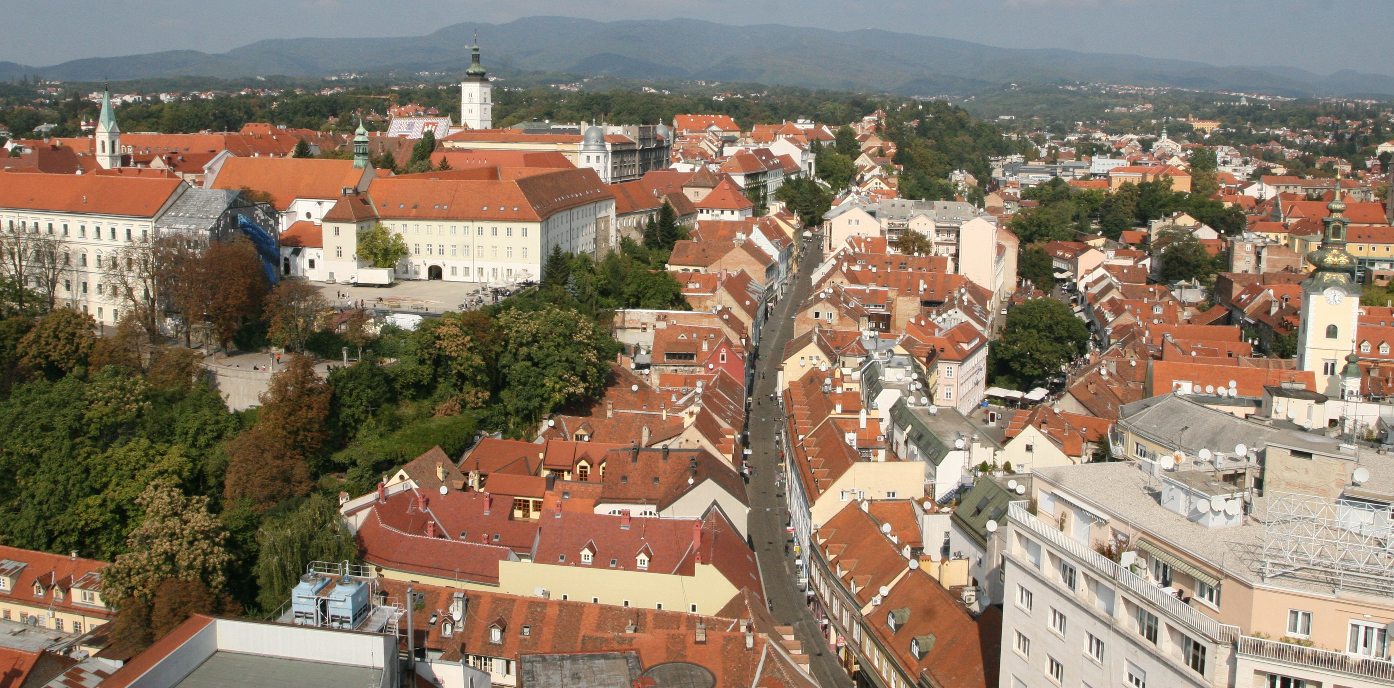
Hvala vam!
cho3@uwm.edu
Supported by NIH (R01HD053636-01A1) and NSF (SES0648539)

