Slide 1



Building a workflow for Documenting Data and Questionnaires:
Challenges and opportunities
Hayley Mills
July 2019

Slide 2

Maximise the use, value and impact of UK longitudinal studies

Slide 3



Partners
Hertfordshire Cohort Study
1946 National Survey of Health and Development
1958 National Child Development Study
1970 British Cohort Study
Understanding Society
ALSPAC
SWS
MCS
1920
1940
1960
1980
2000
Notes:
Spanning from 1930s to the present day.

Slide 4

Aim
Increase discoverability of the UK longitudinal studies
Objectives
Questionnaires and datasets documented
Provenance of question and variables
Identifying similar variables and questions
Available to research community in an accessible website
Notes:
One of CLOSER’s main aims is

Slide 5








discovery.closer.ac.uk
Notes:
portal for metadata from all of those studies in one place.
variables, questions and data collection instruments .
Making it more efficient and easy for researchers to find data.
previously scattered around different sites and resources and this helps to bring it all together in one place.
Most will be familiar, go and try for yourself.
One of CLOSER Discovery's unique aspects is the documentation of the whole questionnaire.

Slide 6
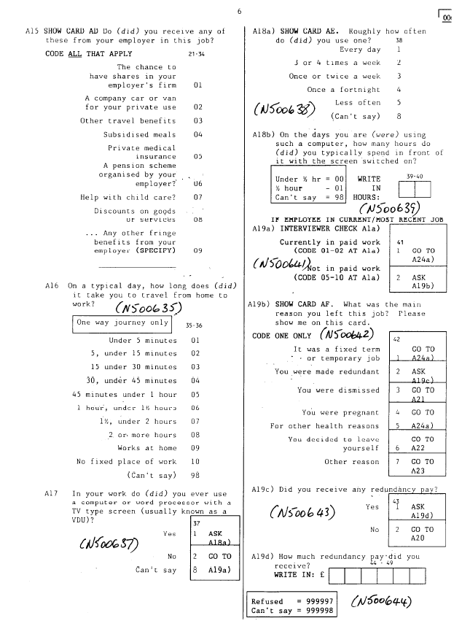
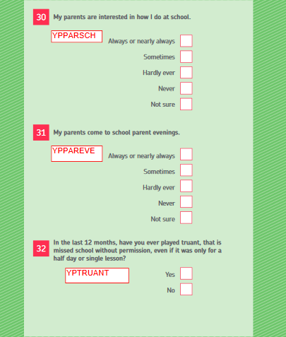
Questionnaires
Notes:
This was one of our biggest challenge.
Many to do (300/400) vary massively across the studiers and across time
with more simple semi-structured questionnaires like this self-completion to
more complex questionnaires like this interview which has more questions and more complicated routing

Slide 7
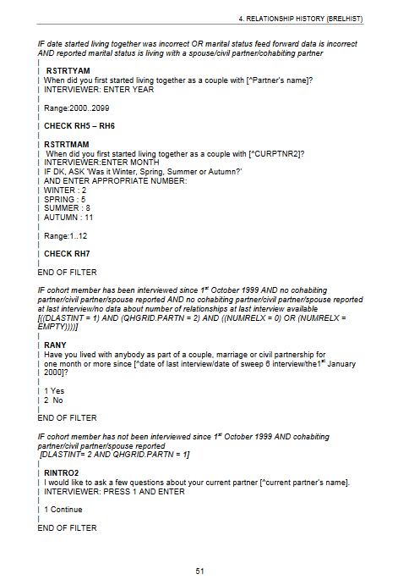
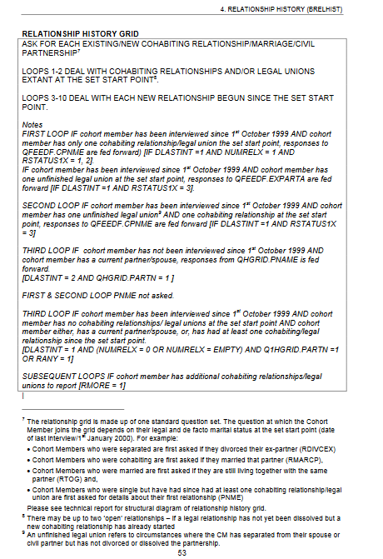
Notes:
to CAPIs which have even more complicated logic and are much larger in size.
In order to document unstructured or semi-structured into highly structured metadata of DDI.
So our main method was entering these manually.

Slide 8
Staffing
Central team of Metadata Assistants (2-5) Grade 5 and Metadata Officer Grade 6 Centralised to ensure;
  High quality
  Consistency
  Developing protocols
Process of entry and verification (QA)
Online guidelines for consistency and ease of training
Notes:
Therefore one of the most important aspects of the project,biggest expenditure.
time it takes to enter a questionnaire varies massively between staff
entry process as easy and straight forward as possible and decrease the amount of training needed,
we needed to balance this with using DDI which is quite complex.
So this is why our in-house software was developed. …

Slide 9
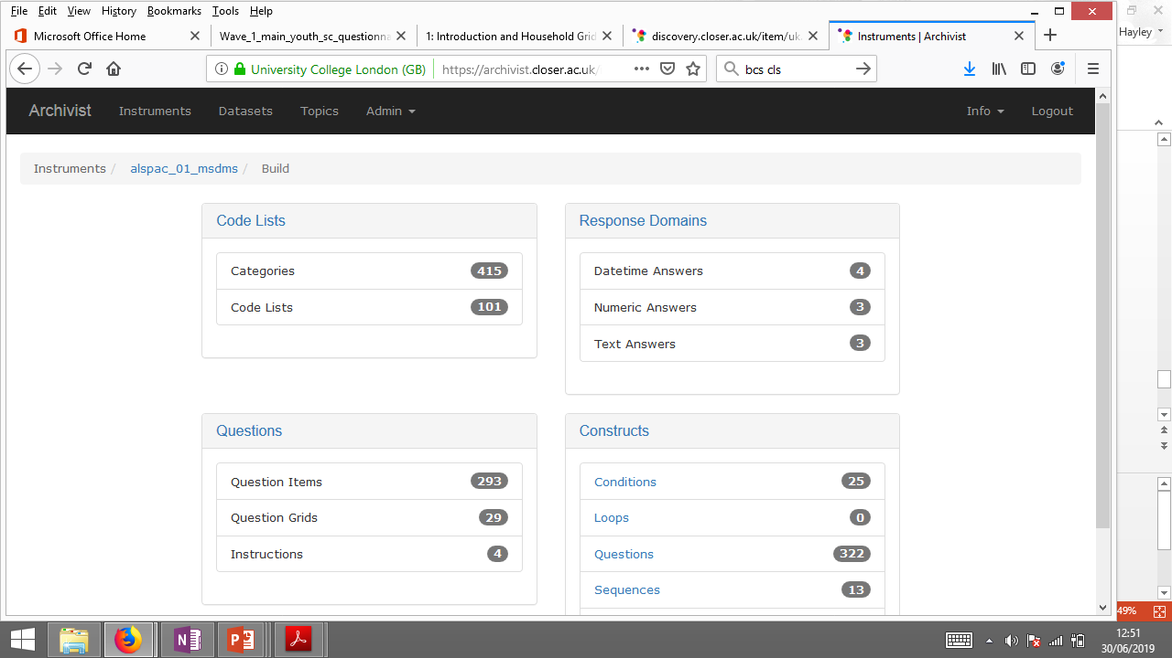
Archivist
Code Lists
Response Domains
Questions
Constructs
Build view
Notes:
web application document the questionnaire and exports this as a DDI instance.
example of the build view of a questionnaire.

Slide 10
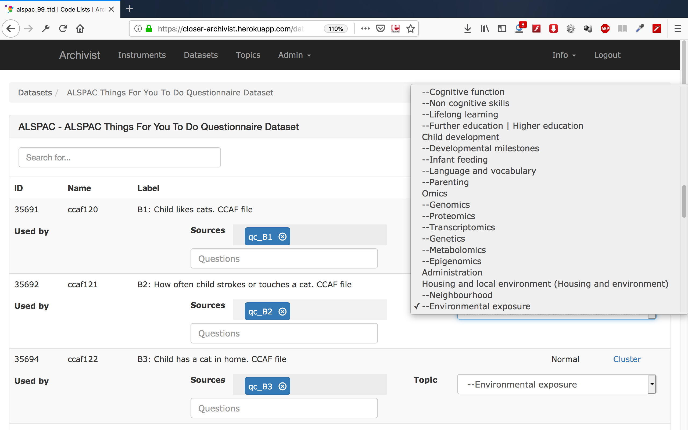
Archivist
Topics
Variable id / name / label
Variable source
Variable type
Dataset view
Notes:
In addition…
Archivist also allows for adding mappings. provenance of a variable these need to be mapped to questions can be done here.
we also map all questions and variables to a controlled vocab of concepts. Which can also be seen here.
simplified interface has reduced the amount of time training on software and also reduced the amount of DDI knowledge needed.
However, it has meant we have had to do a lot of software development and another challenge we have had is the recruitment of programming staff.

Slide 11
CAPI/CAIs
Data collection code
  e.g. Blaise code
  Lots of different software needed
  Difficult to make transparent
  ~80% solution
Capture the design
  e.g. Understanding Society QSL
  May vary from the actual data collection
Machine learning
  Lots of metadata for training
  Unknown quantity
  Potential to unlock archives of questionnaires
Notes:
Another ongoing challenge has been the CAPIs as mentioned earlier they are complex and large in size and are semi-structured. We have been entering these manually, however, is not sustainable in the medium term. So we have determined different alternatives to manual entry.
Questionnaire Design Development tool NSD

Slide 12
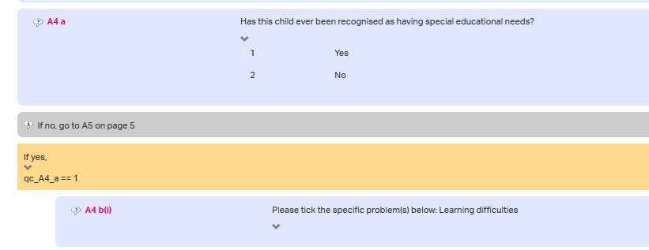
CLOSER Discovery: Data collection instruments
Question label
Question literal
Code list
Statement
Condition
Flowchart view
Notes:
So why are we doing this?
obvious benefits to researchers in terms of exploring and finding data,
but it also unlocks potential benefits for researchers and data mangers.
As mentioned earlier one of the unique features of discovery is being able to see the whole questionnaire.- statements, sequences, questions, response domains routing, logic, loops.
Having the response domain and routing together means you don’t have to go cross tabbing in datasets or searching through PDFs
to work out what the population is in your data.
In addition, having well described questions with responses and concepts can form the basis of a question bank.

Slide 13
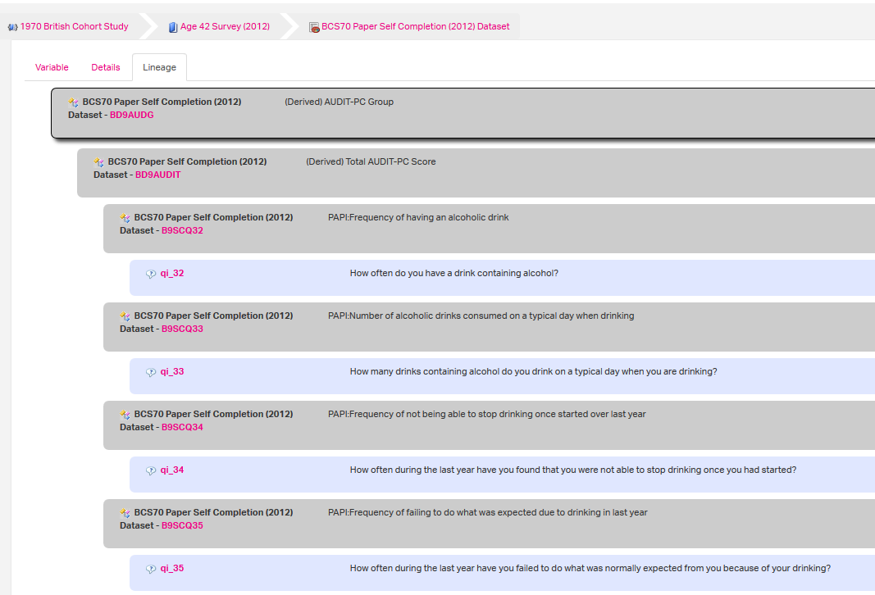
CLOSER Discovery: Derived variable provenance
Derived Variable
Variable
Question
Variable lineage view
Notes:
As mentioned previously questions are mapped to variables and these can be seen on the linage page in Discovery. So we have questions here and each question is mapped to its corresponding variable. We also map variables to derived variables which can be seen at the top showing that all the variables in purple go into creating the derived variable in blue.
Knowing how a derived variable was constructed means you don’t have to trawl through syntax or code. At the moment we are not planning to add syntax as this is just too complicated to manage at this scale and with historical data, but projects like C2Metadata may mean that this is a viable option in the future.

Slide 14
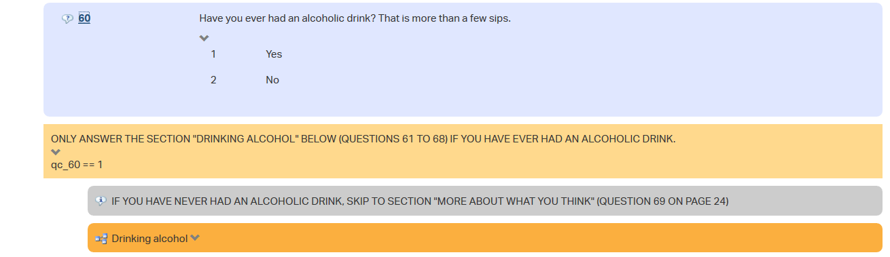
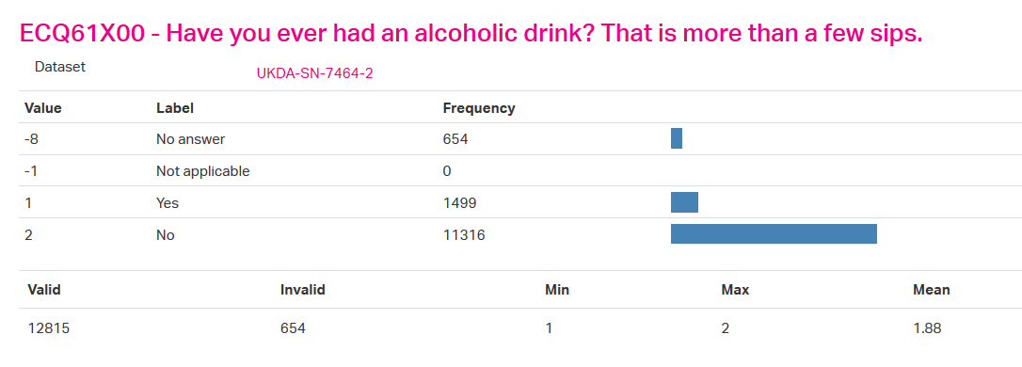
CLOSER Discovery: Routing
Flowchart view
Variable view
Notes:
So here is another couple of snips of Discovery to demonstrate that we can use the routing and data in combination can be used to help data management / QA processes and could potentially validate incoming survey data more automated way.

Slide 15
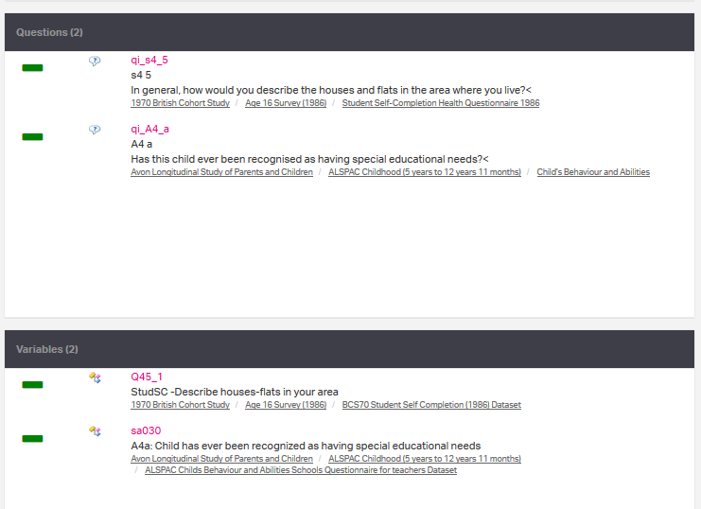
CLOSER Discovery: Lists
Notes:
planning research or surveys, or to send off to a study for a data request.
We will soon be adding the option to download as a csv to make them more intetrporable with the study request systems.
Within the year we will be making the lists persistent and publishable turning them into mini DOIs and allowing them to be referenced in journals or for teaching purposes.

Slide 16
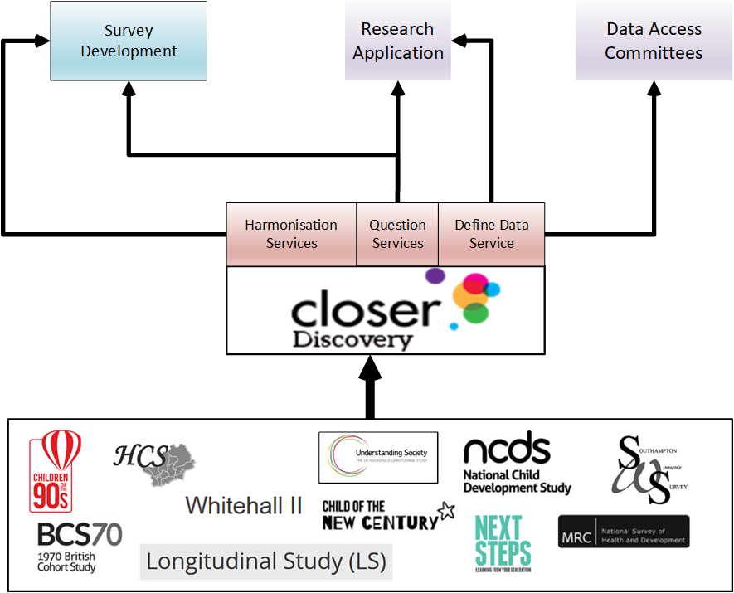
Notes:
So this is where we see Discovery fitting in within the research lifecycle.
The study metadata feeds into Discovery. We can provide services like harmonization or questions.
and then this can be used to input into survey development fort example.

Slide 17
Summary
Documenting questionnaires using DDI is challenging but offers many opportunities
CLOSER Discovery provides centralised, standardised and simplified method of finding research data
We are increasing transparency by providing metadata of the questionnaires, variable provenance and persistent lists
The rich metadata offers new and innovative opportunities e.g.
  Validating incoming data
  Question banks
  Unlocking archives
Notes:
And the final take home message is
this rich layer of metadata can be leveraged to unlock further benefits and opportunities including.

Slide 18
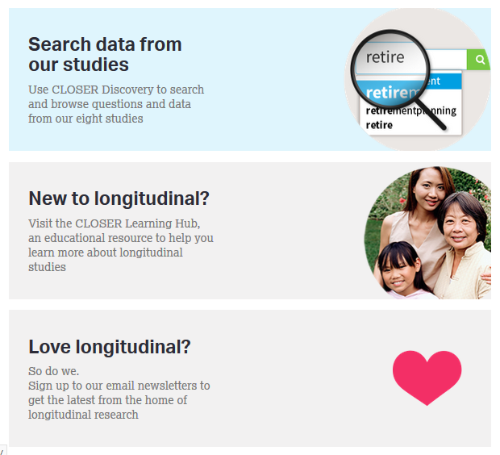


Thank you
Search data from
our studies
@CLOSER_UK
closer@ucl.ac.uk
discovery.closer.ac.uk
Love longitudinal?
So do we.
Sign up to our email newsletters
Survey Data Harmonisation: Potentials and Challenges 2
The Obstacles and Opportunities of Longitudinal Data Harmonisation: Experiences from CLOSER
Dara O'Neill
closer.ac.uk

