Slide 1
Can We Get Anything from Non-Respondents? A Pilot Test of the Third European Survey of Enterprises on New and Emerging Risks (ESENER-3) Session: ‘Business Surveys and the Changing Data Environment– How Can We Know Best about Businesses?’ ESRA Conference, Zagreb, 19 July 2019
Xabier Irastorza, Prevention and Research Unit, EU-OSHA
Arnold Riedmann, Kantar Public

Slide 2
Content
EU-OSHA
ESENER-2
ESENER-3 Non-respondents
ESENER-3 Outlook

Slide 3
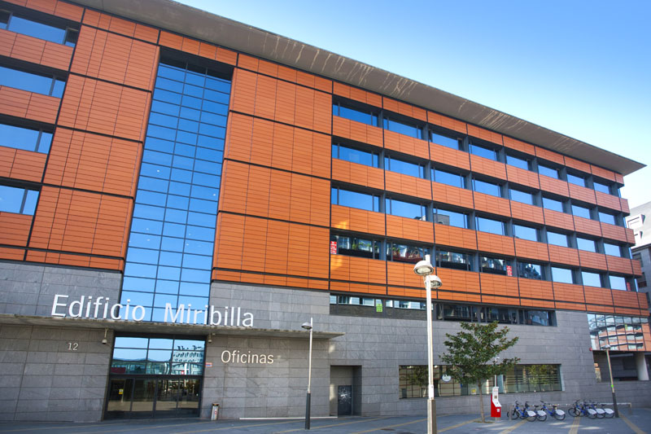
1. EU-OSHA - Who we are
The European Union body responsible for the collection, analysis and dissemination of relevant information to serve the needs of those involved in safety and health at work.
One of 40 EU agencies
Governed by European law
Mostly financed from the general EU budget
Independent in the execution of its mission/tasks
A tripartite network organisation, closely linked to EU actors and national networks through the national focal points
Legislation - inspection. NO

Slide 4
2. ESENER: Quick overview
How do establishments manage health and safety at work?
Greater geographical coverage | ESENER-1 (2009) | ESENER-2 (2014)
Countries | Total of 31: EU-28 + Turkey, Norway, Switzerland | Total of 36: ESENER-1 + Albania, Iceland, Montenegro, North Macedonia and Serbia
Establishments surveyed | 30,000 | 49,320
National versions of questionnaire -Adapted for language and national OSH terminology | 41 | 47
Increased proportion of workplaces | ESENER-1 | ESENER-2
Smallest business size | 10 workers | 5 workers
Sector | All, including public, except agriculture and fishing | All, including public and agriculture and fishing

Slide 5
2. ESENER-2 Respondent EU28 (in %) ‘Person who knows most about safety and health at the workplace’

Slide 6
2. ESENER-2 Response and cooperation rates, by establishment size.
Response rate: % completed interviews from all touched addresses
Cooperation rate: % completed interviews from eligible contacts
Notes:
See ESENER-3 Technical report. The rates we calculated deviate from AAPOR in that we considered all refusals and most non-contacts (except for establishment does not exist any more and similar codes) as eligible whereas AAPOR 3 (as used by IPSOS in their technical assessment of ESENER-2) calculates an estimated eligibility rate for these addresses. This rate is based on the rate of eligible addresses among the contacts where we know the eligibility for sure because either the persons stated this at the contact phase of the interview (e.g. “this is not an establishment, we are a private household”) or because it turned out during the interview itself (question on the number of employees). For these reasons, the AAPOR 3 rates are considerably higher (RRR3 AAPOR 21% according to the ESENER-2 technical assessment vs. 14% response rate in slide and Technical Report).

Slide 7
3. ESENER-3 (2019) – target sample size
Fieldwork: 1 April – mid July 2019
Country | Interviews for ESENER-3
Austria | 1,500
Belgium | 1,500
Bulgaria | 750
Croatia | 750
Cyprus | 750
Czech Republic | 1,500
Denmark | 1,500
Estonia | 750
Finland | 1,500
France | 2,250
Germany | 2,250
Greece | 1,500
Hungary | 1,500
Iceland | 750
Ireland | 750 + 1250
Italy | 2,250
Latvia | 750
Country | Interviews for ESENER-3
Lithuania | 750
Luxembourg | 750
North Macedonia | 750
Malta | 450
Netherlands | 1,500
Norway | 1,500 + 450
Poland | 2,250
Portugal | 1,500
Romania | 1,500
Serbia | 750
Slovakia | 750
Slovenia | 750 + 300
Spain | 2,250
Sweden | 1,500
Switzerland | 1,500
United Kingdom | 2,250
Total | 45,200

Slide 8
3. ESENER-3 Non respondents - Background
Response/cooperation rates: non response bias?
Voluntary – only good OSH (occupational safety and health) performers?
ESENER-3 questionnaire development process
Phase | Timeline
Cognitive pre-test: 36 interviews, 3 countries | August – September 2018
Translation (TRAPD) | October 2018 – February 2019
Pilot test: 1,059 interviews, 33 countries | January - February 2019
Questions to participants and ‘refusers’
tested in cognitive interviews
answered not only by targeted respondents but also gatekeepers
y/n

Slide 9
3. ESENER-3 Non respondents - Questions
That is a pity, but of course we respect your decision. For an assessment of the representativeness of the survey, it would be very helpful if you could nevertheless answer us four short questions. They won't take more than one minute in total. May I ask these four questions right now?
Size class
Three statements on OSH:
The health and safety measures in this establishment ensure that accidents are avoided (health_1).
The health and safety of employees is a priority in this establishment (health_2).
In this establishment, it is mainly the responsibility of the employees to take care of their well-being at work (health_3).

Slide 10
3. ESENER-3 Non respondents – Findings (% share of refusers)
522 establishments – 14% of all refusers.
country differences.
only 8 countries n>20. NL=81, CZ=53, AT=51

Slide 11
3. ESENER-3 Non respondents – Findings
80% target respondent vs. 20% gatekeeper.
Size:
5-9: 42%
10-49: 33%
50-249: 12%
250+: 6%
<5: 5%
Refusers (R) vs. participants (P),….
Very little difference (R > P):
The health and safety measures in this establishment ensure that accidents are avoided (health_1).
The health and safety of employees is a priority in this establishment (health_2).
Difference (P>R):
In this establishment, it is mainly the responsibility of the employees to take care of their well-being at work (health_3).
Refusers ‘better’ OSH culture than participants. Unexpected!

Slide 12
3. ESENER-3 Non respondents – Findings (2) Multivariate analyses (odds ratio)
Participation - Country has a significant effect (high correlation).
The Netherlands vs. Poland, Romania, Spain, Germany
Not for size or sector.
OSH statements:
The health and safety measures in this establishment ensure that accidents are avoided (health_1).
The health and safety of employees is a priority in this establishment (health_2).
In this establishment, it is mainly the responsibility of the employees to take care of their well-being at work (health_3).
‘Health_ 1’ and ‘health_3’: establishments answering refusal questionnaire seem to have a better OSH culture.
No correlation with target respondent.

Slide 13
3. ESENER-3 Non respondents – Findings (3) Multivariate analyses (odds ratio)
OSH statements:
The health and safety measures in this establishment ensure that accidents are avoided (health_1).
The health and safety of employees is a priority in this establishment (health_2).
In this establishment, it is mainly the responsibility of the employees to take care of their well-being at work (health_3).
Size: ‘health_3’ significant effect for 250+ (less likely).
Sector: ‘health_2’ significant effect for public and social services (more likely).
Country (ref NL):
Health_1: France, less likely.
Health_2: France, less likely.
Health_3: diverse picture. Hungary and Finland, less likely.
Notes:
It might be worth considering to mention in the presentation of this slide that the differences in responses between main survey and refusal questionnaire were just a few percentage points in the bivariate analysis. In this perspective, one would consider the differences as only slight, they are just so big in the multivariate analysis because there is so little variety in the answers, almost all persons saying yes in health 1 and 2.

Slide 14
3. ESENER-3 Non respondents – Conclusions
Upfront refusals.
Small minority are willing to answer refusal questions.
Not even possible to ask!
Findings on a small sub-group of non-respondents only.
OSH culture in this sub-group may differ substantially from those refusing participation in the survey.
If success getting through,…
Hardly any negative reactions.
Questions perceived to be short enough and not too sensitive.
Statements to be revisited.
Worked well in cognitive: face-to-face vs. CATI.
Four-point scale vs. Y/N
Third statement open to misinterpretations.

Slide 15
THANK YOU!
www.esener.eu
http://oshwiki.eu/wiki/Category:Statistics

