Slide 1
Teaching the Re-Use of Survey Data: Online, Interactive “Data Skills Modules”
Dr Vanessa Higgins
@VanessaAHiggins
ESRA Conference, 17th July 2019
Copyright © 2019 UK Data Service. Created by Cathie Marsh Institute for Social Research, University of Manchester.

Slide 2
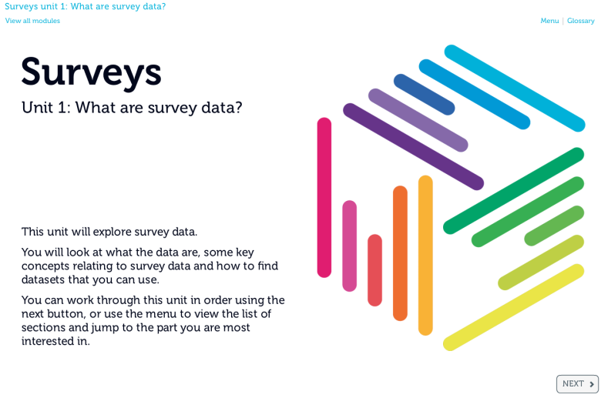
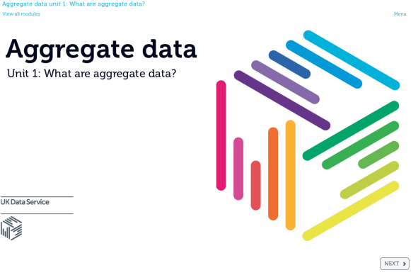
Data Skills Modules
Why?
What?
How?
Was it worth it?

Slide 3
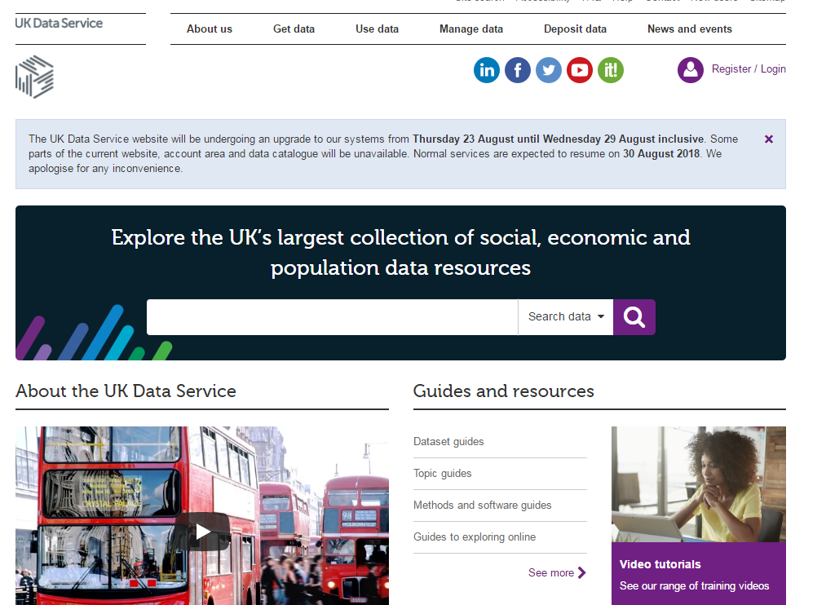
UK Data Service
access to secondary data
survey data
longitudinal
Census
international macrodata
qualitative data……and more
training and guidance
events
online materials
helpdesk

Slide 4
Why?
Previous (and current) training
workshops
webinars
online static guides/web pages
Identified a need for
basic data skills
skills-building
distance-learning (accessible)
less reliance on workshops
MOOC too expensive/resource intensive – not sustainable

Slide 5
What are the Data Skills Modules?
Aim: introduce key data types & basic skills
Audience: beginners
3 modules (each 2 hours long)
Survey data
Longitudinal data
Aggregate data
Multi-media & interactive: videos, slides, quizzes
Open source software (and SPSS)
Can be used for self learning or teaching

Slide 6
Pedagogy
Experiential learning and active learning
Real data
Exercises
Quizzes
Reflection
Evaluation of learning and correction (quizzes)
Motivation to keep going - multi-media
Case-studies – real use of the data
Structured and chunked
Directional learning ‘v’ locus of control

Slide 7
Content - example
SURVEY DATA MODULE
Unit 1: What are survey data?
Unit 2: Use cases
Unit 3: Exploring data
Unit 4: Looking at characteristics with graphs and charts
Unit 5: Looking at two variables to understand patterns
Unit 6: Considering the impact of sampling on your results

Slide 8
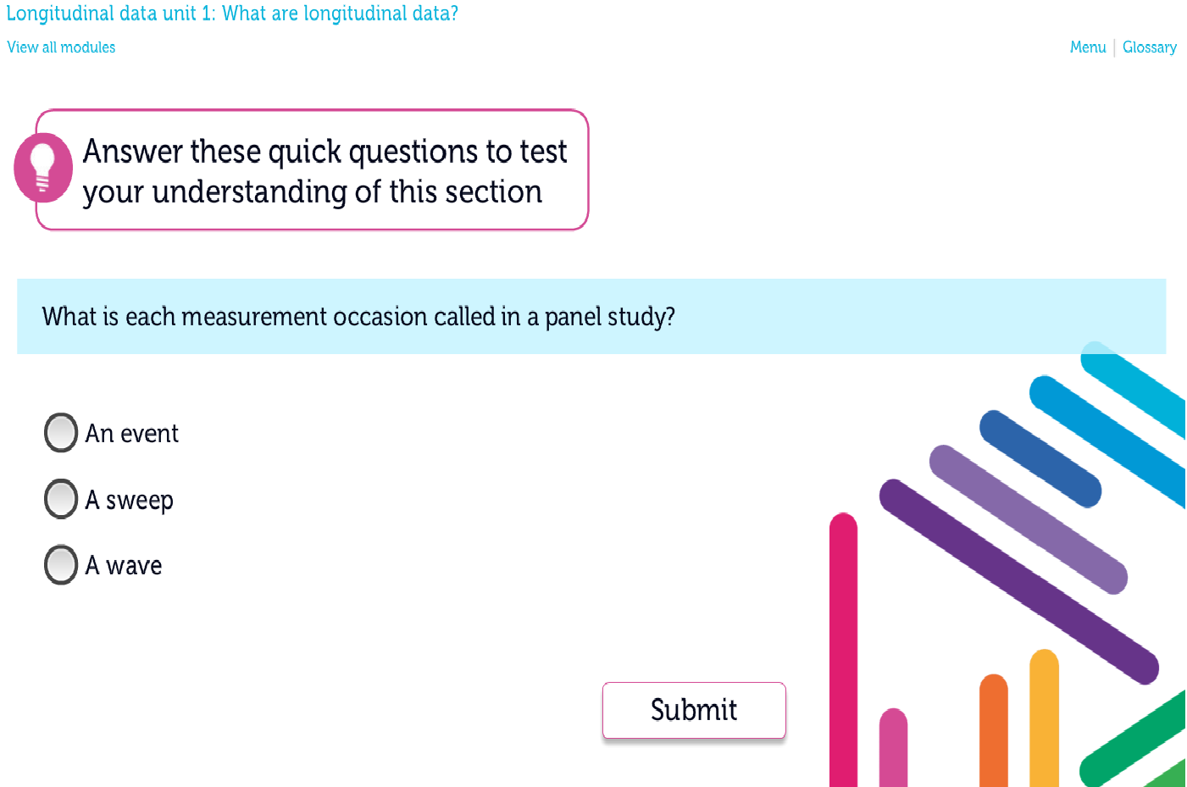
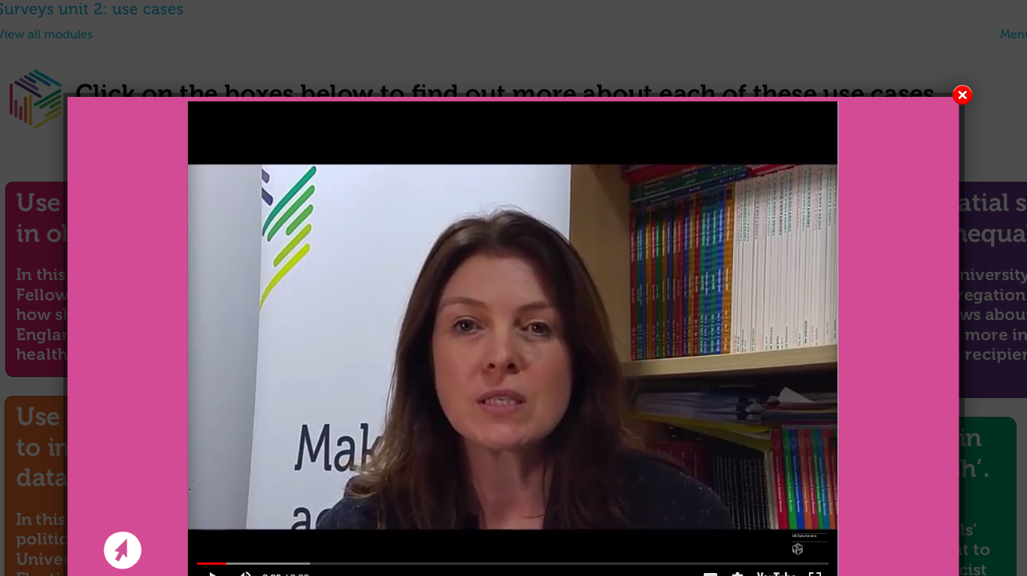
Examples of content

Slide 9
How much effort was it?

Slide 10
Effort
Investment in staff time
E-learning technologist
Data specialists & educators within the UK Data Service
Planning
Learning outcomes for each unit
Storyboards – each screen carefully planned out
Learn software (Articulate Storyline)

Slide 11
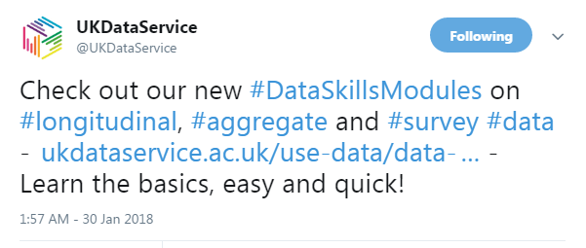
Was it worth the effort?
Twitter
4775 impressions (views)
166 engagements (retweets, clicks etc)
3.5% engagement rate
Our most popular tweet
for a long time

Slide 12
Data Skills Modules – Monthly breakdown
Launched end Jan; Google Analytics start May 2018
Advertising – spikes and increased traffic
637 unique users

Slide 13
Focus groups
Two groups, n=11
Modules discussed in wider context of UKDS online materials
Very positive results:
Like the modules
Good for beginners
Good mode for content delivery
Further focus group work planned
More detailed feedback on current modules - improvement
Preferences for future developments – new modules, topics

Slide 14
open resource (no registration, no charge, open software)
convenient (no travel, self-study, dip in and out)
skills building (not stand alone resource)
real life data
teaching resource readily available
cheaper than a MOOC
Costly to produce
Steep learning curve to create – lots of effort
Need e-learning technologist
Regular updates needed
No online help if learner does not understand

Slide 15
Thank you for listening!
I’m interested to hear your ideas for future developments
@VanessaAHiggins
Vanessa.higgins@manchester.ac.uk
https://www.ukdataservice.ac.uk/use-data/data-skills-modules

