Slide 1
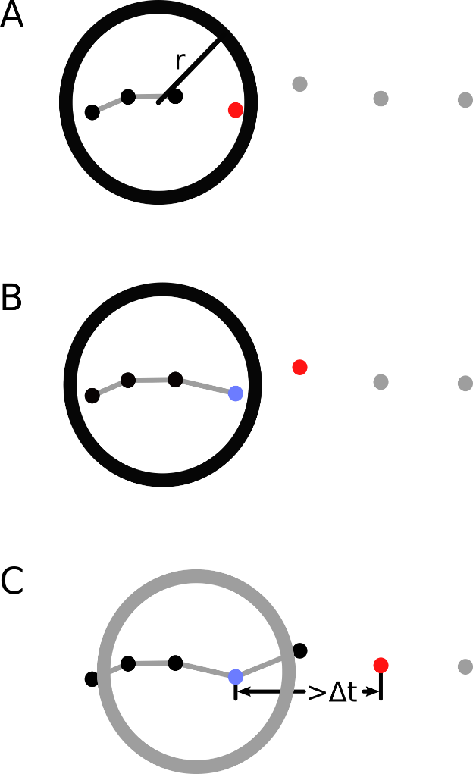
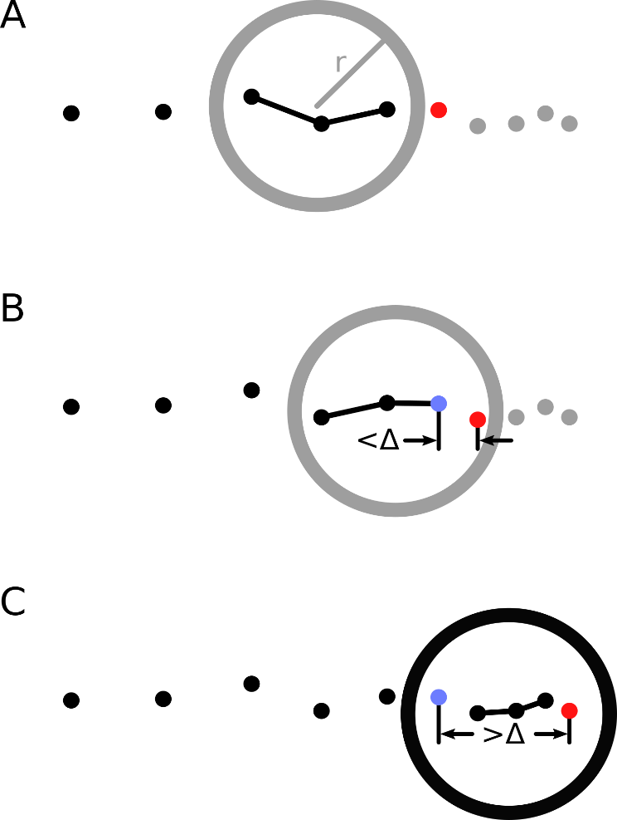

Stop detection decisions in a travel survey app
Lars Killaars, Danielle McCool, Ole Mussmann and Barry Schouten
ESRA, The power and pitfalls of combining survey and sensor data

Slide 2
Why stop detection is relevant in surveys?
  Stop detection splits a series of time-location sensor data (GPS, WiFi, GSM) into stops and tracks, i.e. adds purpose and meaning
  Stops and tracks are useful ingredients to many surveys:
    Travel surveys
    Time use surveys
    Geo-fencing in expenditure surveys and food surveys
  In active sensor data collection, stop detection is crucial in order to ask respondents for feedback, validation and supplemental data
Stop detection, July 17, ESRA 2019, Zagreb

Slide 3
What is a stop?
  Complicated question that is answered ambiguously by substantive researchers.
  In paper/online travel surveys, this is left to the respondents with some basic instruction
  Here: A person has a stop when
    he/she is in a certain area for at least a certain time period,
    he/she is there with a purpose that is different from a change of transportation mode
  A change of transportation mode splits tracks into subtracks
Stop detection, July 17, ESRA 2019, Zagreb

Slide 4
Stop detection: methodology and IT chocies
  A candidate stop is detected when a respondent resides in an area of with perimeter smaller than r for at least a duration of d minutes.
  Start/end times/average location are slightly more complicated, because a respondent can move while in a stop, e.g. during work
  IT choices:
  Choice of a high and low tracking mode to save battery
  Frequency of tracking in both tracking modes
  Accuracy of location measurements
  Keeping app active on background
Stop detection, July 17, ESRA 2019, Zagreb

Slide 5
Design of field test for Dutch Travel survey
n=1902 sample units from Dutch population of >=16 years were
invited to install the travel survey app and to participate for a week
  Sample units were varied randomly over
  Duration d: {2,3,4,5} minutes
  Perimeter r: [60,100] meters
  All r=674 sample units that registered, were asked for an online survey
  In the analysis, we simulated d ϵ {1,1.5,2,3,5,7,10} min, r ϵ [10,100] m
Stop detection, July 17, ESRA 2019, Zagreb

Slide 6
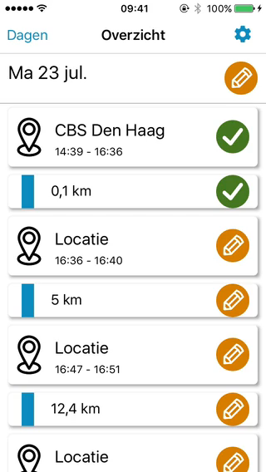
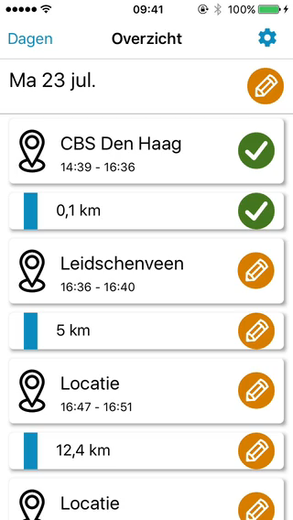
Design of field test for Dutch Travel survey
Stop detection, July 17, ESRA 2019, Zagreb

Slide 7
Research questions in travel survey experiment
  Do reported respondent issues depend on stop detection rules?
  What are optimal stop detection parameters for data quality?
  Do stop detection parameters impact missing data/break-off?
  Do stop detection parameters impact traveled distances?
Stop detection, July 17, ESRA 2019, Zagreb

Slide 8
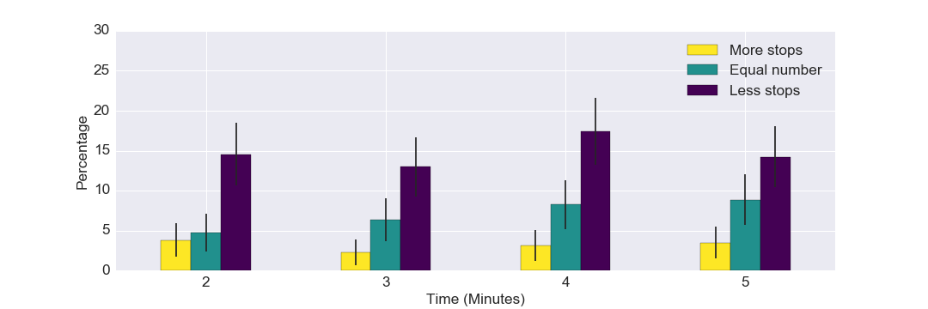
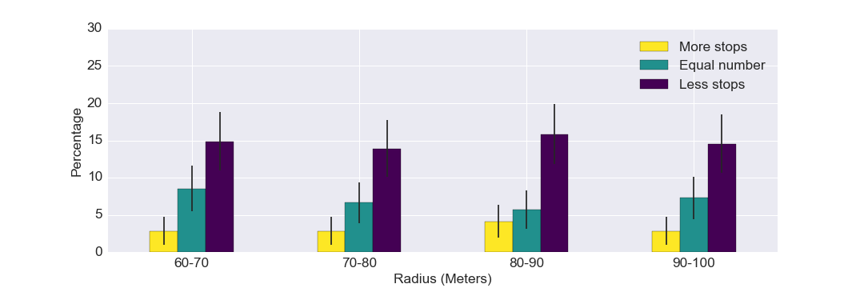
RQ1RQ1: Reported stop detection issues
Figure 7: Answers of respondents to the question: How does the number of stops that the app found compare to the amount of stops you expected?
Stop detection, July 17, ESRA 2019, Zagreb

Slide 9
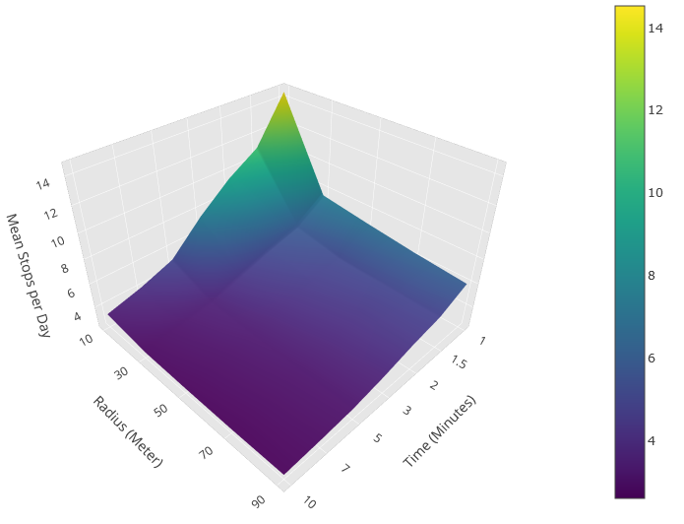
RQ2: average number of stops as function of (d,r)
Stop detection, July 17, ESRA 2019, Zagreb

Slide 10
RQ3: missing data/break-off
No association at all between stop detection parameters and break-off/attrition
  Incentive conditions 5 + 5+ 5, 5+ 0 + 10, 5 + 0 + 20
 | 5+5+5 | 5+0+10 | 5+0+20
Registration | 191 | 232 | 251
Rate | 30% | 36% | 40%
>=7 days | 116 | 137 | 168
Rate | 18% | 22% | 27%
Stop detection, July 17, ESRA 2019, Zagreb

Slide 11
RQ4: stop and track durations as function of (d,r)
Time | Stop duration (minutes) | Track duration (minutes) | Distance of the track (meters)
1,0 | 163 ± 0.875 | 54 ± 0.660 | 9.248 ± 259
1,5 | 209 ± 0.948 | 73 ± 0.786 | 11.480 ± 282
2,0 | 238 ± 1.04 | 83 ± 0.797 | 12.262 ± 280
3,0 | 286 ± 1.15 | 103 ± 0.870 | 12.176 ± 247
5,0 | 368 ± 1.30 | 137 ± 0.996 | 14.124 ± 250
7,0 | 428 ± 1.42 | 161 ± 1.04 | 15.384 ± 265
10,0 | 480 ± 1.41 | 197 ± 1.26 | 15.693 ± 256
Radius | Stop duration (minutes) | Track duration (minutes) | Distance of the track (meters)
10 | 145 ± 0.779 | 71 ± 0.769 | 6.798 ± 204
30 | 290 ± 1.13 | 104 ± 0.920 | 12.976 ± 275
50 | 335 ± 1.24 | 111 ± 0.913 | 14.932 ± 293
70 | 355 ± 1.29 | 115 ± 0.910 | 15.796 ± 300
90 | 368 ± 1.32 | 116 ± 0.900 | 16.337 ± 305
Stop detection, July 17, ESRA 2019, Zagreb

Slide 12
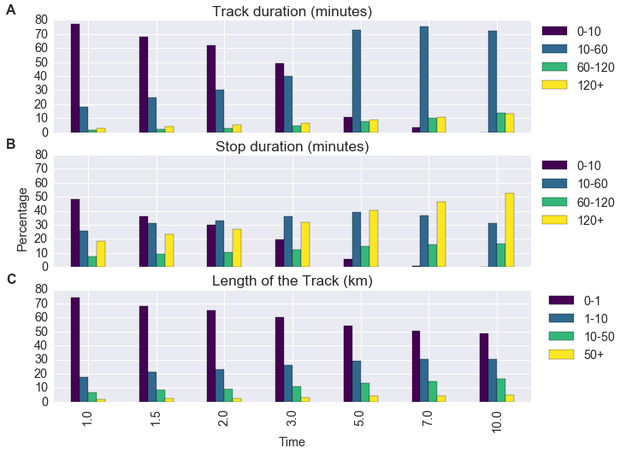
RQ4: stop and track durations - continued
Figure 5: Percentage of stops/tracks with a duration/distance that falls within the specified boundaries on the right. Shown for all used time parameters.
Stop detection, July 17, ESRA 2019, Zagreb

Slide 13
Conclusions and future
  Issues reported by respondents show weak relation to parameters
  Number of stops is robust, unless unrealistically small/short
  Attrition showed no relation to parameters
  Parameters have slight impact on travel statistics
  Future:
  Further improvement of stop detection is only feasible using online geolocation databases/points-of-interest
  Commercial apps include individual learning, but require >7 days
  Keeping app active is a crucial IT challenge
Stop detection, July 17, ESRA 2019, Zagreb

