Slide 1
Designing a device agnostic online survey for 17 year olds: Experiences of the Millennium Cohort Study
Emily Gilbert, Centre for Longitudinal Studies
Lucy-Jane Lindley, Ipsos MORI

Slide 2
Thanks to our funders and host institution
Funded by
Hosted by
www.esrc.ac.uk
www.ioe.ac.uk

Slide 3
Outline
Introduction to the Millennium Cohort Study
Development of the age 17 online survey
Take up and selection
Data quality

Slide 4
Millennium Cohort Study
Following the lives of approximately 19,000 children born between 2000-2002 in the UK.
Seven sweeps completed: 9 months, 3, 5, 7, 11, 14 and 17 years.
Multidisciplinary focus: child development, behaviour, education, health, poverty, etc.
Linked with admin data: education records, birth records, medical records.
Funded by ESRC and consortium of UK government departments.
Online survey: new element at Age 17.

Slide 5
Age 17 Survey
Conducted by Ipsos MORI.
Multiple in-home elements (1 hour 40 minutes)
  Face-to-face interview
  CASI
  Cognitive assessment
  Physical measurements
  Consents to data linkage
  Parent paper questionnaire and online survey
15 minute online survey for the cohort member to be completed after the interviewer’s visit

Slide 6
Age 17 Survey
Conducted by Ipsos MORI.
Multiple in-home elements (1 hour 40 minutes)
  Face-to-face interview
  CASI
  Cognitive assessment
  Physical measurements
  Consents to data linkage
  Parent paper questionnaire and online survey
15 minute online survey for the cohort member to be completed after the interviewer’s visit
Notes:
The focus of this talk will be on the design and implementation of the short online survey which took place after the interviewer’s visit.

Slide 7
The online survey

Slide 8
Content and protocol
Activities and risky behaviour, diet and body image, identity, learning and future, life and wellbeing, personality and attitudes, risk and time preferences.
Lower priority questions than those included in the CAPI and CASI.
Post-visit because didn’t want online component to have negative impact on overall RR.
Placed by interviewer in household: login leaflet containing unique ID
Reminders: SMS day 4, email day 8, postcard c. 2 weeks

Slide 9
Challenges
Device agnostic important
  17 year olds likely to have smartphones (95% of 16-24 year olds do. Ofcom 2018).
  Completions by smartphone are increasing c.4% year on year on Active Lives, a large-scale gen pop survey
  Age 14 Survey - 69% completed a time use diary using an app
  Crucial to be able to complete on smartphone to increase RR.
Functional across operating systems and browsers
Design issues
  Presentation of grids
  Incorporation of text-heavy help screens for words or phrases
  Functionality/feel the same as previous CASI questionnaires
  Minimise need for scrolling and text entry (respondent burden)

Slide 10
A continuum from mobile-unfriendly to mobile-first
Device agnostic
(not tied to a particular device)
Mobile unfriendly
Mobile functional
Mobile
optimised
Mobile
first
The questionnaire is not functional on mobile
Mobile completion is:
    discouraged
    not allowed/screened out
Questionnaire is designed for desktop users
Mobile is smaller version of desktop
Functional on mobile but not really user-friendly despite it often being referred to as mobile ‘friendly’
Questionnaire is designed to optimise reformatting for mobile; e.g. single column, minimalist, uncluttered, etc.
Questionnaire responds to the screen size, i.e. it is reformatted/restructured for the device being used
Questionnaire is designed for mobile
The questionnaire looks the same across all devices to ensure comparability
Notes:
We can define mobile first as sitting on a continuum from mobile unfriendly to mobile first.
Mobile unfriendly refers to surveys that cannot be completed on a mobile device. These surveys will often explicitly advise the respondent they cannot use a mobile device to complete the survey.
Next is mobile functional. This allows respondents to complete the survey on their mobile, but as the survey is designed for desktop and then squeezed on to a mobile screen, it is not particularly mobile or user friendly.
Mobile optimised, on the other hand, starts making design decisions to help optimise mobile completion. For example, responsive questions that detect the screen size of the device being used and then displayed the question in the most appropriate format.
Best practice, however, is designed online surveys as mobile first. This means designing the questionnaire to work on a mobile screen, and then applying those same design decisions across all devices. The rationale here is that, if it works on the smallest of screens, it will also work on the largest. As a result, questionnaire design is harmonised and comparable across devices.

Slide 11
A continuum from mobile-unfriendly to mobile-first
Device agnostic
(not tied to a particular device)
Mobile unfriendly
Mobile functional
Mobile
optimised
Mobile
first
The questionnaire is not functional on mobile
Mobile completion is:
    discouraged
    not allowed/screened out
Questionnaire is designed for desktop users
Mobile is smaller version of desktop
Functional on mobile but not really user-friendly despite it often being referred to as mobile ‘friendly’
Questionnaire is designed to optimise reformatting for mobile; e.g. single column, minimalist, uncluttered, etc.
Questionnaire responds to the screen size, i.e. it is reformatted/restructured for the device being used
Questionnaire is designed for mobile
The questionnaire looks the same across all devices to ensure comparability

Slide 12
Literature
95% of 16-24 year olds own a smartphone (Ofcom 2018).
Differences in data quality between mobile functional surveys and PC (Mavletova 2013; Wenz 2017), and measurement differences (Struminskaya 2015).
However, evidence suggests that as long as a survey is designed appropriately for smartphones, data quality can be as good as PC-completed web surveys (Antoun et al. 2017, Erens et al. 2019).

Slide 13
Development work
Expert workshop
Methodologist and online programmer systematically reviewed proposed questionnaire
  Each question suitable for online?
  Suitable for any device?
“Mr Tappy” usability testing
Pilot and dress rehearsal

Slide 14
Challenges
Device agnostic important
  17 year olds likely to have smartphones (95% of 16-24 year olds do. Ofcom 2018).
  Completions by smartphone are increasing c.4% year on year on Active Lives, a large-scale gen pop survey
  Age 14 Survey - 69% completed a time use diary using an app
  Crucial to be able to complete on smartphone to increase RR.
Functional across operating systems and browsers
Design issues
  Presentation of grids
  Incorporation of text-heavy help screens for words or phrases
  Functionality/feel the same as previous CASI questionnaires
  Minimise need for scrolling and text entry (respondent burden)

Slide 15
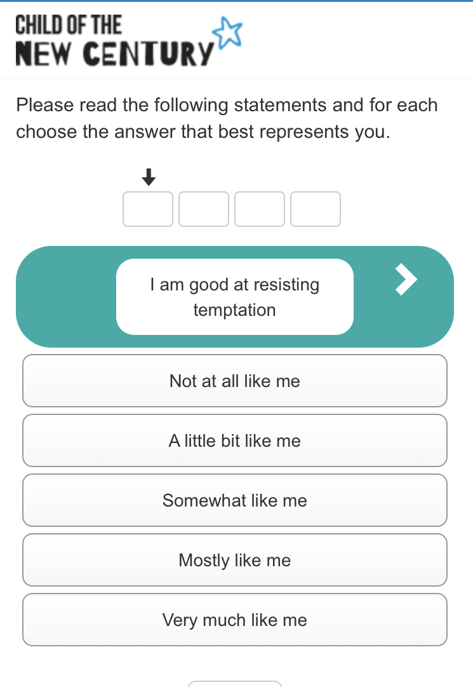
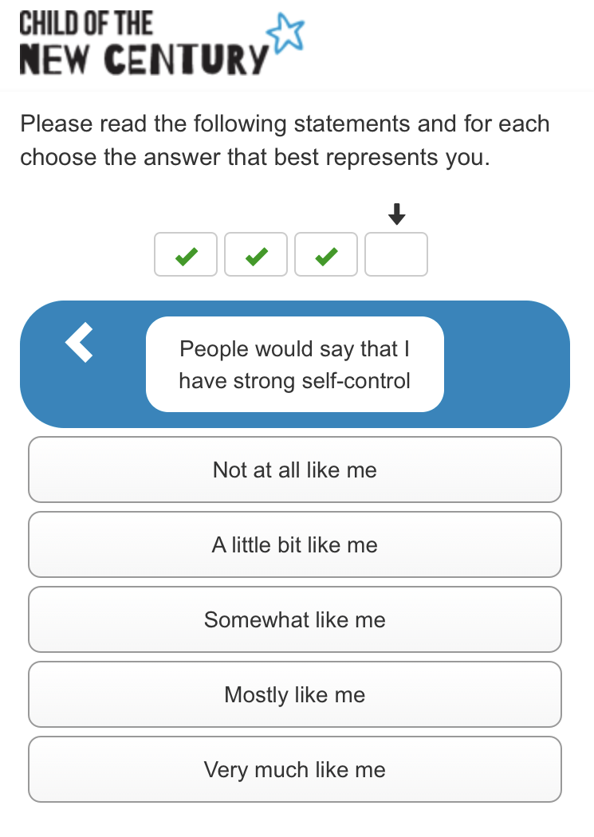
Grids
Notes:
Colour change of statement to provide a visual indication that it’s a new statement
Progress bar at the top – boxes indicate the number of statements in total, a tick shows it’s been answered, a cross shows the answer is missing.
Arrows in the coloured statement box allow respondents to move back and forth between statements. They can also do this using the boxes at the top.

Slide 16
Challenges
Device agnostic important
  17 year olds likely to have smartphones (95% of 16-24 year olds do. Ofcom 2018).
  Completions by smartphone are increasing c.4% year on year on Active Lives, a large-scale gen pop survey
  Age 14 Survey - 69% completed a time use diary using an app
  Crucial to be able to complete on smartphone to increase RR.
Functional across operating systems and browsers
Design issues
  Presentation of grids
  Incorporation of text-heavy help screens for words or phrases
  Functionality/feel the same as previous CASI questionnaires
  Minimise need for scrolling and text entry (respondent burden)

Slide 17
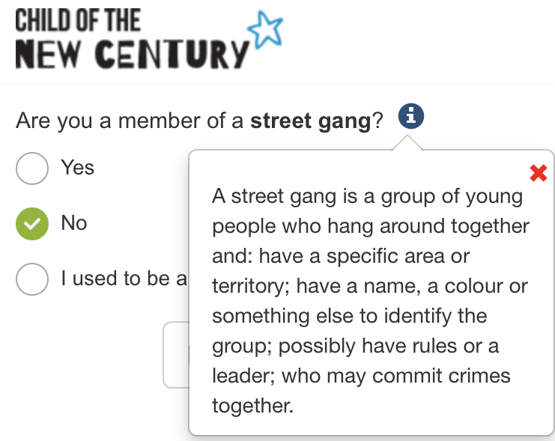
Help screens
Notes:
Visual indication that a help screen is available through the blue ‘i’ symbol
Clicking or tapping the symbol opens a pop-up box on screen with the help text

Slide 18
Challenges
Device agnostic important
  17 year olds likely to have smartphones (95% of 16-24 year olds do. Ofcom 2018).
  Completions by smartphone are increasing c.4% year on year on Active Lives, a large-scale gen pop survey
  Age 14 Survey - 69% completed a time use diary using an app
  Crucial to be able to complete on smartphone to increase RR.
Functional across operating systems and browsers
Design issues
  Presentation of grids
  Incorporation of text-heavy help screens for words or phrases
  Functionality/feel the same as previous CASI questionnaires
  Minimise need for scrolling and text entry (respondent burden)

Slide 19
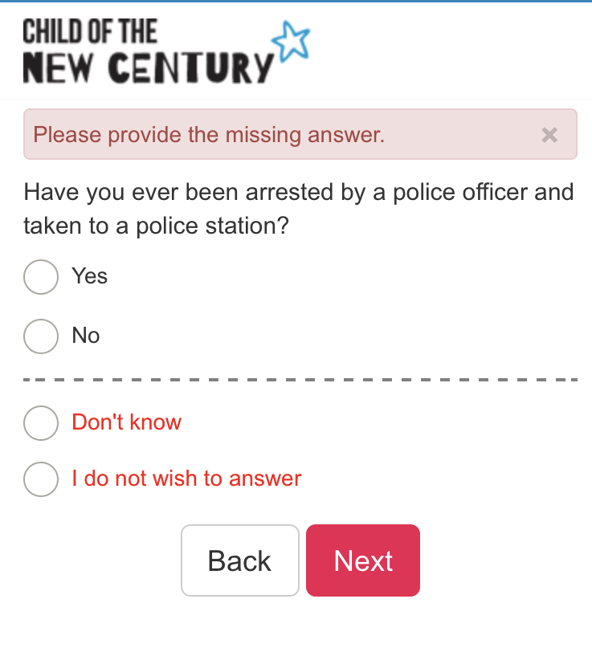
Functionality – hidden ‘DK/REF’
Notes:
Young people completed a CASI using the interviewer’s tablet at age 14.
Allowed to say ‘don’t know’ or refuse any question, but for lots of questions these options were hidden. In order to access them, respondents had to click ‘next’ without inputting an answer, then the two codes would appear
Appeared the same across devices – ‘missing’ error text, red text for the two codes, and placed under a dotted line to separate them from the substantive answers

Slide 20
Respondent feedback
Generally very positive!
Usability testing feedback
  “I think it was generally quite clear”
  “Pretty simple to follow the questionnaire... I understood it all”
Pilot feedback
  91% of young people said accessing the online survey was easy
  93% said moving from one question to the next was easy
  98% of young people completed the questionnaire in one go

Slide 21
Take up and selection - mainstage

Slide 22
Device used
64% response rate
Notes:
Intuition was right – the vast majority of cohort members completed the survey on their smartphone. Device use here is self-reported at the end of the survey. We will have paradata to be able to look at whether reported device and the device type collected automatically match.

Slide 23
Where survey was completed by device

Slide 24
Average number of sessions

Slide 25
Characteristics of smartphone completers
 | Smartphone
Sex – female | 67.5% (n=1720)
Sex - male | 72.9% (n=2383)
Hours playing electronic games: none | 70.6% (n=1068)
Hours playing electronic games: >0 - <5 hours | 70.4% (n=2504)
Hours playing electronic games: 5+ hours | 71.6% (n=752)
Notes:
Boys were more likely than girls to use a smartphone to complete the survey

Slide 26
Characteristics of smartphone completers
 | Smartphone
Hours spent social networking: none | 39.8% (n=37)
Hours spent social networking: >0 - <5 hours | 67.7% (n=2555)
Hours spent social networking: 5+ hours | 77.0% (n=1732)
Notes:
The more hours spent social networking more likely they were to use a smartphone to complete the survey

Slide 27
Characteristics of smartphone completers
 | Smartphone
Addicted to social media: yes | 74.4% (n=2167)
Addicted to social media: no | 67.3% (n=2154)
Happier online: yes | 72.0% (n=1205)
Happier online: no | 70.2% (n=3107)
Notes:
- Those who admitted being addicted to social media were more likely to use a smartphone to complete the survey.
- There were no large differences between those who said they were happier online and those who said they were happier in real life in the type of device they used to complete the survey.

Slide 28
Data quality

Slide 29
Break-offs
Breakoff rate very low – c.3% (n=219)
Majority of breakoffs occur in the intro screens
Don’t yet know the breakdown of this by device

Slide 30
Non-differentiation
Three grids for which we would expect different answers across grid items.
Extremely low occurrence of respondents selecting exactly the same answer for each item in these grids (23/6144, 19/6144, 145/6144).

Slide 31
Item non-response – average # DK/REF by device

Slide 32
Length of open-ended question response
One open-ended question included – asking for feedback about the questionnaire.
 | Desktop | Laptop | Tablet | Smartphone
Mean character length | 96 (n=68) | 90 (n=136) | 58 (n=54) | 66 (n=526)

Slide 33
Conclusions

Slide 34
Summary and conclusions
Online surveys successfully used to capture information from 17 year olds.
The vast majority (71%) used a smartphone to complete the survey.
There appear to be selection effects in terms of which device people choose to complete the survey on:
  Boys more likely than girls to use smartphones
  More hours spent social networking, more likely to use a smartphone
  Addicted to social media, more likely to use a smartphone
Very limited evidence of differential data quality between devices – only difference in length of response to open ended question. High quality data collected using smartphones and other devices.

Slide 35
Data
Data from the Millennium Cohort Study Age 17 Survey will be available from UKDS early 2020 (www.ukdataservice.ac.uk).

Slide 36
Thank you
emily.gilbert@ucl.ac.uk
@DrEmilyGilbert

Slide 37
Whether completed alone by device

