Slide 1
The coverage of micro establishments in an international enterprise survey
Session: ‘Ensuring Validity and Measurement Equivalence through Questionnaire Design and Cognitive Pretesting Techniques-1’
ESRA Conference, Zagreb, 19 July 2019
Xabier Irastorza
Prevention and Research Unit, EU-OSHA

Slide 2
Content
EU-OSHA
ESENER-2
ESENER-2 Follow-up study
ESENER-3 Outlook

Slide 3
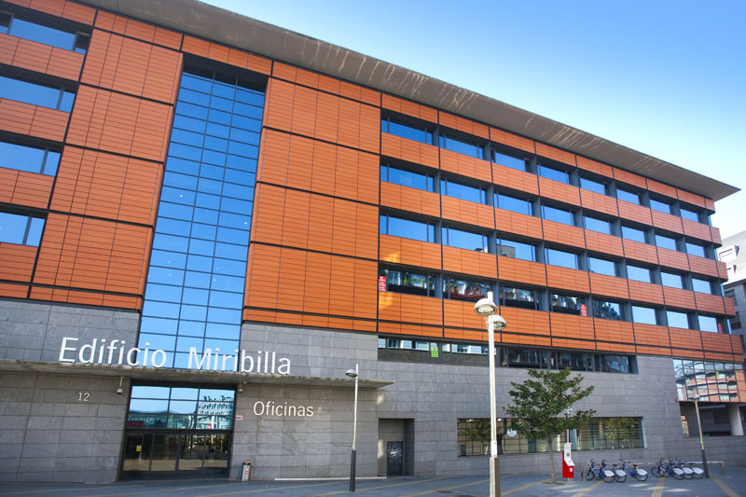
1. EU-OSHA - Who we are
The European Union body responsible for the collection, analysis and dissemination of relevant information to serve the needs of those involved in safety and health at work.
One of 40 EU agencies
Governed by European law
Mostly financed from the general EU budget
Independent in the execution of its mission/tasks
A tripartite network organisation, closely linked to EU actors and national networks through the national focal points
Legislation - inspection. NO

Slide 4
2. European Survey of Enterprises on New and Emerging Risks (ESENER) - changes
Greater geographical coverage | ESENER-1 (2009) | ESENER-2 (2014)
Countries | Total of 31: EU-28 + Turkey, Norway, Switzerland | Total of 36: ESENER-1 + Albania, Iceland, Montenegro, North Macedonia and Serbia
Establishments surveyed | 30,000 | 49,320
National versions of questionnaire Adapted for language and national OSH terminology | 41 | 47
Increased proportion of workplaces covered | ESENER-1 | ESENER-2
Smallest business size | 10 workers | 5 workers
Sector | All, including public, except agriculture and fishing | All, including public and agriculture and fishing

Slide 5
2. ESENER-2 Respondent EU28 (in %)
‘Person who knows most about safety and health at the workplace’

Slide 6
2. ESENER-2 Response and cooperation rates, by establishment size.
Response rate: % completed interviews from all touched addresses
Cooperation rate: % completed interviews from eligible contacts

Slide 7
2. ESENER-2 Response rates
      Little knowledge about self-selection effects (‘good OSH performers‘)
        lack of information on non-participants or benchmark data
      Only indication from data:
        All OSH provisions (risk assessments, information etc.) are taken less often by micro and small establishments (MSEs) than by larger workplaces
        Notable country differences
Non-response bias?

Slide 8
3. ESENER-2 Follow-up study
Ipsos MORI and Cardiff University
Impact of expansion of survey universe in ESENER-2
Informed by and structured around the TSE
  Focus on measurement error - inclusion of micro establishments.
Are the survey questions applicable to micro establishments (their respondents)?
    review ESENER-1 and -2 questionnaires and relevant background information.
    assessment of capability based on ESENER-2 interview responses.
    in-depth qualitative interviews (28) with respondents from micro establishments in Spain and Romania.

Slide 9
3. ESENER-2 Follow-up study
      More difficulties to reach micro establishments:
        Partly no regular office hours.
        Target persons in MSE is often the boss (very busy)
      OSH in micro is handled differently:
        OSH often considered not relevant by micro (services):
          Uncertain about OSH obligations.
          Less formalized approach to OSH, measures taken ad hoc/on demand.
        For most respondents in micro, OSH is not their main task, but an obligation (motivation?).
          Often no person specialised on OSH within the establishment.
          OSH frequently outsourced.
        Small dependent units often not allowed to participate.
        OSH committment highly dependent on owner/site manager

Slide 10
3. ESENER-2 Follow-up study
        ‘Small establishments didn‘t know who is in charge of health and safety, sometimes it seemed that they hear about it for the first time. Even managers of such establishments sometimes didn‘t know about this topic‘
        ‘Identification was more difficult in small companies, which rely on external providers for the health and safety at work issues. In some cases our study was treated as some kind of inspection, considering that the small companies are frequently unaware of the requirements for the health and safety at work and feel uncomfortable about the issue.‘
        ‘In many institutions with multiple organisations there is only one person that is in charge of several organisations. Others are mostly not adequate to talk about the topic nor authorized‘.
        Source: ESENER-2

Slide 11
Conclusion and recommendations
One-size does NOT fit all - develop survey methods and content that are appropriate for the smallest as well as the largest businesses.
Recommendations:
  Respondents’ understanding and interpretation of key concepts and terms, and its implications for survey development –prompts, hints, clarity,...
  Qualitative follow-up for some establishments (micro) exploring survey answers and workplace practice – ideally including brief interview with a worker.
  Collection of sufficient contextual detail for meaningful data analysis and interpretation.
  Intensive efforts to convert micro establishment refusals during or after the survey.

Slide 12
ESENER-3 2019
Phase | Timeline
Cognitive pre-test: 36 interviews, 3 countries | Aug – Sep 2018
Translation (TRAPD) | Oct 2018 – Feb 2019
Pilot test: 1,059 interviews, 33 countries | Jan - Feb 2019
Fieldwork: 45,200 interviews, 33 countries | Apr – Jul 2019
      First findings: Q4 2019
      Launch event: Q2 2020

Slide 13
Discussion
      How to develop survey methods for all business size classes?
      Comparative information,... by not asking exactly the same?

Slide 14
THANK YOU!
www.esener.eu
http://oshwiki.eu/wiki/Category:Statistics

