Slide 1
ESENER: The European Survey of Enterprises on New and Emerging Risks
Session: ‘How to survey health and safety at work in the changing world of work?
Theory, challenges and practice-1’
ESRA Conference, Zagreb, 18 July 2019
Xabier Irastorza and Marine Cavet
Project Manager, Prevention and Research Unit, European Agency for Safety and Health at Work

Slide 2
Content
European Agency for Safety and Health at Work – EU-OSHA
ESENER
Available resources
Outlook

Slide 3

1. EU-OSHA - Who we are
The European Union body responsible for the collection, analysis and dissemination of relevant information to serve the needs of those involved in safety and health at work.
One of 40 EU agencies
Governed by European law
Mostly financed from the general EU budget
Independent in the execution of its mission/tasks
A tripartite network organisation, closely linked to EU actors and national networks through the national focal points
Legislation - inspection. NO

Slide 4
2. ESENER: a tool that complements the existing sources of information on OSH in Europe
Existing sources of information on occupational safety and
health (OSH):
Workers’ surveys
  EU Labour Force Survey (Eurostat)
  European Working Conditions Survey (Eurofound)
Registers
  European Statistics on Accidents at Work (Eurostat)
  European Occupational Diseases Statistics (Eurostat)
We have a fairly good picture of some outcomes (injuries and concerns), less comprehensive for others (occupational diseases)
We have little information linking policies to outcomes (why are some effective and others not)

Slide 5
2. ESENER
What can an enterprise survey tell us?
?
Outcomes
Laws
Guides
Enforce-ment
Accidents
Exposure
Ill-health
Culture
Policy
Practice
Regulatory
context

Slide 6
2. ESENER – survey design
What is our universe?
Clear objective:
  How is health and safety managed in practice in Europe’s workplaces?
  Valid comparisons between countries by enterprise size and sector - all
Geographical coverage:
  EU-OSHA mission - inclusion of all EU member states.
  Agreements with EEA, EFTA and pre-accession countries.

Slide 7
2. ESENER: Quick overview
How do establishments manage health and safety at work?
Greater geographical coverage | ESENER-1 (2009) | ESENER-2 (2014)
Countries | Total of 31: EU-28 + Turkey, Norway, Switzerland | Total of 36: ESENER-1 + Albania, Iceland, Montenegro, North Macedonia and Serbia
Establishments surveyed | 30,000 | 49,000
National versions of questionnaire -Adapted for language and national OSH terminology | 41 | 47
Increased proportion of workplaces | ESENER-1 | ESENER-2
Smallest business size | 10 workers | 5 workers
Sector | All, including public, except agriculture and fishing | All, including public and agriculture and fishing

Slide 8
2. ESENER – survey design
What is the sampling unit?
We are interested in workplace health and safety management in practice
  No interest in ‘strategic’ level; what is happening at workplace level?
  ‘Establishment’ level, i.e. local business units, branches, delegations, etc.
  Not corporate HQ or government ministry
CATI survey
– 2.6% CAWI (ESENER-2, 2014)

Slide 9
2. ESENER – survey design
Single or dual respondent?
ESENER-1 sought a ‘dual voice’:
  Highest-ranking manager responsible for health and safety at work
  If possible, additional interview with workers' health and safety representative (ER)
But:
  Big differences in proportion of additional ER interview between countries
  Refusals - defined respondent did not exist and confusion over management and ER roles
ESENER-2 sought a single voice:
  ‘person who knows best about the way safety and health risks are managed at their workplace’

Slide 10
2. ESENER-2 Respondent EU28 (in %)
‘Person who knows most about safety and health at the workplace’
Notes:
Closely related to measurement errors deriving from the survey instrument and those owed to erroneous data provided by respondents are measurement errors related to the definition of respondents. In the preparatory phase of the survey there were intense debates about the most appropriate definition of the respondent. For ESENER-2, finally “the person who knows best about health and safety in this establishment” was defined as preferred target person. In order to help with the identification of the proper respondents, additional hints on who this person could be were provided in the questionnaire text, filtered by size and sector (managing director or branch manager in smaller establishments, technical director or personnel manager in larger establishments of the producing industries, just personnel manager in larger service establishments).
According to the feedback from (some of) the field institutes, it was not always easy to get to the right person within the firm. The information in the questionnaire and in the survey manual helped however to get through to the right persons. The rather low item non-response rates measured for ESENER-2 are an indicator that the identification of the adequate respondent was largely successful.
The only respondent category not meant to be targeted, but only tolerated if otherwise no interview with the selected establishment would have been possible was Q100_6 “External OSH consultant” (see also Q006, a question inserted to persuade respondents to answer the questionnaire locally instead of referring it to their external OSH consultant). The share of respondents of this type can therefore be used to a certain extent as a quality indicator regarding the choice of the definition.

Slide 11
2. ESENER – information that is relevant
What do we want to ask? ... What can we ask?
Based on the requirements of the EU Framework Directive on OSH:
  How is OSH managed in practice?
  How are psychosocial risks managed?
  What are the drivers and barriers?
  How are workers involved?
Limitations:
  CATI can only probe the knowledge of the respondent (no access to documents, etc.)
  Questions - simple, readily understood by a range of respondents in a range of situations, over the telephone (i.e. no show-cards)

Slide 12
2. ESENER-3 (2019) – target sample size
Fieldwork: 1 April – mid July 2019
Country | Interviews for ESENER-3
Austria | 1,500
Belgium | 1,500
Bulgaria | 750
Croatia | 750
Cyprus | 750
Czech Republic | 1,500
Denmark | 1,500
Estonia | 750
Finland | 1,500
France | 2,250
Germany | 2,250
Greece | 1,500
Hungary | 1,500
Iceland | 750
Ireland | 750 + 1250
Italy | 2,250
Latvia | 750
Country | Interviews for ESENER-3
Lithuania | 750
Luxembourg | 750
North Macedonia | 750
Malta | 450
Netherlands | 1,500
Norway | 1,500 + 450
Poland | 2,250
Portugal | 1,500
Romania | 1,500
Serbia | 750
Slovakia | 750
Slovenia | 750 + 300
Spain | 2,250
Sweden | 1,500
Switzerland | 1,500
United Kingdom | 2,250
Total | 45,200

Slide 13
2. ESENER-3 Questionnaire development process
Phase | Timeline
Cognitive pre-test: 36 interviews, 3 countries | August – September 2018
Translation (TRAPD) | October 2018 – February 2019
Pilot test: 1,059 interviews, 33 countries | January - February 2019
Team:
  EU-OSHA
  Kantar Public (lead contractor)
  Experts:
    Latvia, IOSEH at Stradins University Riga.
    The Netherlands, TNO.

Slide 14

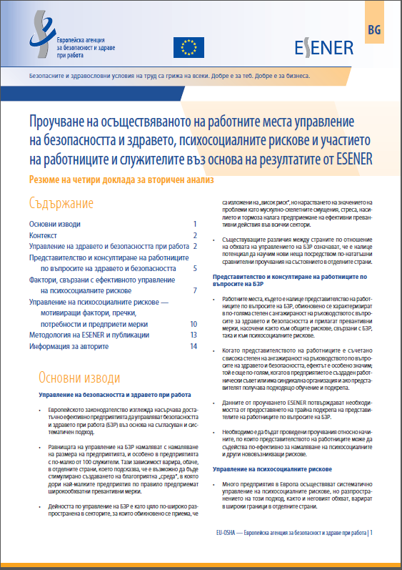
3. ESENER Resources www.esener.eu
Publications
  Descriptive overview reports (English)
  Summary of main findings (25 languages)
  In-depth secondary analysis reports (English)
  Summary of secondary analyses (25 languages)
Methodology https://oshwiki.eu/wiki/ESENER-2_Methodology
  Background information, including a technical report.
  Master and national questionnaires
Data
  ‘Mapping tool’ showing results by country, size and sector
  Access to full micro-data for non-commercial use
    UKDA
    GESIS

Slide 15
4. ESENER – Outlook
Established monitoring tool:
  Survey to be repeated in five year cycles: 2009-2014-2019 and beyond?
EU level
  European Commission – expectations
National level
  ESENER-1:
    Impact into policy making – Slovenia, Cyprus.
    National debates on prevention systems
  ESENER-2:
    National sample boosts: Slovenia, Spain, the United Kingdom.
  ESENER-3:
    National sample boosts: Ireland, Norway and Slovenia.
    Switzerland: all three waves.
Feeds into other Agency activities

Slide 16
Conclusions
Long, challenging process
International comparability:
  Same questionnaire in all countries/national versions
  Are we measuring the same?
Respondent definition:
  Unit of observation: establishment vs. company level
  Quality of business registers: incorrect sector classifications
  Actual respondent: ‘the person who knows most about health and safety in the establishment’
Interviewers:
  Expertise – Number – Consistent teams (supervisors)
  Training
  Monitoring
Involve stakeholders throughout
Learn from others
Communication

Slide 17
THANK YOU!
www.esener.eu
http://oshwiki.eu/wiki/Category:Statistics

