Slide 1


Response rates in psychological online surveys.
A meta-analysis on the effects of study design and time.
Tanja Burgard, ZPID
Nadine Kasten, University of Trier
Michael Bosnjak, ZPID
Talk at the Conference of the European Survey Research Association (ESRA)
16.07.2019, Zagreb (Croatia)

Slide 2
PROBLEM: DECLINING PARTICIPATION IN PSYCHOLOGICAL SURVEYS
Nonresponse has increased since the 1990s
  in social sciences and politics (Brick & Williams, 2013) and
  in counseling and clinical psychology (Van Horn & al., 2009)
  Problem: Often systematic → Biased results
Trend in recent years: Growing popularity of online surveys in psychology
  Web surveys yield lower response rates than other survey modes (Lozar Manfreda & al., 2008)
  Web surveys may be less representative
  Dynamic field: Growing number of internet users and increase in web surveys → Change over time?
Response
Decreased willingness due to oversurveying
Time
Response
Increased access and acceptance of the internet
Time
Notes:
Definition of psychological online surveys: Survey conducted via an online-questionnaire, link may be shared via e-mail, after a telephone call or personal invitation
Psychological focus here: Samples with a relevant share of depression and / or anxiety disorder
Example 1 : Sample of junior doctors highly vulnerable for depression answers online questionnaire on working conditions
Example 2: Sample of anxiety patients at a clinic answers online questionnaire about side effects of medicine
Example 3: Sample of sport athletes with high share of depression answers online survey on needs and use of psychological therapies
Important: The number of people contacted has to be known (not the case, if a link is shared anywhere in a forum or on a website) to be able to compute a response rate

Slide 3
RESEARCH QUESTIONS
  How has the willingness to participate in psychological online surveys developed over time?
    We assume declining initial response rates.
  Which further variables do moderate initial response rates?
    We explore the influence of the following moderators: Mode of invitation, incentives and length of the questionnaire
    The findings should guide researchers in how to optimally implement psychological online surveys yielding high response rates
  We focus on samples with a relevant share of people suffering from depression or anxiety disorder → epidemiologically relevant subgroup in psychology

Slide 4
HYPOTHESES ON MODERATORS OF PARTICIPATION
H 1: The initial response rate in psychological online surveys has decreased over time.
  Amount of communication has increased, as well as number of surveys and scientific studies, especially online surveys become more popular → oversurveying
  More information has to be processed, less stimulation and attention to single communication requests
  H 2: The higher the number of items in a questionnaire, the lower the initial response rate.
  H 3: Initial response rates are higher, if incentives are given for participation.
  Cultural change to individualism: Respondents feel less socially obliged and rather base their decision to participate on costs and benefits (Johnson & al., 2002).
  H 4: The more personal the contact mode of the invitation, the higher the initial response rate.
  In the mass of communication requests, personal address is a way to get attention.
Notes:
Definition initial response in the appendix

Slide 5
ELIGIBILITY CRITERIA
Population: At least 30 % of adults (> 18 years) with depression or anxiety disorder, no student samples
Outcomes: Response rate or information on the flow of participants that allow the computation of the response rate
Study type: Psychological online surveys reporting on relevant study design characteristics (burden of participation or incentives or contact mode)

Slide 6
LITERATURE SEARCH: DATABASES AND SEARCH TERMS
10 databases searched:
  PsycInfo, Embase, Medline & In-Process Citations, Medline Ahead of Print & Daily Update, Campbell Library, Science Citation Index, SocIndex, CENTRAL, PubPsych, ReStore
Conference proceedings searched manually:
  ESRA and AAPOR (the past three years)
Search terms:
  ("participation rate" OR "response rate“)
  AND ("online survey" OR "online surveys" OR "internet survey" OR "electronic survey" OR "email survey")
  AND (Anxi* OR depress*)

Slide 7
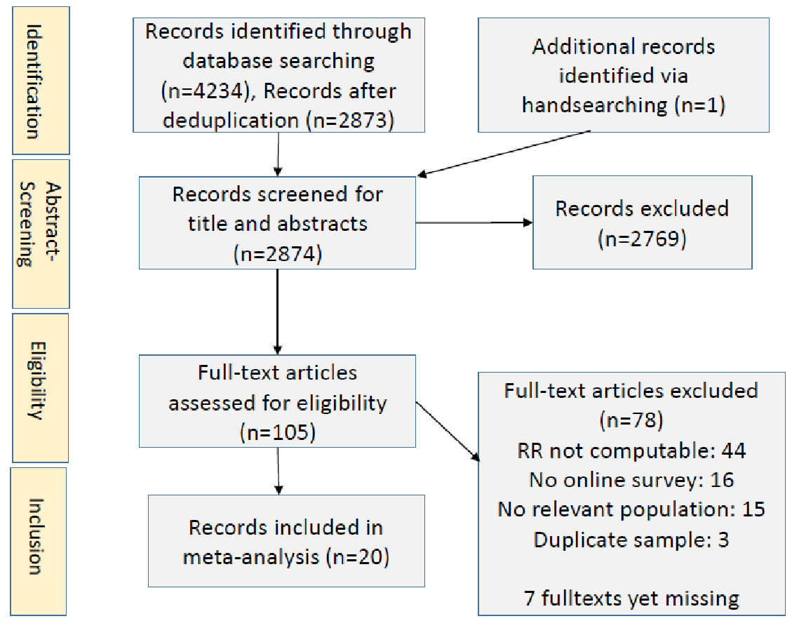
LITERATURE SELECTION PROCESS: PRISMA FLOW

Slide 8
CODING AND DATA EXTRACTION
Report | Sample | Study design | Effect sizes
First author Publication year Publication type Peer-Reviewed? Sponsorship | Target population Percentage female Mean age Year data collection Country data collection | Type of recruitment (list-based, probability- or access-panel) Mode of invitation (E-Mail, Mail, Telephone, Other) Duration of study participation (items) Incentives (yes, no) Topic | Results from the report: Returned questionnaires, Refusals, Non-contacts, Unknown eligibility, Not eligible (screened out / quota filled) Effect size: Response rate = Percentage of the target population responding (Cook et al. 2000)

Slide 9
ANALYSIS METHOD
  All analyses are conducted using the metafor package (2.1-0) in R (Viechtbauer 2010)
  We computed four meta-analytic models:
  Overall effect: Random-Effects model without moderators
  Time effect: Random-Effects model with only publication year as moderator
  Effect of study characteristics: Random-Effects model with all hypothesized moderator variables (publication year, mode of invitation, length survey, incentives)
  Full model + controls: Model 3 + additionally controlling for type of recruitment, use of funds for study conduction and mean age of the sample

Slide 10
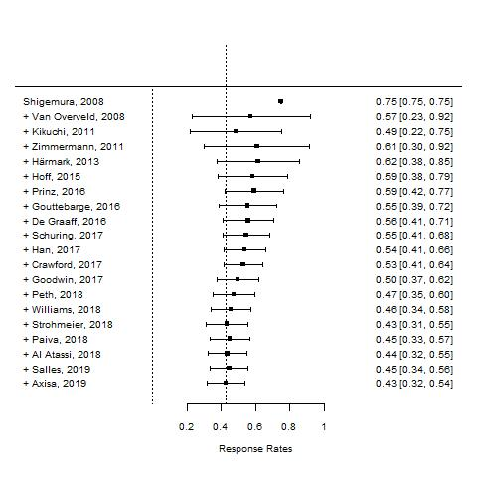
OVERALL EFFECT
Cumulative forest plot
Random-Effects Model (k = 20)
tau^2: 0.063
I^2: 99.92%
Test for Heterogeneity: p-val < .001
Overall mean: 0.428 [0.317; 0.539]

Slide 11
TIME EFFECT
Random-Effects Model (k = 20)
Estimated effect of publication year on RR:
-0.112, p-val < .034
15.75 % of heterogeneity are accounted for by Pubyear

Slide 12
STUDY DESIGN EFFECTS
The hypothesized study design effects (publication year, number of items, use of incentives and mode of invitation) explain 29 % of the heterogeneity of the dependent variable RR
If additionally controlled for the type of recruitment, the use of funds and the mean age of the sample, 53 % of the heterogeneity are explained
All in all, the results of the meta-regression support the hypotheses for the effects of publication year (H1), number of item (H2) and the mode of invitation (H4)
The hypothesized effect of incentives (H3) cannot be supported

Slide 13
DISCUSSION AND OUTLOOK
Hypothesized influences on participation mostly confirmed:
  The mean response rate is about 43 %
  Response rates are lower in more recent years and in case of longer questionnaires
  More personal forms of approaching people yield higher response rates than E-Mail invitations
  Effect of incentives could not be confirmed (perhaps not enough evidence to draw conclusions, due to small number of studies that reported use of incentives)
Further evidence needed!
  Meta-analysis restricted to populations with depression or anxiety disorders
  → validation with other populations important!
  We need more evidence from online surveys using incentives to test this effect, too
Notes:
A bit higher than in former meta-analyses on participation in online surveys (Cook 2000, Shi / Fan 2007/2008)

Slide 14
LITERATURE
Brick; Williams (2013): Explaining rising nonresponse rates in cross-sectional surveys. Annals of the American Academy of political and social science, 645(1), 36-59.
Cook; Heath; Thompson (2000): A meta-analysis of response rates in web- or internet-based surveys. Educational and psychological measurement, 60(6), 821-836.
Johnson; O‘Rourke; Burris; Owens (2002): Culture and Survey Nonresponse. In: Groves; Dillman; Eltinge; Little (Hrsg.): Survey Nonresponse. John Wiley & Sons, New York.
Lipsey; Wilson (2001): Practical Meta-Analysis. Sage Publications, Thousand Oaks.
Lozar Manfreda; Bosnjak; Berzelak; Haas; Vehovar (2008): Web surveys versus other survey modes: A meta-analysis comparing response rates. Journal of the market research society, 50(1), 79-104.
Shi; Fan (2008): Comparing response rates from web and mail surveys. Field methods, 20(3), 249-271.
The American Association for Public Opinion Research (2016). Standard Definitions: Final Dispositions of Case Codes and Outcome Rates for Surveys. 9th edition. AAPOR
Tourangeau; Rips; Rasinski, (2000): The psychology of survey response. Cambridge University Press.
Van Horn; Green; Martinussen (2009): Survey Response Rates and Survey Administration in Counseling and Clinical Psychology. Educational and psychological measurement, 69(3), 389-403.
Viechtbauer (2010): Conducting Meta-Analyses in R with the metafor Package. Journal of Statistical Software, 36(3), 1-48.

Slide 15
DEFINING AND COMPUTING RESPONSE RATES AS MAIN OUTCOME
  Information retrieved from studies (AAPOR 2016)
    A: Participants providing sufficient information
    B: Eligible, but non-interview (Refusal, no contact, language barrier)
    C: Unknown eligibility, non-interview (Nothing returned, undelivered)
    D: Not eligible (screened out, quota filled)
  Computation of Response Rate (RR)
    RR = Number of responders providing usable response (A) / number of eligible sample units (A+B+C)
  Problems:
    Missing information on flow of participants
    Online surveys often self-selected, information on population targeted / reached and refusals not available → no response rates computable!
Notes:
AAPOR: RR2 (Minimum Response Rate including interviews with sufficient information)

Slide 16
ELIGIBILITY CRITERIA
Criteria | Inclusion | Exclusion
Population | Studies consisting of at least one sample or subgroup with at least 30 % of adults (> 18 years) with depression or anxiety disorder | - Student samples - Studies reporting on children or adolescents - Individuals with post-partum depression - Individuals with bipolar disorder
Outcomes | Response rate or information on the flow of participants that allow the computation of the response rate | Studies that do not give information necessary for computing response or participation rates
Study type | Psychological online surveys reporting on at least one of the following study characteristics: - Kind of invitation (personalised, non-personalised or none) - Burden of participation (time spent, number of items, cognitive complexity) - Incentives for participation (monetary, non-monetary) | - Studies reporting on any survey type other than online surveys - Studies reporting on mixed survey types that don’t explicitly report on an online survey subgroup. - Case reports and case studies reporting on <20 participants. - Panel studies that do not report results from the first wave. - Review articles and editorials.
Studies were not restricted based on publication date, language or publication format.
Notes:
Bipolar disorder: Depressive and manic phases, willingness to participate may vary significantly between these stages. Therefore, these samples could bring in heterogeneity, that cannot be explained with study design characteristics later.
Post-partum depression: People are in a special situation with greater time restrictions, lack of sleep etc. This may influence their response behavior in unknown ways

Slide 17
OVERVIEW: VARIABLE DISTRIBUTION AND CORRELATION MATRIX
Variable | Mean | SD | Pub year | List-based sample | E-Mail invitation | Number items | Incentives | Resp. Rate
Publ. year | 2016 | 3.44 | - | 0.298 | -0.313 | -0.176 | -0.037 | -0.444
List-based sample | 0.80 | 0.41 | - | - | -0.210 | 0.249 | -0.375 | 0.184
E-Mail invitation | 0.85 | 0.37 | - | - | - | -0.485 | 0.210 | -0.018
Number items | 54 | 42.9 | - | - | - | - | -0.192 | -0.191
Incentives | 0.20 | 0.41 | - | - | - | - | - | -0.059
Response Rate | 0.43 | 0.25 | - | - | - | - | - | -

Slide 18


META-ANALYTIC MIXED-EFFECTS MODELS
Moderator | Model 3 results | Model 4 results | Hypothesis
Intercept | 0.7291 [0.426; 1.033], p<0.001 | 0.724 [0.398; 1.050], p<0.001 | -
Publication year | -0.177 [-0.287; -0.068], p=0.0015 | -0.215 [-0.316; -0.113], p<0.001 | 1
Number of items | -0.144 [-0.264; -0.024], p=0.0184 | -0.149 [-0.270; -0.027], p=0.016 | 2
Incentives | -0.055 [-0.295; 0.185], p=0.6542 | 0.066 [-0.146; 0.277], p=0.541 | 3
E-Mail invitation | -0.342 [-0.683; -0.000], p=0.0497 | -0.312 [-0.636; 0.013], p=0.060 | 4
List-based sample |  | -0.394 [-0.634; -0.153], p=0.001 | -
Funds | - | 0.099 [-0.101; 0.299], p=0.333 | -
Mean age sample | - | 0.052 [-0.045; 0.149], p=0.295 | -
I^2 | 99.72% | 99.27 %
R^2 | 28.79% | 52.58 %

Slide 19
MODEL PREDICTIONS FOR RESPONSE RATES
Pubyear | Length | E_Mail | Real_Response | Pred_Response | Difference
2008 | 34 | 1 | 0.7496 | 0.7134 | 0.04
2008 | 187 | 1 | 0.3966 | 0.3518 | 0.04
2017 | 31 | 1 | 0.1053 | 0.0949 | 0.01
2011 | 18 | 1 | 0.9839 | 0.8916 | 0.09
2017 | 56 | 1 | 0.4457 | 0.2543 | 0.19
2019 | 75 | 0 | 0.6602 | 0.4964 | 0.16

Slide 20
THEORETICAL PERSPECTIVES TO EXPLAIN PARTICIPATION
Study participation as a decision 🡪 various theoretical perspectives
Cultural influences on compliance (Gudykunst et al 1996)
Power distance (Hofstede 1983): Higher compliance for in-group requests in collectivist cultures, less pressure to comply in low power distance cultures (independent of group membership) (Johnson 2002)
Social distance (Dohrenwend 1968) 🡪 Matching interviewers and neighbourhoods
Collectivism
Solidarity in-group
Distinction out-group
Local talent (Gwiasda et al 1997)
Individualism
Independence
Cost-Benefit-calculus
Rational Choice (Voss and Diekmann 2004)
Reciprocity and social exchange (Homans 1958, Brehm and Cole 1966)
Incentives, Communication, Survey design (Groves 1992, Esser 1986)

Slide 21
FACTORS INFLUENCING PARTICIPATION RATES
The respondent and his environment (Groves, Couper 1998) | Interviewer (West, Blom 2017) | Study design / data collection
Cognitive functionality (Hauser 2005) Sex, age Education Population density Attitudes and experience with surveys (Stocké, Langfeld 2004) Interest in the topic Country (De Leeuw and de Heer 2002) | Sex, age Experience Training Affinity for the topic Sympathy | Invitation letter / communication with potential respondents (de Leeuw et al 2007) Data collection mode (F2F, Telephone, Web) and conduction (self-administered or Interviewer) (Shih / Fan 2007, Cook et al 2000) Length of the survey / experiment (Rolstad et al 2011) Incentives (Pforr et al 2015) Sponsorship (Mercer 2015)
Interaction interviewer and respondent
Decision on participation
Adapted from: Groves and Couper 1998

Slide 22
CHALLENGE: FEW INCLUDED STUDIES DUE TO INCLUSION CRITERIA AND REPORTING
Main reasons for exclusion
Sample includes individuals without depression or anxiety disorder
🡪 Possible solution: Setting a threshold for the share of respondents with depression or anxiety disorder (e.g. 60 %) and including studies with samples above the threshold
Response rate cannot be computed due to many self-selected / convenience samples in the area of online surveys

