Slide 1


Moderators of panel conditioning in sensitive questions. A meta-analysis.
Tanja Burgard, ZPID Trier
Nadine Kasten, University of Trier
Michael Bosnjak, ZPID Trier
Talk at the Conference of the European Survey Research Association (ESRA)
18.07.2019, Zagreb (Croatia)

Slide 2
Definition and relevance of panel conditioning
An example:
Veroff, Hatchett and Douvan (1992) randomly assigned newlywed couples to one of two groups: one that participated in frequent and intensive interviews (the study group) about marital satisfaction [..] and another that participated in minimal and infrequent interviews […]. The authors concluded that ‘‘[b]y the fourth year . . . The marriages of the study group couples appeared to be better adjusted on several dimensions of marital quality’’ (p. 315).
Panels are necessary to answer longitudinal research questions, but dangers to validity: panel mortality and panel conditioning
Panel Conditioning = Learning effect in panel studies
Problem: Due to the conditioning of respondents in former survey waves, they are no longer representative for non-respondents in later waves.
Examples: Avoidance of follow-up questions, cristallizing of attitudes, increased attention for survey topics, knowledge changes
Warren, Halpern-Manners (2012): Panel Conditioning in Longitudinal Social Science Surveys. Sociological Methods and Research 41(4): 491-534.
Notes:
Rationale for example: Survey reactivity → Frequent and intensive interviews stimulate reflection on the relationship. The partners are more attentive for each other and more aware of possible problems in the relationship. At the same time, the confrontation and reflection, stimulates caring for the relationship. Thus, attitudes about the relationship may change and the behavior and communication between the partners also may have been affected by the survey participation.
Other possible effect of panel participation: Respondents learn rules of the interview
→ strategic survey taking behavior: e.g. negative answering of filter questions
Threats to the validity of results from panels: Attrition + PC

Slide 3
sensitivity and its relevance for panel conditioning
Three characteristics of sensitive questions (Tourangeau & al., 2000):
  Answer calls for socially unaccepted answer
  Intrusive and private, taboo in everyday conversation (religion, income, sexuality)
  Concern for data privacy, data security and use of data
  Two possible effects of panel conditioning in case of sensitive questions:
  Desirable: More trust in survey situation
  → More honest answers, less social desirability effects for attitude questions
  Not desirable: Consistency effect on behavior or self-reporting
  → Adjustment of actual or reported behavior to greater conformity in case of deviant behavior

Slide 4
Measurement of panel conditioning
Time 1
Time 2
Time 3
Group 1
T
T
Between-subjects design: Comparison of parameters of experienced and fresh participants
Group 2
C
Group 3
C

Slide 5
Hypotheses
H1: The answers of experienced respondents differ from the answers of fresh respondents in case of sensitive questions.
H2: Social desirability effects in sensitive questions differ depending on the type of question.
  H2.1: Experienced respondents answer less socially desirable in case of attitude questions.
  H2.2: Experienced respondents answer more socially desirable in case of behavior questions.
Dosage effects
  H3: The more often the treatment group was interviewed, the greater the difference between groups.
  H4: The greater the time-lag between waves, the smaller the difference between groups.
H5: The kind of sensitivity interacts with the type of question
  H5.1: Questions that call for social desirable answers increase PC effects in case of behavior questions.
  H5.2: Intrusive and private questions decrease PC effects in case of attitude questions.

Slide 6
Information search and selection
First literature search:
  CLICsearch (broad search interface containing for example PsycInfo, PsycArticles, PubMed, Sociological Abstracts)
  Search terms: „panel conditioning“, „survey conditioning“, „time in sample“, „rotation group bias“ and 10 more related synonyms
Eligibility criteria:
  (Quasi-) experiments
  Population: Experienced and fresh panel respondents (treatment and control group)
  Treatment: Fomer conditioning by sensitive survey question
  Time of comparison: Both groups are asked for the same, sensitive question
  Outcome: Reported behavior or attitudes of both groups → SMD
Forward and backward search with records from the first search meeting eligibility criteria

Slide 7
PRISMA Flow Chart

Slide 8
Data collection and outcome
Coding
  Information on the report: Author, Year of publication, funding
  Intervention: Dataset, survey mode, year of comparison, country of conduction, incentives, Type of question, topic, conditioning frequency, interval between waves
  Results: Outcomes of both groups, Odds Ratios, test statistics
Effect size measure: Standardized mean differences
  SMD > 0: Experienced panelists respond less socially desirable
  SMD < 0: Experienced panelists respond more socially desirable

Slide 9
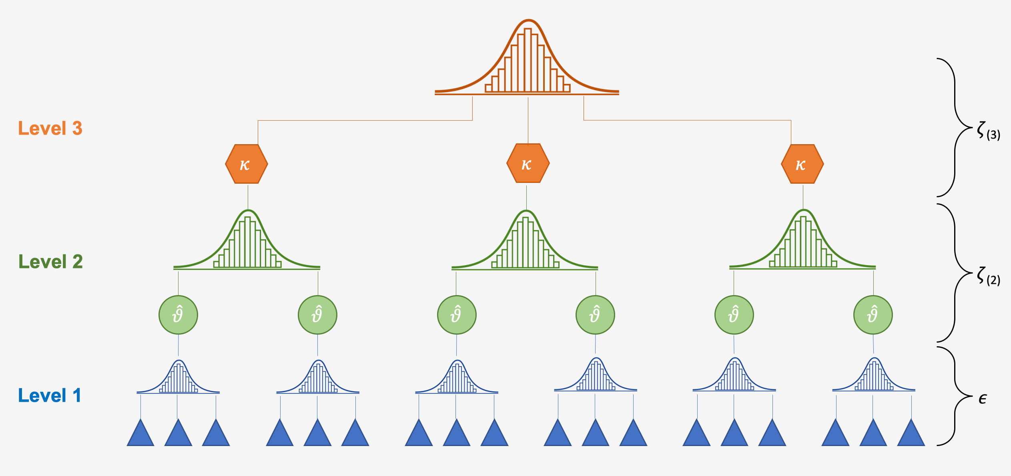
Analysis method
To account for the hierarchical data structure, a three-level meta-analysis is used
Source: Harrer, M. & Ebert, D. D. (2018). Doing Meta-Analysis in R: A practical Guide. PROTECT Lab Friedrich-Alexander University Erlangen-Nuremberg. https://bookdown.org/MathiasHarrer/Doing_Meta_Analysis_in_R/
R package used: metafor 2.0-0
Level | Unit | Variance
3 | Studies | Between studies
2 | Out-comes | Within studies
1 | Partici-pants | Sampling

Slide 10

Overall effect (H1) and variance distribution
k = 154 effect sizes, x = 85 samples, n = 19 reports
Mean effect of panel conditioning: -0,028*** [-0,042; -0,013]
→ Overall, experienced panelists respond more socially desirable than fresh panelists → H1
Distribution of heterogeneity:
  Sampling variance: 5,26 %
  Within studies: 80,40 %
  Between studies: 14,33 %
True heterogeneity, that may be explained with moderators
Notes:
sigma^2(within): 0,0044
sigma^2(between): 0,0008

Slide 11

Moderating effect of Type of outcome (H2)
  H2.1: Experienced respondents answer less socially desirable in case of attitude questions.
  H2.2: Experienced respondents answer more socially desirable in case of behavior questions.
  13,6 % of the variance of SMD‘s within studies and 37,5 % of the variance between studies is explained by the type of outcome
Type of outcome | k | Estimated PC-effect | Conf. Interval | Hypothesis
Attitudes | 38 | 0,027 | [-0,006; 0,061] | 2.1
Behavior | 116 | -0,038*** | [-0,053; -0,023] | 2.2
Notes:
sigma^2 (within): 0.0038 → explained: 0,0044-0,0038/0,0044 = 13,6 %
Sigma^2 (between): 0.0005 → explained: 0,0008-0,0005/0,0008 = 37,5 %

Slide 12
Dosage effects (H3 / H4)
 | Overall | Attitudes | Behavior
Number outcomes | k=154 | k=38 | k=116
Estimated effect frequency (H3) [CI] | 0.001 [-0.009; 0.010], p = 0.842 | 0.028 [-0.015; 0.071], p = 0.206 | -0.013 [-0.024; -0.001] , p = 0.027
Estimated effect interval (H4) [CI] | 0.004 [-0.003; 0.011] , p = 0.285 | 0.006 [-0.002; 0.014] , p = 0.172 | -0.016 [-0.022; -0.010] , p < 0.001
Gesamt

Slide 13
kind of sensitivity and type of question (H5)
  H5.1: In case of questions that call for social desirable answers, PC effects for behavior questions are stronger.
  H5.2: In case of intrusive and private questions, PC effects for attitude questions are smaller.
Type of sensitivity | Attitudes, k=38 | Behavior, k=116
Social desirability (H5.1), k = 126 |  | -0.041 [-0.056; -0.025], p <.001
Private (H5.2), k= 41 | 0.062 [-0.013; 0.138], p = 0.106

Slide 14
Summarized findings
Hypothesis | Results | Conclusions and comments
1 (Overall effect of PC) |  | Experienced panelists answer more socially desirable
2.1 (Less social des. Attitudes) |  | Significant difference between attitude and behavior questions
2.2 (More social des. Behavior)
3 (Frequency increases PC) |  | Only for behavior questions
4 (Time lage decreases PC) |  | Time lage increases PC for behavior questions (against direction expected)
5.1 (For questions calling for social desirable answers, PC for behavior questions is stronger)
5.2 (For private questions, PC for attitudes is weaker) |  | Few observations, but tendendy to expected effect

Slide 15
Conclusions
As expected, PC effects differ significantly between attitude and behavior questions.
  No evidence for PC effects in attitude questions
  Experienced respondents report more socially desirable behavior
Moderators of behavior questions
  Frequency slightly increases the PC effect
  Contradictory to expectations, time lage increases PC effect → plausible, as behavior is learned over time?
  Questions calling for social desirable answers increase PC effects in behavior questions
What‘s next?
  PC effects for other kind of outcomes (demographics, wellbeing, knowledge)
  Targeted experimental studies evaluating the effects of frequency and timing
Notes:
Weitere Moderatoren: Art des Verhaltens (Sexualität, Drogen, Diebstahl), Form der Sensitivität (Intimität / Privatheiz, soziale Unerwünschtheit)

Slide 16
Thank you for your attention!
Questions?!?

Slide 17
Manifestations of panel conditioning
Panel conditioning in the context of the answering process in surveys (Tourangeau et al. 2000):
Stage 1: Comprehension of the question
→ [-] Change in attitudes or behavior due to reflection / increased attention
(Sturgis et al 2009: Cognitive stimulus model)
→ [+] Less „don‘t know“-answers
Stage 2: Information retrieval
→ [+] More reliable answers due to better accessibity of relevant information
(Bergmann, Bath 2017)
Stage 3: Assessment of available information
→ [-] Freezing of attitudes to appear consistently (Waterton, Lievesley 1989)
Stage 4: Reporting / Selection of adequate answer
[+] Reduction of social desirability bias → more honest answering (Waterton, Lievesley 1989)
[-] Reduction of the cognitive burden of the survey by strategic answering / satisficing
(Krosnick 1991):
    Negative answering of filter questions to avoid follow-up questions
    Selection of acceptable answers without processing the content

Slide 18
Relevance and problems of Panels
Demand of the science council: Infrastructure in psychology for longitudinal data collection → Bruder et. al (2014): Nationally founded online lab
Existing panel-infrastructures: NEPS; GESIS Panel, LISS Panel (Blom et al 2016) → ZPID: Online-Lab
Relevance of panel infrastructures
  Improvement of research possibilities (available database for longitudinal research questions)
  Provision by infrastructure more efficient:
    Recruitment and care for pool of participants
    Methodological and technical expertise
Dangers of panels: panel mortality and panel conditioning

Slide 19
Rationale for the expected time effect of panel conditioning effects
Pluralism / less bindingness of social norms
  Social desirability less important for new respondents, too
Information overload and scarcity of attention
  Cognitive stimulus due to survey participation less pronounced
  Information of previous surveys are less accessible due to amount of information
Increase in surveys and scientific studies
  More familiarity with the rules of surveys
  Satisficing and strategic answering is more probable with new respondents, too
General tendency: Decrease of panel conditioning, because respondents are less affected by the survey participation and thus, differences between new and experienced respondents tend to level out

