Slide 1
DIRECTIONALITY OF THE RELATIONSHIP BETWEEN INTEREST AND KNOWLEDGE AS KEY DETERMINANTS OF THE IMAGE OF SCIENCE
Ana Muñoz van den Eynde
Research Unit on Scientific Culture
CIEMAT

Slide 2
Problem and goal

Slide 3
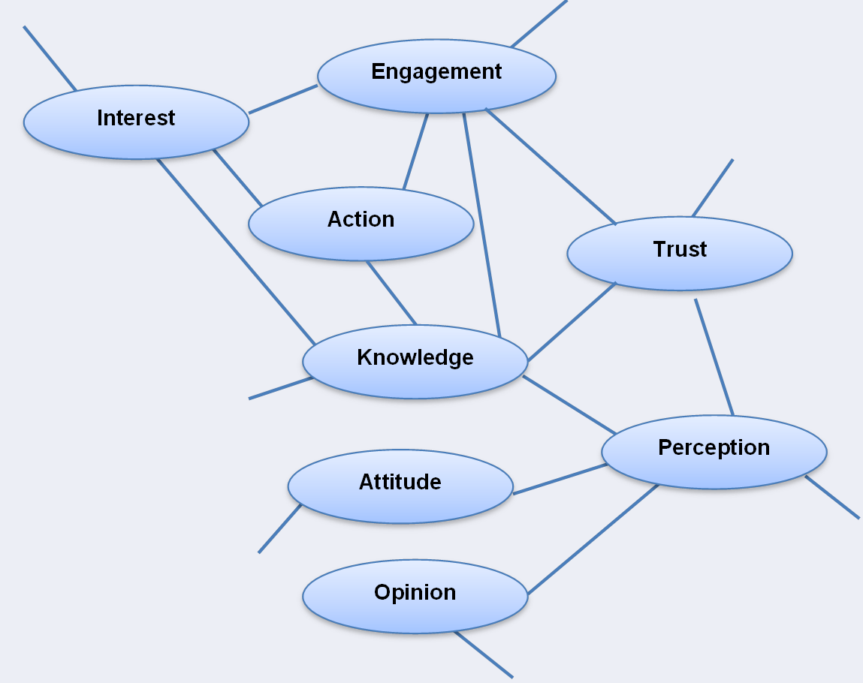
The image of science

Slide 4
Durant, Evans & Thomas (1989): Public Understanding of Science
Knowledge
Interest
Engagement
PIKA hypothesis
Knowledge
Interest
Engagement
The relationship between interest, knowledge and engagement

Slide 5
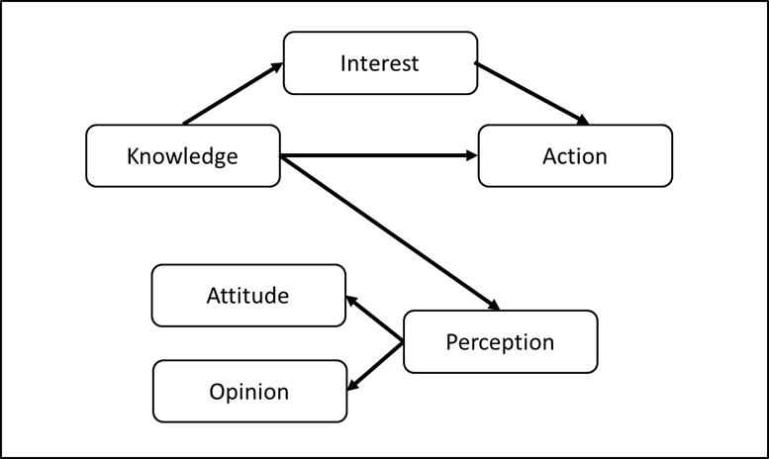
PIKA model

Slide 6
PIKA survey (1)
Took into account:
The inadequacy of the assumption of survey research that human beings are rational and offer all their answers and judgements after thinking on them in detail and thoroughly
The wording of the questions is a key determinant of the answers
In the search of sample representativeness, studies of public understanding of science have forgot that the answers to the surveys are produced by individuals.

Slide 7
PIKA Survey (2)
The PIKA Survey has been designed taking these facts into account.
Its being adjusted. To date, we have tested two versions (2014 and 2017)
Administered via Internet
To convenience samples of people interested in and knowledgeable about science
In 2017 we obtained 1.549 completed questionnaires

Slide 8
.31
.57
Cognitive Reflection
Scientific Literacy
.56
.76
.40
Knowledge
Participation
.64
.89
.50
.40
Action
Evaluation S&T Apps
Willingness to act
.63
.61
.71
.95
.38
.47
.28
Perception
.68
Evaluation of Science
.39
.27
-.86
.35
Interest for Knowing
.74
Opinion on Science
.13
.39
Interest
-.58
.26
.33
.52
Opinion on decisions
.27
Interest - Meaning
Goodness of fit: CFI = .945; RMSEA = .065; PCFI = .609
PIKA 2017: Structural model

Slide 9
.48
.21
Perceived S&T Educ.
Scientific Literacy
.69
.46
Knowledge
.13
.81
.67
Participation
.36
.65
.82
Evaluation S&T Apps
.54
Action
.64
.74
.60
.42
.21
Access S&T news
Perception
.46
Evaluation of Science
.36
.68
.46
Interest
Opinion on Science
.76
.81
.57
.65
Interested
Informed
Goodness of fit: CFI = .951; RMSEA = .061; PCFI = .507
Spanish general sample: Structural model

Slide 10
.13
Scientific literacy
.35
Knowledge
Error K
.31
.88
-.54
Informative Interest
.11
.16
.20
.23
Interest to Know
.29
Interest
Error I
.28
.33
.13
Interest - Meaning
Goodness of fit: CFI = .976; RMSEA = .081
.26
Scientific literacy
.17
Knowledge
Error K
.31
.38
.13
Informative Interest
.09
.16
.20
.28
Interest to Know
.43
Interest
Error I
.28
.33
.15
Interest - Meaning
Goodness of fit: CFI = .897; RMSEA = .168
Evidence: PIKA

Slide 11
.29
Scientific literacy
.22
Knowledge
Error K
.31
.92
Informative Interest
-.78
.08
.33
.16
.20
.22
Interest to Know
.24
Interest
Error I
.28
.33
.09
Interest - Meaning
Goodness of fit: CFI = .996; RMSEA = .038
Final model: PIKA

Slide 12
.17
Level of Studies
.29
Literacy
Error L
.18
.47
.28
Perceived S&T Educ.
-.31
.31
.35
.32
Informed S&T
.57
Interested
Error I
Goodness of fit: CFI = .998; RMSEA = .015
.17
Level of Studies
.29
Literacy
Error L
.17
.47
.28
Perceived S&T Educ.
.00
.05
.35
.37
Informed S&T
.61
Interested
Error I
Goodness of fit: CFI = .98; RMSEA = .104
Spanish general sample

Slide 13
The relationship between knowledge and interest is complex.
We found a univocal relationship from knowledge to interest in a probabilistic sample of the Spanish population.
We identified a bidirectional relationship between interest and knowledge in a biased sample of Spanish people interested in and knowledgeable about science.
We also found that in the Spanish general population engagement in science is directly and significantly influenced by knowledge. Nevertheless in the Spanish biased sample the influence of knowledge in engagement is indirectly mediated by interest.
If public engagement in science is the mean for improving the relationship between science and society, we need to consider the role developed by knowledge in shaping the public image of science depending also on the specific characteristics of the public as different publics interact diferently with science.
Conclusions

Slide 14
Thank you very much
Contact: ana.munoz@ciemat.es

