Slide 1
Innovating a multi-mode design for
a diverse, multilingual population:
Results from a field experiment of
the California Health Interview Survey
Todd Hughes¹, Brian M. Wells¹, Royce Park¹, David Dutwin²
¹ UCLA Center for Health Policy Research ² SSRS
ESRA 2019 – 16 July 2019

Slide 2
Special Thanks
Funding for this research provided by:
  California Department of Health Care Services
Guidance and consultation from the
CHIS Redesign Working Group

Slide 3
California Health Interview Survey (CHIS) Main Objectives
California’s assessment tool to meet state and local needs for population-based health data
Provide Health and Health-related Estimates
  at local-level for counties, cities with health departments, and statewide
  for adults, teens, and children
  for California’s major race/ethnic groups and (if possible) some smaller ethnic groups
  to wide audiences

Slide 4
How is CHIS currently conducted?
Through 2018 used RDD sampling (landline and cell) and Computer-Assisted Telephone Interview (CATI)
CHIS collects detailed information for:
One adult (age 18+) in the household
One adolescent (age 12-17) if present, and
One child (age 0-11) if present (by parent proxy)
Screener Interview
Sample Adult Interview
Sample Child Interview (by Parent Proxy)
Sample Teen Interview (with Parent’s Permission)

Slide 5
Challenges of the Current Design
Declining response rates
Cultural shifts in telephone usage
Increasing challenges with cooperation by telephone
Reduced cost-effectiveness/rising costs
Frames with better coverage available
(e.g., Pew Research Center, 2012; Dutwin & Lavrakas, 2016; AAPOR, 2017; de Leeuw, 2018)

Slide 6
Response Rates by Cycle

Slide 7
CHIS 2018 Fall Web Experiment
ABS mail push-to-web w/ telephone nonresponse follow-up (NRFU)
Conducted from Mid-October 2018 through
mid-December 2018
Statewide pilot with goal of obtaining 10% of annual sample size (~2,000 adult completes)
English and Spanish web instruments
  CATI interviewers available in English, Spanish, Chinese, Korean, Vietnamese, and Tagalog

Slide 8
New CHIS Data Collection Approach for Adults
Phase 1: Push-to-Web
Phase 2: Telephone Nonresponse Follow-up

Slide 9
Targeted Mail Materials in Language
Standard (English dominant)
Spanish dominant (high density Latino communities)
Initial mail invitation
  No greeting on the front of the envelope
  English invitation letter and FAQs
  $2 bill pre-incentive
  Multilingual letter w/ Spanish
English/Spanish
pressure-sealed postcard
English/Spanish final invitation sent via Certified mail
Initial mail invitation
  Spanish/English greeting on the front of the envelope
  Spanish/English invitation letter and FAQs
  $2 bill pre-incentive
  Multilingual letter w/o Spanish
Spanish/English
pressure-sealed postcard
English/Spanish final invitation
sent via Certified mail

Slide 10
Adult Counts and Response Rates
More than doubled the adult response rates
Over 80% completed over the web
Adult | Total Sample | Web | Phone | Completes | Completes/ Total | Weighted RR | CHIS 2017 RR
Completes | 28,000 | 2,042 | 425 | 2,467 | 8.8% | 14.3% | 6.7%

Slide 11
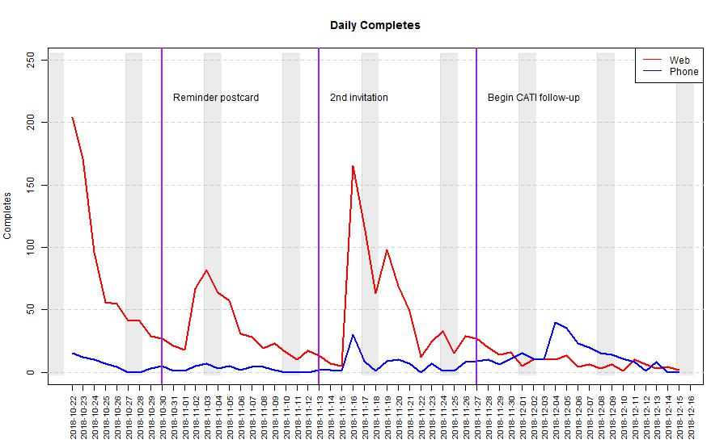
Daily Adult Completes by Mode
~50% of CATI completes were inbound CATI

Slide 12
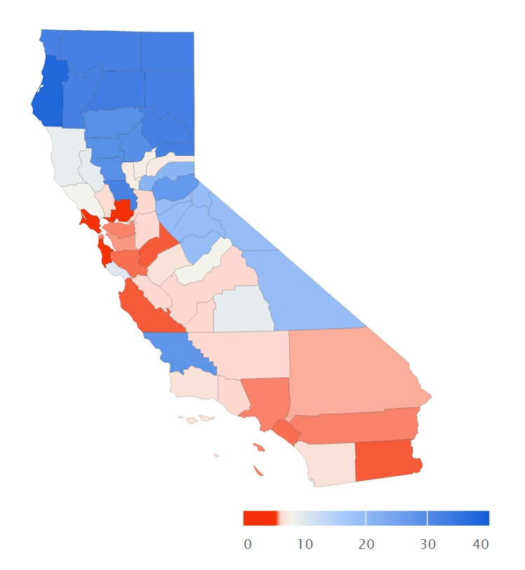
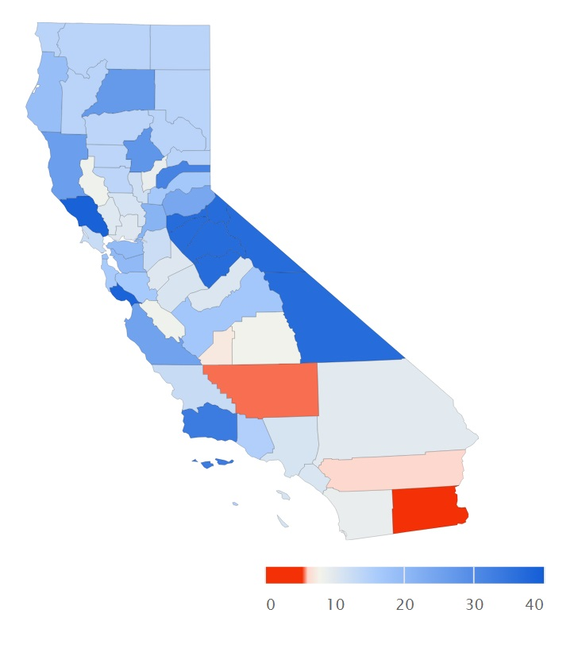
Response Rates Relative to CHIS 2017
CHIS 2017
Fall experiment
San Francisco Metro
San Francisco Metro
Los Angeles Metro
Los Angeles Metro

Slide 13
In-Language Completes
Spanish made up 2.1% of total completes
Asian language interviews accounted for 0.2% of total completes
Still only a 1/10th to a 1/3rd of in-language interviews from previous CHIS cycles
Language | Web | Inbound CATI | Outbound CATI | Completes | % of Total | CHIS 2015-2016 % of Total | CHIS 2017 % of Total
English | 2,008 | 200 | 204 | 2,412 | 97.8% | 88.6% | 92.4%
Spanish | 34 | 9 | 8 | 51 | 2.1% | 9.0% | 7.1%
Any Asian language | n/a | 2 | 2 | 4 | 0.2% | 2.4% | 0.6%
Total | 2,042 | 211 | 216 | 2,467 | - | - | -

Slide 14
Results of Targeted Mail Materials in Language
High-density Latino communities are still hard to recruit
for surveys
Spanish dominant mailing did not significantly reduce response rates compared to English dominant materials,
but nominally increased the number of Spanish language completes
Latinos are more cellphone dependent which has lower match rates for CATI follow-up
  Is this why CATI NRFU not as effective for Spanish speakers?
More research is needed to understand why

Slide 15
Key Indicator Evaluation
Measured differences in over 25 key indicators from the experiment against CHIS 2017 production data
Focus on comparisons using unweighted data for demographics and weighted data for key health indicators
Charts compare:
  Web component of experimental group
  Full experimental group
  Production RDD comparison group

Slide 16
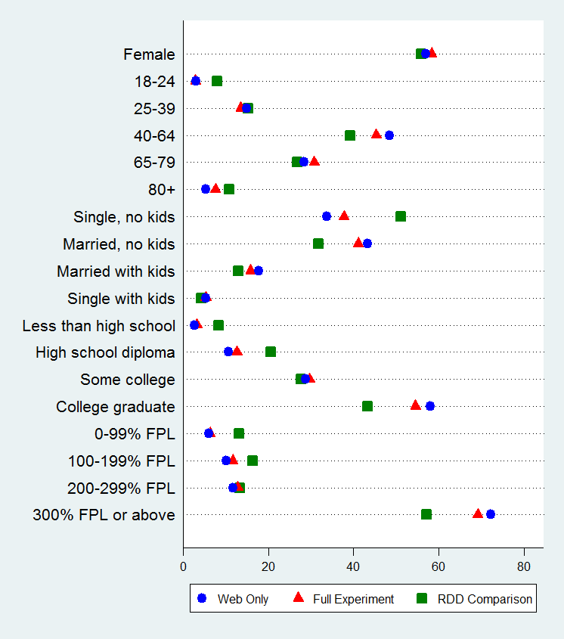
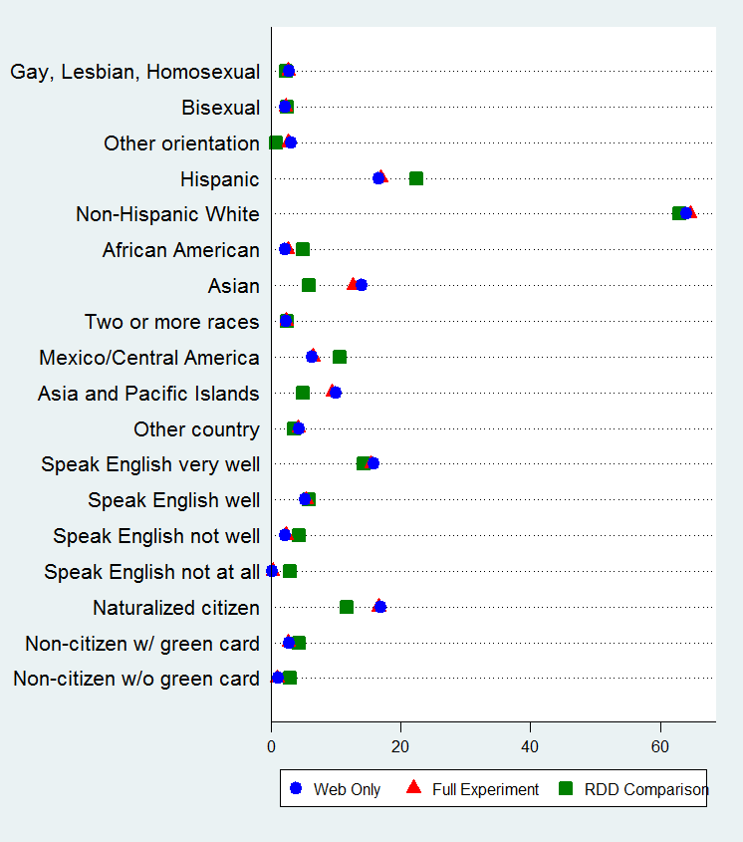
Key Indicators (Unweighted Demographics)

Slide 17
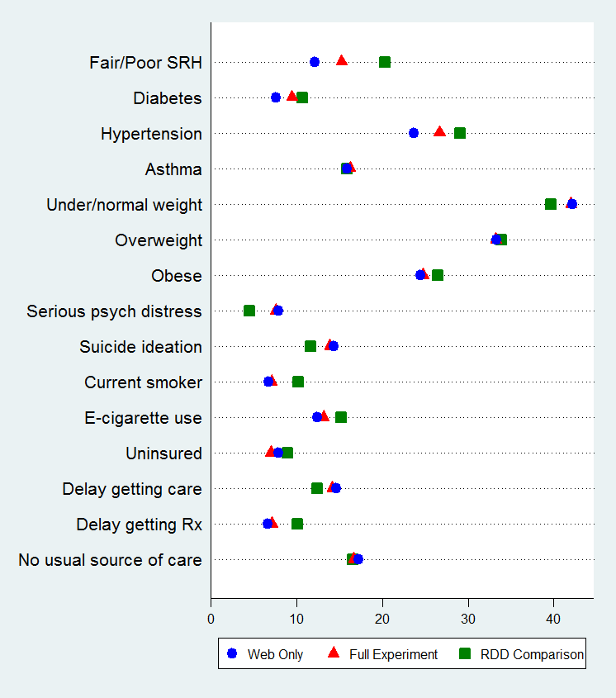
Key Indicators (Weighted Health Variables)
Most health indicators were not statistically significant
Largest differences
(p < 0.01)
  Higher self-rated health
  Increased serious psychological distress in last 30 days
  Fewer delays getting prescriptions

Slide 18
Comparing Data Collection Costs for
Fall Test vs. Production
 | Test Cost per Complete | CHIS 2017-2018 Production Cost per Complete | Test Cost Per Complete as % of Production Cost per Complete
Sample | $1.55 | $9.24 | 17%
Sampling Labor | $3.62 | $1.73 | 210%
Telephone Labor | $31.82 | $235.64 | 14%
Editing/Coding | $0.41 | $0.92 | 44%
Programming (Maintenance) | $0.46 | $1.03 | 45%
Project Management | $42.65 | $14.72 | 290%
Postage | $60.04 | $6.40 | 938%
Printing/Fulfillment | $26.12 | $11.12 | 235%
Incentives | $25.86 | $25.64 | 101%
Total | $192.53 | $313.23 | 61%

Slide 19
Child and Teen
Child-first experiment (AAPOR - Park et al., 2019)
  Had parent complete the child survey before completing the adult survey
  Significantly increased child response rate without lowering adult response rate
Teen permission experiment
  Presentation tomorrow @ 9am,
  Surveying Young People and Children

Slide 20
Next Steps
Implementing into production for 2019
Oversampling groups that were less well represented, modelling characteristics of the households at the address
Adding Asian languages to web survey
Targeting Spanish-dominant, Asian-dominant, or English-dominant mail materials based on predicted household characteristics

Slide 21
References
Park, R., Wells, B. M., Hughes, T., & Goyle, A. (2019, May). No child left behind: Advantages of asking about children before adults in a household web survey. Paper presented at the 74th Annual Conference of the American Association for Public Opinion Research, Toronto, Canada.

Slide 22
Thank you!
Todd Hughes
toddhughes@ucla.edu
The full report is available at:
healthpolicy.ucla.edu/chis/design/Pages/data-quality9.aspx

