Slide 1
Split Survey Design: Missing Completely At Random?
Impact on Attribute Importance
ESRA 2019 - Zagreb
Kurt A. Pflughoeft, Ph.D.
University of Wisconsin at Stevens Point
Sharon Alberg
MaritzCX

Slide 2
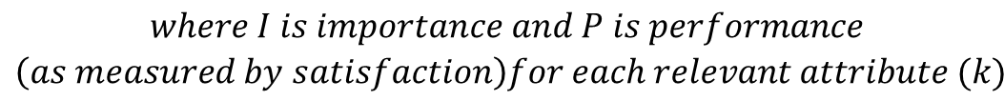

Multi-Attribute Attitudinal Model
Management - what should we focus on to increase overall customer satisfaction?
Adapt Fishbein’s (1967) & Rosenberg’s (1956) model to overall satisfaction (OSAT)
  Regression could be used for predictive purposes but explanatory models for customer satisfaction are elusive due to multicollinearity
    Use Random Forest or Theil’s Importance
$$OSAT= \sum_{k=1}^{n}{I_{k}P_{k}}$$
$$\begin{aligned}where I is importance and P is performance \\ \left(as measured by satisfaction\right)for each relevant attribute (k)\end{aligned}$$

Slide 3
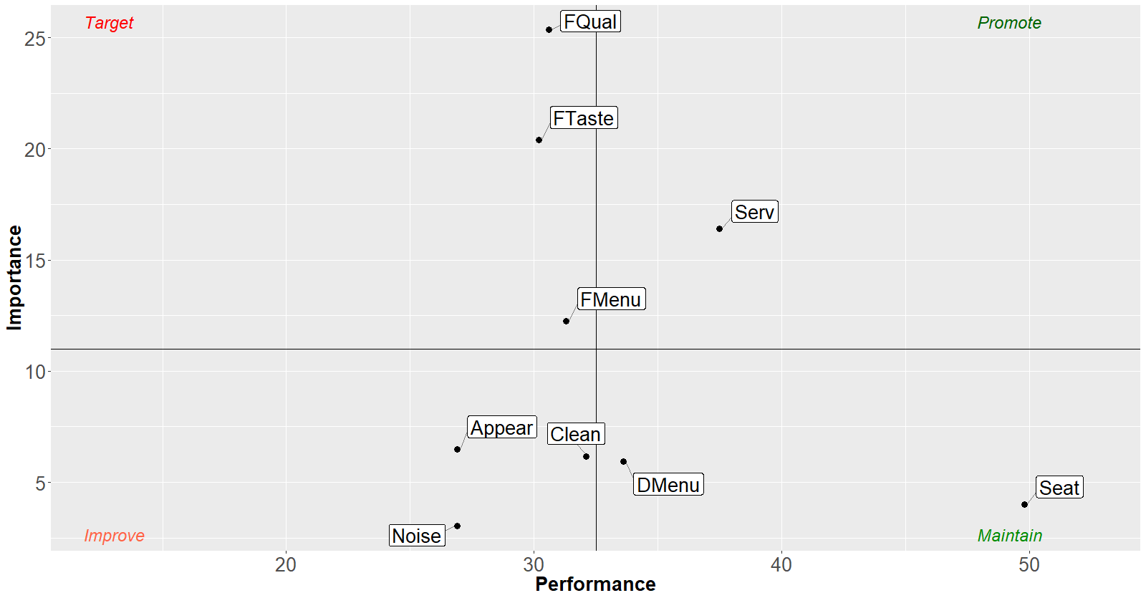

Performance Improvement Planner
Fast Food
Bits are converted to Percentages
Percent of 6 and 7s

Slide 4
Theil’s Derived Importance (Attributes)
A weighted average of all possible n^{th} ordered partial correlations – i.e. just the correlation matrix is needed
Log transformation leads to the amount of each predictor’s contribution for explaining dependent variable in bits
  Its not an arbitrary calculation but has theoretical meaning
  Combinatorially explosive calculation
  Can handle up to ~20 predictors
Dependent variable is overall satisfaction (OSAT)

Slide 5
Respondent Survey
Large Panel Survey
  About 80 possible questions on fast food dining
  n=4,625
  Panel members – questions almost always answered when applicable
  Several Research Purposes
    Media
      Mobile, Tablet, PC
    Mobile – Portrait versus Landscape (Scale)
    Voice to Text
    Stated vs Derived Importance
    Modular (Split Survey)
  Data collection 2016

Slide 6
Module Quota
(Random when eligible)
Version | Modules | Mobile Phone | PC | Tablet
1 | ABCF | 150 | 125 | 125
2 | ABDF | 150 | 125 | 125
3 | ABEF | 150 | 125 | 125
4 | ACDF | 150 | 125 | 125
5 | ACEF | 150 | 125 | 125
6 | ADEF | 150 | 125 | 125
7 | ABCDF | 150 | 125 | 125
8 | ABCEF | 150 | 125 | 125
9 | ABDEF | 150 | 125 | 125
10 | ACDEF | 150 | 125 | 125
11 | ABCDEF | 225 | 200 | 200
 | TOTAL SURVEYS | 1,725 | 1,450 | 1,450
Overages possible due to concurrent surveys
Mutually exclusive cells
*Mixed = Versions 3,5,6,7

Slide 7
Survey Module Content
Mostly about recent restaurant chain experience
Mod | Major Content
A | Some Demos, OSAT (required)
B | Menu and Drink Options, Pricing (may be missing)
C | Quality and Flavor (may be missing)
D | Appearance, Cleanliness, Noise (may be missing)
E | Service, Timeliness (may be missing)
F | Some Demos, Survey Experience (required)

Slide 8

Predictors
Most predictors were 7 points with similar distributions
Multicollinearity, about 4 condition indices > 30 and two VIF’s > 5
Potential predictors, Price and noise, were 11 point scales to allow portrait to landscape on mobile

Slide 9
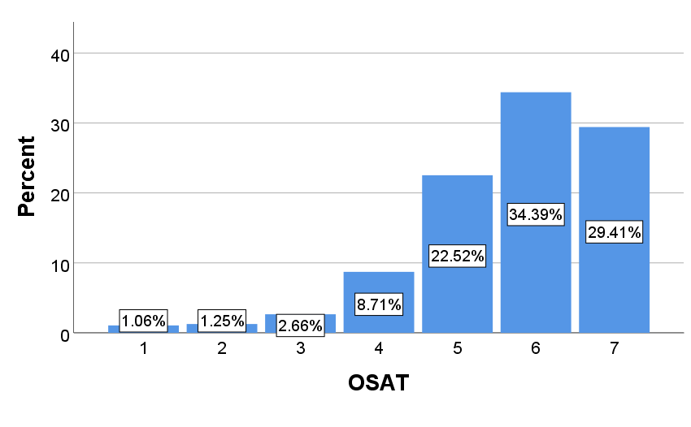
Skewness - Overall Satisfaction
Mean = 5.71, Variance = 1.49, Skewness = -1.19

Slide 10
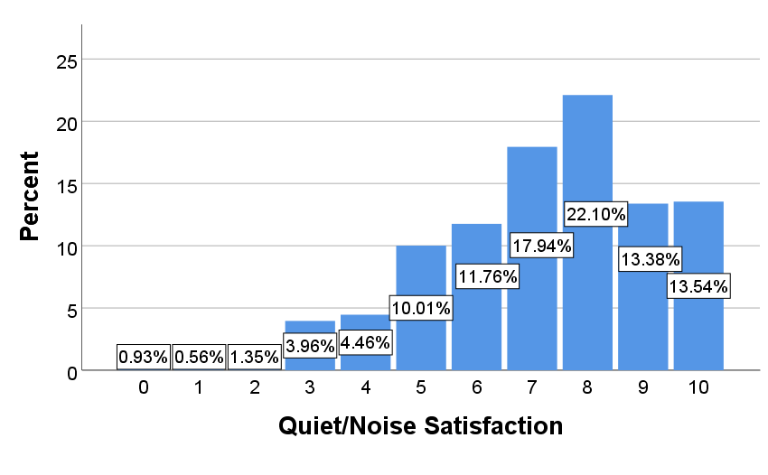
Noise and Price Exceptions
VALUE
OSAT
PRICE

Slide 11
Theil’s Attribute Importance based on Correlation Matrix (no imputation)
Attributes | Full Mods | Pair Mods | Tri Mods | Mixed Mods | ALL OBS
Food Quality | 25.5 | 25.7 | 26.3 | 25.0 | 26.3
Food Taste | 20.4 | 19.2 | 24.7 | 19.3 | 21.6
Service | 16.5 | 19.8 | 12.4 | 19.9 | 15.5
Menu Select | 12.3 | 13.4 | 12.6 | 9.3 | 13.0
Rest. Appear. | 6.4 | 6.3 | 7.7 | 9.7 | 7.1
Clean | 6.1 | 6.0 | 5.3 | 7.4 | 5.8
Drink Select | 5.9 | 4.7 | 5.4 | 3.8 | 5.2
Time Seat | 3.9 | 2.9 | 2.8 | 3.3 | 2.9
Noise | 3.0 | 2.1 | 2.8 | 2.2 | 2.5
TOTAL SURVEYS | 626 | 1,200 | 1,200 | 800-1200 | 3025-4625
Little's MCAR Pair, Sig. = 0.16, Tri, Sig. = 0.99 Mixed, Sig=0.99 All obs, Sig.=0.03 All Mobile, Sig.=0.00 All PC, Sig.=0.24 All Tablet, Sig.=0.43 (SPSS V25)

Slide 12
Standard Error for Theil’s?
Top 3 attributes as noted by importance largely the same expect menu select for Tri-Mod; order within Top 3 has some variations
Treat Full Mods Data Bootstrapped as truth
  Reason
    Analytical formula for standard error not available
    Bootstrapping can be done but is expensive for one model and very expensive for multiple models

Slide 13
Importance Bootstrap Distributions

Slide 14
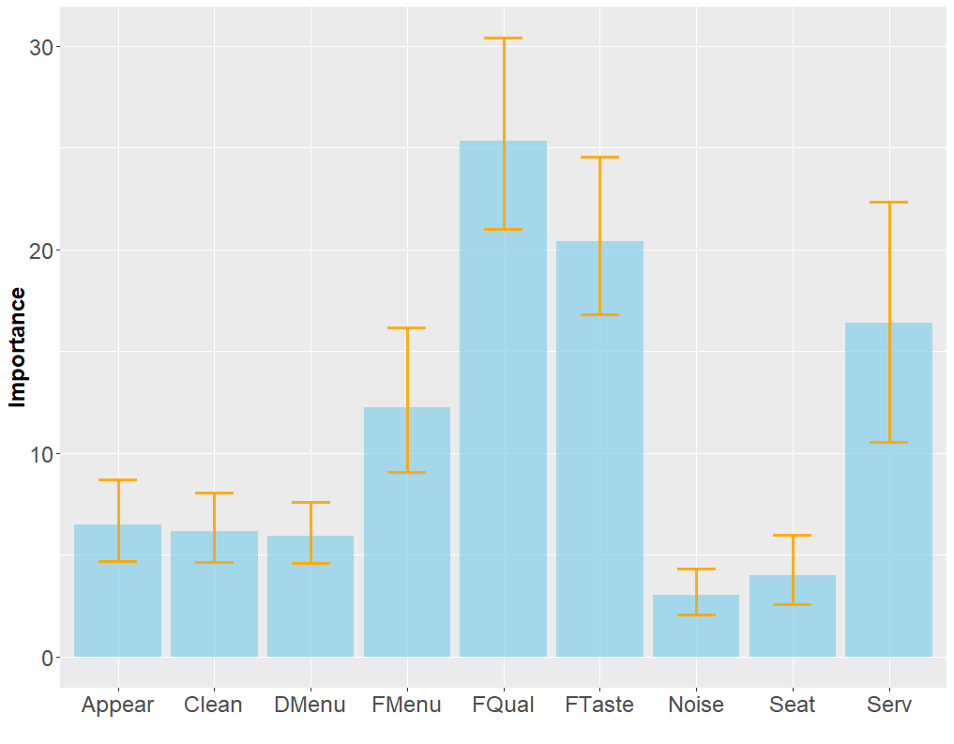
Attribute Importance Intervals
Lower & Upper Bounds
L_{0.025}
U_{0.975}
_{Boot n = 1000}
_{OSAT = Dependent Variable}

Slide 15
Differences in Importances based on Correlation Matrix
Attributes | Boot Ave | Pair Mod | Tri Mod | Mixed Mod | All Obs
Food Quality | 25.35 | 0.32 | 1.00 | -0.34 | 1.00
Food Taste | 20.39 | -1.16 | 4.31 | -1.12 | 1.23
Service | 16.40 | 3.37 | -4.05 | 3.47 | -0.93
Menu Select | 12.24 | 1.16 | 0.31 | -2.91 | 0.79
Rest. Appear. | 6.48 | -0.20 | 1.18 | 3.26 | 0.61
Clean | 6.17 | -0.21 | -0.87 | 1.23 | -0.35
Drink Select | 5.94 | -1.22 | -0.53 | -2.10 | -0.76
Time Seat | 4.00 | -1.15 | -1.16 | -0.71 | -1.08
Noise | 3.03 | -0.92 | -0.19 | -0.79 | -0.51
TOTAL | 100
Green within 95 Percentile Interval (PI), Red outside PI

Slide 16
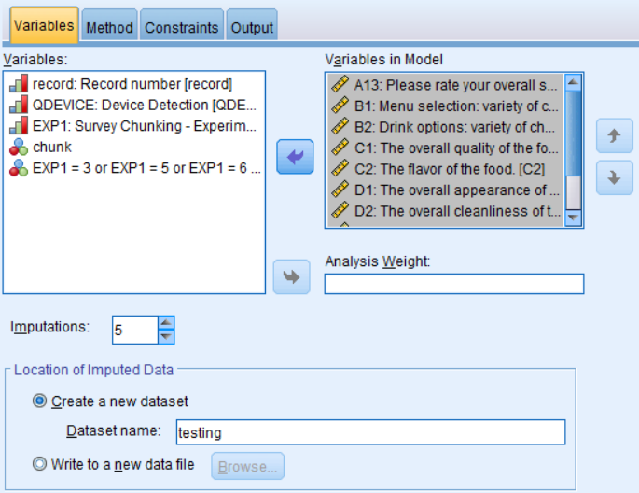
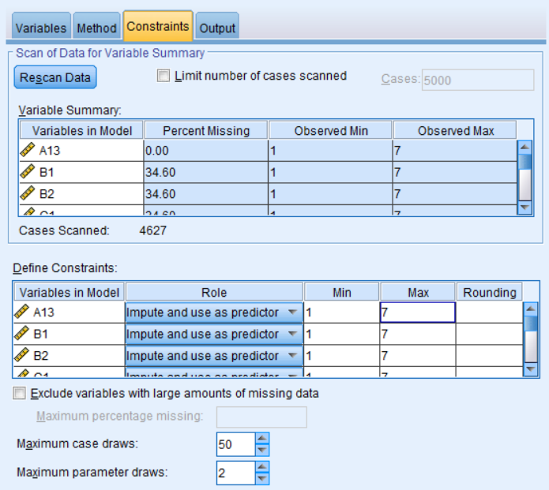
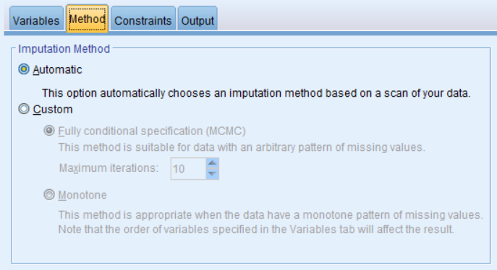
Multiple Imputation - SPSS

Slide 17
Multiple Imputation - Pairwise
Red indicates pooled correlation is lower; green indicates larger
  Average decrease -0.0212 (off diagonal)
OSAT had no missing
Used MI in SPSS as the package is common in market research
  M=5

Slide 18
Differences in MI Importances
Attributes | Boot Ave | Pair Mod | Tri Mod | Mixed Mod | All Obs
Food Quality | 25.35 | 0.18 | 1.65 | -1.77 | 1.42
Food Taste | 20.39 | -1.89 | 4.34 | -1.91 | 1.29
Service | 16.40 | 2.76 | -4.08 | 5.94 | -1.50
Menu Select | 12.24 | 1.35 | 0.68 | -3.02 | 0.73
Rest. Appear. | 6.48 | 0.27 | 0.93 | 3.86 | 0.61
Clean | 6.17 | 0.24 | -1.16 | 0.69 | -0.13
Drink Select | 5.94 | -1.02 | -0.25 | -2.06 | -0.61
Time Seat | 4.00 | -1.13 | -1.64 | -0.93 | -1.33
Noise | 3.03 | -0.74 | -0.48 | -0.80 | -0.47
TOTAL | 100
Green within 95 Percentile Interval (PI), Red outside PI

Slide 19
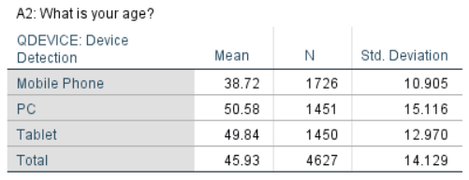
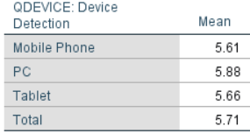
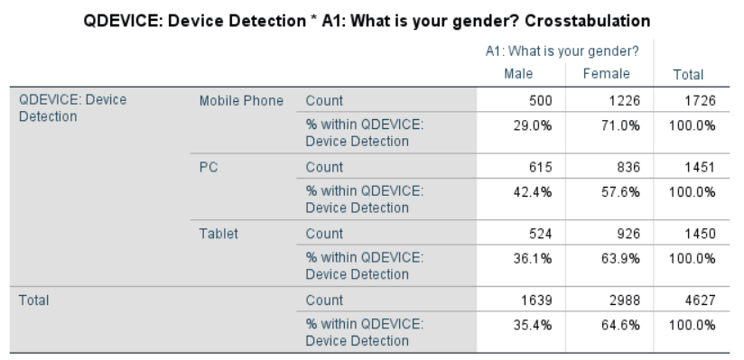
Differences in Devices/Demos
OSAT

Slide 20
Differences in Weighted Importances
Attributes | Boot Ave | Pair Mod | Tri Mod | Mixed Mod | All Obs
Food Quality | 24.68 | 1.39 | 1.95 | 0.72 | 1.84
Food Taste | 20.15 | -0.66 | 4.56 | -0.06 | 1.58
Service | 16.64 | 2.42 | -4.36 | 2.67 | -1.26
Menu Select | 12.62 | 0.81 | -0.34 | -3.49 | 0.37
Rest. Appear. | 6.35 | -0.36 | 1.13 | 2.86 | 0.47
Clean | 5.91 | 0.20 | -0.47 | 1.72 | -0.08
Drink Select | 6.20 | -1.36 | -0.78 | -2.36 | -0.97
Time Seat | 4.31 | -1.45 | -1.33 | -1.04 | -1.35
Noise | 3.14 | -0.98 | -0.35 | -1.02 | -0.60
TOTAL | 100
Green within 95 Percentile Interval (PI), Red outside PI
Cell Weighting to adjust for age, gender and device

Slide 21
Survey Experience
Slightly lower scores by length (significant)
1=Completely Disagree 5 = Completely Agree

Slide 22
Survey Experience
time (fun not significant)

Slide 23
Conclusions
Relatively, few changes in attribute importances, especially for rank
  Large percentile intervals for importance
  Differences more likely on three-way and mixed module
  Cell weights didn’t eliminate all differences in attribute importances
    Additional MAR tests needed
  Adjust for overall alpha
More investigation needed on mobile phones and potential lurking variables

Slide 24
Multivariate Cell Weighting
Device by Gender by Age Categories
Weighted each cell to the average across cells
 |  |  | ABCF | ABDF | ABEF | ACDF | ACEF | ADEF | ABCDF | ABCEF | ABDEF | ACDEF | ABCDEF | Average across Modules
Device | Gender | Age
Mobile | Male | 18-34 | 2.5% | 2.8% | 2.8% | 2.8% | 2.5% | 4.7% | 2.8% | 3.0% | 2.5% | 3.8% | 3.2% | 3.0%
Mobile | Male | 35-44 | 3.0% | 4.5% | 5.3% | 3.8% | 2.0% | 4.7% | 3.0% | 3.8% | 3.5% | 3.0% | 3.2% | 3.6%
Mobile | Male | 45-55 | 2.5% | 2.3% | 2.5% | 2.8% | 3.5% | 2.0% | 3.5% | 3.3% | 4.0% | 2.8% | 1.1% | 2.7%
Mobile | Male | 55+ | 1.8% | 1.8% | 1.8% | 1.3% | 1.5% | 2.0% | 1.3% | 1.3% | 0.8% | 1.8% | 1.8% | 1.5%
Mobile | Female | 18-34 | 12.8% | 12.5% | 13.5% | 10.5% | 13.0% | 10.7% | 13.0% | 11.0% | 11.0% | 12.0% | 12.3% | 12.0%
Mobile | Female | 35-44 | 9.8% | 6.0% | 7.8% | 10.0% | 9.0% | 6.7% | 9.8% | 8.5% | 9.0% | 8.5% | 7.7% | 8.4%
Mobile | Female | 45-55 | 4.0% | 5.3% | 3.0% | 5.0% | 3.8% | 5.0% | 2.8% | 4.3% | 4.8% | 4.5% | 5.4% | 4.4%
Mobile | Female | 55+ | 1.3% | 2.5% | 1.0% | 1.5% | 2.3% | 1.7% | 1.5% | 2.5% | 2.0% | 1.3% | 1.3% | 1.7%
PC | Male | 18-34 | 1.5% | 1.3% | 1.0% | 1.3% | 1.0% | 0.7% | 1.3% | 0.8% | 0.8% | 0.8% | 1.3% | 1.1%
PC | Male | 35-44 | 1.5% | 1.3% | 1.8% | 1.5% | 2.3% | 1.7% | 2.0% | 1.8% | 0.8% | 3.3% | 1.9% | 1.8%
PC | Male | 45-55 | 3.8% | 2.5% | 1.3% | 3.0% | 3.0% | 2.7% | 1.3% | 2.8% | 2.8% | 3.3% | 2.9% | 2.7%
PC | Male | 55+ | 7.3% | 6.0% | 11.0% | 6.5% | 7.3% | 9.2% | 9.8% | 8.0% | 7.8% | 7.5% | 6.2% | 7.8%
PC | Female | 18-34 | 5.3% | 5.5% | 3.8% | 6.0% | 5.8% | 4.7% | 2.8% | 3.3% | 5.0% | 5.5% | 4.8% | 4.8%
PC | Female | 35-44 | 3.3% | 5.8% | 4.0% | 2.0% | 4.3% | 2.7% | 4.8% | 3.3% | 3.3% | 3.0% | 3.5% | 3.6%
PC | Female | 45-55 | 4.0% | 2.3% | 3.8% | 5.0% | 4.5% | 4.5% | 4.3% | 6.5% | 5.3% | 3.5% | 5.6% | 4.5%
PC | Female | 55+ | 4.8% | 6.8% | 4.8% | 6.0% | 3.3% | 4.7% | 5.3% | 5.0% | 5.8% | 4.5% | 5.9% | 5.2%
Tablet | Male | 18-34 | 0.8% | 1.5% | 0.8% | 0.8% | 1.3% | 0.0% | 0.8% | 2.3% | 1.8% | 1.5% | 1.3% | 1.1%
Tablet | Male | 35-44 | 2.0% | 2.0% | 2.3% | 2.0% | 1.3% | 1.7% | 1.0% | 1.8% | 2.0% | 3.3% | 2.1% | 1.9%
Tablet | Male | 45-55 | 4.0% | 2.0% | 4.0% | 3.5% | 1.8% | 3.7% | 3.8% | 2.3% | 3.3% | 2.3% | 3.7% | 3.1%
Tablet | Male | 55+ | 5.0% | 5.3% | 3.0% | 4.5% | 6.3% | 5.7% | 4.5% | 6.0% | 5.8% | 5.8% | 4.6% | 5.1%
Tablet | Female | 18-34 | 2.5% | 3.8% | 4.5% | 3.0% | 3.0% | 4.2% | 3.0% | 2.8% | 3.5% | 3.5% | 3.0% | 3.3%
Tablet | Female | 35-44 | 3.5% | 4.3% | 4.5% | 4.5% | 5.5% | 4.0% | 4.3% | 4.3% | 4.5% | 3.8% | 4.8% | 4.4%
Tablet | Female | 45-55 | 6.8% | 7.0% | 4.5% | 6.3% | 5.3% | 5.5% | 7.8% | 7.3% | 6.0% | 5.5% | 7.2% | 6.3%
Tablet | Female | 55+ | 6.8% | 5.5% | 7.8% | 6.8% | 7.0% | 6.2% | 6.3% | 4.8% | 4.5% | 5.8% | 5.3% | 6.0%
 |  |  | 100.0% | 100.0% | 100.0% | 100.0% | 100.0% | 100.0% | 100.0% | 100.0% | 100.0% | 100.0% | 100.0% | 100.0%
Notes:
Combined Tablet Male 18-34 and 35-44 because of a zero cell percentage.
Weights ranged from .552 to 2.391 which is a ratio of 4.3

Slide 25
References
How Multiple Imputation Makes a Difference
  Ranjit Lall
Applied Missing Data Analysis with SPSS and (R) Studio
  Martin Heymans & Iris Eekhout
  https://bookdown.org/mwheymans/Book_MI
Information-Theoretic Measures of Fit for Univariate and Multivariate Linear Regressions
  Henri Theil and Ching-Fan Chung
Measuring The Information Content Of Regressors In The Linear Model Using Proc Reg and SAS IML
  Joseph Retzer and Kurt Pflughoeft
  https://support.sas.com/resources/papers/proceedings/proceedings/sugi22/STATS/PAPER286.PDF

