Slide 1
Adaptive Survey Design PIAAC Experiment and International Implementation
Tom Krenzke, Leyla Mohadjer, Minsun Riddles (Westat)
Natalie Shlomo (University of Manchester)
The views presented in this paper are those of the author(s) and do not represent
the views of any Government Agency/Department or Westat

Slide 2
Outline
Challenge
Approach
Experiment
Summary
International Implementation

Slide 3
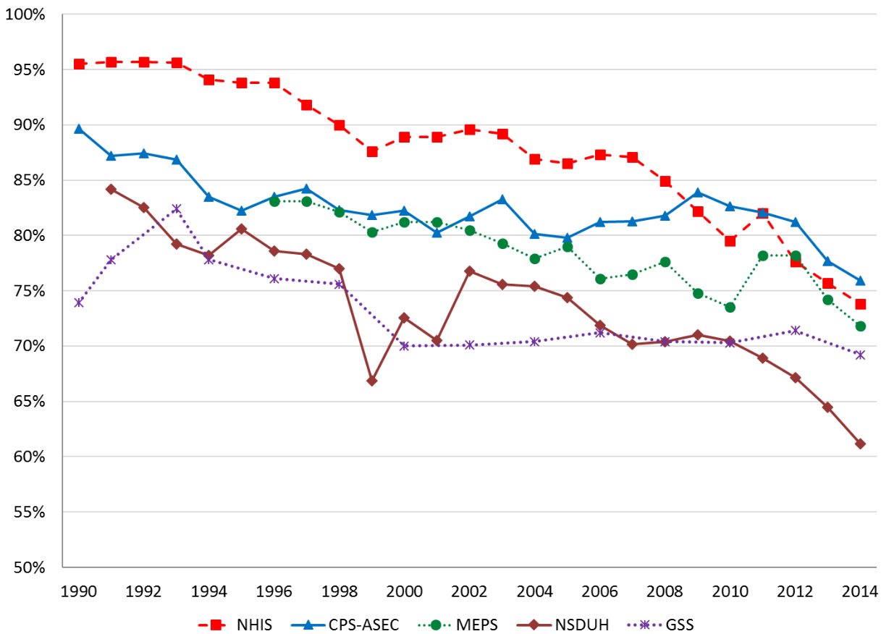
Challenge
Declining response rates
(Williams and Brick, 2018)
Susceptibility to higher potential
for nonresponse bias
Bias is not reduced by continuing
to gain completes from the
easiest cases

Slide 4
PIAAC US 2017 Round 3 sample
International survey with close to 40 countries participating in Cycle 1
US 2017 sample -- sponsored by the National Center for Education Statistics
Non-institutionalized U.S. population of 16 to 74 year olds
Data collection instruments
Screener, Background Questionnaire (BQ), Assessment
Conducted in person within households
Nationally representative four-stage area probability sample
80 Primary Sampling Units, about 700 Secondary Sampling Units
Over 8,500 dwelling units initially selected, which resulted in about 5,000 individuals initially selected using the Screener
Over 3,500 completed cases

Slide 5
Approach
Demand for adaptive survey design (ASD) (Groves and Heeringa, 2006)
PIAAC ASD strategy
Sample yield projections – for timely reaction to potential shortfalls
Sample refreshment – to increase # of completes without introducing bias at fixed cost
Close out very low propensity cases, then release a random group with size that is equal to spending the same expected number of attempts as closed out cases
Subsample of low priority cases – to reduce efforts on such cases without introducing bias
Select 1/3 of low priority cases from among initial released cases
Case prioritization – to minimize bias subject to constraints
Extra postcard to high priority cases

Slide 6
PIAAC Case Prioritization
Ideally, minimize nonresponse bias, subject to
Achieving target sample yield;
Achieving target response rate;
Staying under budget -- Keeping a certain level of contact attempts (CA)
Minimize ${\left(\frac{\sum_{i}{r_{i}w_{i}y_{i}}}{\sum_{i}{r_{i}w_{i}}}−\overline{Y}\right)}^{2}$
s.t. $\sum_{i}{r_{i}}≥SY^{∗}$, $\frac{\sum_{i}{r_{i}w_{i}}}{\sum_{i}{w_{i}}}≥{RR}^{∗}$, and $\sum_{i}{c_{i}}≤C^{∗}$
where
$r$: response indicator, $w$: weight, $y$: outcome, $c$: # CAs
$SY^{∗}$: target sample yield, ${RR}^{∗}$: response rate goal,
$C^{∗}$: maximum number of contact attempts allowed

Slide 7
PIAAC Case Prioritization
In practice
Predict test score for each sampled case, ${\hat{y}}_{i}$
Obtain potential influence of open case $j$on outcome
$$I_{j}={\left(\frac{\sum_{Closed}{r_{i}w_{i}{\hat{y}}_{i}}}{\sum_{Closed}{r_{i}w_{i}}}−\frac{\sum_{i}{w_{i}{\hat{y}}_{i}} }{\sum_{i}{w_{i}}}\right)}^{2}−{\left(\frac{\sum_{Closed}{r_{i}w_{i}{\hat{y}}_{i}}+{\hat{ρ}}_{j}w_{j} {\hat{y}}_{j} }{\sum_{Closed}{r_{i}w_{i}}+{\hat{ρ}}_{j}w_{j}}−\frac{\sum_{i}{w_{i}{\hat{y}}_{i}} }{\sum_{i}{w_{i}}}\right)}^{2}$$
Monotonically increasing w.r.t.
${\hat{ρ}}_{j}w_{j} {(\hat{y}}_{j}−{\overline{\hat{y}}}_{r})({\overline{\hat{y}}}_{s} −{\overline{\hat{y}}}_{r}),$
where ${\hat{ρ}}_{j}$ is response propensity, ${\overline{\hat{y}}}_{r}$=$\sum_{Closed}{r_{i}w_{i}{\hat{y}}_{i}}$/$\sum_{Closed}{r_{i}w_{i}}$ and ${\overline{\hat{y}}}_{s}$=$\sum{w_{i}{\hat{y}}_{i}}/\sum{w_{i}}$
Prioritize by decreasing $I_{j}$

Slide 8
Case Prioritization Simulation
Simulation (Riddles and Krenzke, 2016)
Showed potential reduction in bias and mean square error when prioritization is conducted using the influence measure, when compared to
No prioritization, or
Prioritization based on low response propensity
PIAAC 2017 experiment

Slide 9
PIAAC 2017 Experiment Design
Randomly split selected areas into control and treatment groups, where assignment was based on
SSUs for certainty PSUs
PSUs for noncertainty PSUs
There were about 1800 respondents in each group
Control group – standard contact protocols were used
Treatment group…

Slide 10
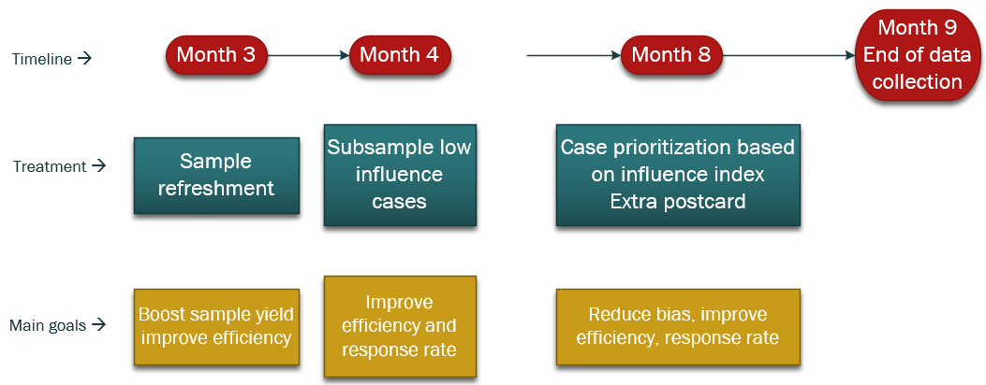
Timeline for Treatments and Their Goals

Slide 11
Indication of Positive Response Status

Slide 12
Indication of Improved Efficiency
Unsuccessful contact attempts by group
It would save about 3,600 attempts in PIAAC (about 1 less unsuccessful attempt per completed interview)

Slide 13
Indication of Potential for Reduced Bias
Interaction of Group and Timing of Response
Literacy (p-value = .08) Numeracy (p-value < 0.05)

Slide 14
Summary
ASD experiment results
Indications of higher response rates due to treatments, likely due to subsampling low influence cases and extra postcard
Indications of being slightly more cost effective due to a combination of treatments
Indications of potential reduction in bias, most likely due to the case prioritizations
Influence measure was derived from optimization framework for case prioritization
Good results in both simulation and experiment

Slide 15
International Implementation
Case prioritization system
Objective: Reduce nonresponse bias
Influenced by experiment; approach was generalized for the system
Provides guidance to the field management staff to help interviewers focus on completing higher priority cases
Two phases
Phase 1: Contact attempt ordering. The first few priority groups are derived from whether or not cases are meeting standard contact attempt protocols
Phase 2: Statistical ordering. For cases meeting the contact protocols, a statistical-based ordering is derived for each case using collected paradata. Option to import the priorities from country.

Slide 16
References
Groves, R. M. and Heeringa, S. G. (2006). Responsive design for household surveys: tools for actively controlling survey errors and costs. Journal of the Royal Statistical Society: Series A (Statistics in Society),169, 439–457.
Riddles, M. and Krenzke, T. (2016). Adapting responsive design strategies in a recurring adult literacy assessment. Presentation at the Joint Statistical Meetings, Chicago, IL.
Williams, D. and Brick, M. (2018). Trends in U.S. Face-To-Face Household Survey Nonresponse and Level of Effort. Journal of Survey Statistics and Methodology. 6, 186-211

Slide 17
Thank You

