Slide 1

Predicting Depression Occurrence Using Classification Algorithm in Data Mining
Abdur Rahman
Department of Statistics
Shahjalal University of Science and Technology
Sylhet, Bangladesh
E-mail: airdipu@gmail.com

Slide 2
Introduction
Universal definition of old age is elusive
Only 6.13 percent is elder (60+) in Bangladesh
Become senile and lose ability in physically and mentally
Aging is one of the embryonic problems in Bangladesh
Self-assessments of health are common components of population-based surveys
Elderly are found to suffer from diseases like depression, sleeping problem, gastric problem, diabetes, mental problem and so on

Slide 3
Methodology
Linear Discriminant Analysis (LDA)
Quadratic Discriminant Analysis (QDA)
Logistic Regression Analysis
K-Nearest Neighbor (KNN)

Slide 4
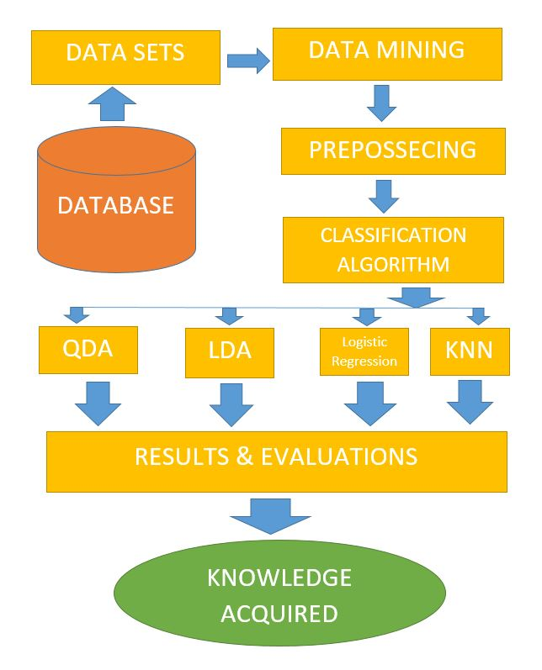
Figure: Architecture of Classification Algorithm

Slide 5
Sampling Method
Cluster sampling
Urban area, rural area, tea garden area and ethnic area
Collected whole population from each cluster

Slide 6
Data
Primary data
Collected during March to September 2015
229 elderly peoples aged ranges from 60 to 60⁺
Face to face personal interviews through questionnaires

Slide 7
Linear Discriminant Analysis
LDA undertakes the same task as Logistic Regression. It classifies data based on categorical variables
  Making profit or not
  Buy a product or not
  Satisfied customer or not
  Political party voting intention

Slide 8
Linear Discriminant Analysis
LDA involves the determination of linear equation (just like linear regression) that will predict which group the case belongs to.
Here
  D: discriminant function
  v: discriminant coefficient or weight for the variable
  X: variable
  a: constant

Slide 9

Quadratic Discriminant Analysis
Quadratic discriminant analysis calculates a Quadratic Score Function
This is a function of population mean vectors and the variance-covariance matrices for the ith group

Slide 10
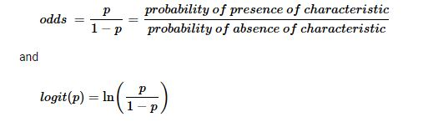
Logistic Regression
In logistic regression, the dependent variable is binary or dichotomous, i.e. it only contains data coded as 1 (TRUE, success, pregnant, etc.) or 0 (FALSE, failure, non-pregnant, etc.)
The logit transformation is defined as the logged odds

Slide 11

KNN
KNN is completely non-parametric: No assumptions are made about the shape of the decision boundary!
We can expect KNN to dominate both LDA and Logistic Regression when the decision boundary is highly non-linear
The most intuitive nearest neighbour type classifier is the one nearest neighbour classifier that assigns a point x to the class of its closest neighbour in the feature space, that is

Slide 12
Figure: Error Rate for Different Value of K

Slide 13
Results & Discussions
If the true decision boundary is
  Linear: LDA and Logistic outperforms
  Moderately Non-linear: QDA outperforms
  More complicated: KNN is superior

Slide 14
Results & Discussions
 | Correctly Classified (%) | Misclassified (%)
QDA | 93.67 | 6.33
LDA | 94.94 | 5.06
Logistic Regression | 94.94 | 5.06
KNN | 98.73 | 1.27

Slide 15
Figure: Graphical Representation of Accuracy

Slide 16
Conclusions
LDA and Logistic regression shows same accuracy
QDA performs lowest accuracy
KNN is better than LDA, QDA and Logistic regression

Slide 17
THANK YOU

