Slide 1
Combining High-Volume Paradata with Survey Data to Understand Respondent, Instrument, and Interviewer Effects on Response Latencies
Patrick Sturgis, University of Southampton
Gabi Durrant, University of Southampton
Olga Maslovskaya, University of Southampton
Ian Brunton-Smith, University of Surrey
Paper presented at the BigSurv18 Conference, Barcelona, October 2018

Slide 2
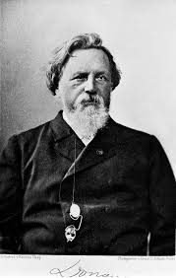
F.C. Donders 1818-1889

Slide 3
Response latency
Indicator of attitude strength
Indicator of respondent effort/measurement error (cf. satisficing)
Interview length -> survey cost
Use in survey practice?

Slide 4
Data Structure
Interviewer data
(survey)
Questionnaire
Demographics
Question types
Response-styles
Paradata
(latencies)
area data
(census)

Slide 5
Survey Data
Wave 3: UK Household Longitudinal Survey (2011-2013), n=30,685
Exclude Scotland and N. Ireland (no MSOA identifiers)
Exclude ethnic minority boost sample + BHPS
Exclude interviewers who did not complete interviewer survey
Analysis sample, n=~13,904 within 288 interviewers
~370 questions with auto-generated CAPI time stamps
= 3,149,871 records

Slide 6
Interviewer characteristics
Survey of NatCen interviewers in 2014
Online and paper self-completion
473 interviewers completed the survey of 823 invited (58%)
Demographic characteristics
Attitudes to fieldwork, data privacy, personality traits

Slide 7
Respondent characteristics
Age
Gender
Education
Satisficing response styles
Don’t knows
Mid-points
Straight-lining/non-differentiation
Extreme responding

Slide 8
Area Characteristics
Middle Super Output Areas (MSOA), size = 4000 households
Linked to Factorial ecology variables from 2011 census counts:
Economic disadvantage
Urbancitiy
Population mobility
Age structure
Housing structure

Slide 9
Question characteristics
Team of 3 coders coded questions according to observable characteristics:
Number of words, interviewer instructions, position in battery, order in questionnaire, response options, show-card, transition statement, definitions, visual emphasis, self/interviewer-administered
Also by question type: demographic, income, behaviour, test, event and whether question addressed potentially sensitive topic

Slide 10
Data Structure
Level 3
Interviewers/areas
I,A₁
I,A₂
…
I,A_{J}
Level 2
Respondents/Questions
R,Q₁
R,Q₃
R,Q₄
R,Q₅
R,Q_{N}
R,Q_{N}
R,Q₂
R,Q_{N}
L₁
L_{P}
L₁
L_{P}
L₂
L_{P}
L_{P}
L_{P}
L_{P}
Level 1
Latencies
L₁
L_{P}
L₁
L₂
L_{1P}
L_{P}
L₂
L_{P}
L_{P}

Slide 11
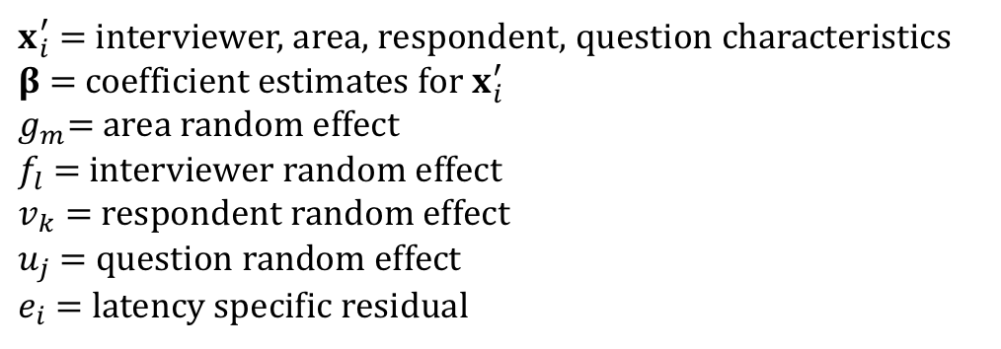
Cross-classified multi-level model
$${log⁡(y}_{i})=x_{i}^{′}β+g_{m}+f_{l}+v_{k}+u_{j}+e_{i},$$
$x_{i}^{′}$ = interviewer, area, respondent, question characteristics
$β$ = coefficient estimates for $x_{i}^{′}$
$g_{m}$= area random effect
$f_{l}$ = interviewer random effect
$v_{k}$ = respondent random effect
$u_{j}$ = question random effect
$e_{i}$ = latency specific residual

Slide 12
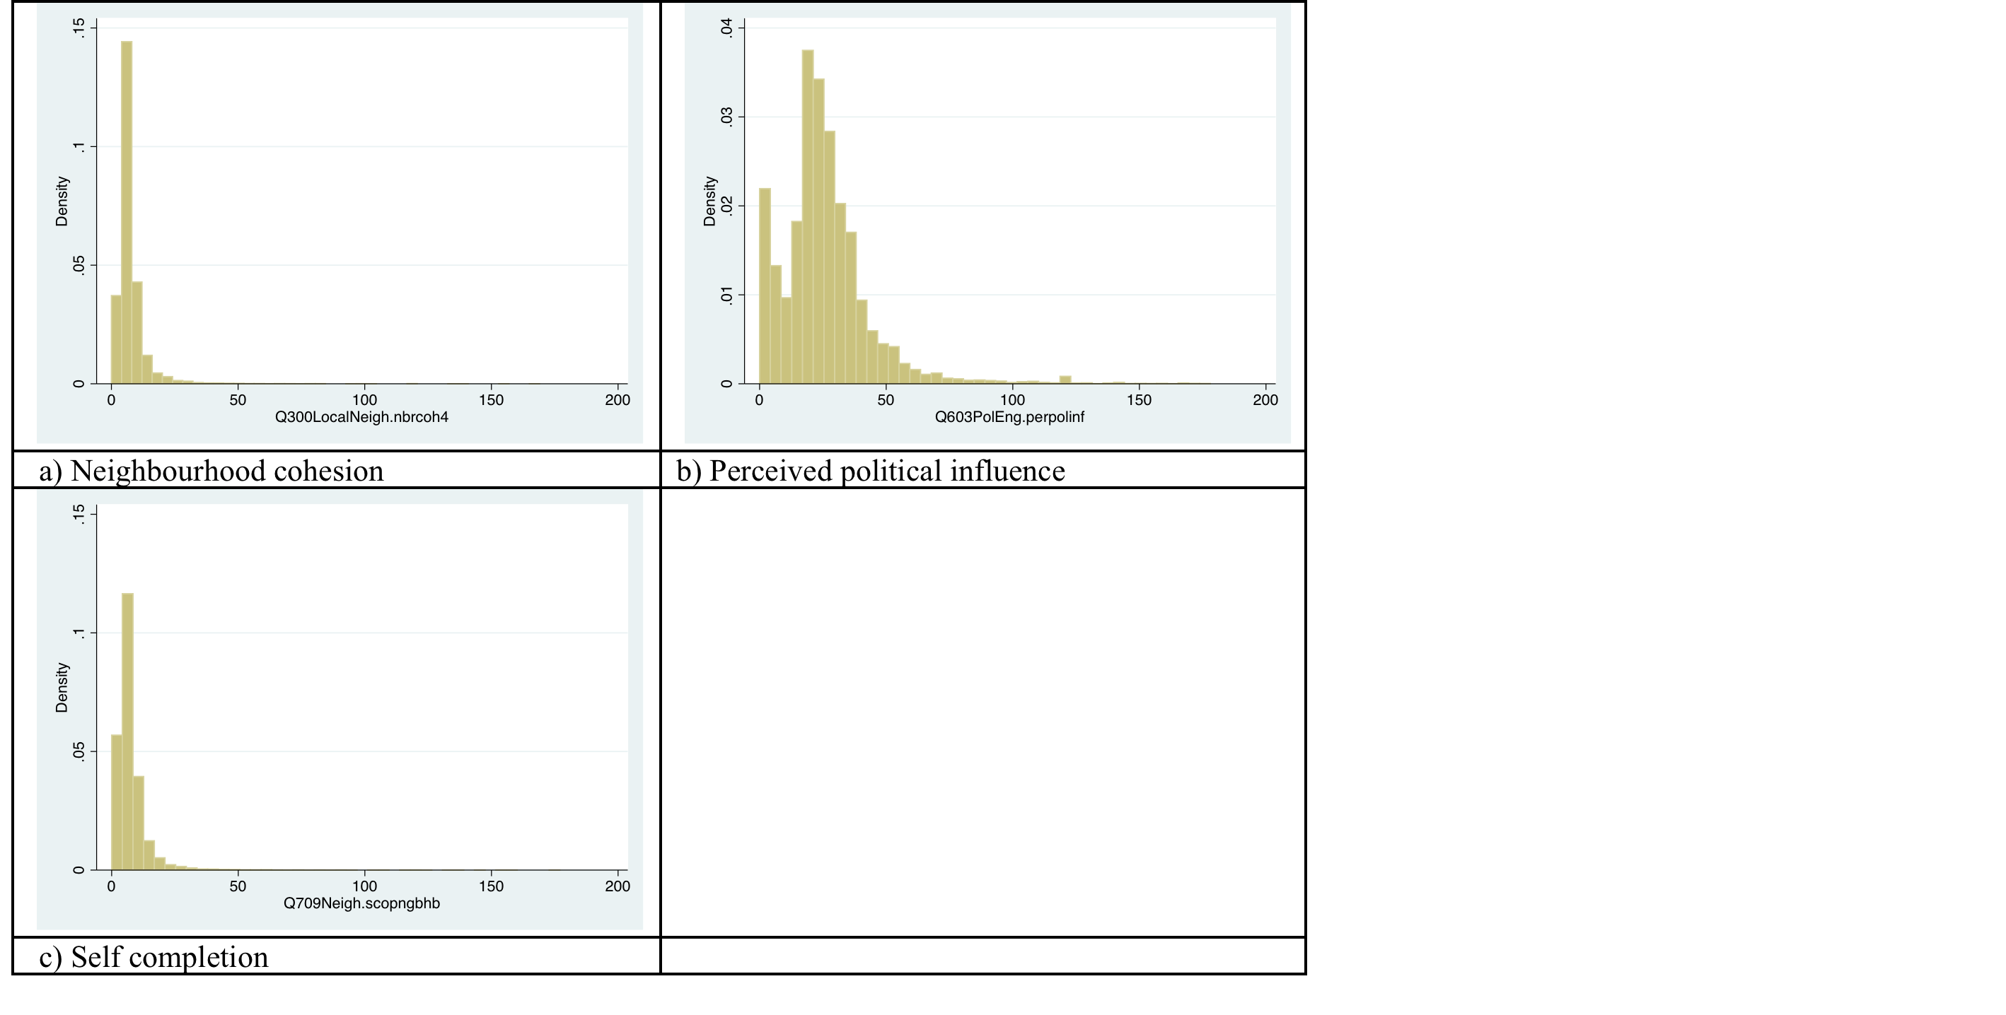
Latency distributions

Slide 13
Latency distribution and outliers
Mean latency = 11 seconds
Median latency = 7 seconds
Range = 0-179 seconds
18% of latencies were <4 seconds
Investigation revealed 0 seconds were due to over-writing
1-3 seconds were due to interviewer behaviour
0 latencies and latencies >100 seconds are excluded

Slide 14
Results

Slide 15
Variance Components

Slide 16
Number of words & use of showcards

Slide 17
Interviewer experience

Slide 18
Respondent education & gender

Slide 19
Interviewer instructions & visual emphasis

Slide 20
Position in battery & help screens

Slide 21
Response options

Slide 22
Respondent & interviewer age

Slide 23
Interviewer attitudes: ‘Wave 1 UKHLS was too long’

Slide 24
No effects for most interviewer characteristics
sex
Personality & trust
Satisfaction with work as interviewer
Attitudes to persuasion
Attitudes to value of surveys
Attitudes to privacy

Slide 25
Response-styles

Slide 26
Interviewer & question specific Intra-class correlations (ICC)

Slide 27
Interviewer ICCs over all questions

Slide 28
Interviewer ICCS for specific questions Q1 Q3

Slide 29
Question specific ICCs

Slide 30
Discussion
Small but significant interviewer component (3.5%)
Similar size to previous studies using quite different designs
Age important for respondents and interviewers
Pattern for questions intuitive, similar to previous studies
Little effect of interviewer attitudes/personality/experience
ICC plots for detecting ‘problem’ interviewers & questions
Does satisficing reduce cognitive costs?

