Slide 1
Moving Social Science into the Fourth Paradigm: Opportunity Abounds
Craig A. Hill, PhD
Senior Vice President: Survey, Computing, and Statistical Sciences

Slide 2
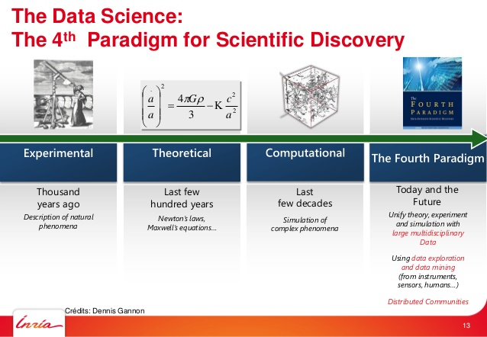
The Fourth Paradigm: Data-intensive (-enabled) scientific discovery
Hey, Tansley, and Tolle (2009)

Slide 3
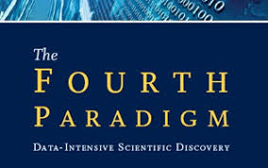

The Four Paradigms
EMPRICAL
Small-scale experiments
THEORETICAL
Theory development
COMPUTATIONAL
Computational chemistry
Observation
TOOLS
Papers/books
Censuses
Counts
Hypothesis-testing
SAS/SPSS
Explanatory/nowcasting
Survey Research (data-rich; case-poor)
Estimates
Inference
Nowcasting
Official statistics
Bioinformatics
High-performance computing
HPC
Hadoop
R
Data Science
Simulation
Synthetic data
Models
d3
PRODUCTS
PRODUCTS
PRODUCTS
TOOLS
TOOLS
(Renaissance/Enlightenment
(1,000 years ago)
19th/20th century
(100 years ago)
Recent past - present
  DATA-ENABLED (eSCIENCE)
  Unification of empirical, theoretical, and computational
  Atheoretical?
  Data mining
  Case-rich;data-poor
  TOOLS
  AI /ML
  Sparq
  Tensor Flow
  NLP
  Neural nets/deep0 learning
  New tools everyday!
  PRODUCTS
  Prediction for decision-making
  CHALLENGES
  Legal
  Ethical
  Error/uncertainty
  Inherent bias

Slide 4
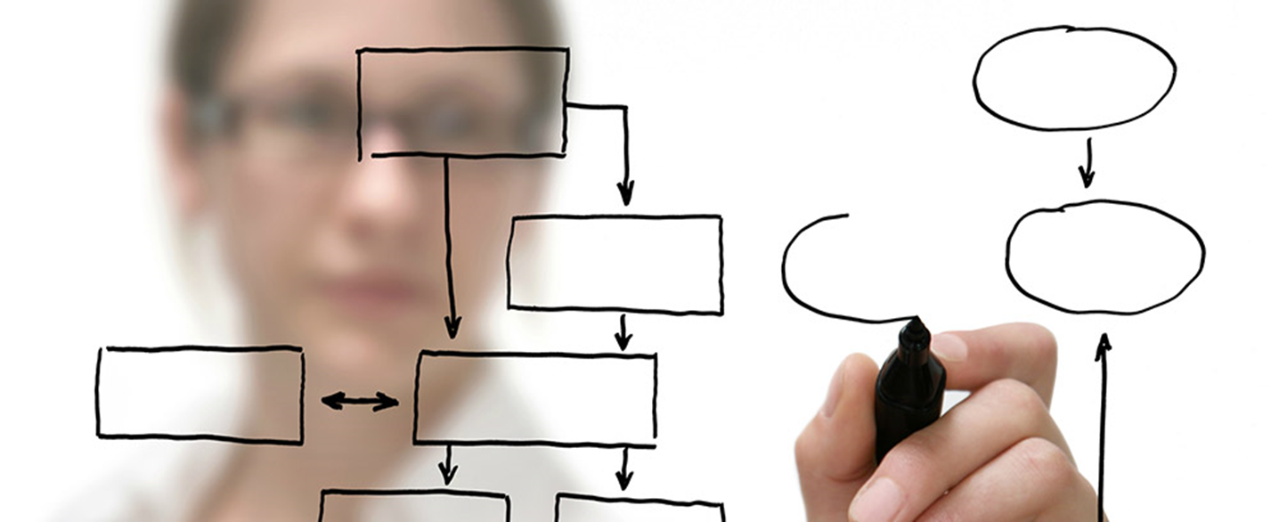
Consequences/Reality: Survey Research being pushed to the margins?
“…a new way of quantifying and visualising populations has emerged that potentially pushes statistics to the margins… Statistics…are giving way to data that accumulates by default, as a consequence of sweeping digitization… Traditionally, statisticians have known which questions they wanted to ask regarding which population, then set out to answer them… As our cities, cars, homes and household objects become digitally connected, the amount of data we leave in our trail will grow even greater. In this new world, data is captured first and research questions come later (emphasis added).”
Davies W. The Guardian. 19 Jan 2017

Slide 5
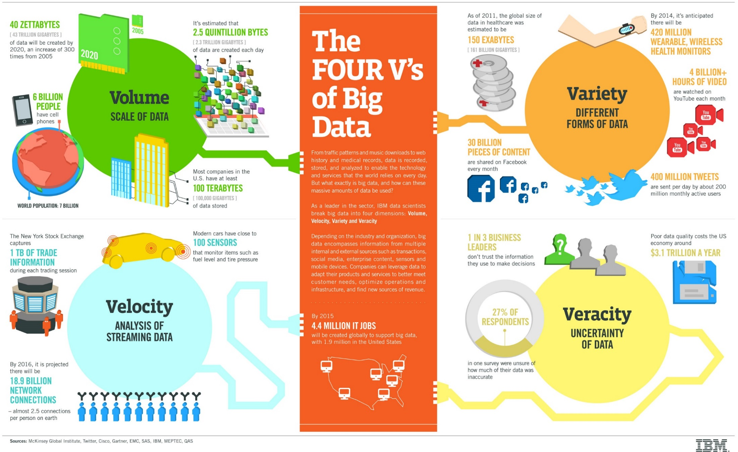
The Four V’s of Big Data

Slide 6
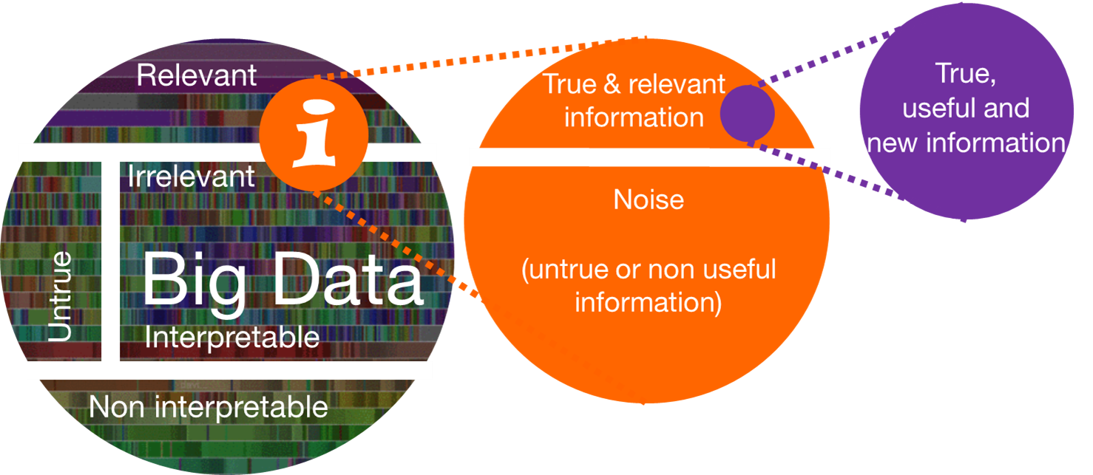
Is Big Data the solution? Uh, it’s really more of a problem so far…

Slide 7
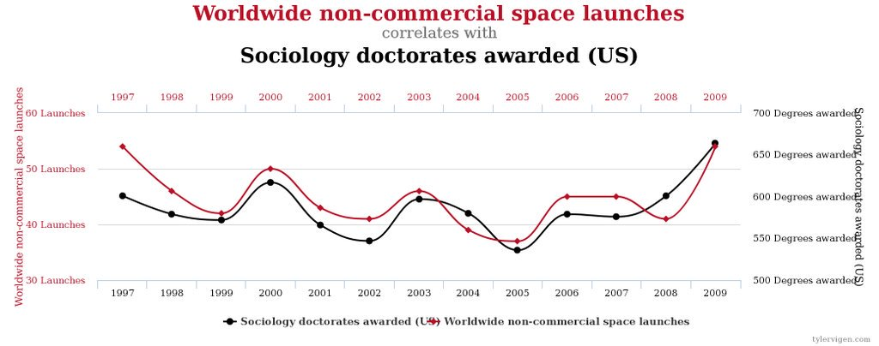
Veracity: The human brain is hard-wired to look for patterns
“People cannot help looking for patterns, even in areas of life where randomness rules.”
Fong WM. Significance, Jun 2017

Slide 8
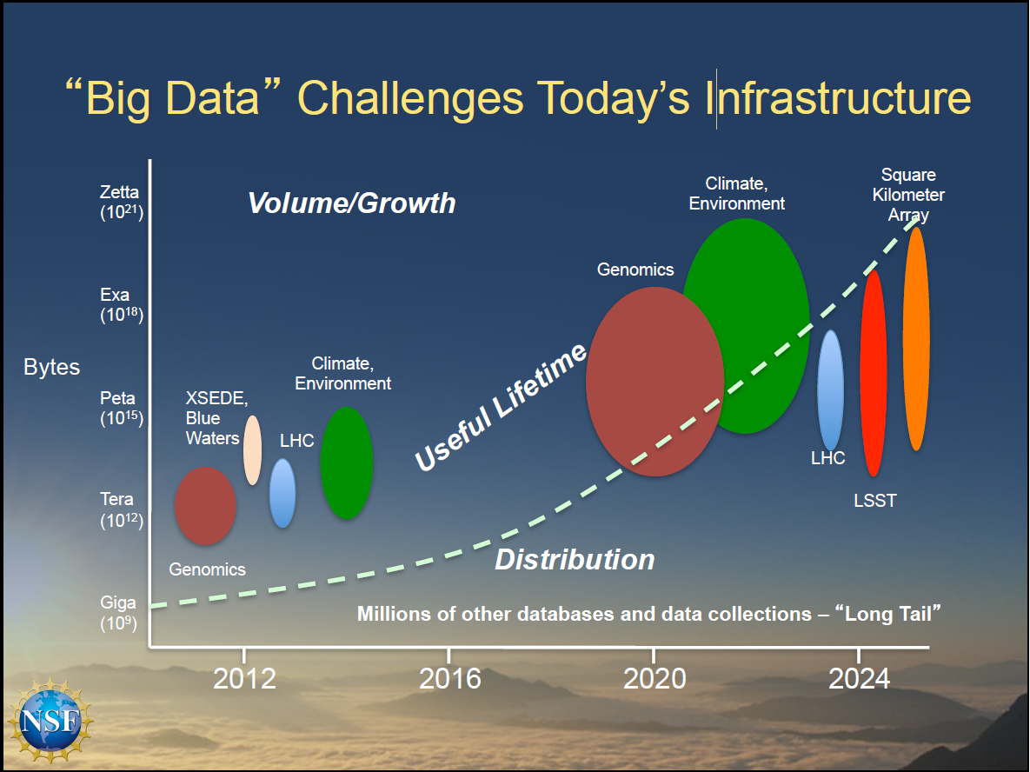

Is Big Data the solution? Uh, it’s really more of a problem so far… (2)

Slide 9
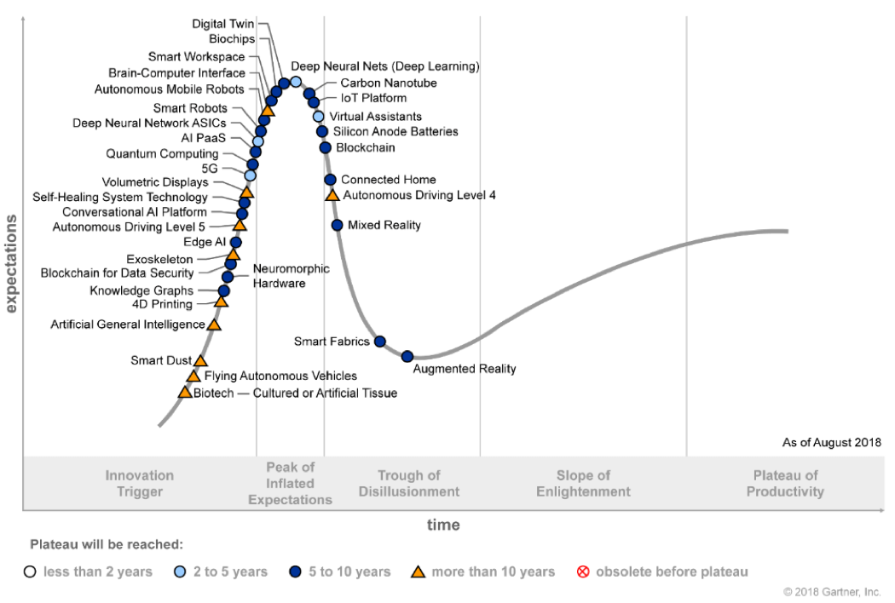
Gartner’s Hype Cycle for Emerging Technologies: 2018

Slide 10
Solution? Fourth Paradigm: Data Life Cycle
Domain Scientists
Computer/Data Scientists
Library Sci/Informatics/Data Engineers
ACQUIRE
(Variety)
Fieldwork
Lab
Survey
IoT
  Sensors
  Smart devices
UAV/drones
MUNGE
Organize
Filter
Clean
Annotate
Label
USE/RE-USE
Analyze
Model
Derive
Visualize
Training set
Algorithmize
  AI/ML
DISSEMINATE
Publish
Patent/IP
Portals
DBs
Repository
Share
  Code
  Workflow
  Data
STEWARD (Volume)
Discoverable
Store
  Subset
  Compress
Index
Curate
Destroy
“The Long Tail”
INTEGRATE: “Data Lake”/Platform (managed, governed set of data/software/tools)
CHALLENGES (or, should I say, “opportunities”)
Bridge the gap between silos
Treat the “data life cycle” as an outcome itself
Privacy/ethics
Uncertainty characterization/quantification (causal inference)
Reproducibility
Algorithm assessment

Slide 11
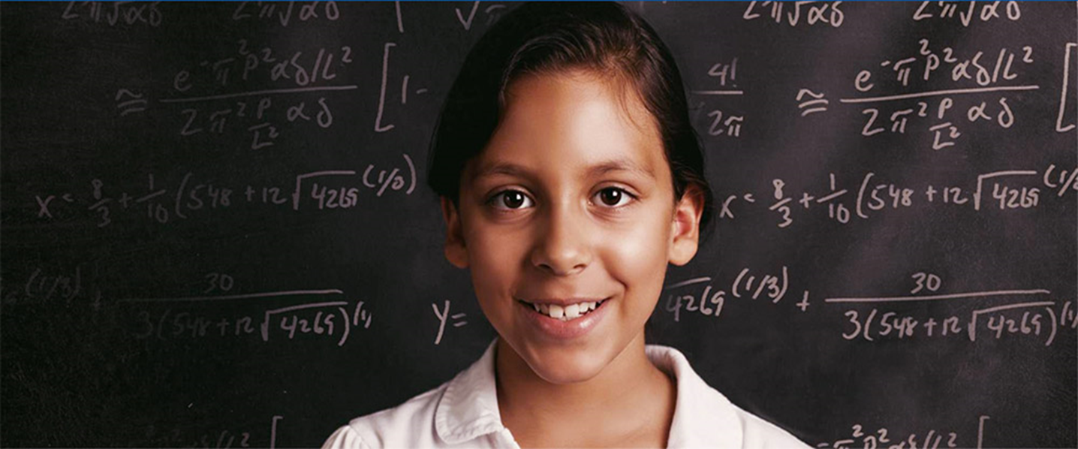
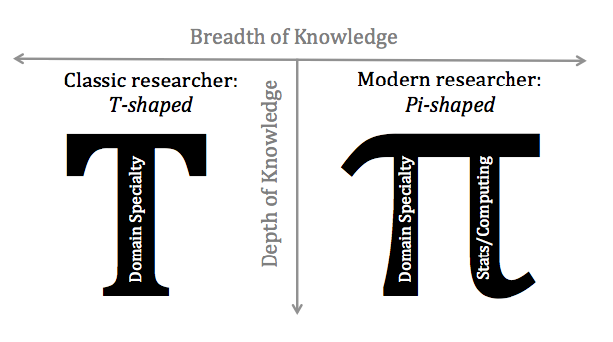
The Future: Data-enabled science

Slide 12
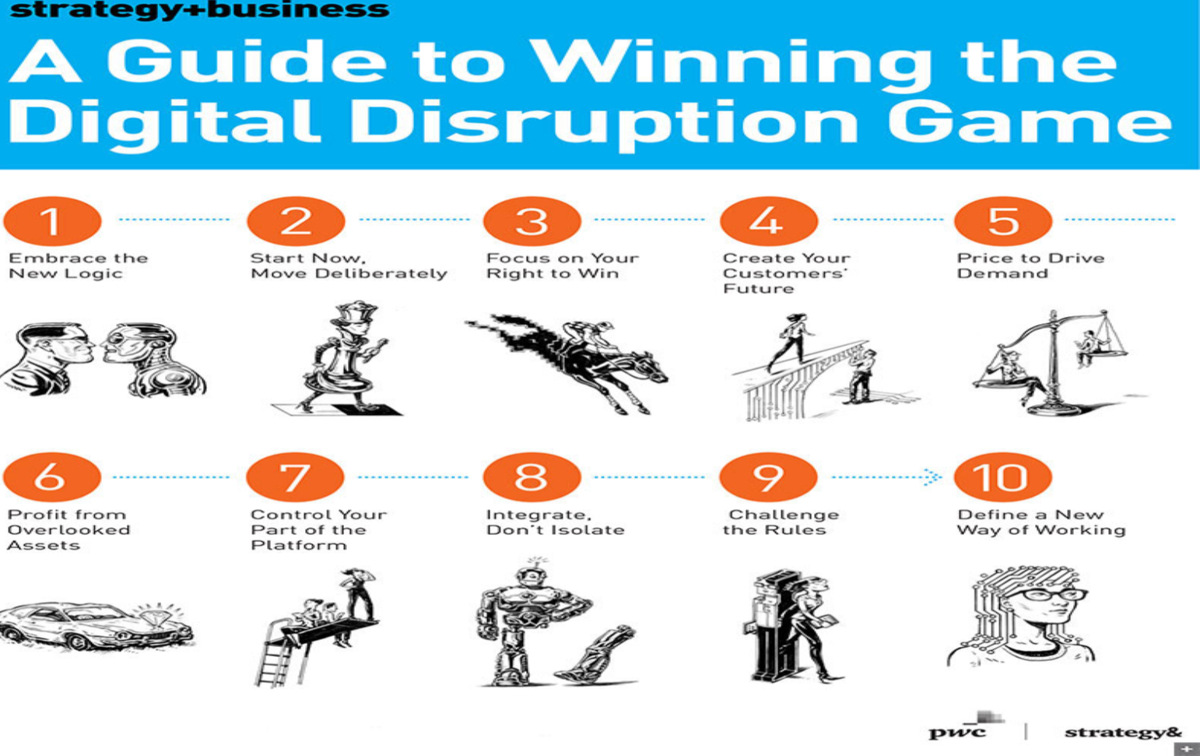
1, 2, 7, 8, 9, 10…

Slide 13


RTI International
Craig A. Hill, PhD
chill@rti.org
@CraigAHill22

