Slide 1
Use of Alternative Data Sources at Statistics Canada: A Case Study With GPS Data
François Brisebois
Statistics Canada
BigSurv 2018 Conference, Barcelona (Spain)
October 25-27, 2018

Slide 2
Outline
Context
Use of alternative data sources (ADS):
  Some examples of sources & their uses
  Feasibility study using GPS data in the trucking statistics program.

Slide 3
Context
Growing demand for statistical information
Traditionally relying on survey taking
Administrative data extensively used
Alternative data sources present opportunities

Slide 4
Context
Statistics Canada has undertaken a
modernization initiative
  More timely and responsive statistics
  Moving beyond a survey-first approach
  New methods and integrating data from a variety of sources
Statistical programs have explored various alternative data sources in order to improve, supplement, or replace survey data

Slide 5
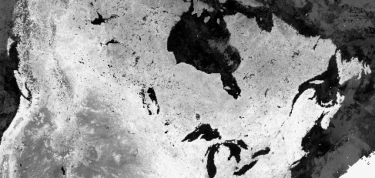
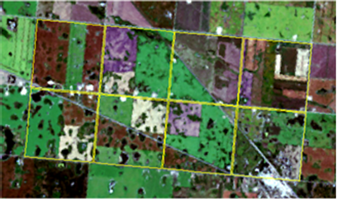
Use of ADS – Some examples
ADS: Satellite imagery
Use: Field crop yield estimation

Slide 6
Use of ADS – Some examples
Question: Can we replace the yield
component of the September field crop
survey with an estimate based on alternative
data sources?
How: Regression model
Results: Similar quality to the September survey
Conclusion: September survey occasion cancelled since 2016

Slide 7
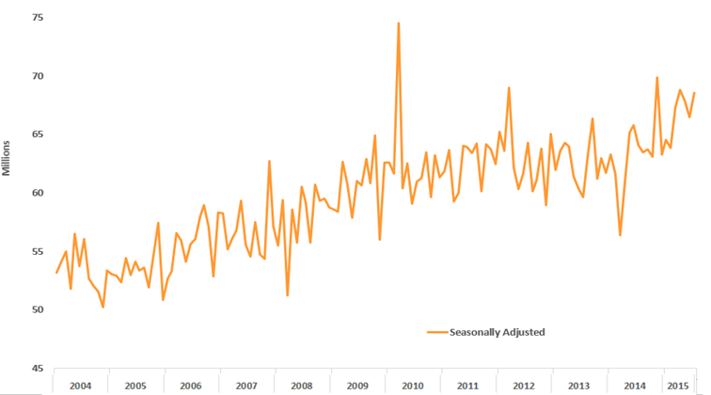
Use of ADS – Some examples
ADS: Daily weather info by climate station
Use: Better explain survey results (time series)
Shoe stores sales in Quebec

Slide 8
Use of ADS – Some examples
Question: Can weather help explain some
of the movements observed in the time series
How: Incorporate as a predictor in the ARIMA model
Results: Validated assumptions made to explain dips and peaks observed
Conclusion: Works – next step is the implementation

Slide 9
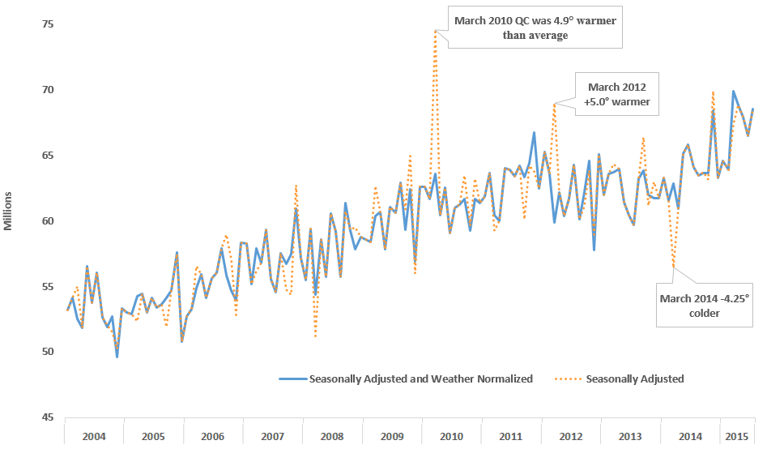
Shoe stores sales in Quebec

Slide 10

Use of ADS – Some examples
ADS: Scanner data from retail stores
Uses:
  Price indexes (item level info)
  Total retail sales (store level info)
  Allocators in household spending

Slide 11
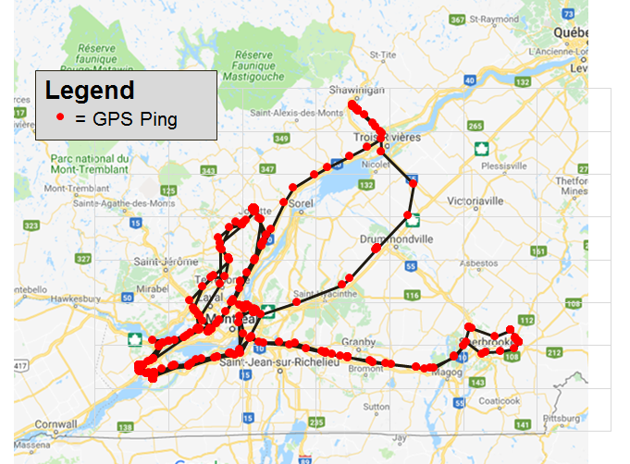

Feasibility study using GPS
ADS: Global Positioning System (GPS)
Use: Freight shipments (trips and commodities)

Slide 12
Feasibility study using GPS
Trucking Commodity Origin and Destination
Objective: Measure the commodity movements
and the activities of the Canadian trucking industry
Carrier | Origin | Destination | Commodity | Shipment Tonnage | Shipment Distance | Shipment Value | Shipment Revenue
C1 | Pt B | Pt D | Widgets | 900 kg | 100 km | 40,000$ | 1,000$
C1 | Pt E | Pt H | Food | 4,000 kg | 125 km | 6,000$ | 700$
… | … | … | … | … | … | … | …
C2 | Pt X | Pt Z | Tires | 1,000 kg | 200 km | 500$ | 250$
C2 | Pt S | Pt Y | Lumber | 9,000 kg | 900 km | 15,000$ | 9,000$
… | … | … | … | … | … | … | …

Slide 13
Feasibility study using GPS
Description of the GPS data
  Generated from GPS tracking devices located
  in each truck
  Sequence of records called pings (high frequency)
    Test file: 6 months, 670 carriers, 40K trucks, 750M pings
Carrier ID | Truck ID | Date-time | Latitude | Longitude
A | A1 | 25/04/2018 8:03:12 | 45.555586 | -125.896732
A | A1 | 25/04/2018 8:04:34 | 45.235238 | -125.714385
A | A1 | 25/04/2018 8:06:21 | 45.265958 | -125.577085
… | … | … | … | …

Slide 14

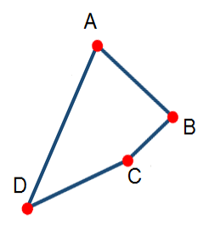
Feasibility study using GPS
Carrier | Origin | Destination | Commodity
C1 | Pt B | Pt D | Widgets
Start from GPS pings
Find trucking stops
Link stops to businesses
  Determine carrier
Model to determine the
O&D and its shipment
C1
…
…
…
…

Slide 15
Feasibility study using GPS
Results:
  Using 6-month test file
  Data comparison for (25) common units
    Most survey’s data shipments linked to observed movements in GPS data
Conclusion:
  Promising, but more work to improve & expand

Slide 16
Conclusion
ADS have shown great potential
  Some applications already in place,
  Some are in development,
  Others are at the feasibility stage
Methods far from the traditional survey methodology
  Explore and innovate

Slide 17



THANK YOU!
For more information,
please visit
www.statcan.gc.ca
#StatCan100

