Slide 1
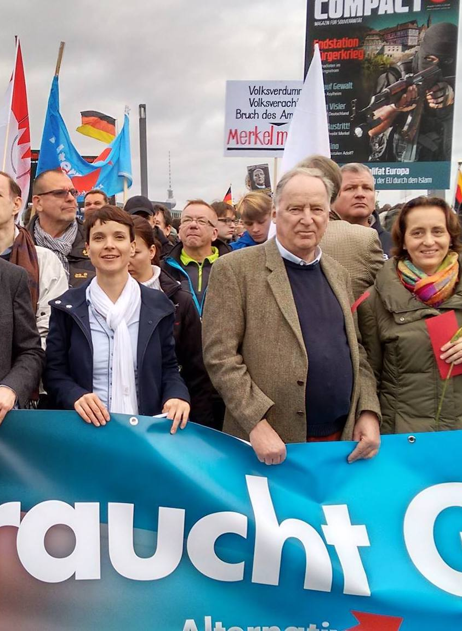
Analyzing Right-Wing Discourse on Twitter:
A Case Study of the 2017 German Federal Election
Aubrey O’Neal
UT Austin, School of Journalism

Slide 2
Outline
Motivation & Goals
Methodologies, particularly curating relevant data given context
Findings on which constituencies are represented and core narratives surrounding the AfD Party.
Limitations

Slide 3
Why Social Media?
Declining response rate
Free form response allows for novelty topics to emerge
Potential for time series/retrospective look
Ease/cost of collection
Potential to overcome the “Spiral of Silence” (Noelle Neumann, 1980)
Notes:
The alternative, election polls, has been shown to be potentially inaccurate.
This is in part due to a non-response bias that leads towards underrepresentation of certain groups and in part due to the social-desirability bias (Pew Research, 2016), where survey respondents give responses that are socially acceptable, similar to concepts found in the Spiral of Silence.
An ideal gauge of public opinion would triangulate between multiple sources such as social media data and poll data.

Slide 4
Why Twitter?
Ethnographic studies on FB communities focus on rally organizers instruction to audiences, rather than the public itself (Puschmann, Ausserhofer, Hametner, & Maan, 2016; Schelter and Kunegis, 2017; Schelter, Biessmann, Zobel, & Teneva, 2016).
Users may self-censor less on Twitter (Marwick and boyd 2010)
The egocentric structure of the Twitter platform encourages users to believe that their tweets are important, correct, and supported by the audience (Twenge & Campbell, 2009; Panek, Nardis, & Konrath, 2013; Marwick and boyd 2010).
4. Ease of data collection and the “Social Media Blitz” by Harris Media
Notes:
Josh Pasek already talked about Twitter as a way of measuring “What audiences are thinking about”

Slide 5
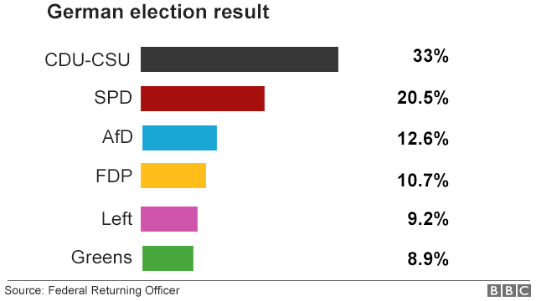
Why the German Elections?
A follow up to America’s elections, where voters felt “under reported” in mainstream media.
AfD’s sharp rise in popularity is surprising
Significant conversation on social media. ~30% of all German election-related Tweets included the hashtag #AfD (Kollanyi & Howard, 2017).

Slide 6
TWO GOALS
Theoretical
Methodological
Can we test if the Spiral of Silence exists online for a German culture around discussion of right-wing ideals?
In essence: Is Twitter a useful monitoring solution?
Can we create a better way of monitoring public opinion using Twitter data through filtering mechanisms that increase relevancy of the data?

Slide 7
TWO GOALS
Testing SoS Online
Measuring Public Opinion
Conceived in Germany in context of strong social and legal stigma against voicing nationalist sympathies.
Strafgesetzbuch § 86
Does the SoS apply online?
Skeptics include:
Jungherr, Jürgens, & Schoen, 2012 O’Connor, 2010
Kollyani & Howard, 2017
Many others

Slide 8
Keywords on general election Sept. 16-30 (n = 1.5 Million )
The Data Part I
General election analysis (n = 980, 84% agreement)
Bag-of-words to narrow topic
to AfD
Notes:
This study was limited to a hand-coded sample of tweets because sentiment analysis tools such as Vader, NLTK, and SentiWS were accurate less than 50% of the time. Given the large corpus of tweets and variety of tweets, this study could benefit from a larger hand-coded sample.

Slide 9
Keywords rather than hashtags
The Data Part II
Bag-of-words to narrow topic
Geolocating to narrow to relevant local
Unique users rather than volume
Hand-coding sentiment and themes

Slide 10
Current Literature
Data Collection
Topic
Relevancy Local
Text Analysis

Slide 11
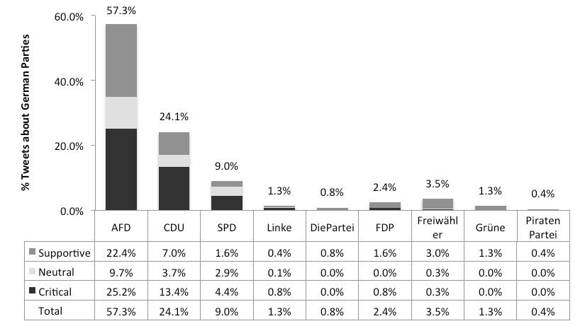
57.3% of tweets about AfD.
31.5% tweets contained #AfD.
39.1% of AfD tweets are supportive.
The Data Part I
Are tweets posted during the federal election interpreted as supportive or critical of AfD?
Sentiment Analysis of Global Tweets. n = 980
Notes:
Negative sentiment overall aligns with findings from Pew Research
In a sample that includes German election tweets from all locations across the globe (n = 980), 57.3% of tweets are specifically on the topic of AfD. Of the global AfD tweets, 39% of these tweets were supportive of the party, while 44% were in fact critical (see Figure 1).
Taken at face value, this finding implies a high level of support for AfD in online discussion.

Slide 12
36.0% of tweets from Germany are about AfD.
14.3% of AfD tweets from unique users from Germany are supportive
(n = 1068).
12.6% of Germans voted for AfD
Let’s narrow the set to AfD tweets within Germany and unique users only.
The Data Part II
Notes:
However, tweets confined to unique users within Germany are far more critical of the AfD party than this global discussion. From the random sample of tweets (n = 1,068) that were geocoded and narrowed down to unique users within Germany, 14.25% of tweets are supportive of AfD (95% confidence, ±2.93%). This more conservative estimate of support for the rightwing party is comparable to the actual election results, in which AfD achieved 12.6% of the vote.

Slide 13
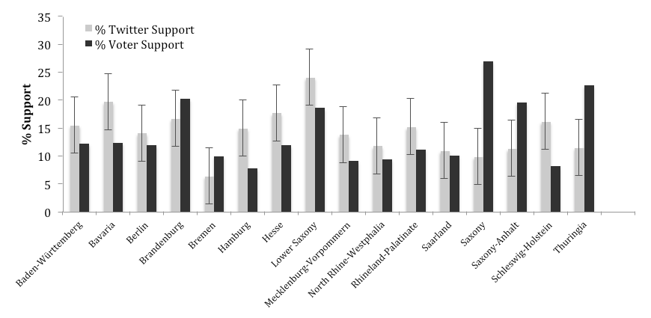
AfD tweeting versus voter support.
The Data Part II
n = 1068. 95% confidence, ±5.7-9.5% MOE, using proportionate stratified random sampling
Notes:
Findings show that Twitter sentiment analysis on a state-by-state level tends to be more supportive of AfD than actual voter results. In half of the states, Twitter sentiment was comparable to voter results, within a margin of error (MOE) of under 10%
In three East German states, the election results far outstripped Twitter sentiment in terms of support for AfD: Saxony, Saxony-Anhalt, and Thuringia. There are many possible explanations for this—these states may have both a significantly different political history and demographic characteristics (education, age, industry, employment, population density) than other German states, which would influence how citizens are represented on Twitter. Further investigation would analyze how such variables correlate with sentiment results. Saxony presents an interesting case, as its capital, Dresden, is home to former AfD party leader and arch chancellor candidate, Frauke Petry.

Slide 14
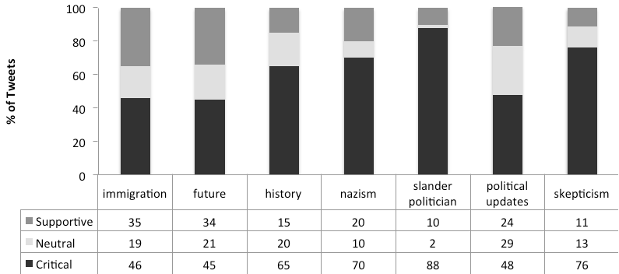
Topic Saliency by Sentiment.
The Data Part II
n = 1,068.
Notes:
While most of these tweets included insults or accusations of AfD supporters, there were also a significant number of tweets that made specific historical references.
These tweets included specific years (1933, 1945), quotes from speeches made by National Socialist party members, and references to party symbols and colors. AfD sympathizers did not avoid this subject altogether, but their tweets tended to use hashtags instead of a complete thought and it is thus hard to understand the user's exact meaning.
Both AfD sympathizers and critics discuss the future, which included predictions of the impending composition of the Bundestag or long-term discussion of what Germany would look like down the road, often in the context of immigration.

Slide 15
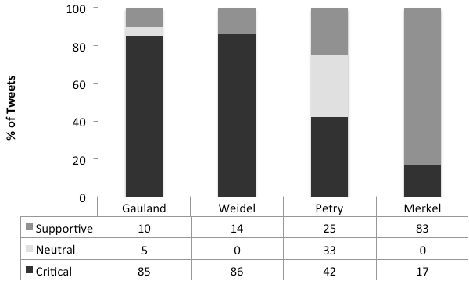
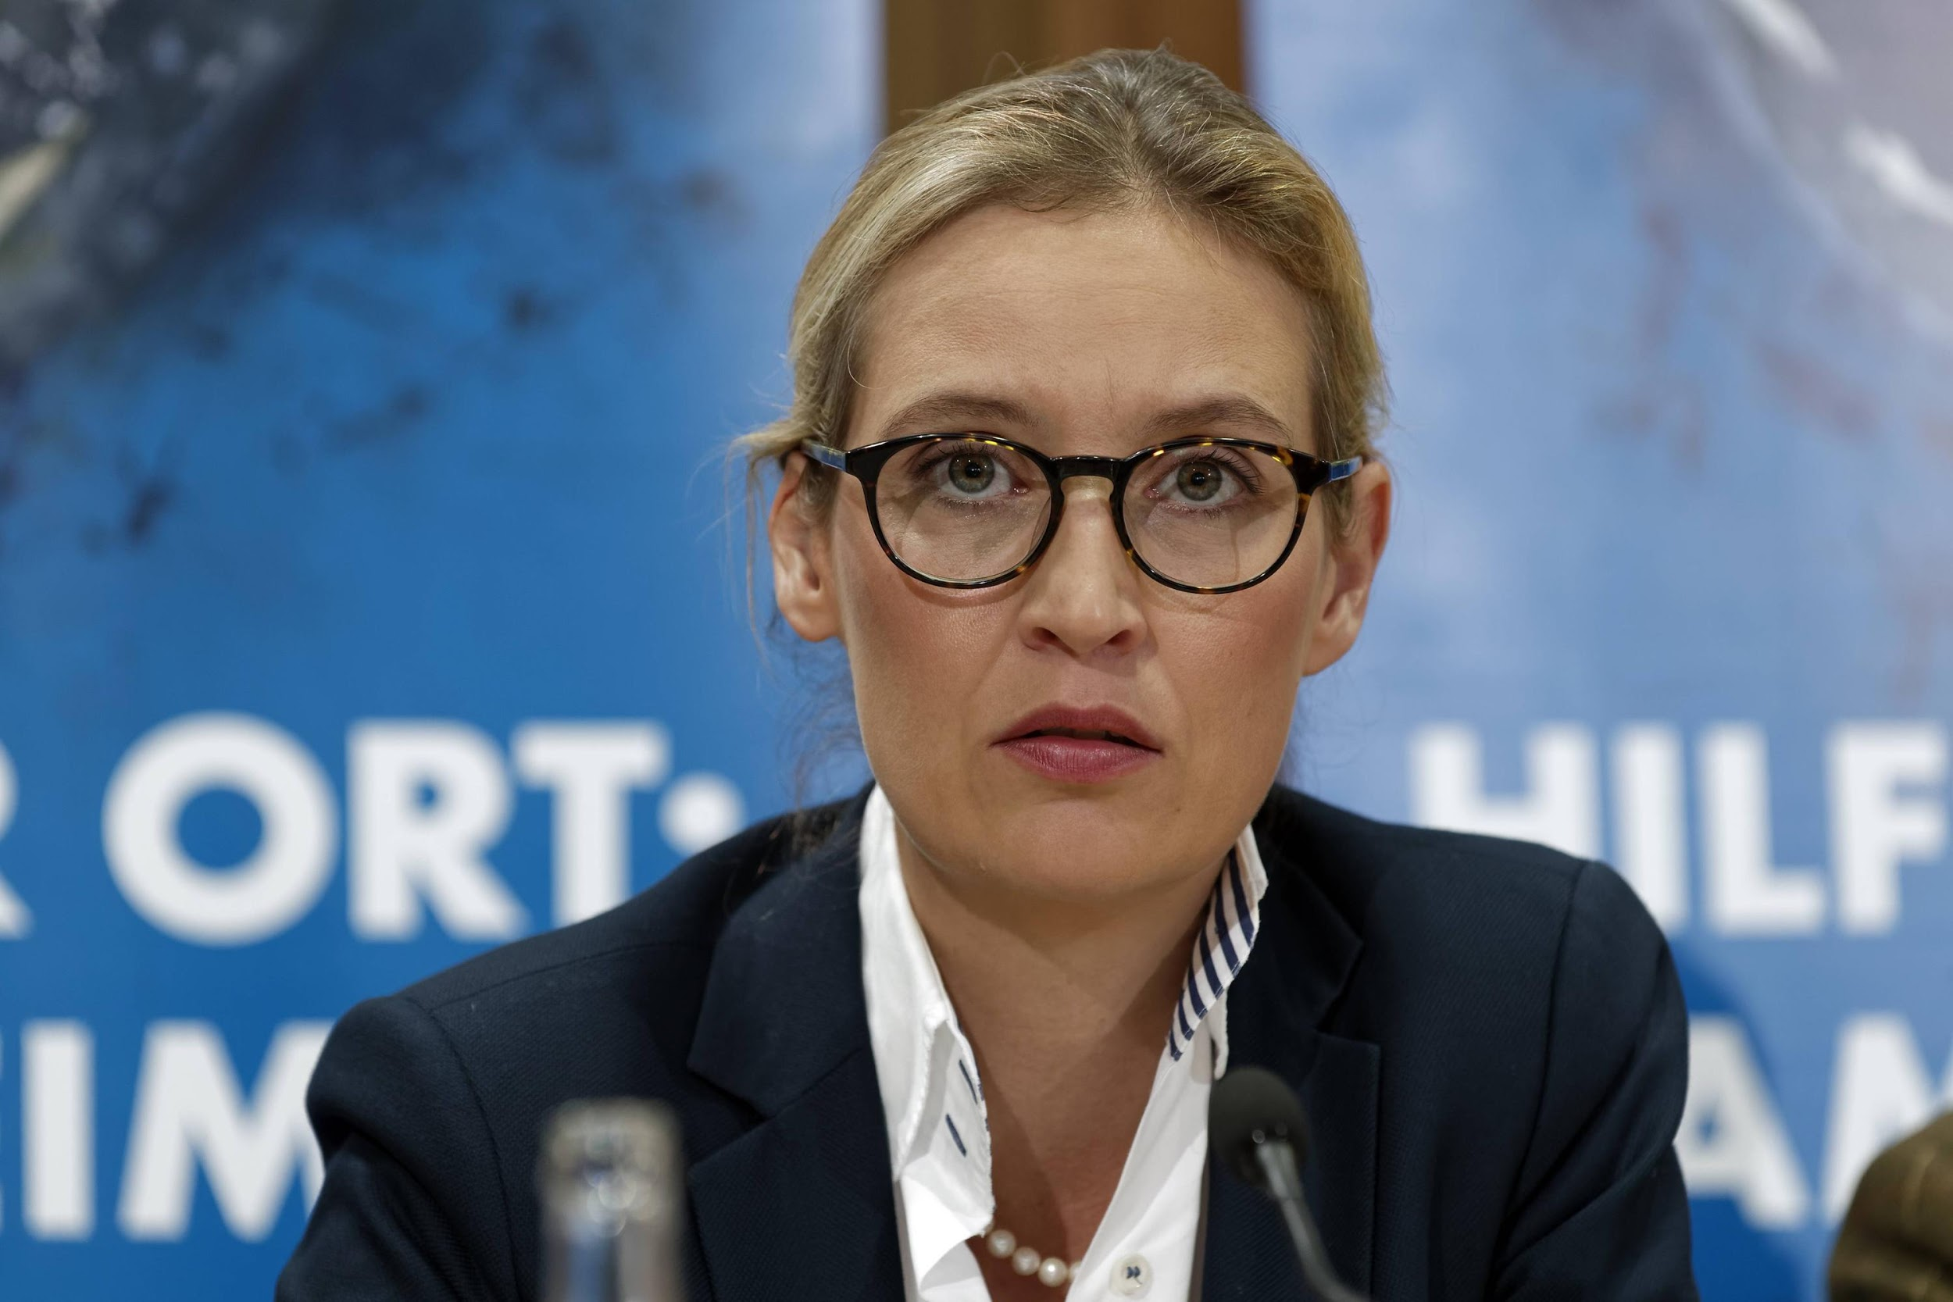
Politician Saliency by Sentiment.
The Data Part II
n = 1,068.
Notes:
This figure reveals heavy discussion of opposition party leaders. AfD supporters, who were often critical of the established party, CDU, commonly tweeted discontent towards Angela Merkel.
Meanwhile, AfD critics discussed Gauland and Weidel equally as often. Petry, who dropped out of the AfD party leading up to the election, was a person of interest for many. Overall, Twitter appeared to support discourse criticizing AfD rather than creating a space where AfD sympathizers voiced strong opinions.

Slide 16
LESSONS LEARNED
While there exists German AfD supports online, it is a smaller, more conservative conversation than initially anticipated.
We have the tools to perform a more nuanced analysis for location-based events on social media, allowing us to monitor public opinion and discourse. Not taking advantage of these methods can lead to misleading results.
Thank you very much for your time
aoneal@utexas.edu @aubrilya
Notes:
Results indicate that Twitter users tend to be more critical than supportive in discussion of all political parties, and that there is less far-right support for AfD than expected. This may indicate that there is still a strong influence of the Spiral of Silence in the context of German culture and in discussion of nationalist sentiments even online. Discourse analysis reveals a split in discussion topics of AfD supporters and critics. The former tended to focus on the future of Germany and immigration, while the latter focused on Germany's history and slandering AfD party candidates. A lack of concrete discussion of National Socialist sentiment by AfD supporters may be due to fear of legal or social ramifications described in the concept of the Spiral of Silence.

