Slide 1

Income Inequality and Health: Expanding our Understanding of State Level Effects by using a Geospatial Big Data Approach
Tim Haithcoat¹, Eileen Avery^{1,2}, Kelly Bowers^{1,3}, Richard D. Hammer^{1,3}, and Chi-Ren Shyu^{1,4}
(¹Informatics Institute; ²Department of Sociology; ³Department of Pathology & Laboratory Medicine; ⁴Department of Electrical Engineering)
This work is supported by the NIH BD2K T32 Training grant (5T32LM012410-02)
The Big Data ecosystem is supported by the NSF CNS-1429294
Prepared for BigSurv18
Barcelona, Spain
October 27, 2018

Slide 2
Motivation
New directions in big data technology allow scholars to answer new or revisit existing research questions in unique ways
Team currently working on a big data tool “Geospatial Health Context Big Table” (GeoHCBT)
Table contains/will contain variables that include decennial census and American Community Survey data, land use/greenspace, pollution/exposures, crime, and so forth
Here it is used to examine the relationship between income inequality and health in a unique way

Slide 3
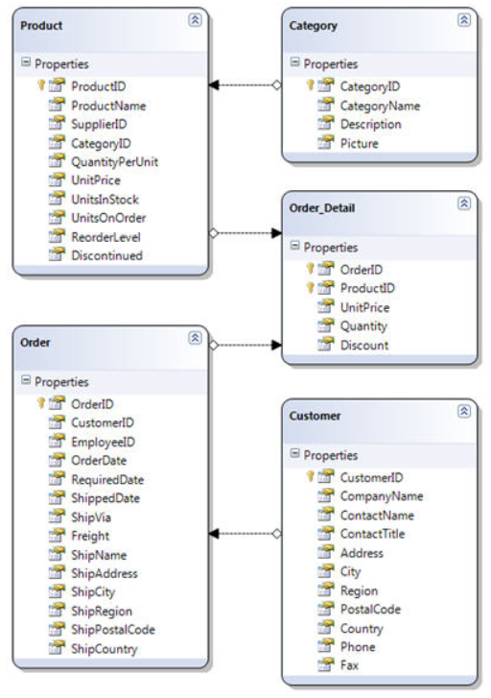
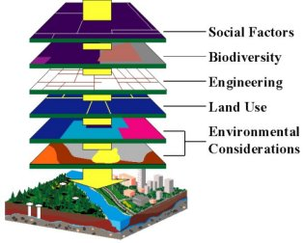
Unique Infrastructure
Using Spark big data ecosystem - Clusters
Defined a point file with 318 million points for contiguous 48 states.
Determined Main Common Keys
Census Geography
Zip Code
Watershed
School District
Etc.
Created point summary counts for all geographies to use for analytics
Typical Geospatial DB
Typical Relational DB

Slide 4
Relevance
The Geospatial Health Context Cube provides:
Health Researchers an integrated big data repository to:
Search - Enable stronger research designs (i.e. develop sampling / surveillance approached).
Explore - Understand spatial interaction models.
Add contextually derived characteristics
Decision Makers with a new tool to evaluate policy implications and focus on areas / populations affected.
Public Health Professionals an ability to identify, mitigate, and potentially prevent health disparities.

Slide 5
Income Inequality and Health
Income inequality hypothesis
Strong and weak versions
Individual level hypotheses (absolute and relative income, deprivation, relative position)
Mechanisms
Issues with geography
Our focus is on ecological income inequality, or the extent of inequality that exists in a given place.

Slide 6
Current Study
In this research, we utilize advances in geospatial big data tools and apply them to traditional survey data in order to examine
the extent to which overall income inequality in states as captured by the Gini coefficient
the overall uniformity of this measure within states across counties
the extent to which this inequality is more uniformly high or low
are associated with health outcomes in the Behavioral Risk Factor Surveillance System (BRFSS).
Results add to a better understanding about the ways that the relationship plays out across space within higher levels of geography such as large political units.

Slide 7
Health Outcomes
Mental Health:
Diagnosed with depression (including depression, major depression, or minor depression).
If yes to: “Because of a physical, mental, or emotional condition, do you have serious difficulty concentrating, remembering, or making decisions?”
Accessibility:
Restriction to care due to cost (care too expensive) if “yes” to: “Was there a time in the past 12 months when you needed to see a doctor but could not because of cost?”
Physical Health:
Obese if the respondent’s body mass index (BMI) is 30 or above
Diagnosis of chronic obstructive pulmonary disease (COPD)
Diagnosis of cardiovascular disease (CVD)
Fair or poor self-rated health (versus excellent, very good, or good).

Slide 8
Gini Coefficient and Uniformity Measures
Gini index is a measure of statistical dispersion intended to represent the income or wealth distribution of a unit’s residents, and is the most commonly used measurement of inequality.
e.g.: United States (41.5 [2016]); Spain (36.2 [2015]); UK (33.2 [2015]); Brazil (51.3 [2015]); South Africa (63 [2014]); China (42.2 [2012]); Ukraine (25.5 [2015]); Sweden (29.2 [2014])
Developed by the Italian statistician and sociologist Corrado Gini and published in his 1912 paper Variability and Mutability
Uniformity level overall
Uniformly high
Uniformly low

Slide 9
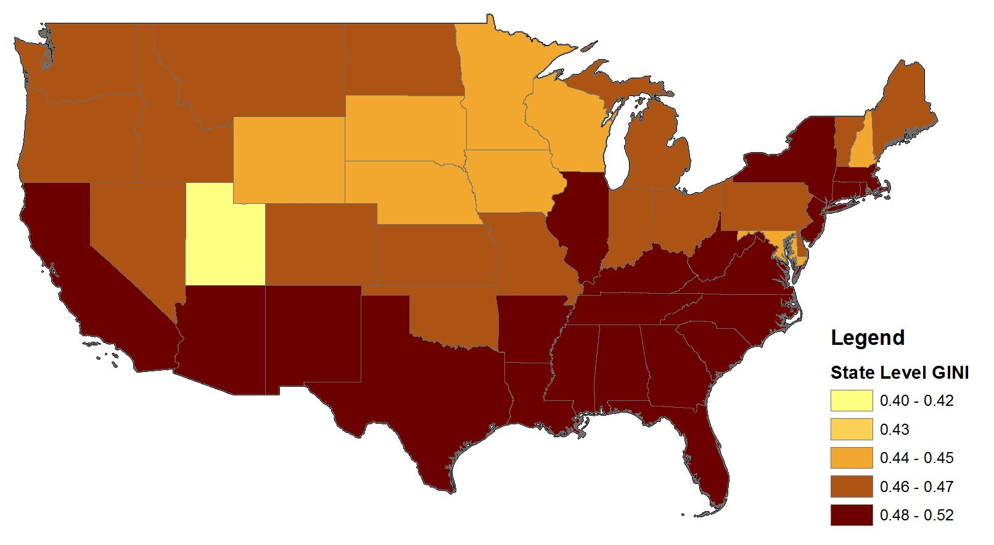
State Level Gini Distribution

Slide 10
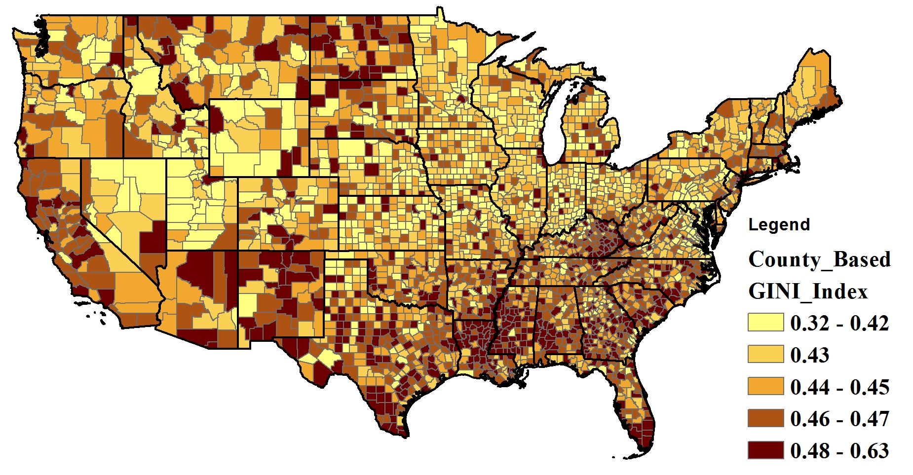
County Level Gini Distribution

Slide 11
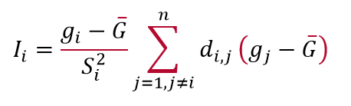
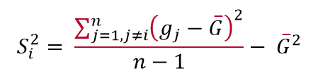
Measure of Spatial Association, Local Moran’s I
Local Moran’s I is given as:
n equals the total number of counties
Positive Value: neighboring county features have either high or low Gini indexes making it a member of a cluster.
Negative Value: neighboring features have dissimilar values, which flags this county feature as an outlier.
where g_{i} is an the Gini index for county i, G is the mean of the Gini index across all counties (n), d_{i,j} is the spatial weight (distance) between county i and county j, and:

Slide 12
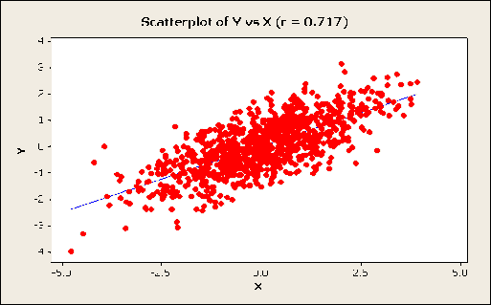
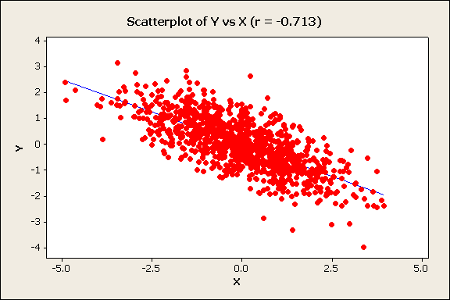
Moran’s I and Correlation Coefficient r Differences and Similarities
r = 0.71
Correlation Coefficient r
Relationship between two variables
Income
Moran’s I
Involves one variable only and is the correlation between variable, X, and the spatial lag of X formed by averaging all the values of X for the neighboring polygons
Education
Grocery Store Density Nearby
r = -0.71
Grocery Store Density

Slide 13
Clustering and Outliers
Cluster is developed by assessing each county’s Gini value through evaluating it against its neighborhood of counties within a specified distance threshold. A statistically significant cluster of Gini values represents regionalized areas where surrounding counties share similar values.
A county with a high Gini index surrounded by other highs, would be labeled HH as a member of a high Gini index cluster, and LL for a county with a low Gini index associating with low Gini index cluster.
An outlier is then defined relative to a cluster as being a county Gini index that falls within the space of an assembled cluster that is significantly dissimilar to that associated cluster.
A county with a high Gini index would be labeled HL as an outlier if its surrounding counties are primarily low values, or LH as an outlier in which a low value is surrounded primarily by high values.
Statistical significance for this assessment was set at 95% confidence level.

Slide 14
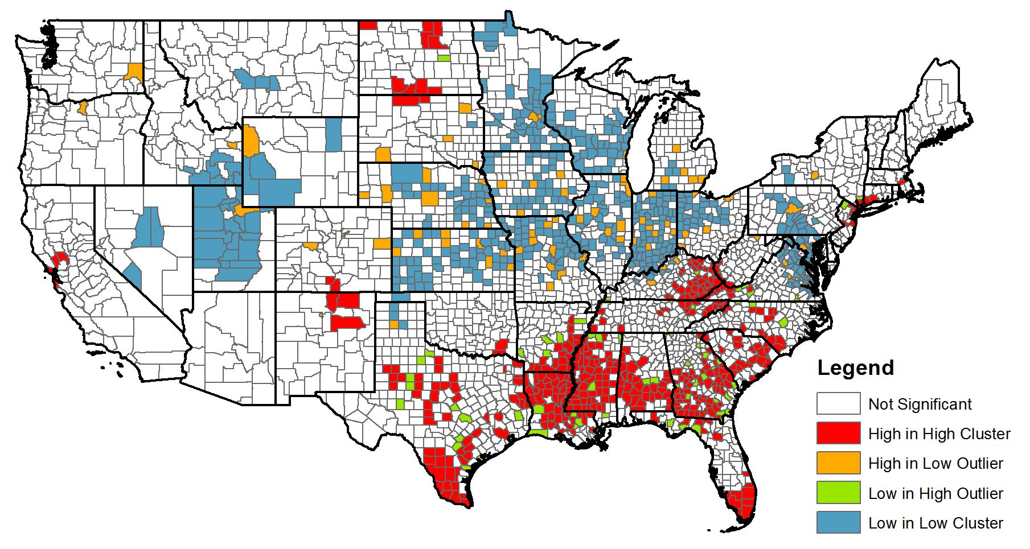
Clustering and Outliers

Slide 15
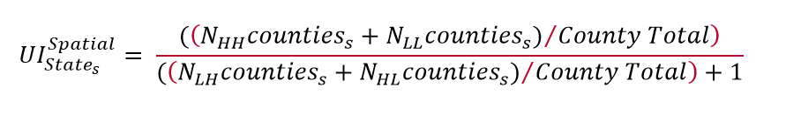
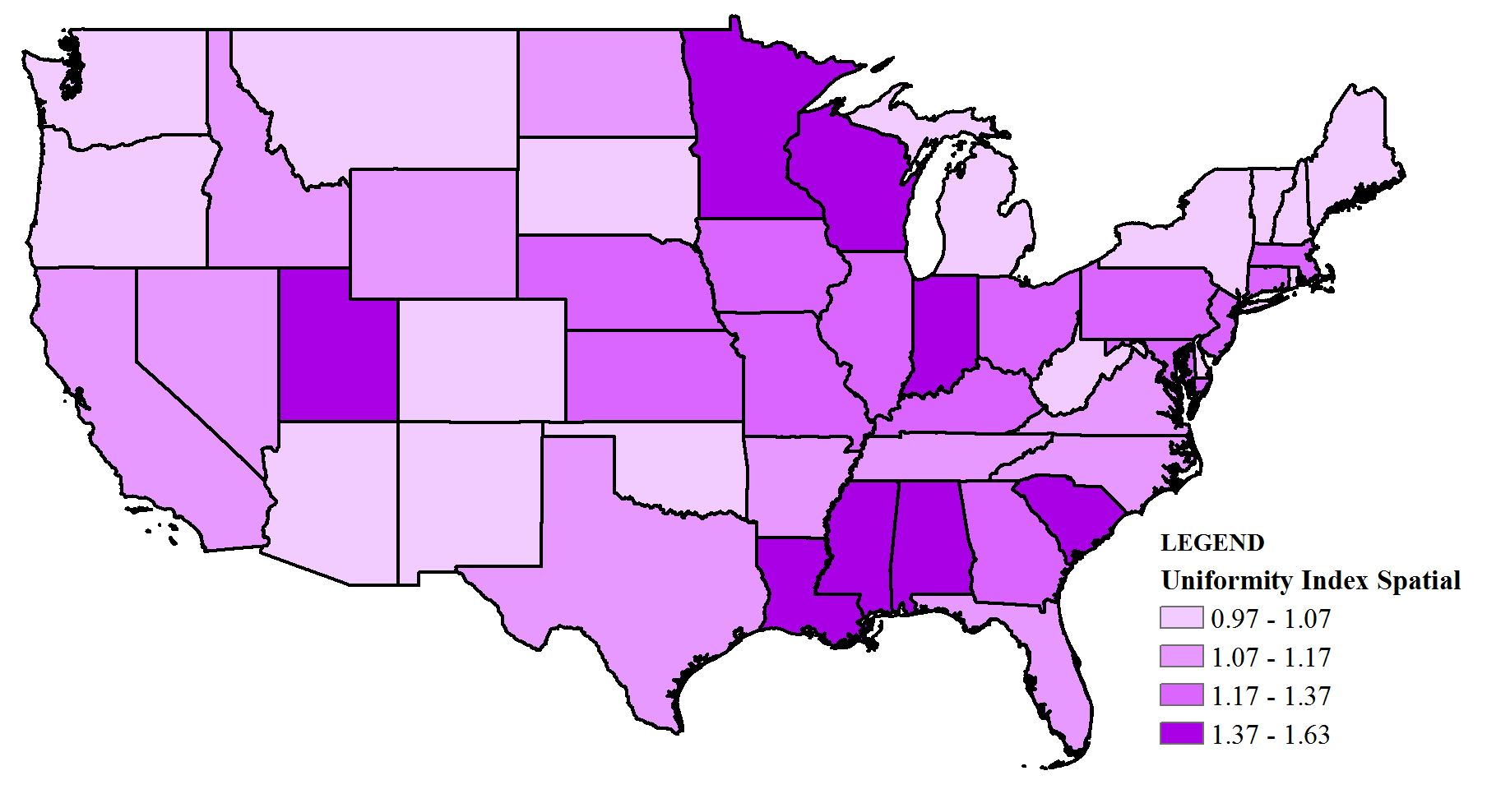
Uniformity Index

Slide 16
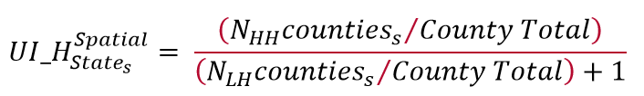
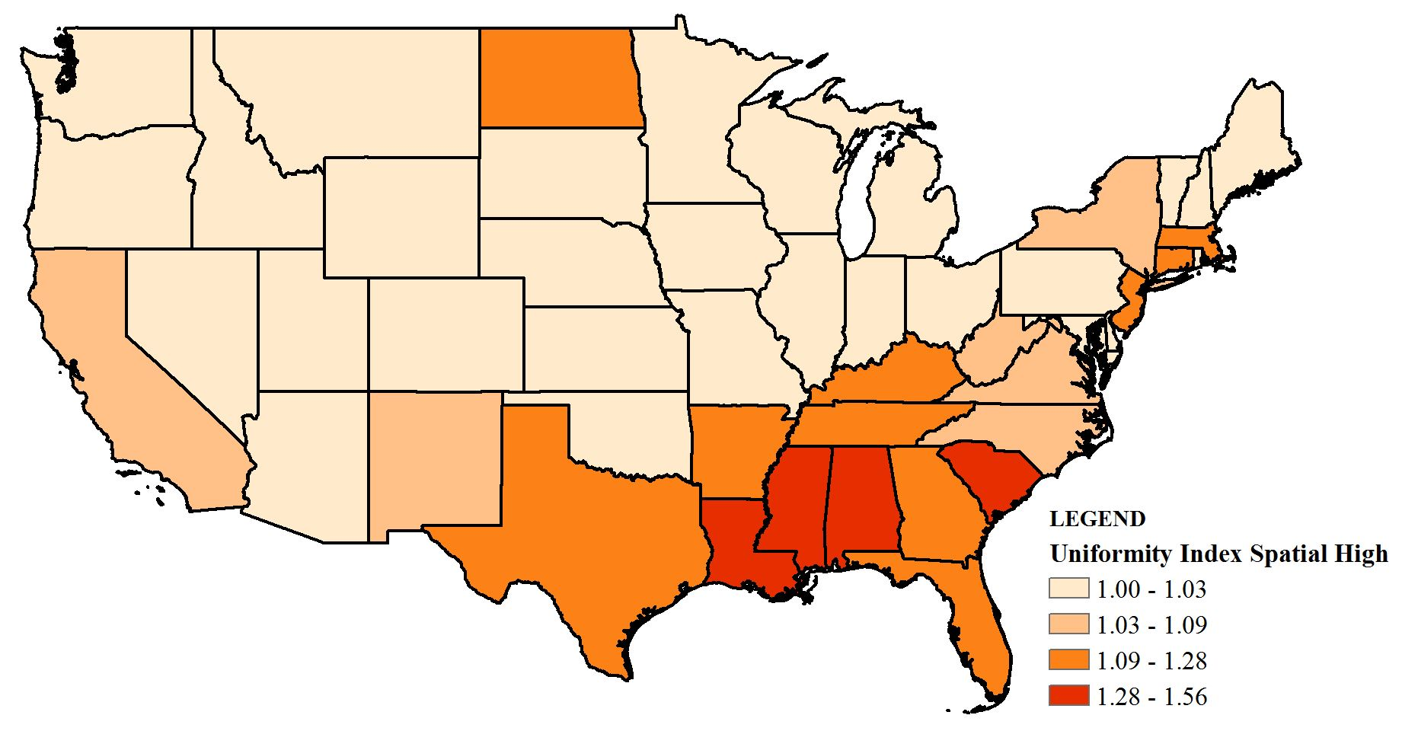
Uniformity Index High

Slide 17

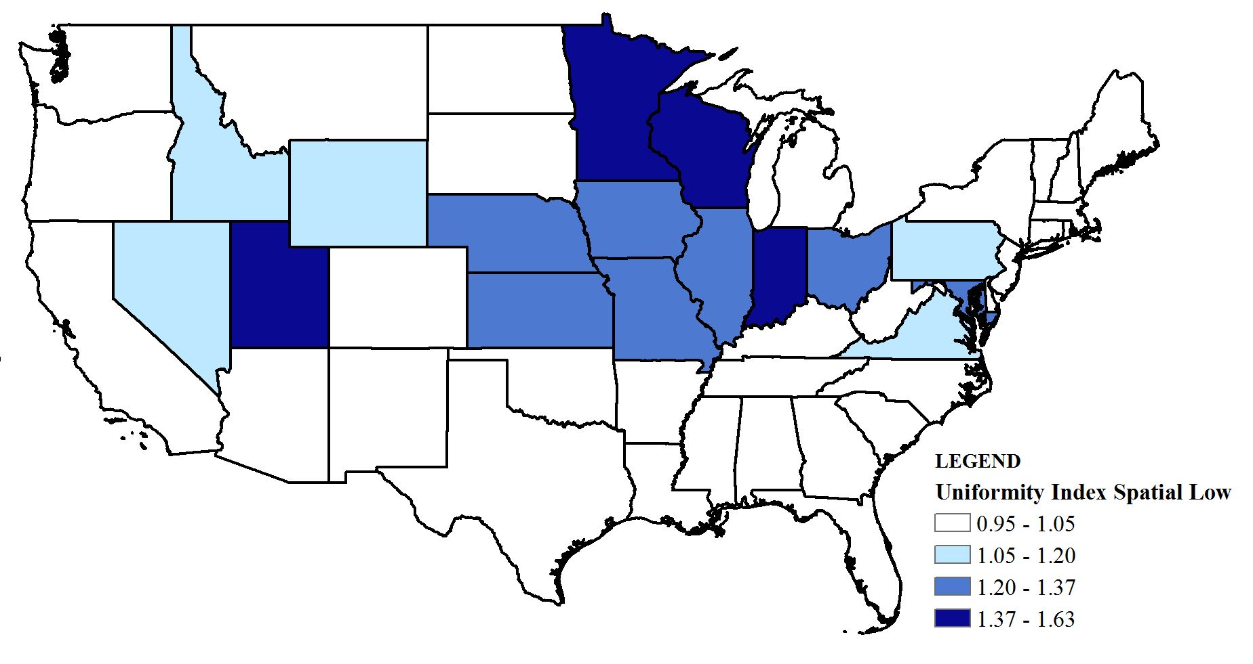
Uniformity Index Low

Slide 18
Controls and Analytic Strategy
Controlled for MHI, health insurance (state and individual), % on SNAP, age, race, ethnicity, education, income, relationship status, health behaviors
Hierarchical logistic regression models. Random intercepts. Individuals nested within states. Weights utilized.

Slide 19
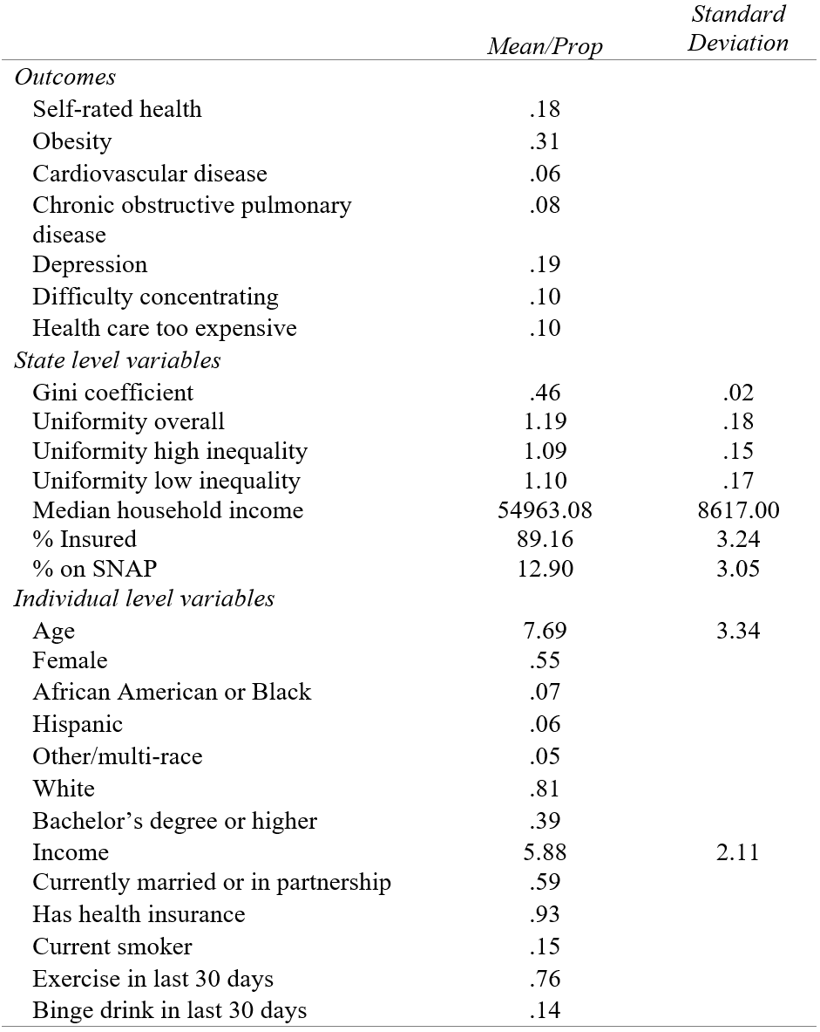
Descriptive Statistics for all Variables (n = 954,671 / 48)

Slide 20
Hierarchical Logistic Regressions Health Outcomes on Measures of Inequality and Uniformity in Inequality

Slide 21
Conclusions
However, Gini reduced the odds of obesity and depression, and residents with more uniformly low inequality states were more likely to be obese.
These findings, while disputing the IIH, suggest inequality, and its distribution across space, matters differently for different health outcomes.
The nature of the dispersion of inequality across geographies is an important variable to consider when evaluating the IIH.
Income inequality, as captured by the Gini coefficient, did not significantly increase the odds of any outcome.
Residents of states with more uniformly high levels of inequality across space are more likely to report:
below average health,
cardiovascular disease,
difficulty concentrating
lack access to care due to cost.

Slide 22
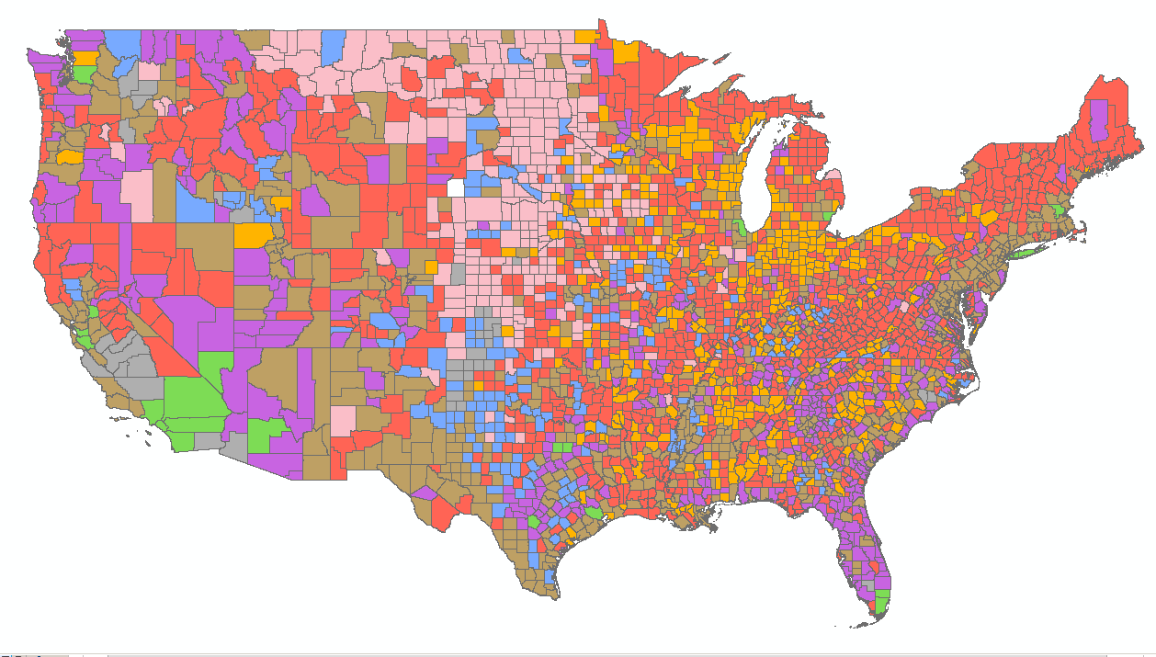
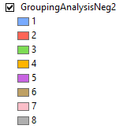
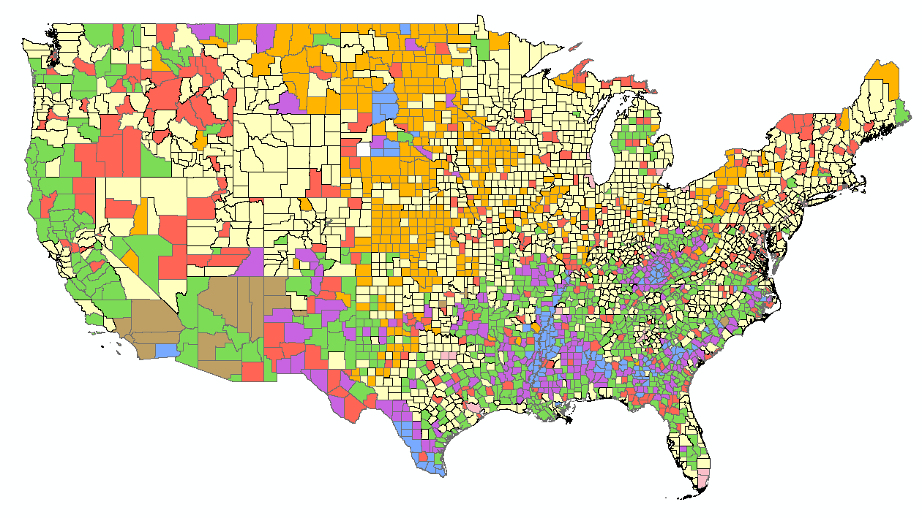
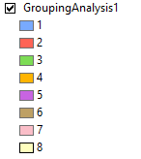
Future Directions
Grouping Analysis based on positive and negative variable correlations / associations with Gini Index
Explore other inequality measures
Explore the stability of these relationships across various geographic levels
Negative
Positive

