Slide 1
Understanding the Effects of Record Linkage on Estimation of Total when Combining a Big Data Source with a Probability Sample
Benjamin Williams, Statistical Science

Slide 2
Introduction
The US National Oceanic and Atmospheric Administration (NOAA) is responsible for:
Fishing season lengths
Bag limits
Keeps fish populations stable, prevents overfishing, and combats effects of natural disasters

Slide 3
Background
NOAA estimates the total fish caught by recreational anglers
Catch = Catch per Unit Effort X Effort
CPUE is estimated from a public dockside intercept survey
Effort is estimated from an address-based mail survey

Slide 4
Problems
The mail survey suffers from low response rates and lengthy estimation
The National Research Council has recommended electronic reporting
Electronic reporting may allow for near real time estimation

Slide 5
Electronic Reporting
NOAA is experimenting with allowing recreational charter captains to self-report trips
Captains volunteer to participate – this data can hopefully replace the mail survey and improve estimation

Slide 6
Electronic Reporting
The self-reports constitute a non-probability sample
Estimators using data from non-probability samples may suffer
The self-reports are a large sample containing useful information

Slide 7
Current Methods
Liu et al. (2017) and Breidt, Opsomer, & Huang (2018)
Use self-reports as auxiliary information, allowing evaluation of the estimators
The proposed estimators use capture-recapture methodology

Slide 8

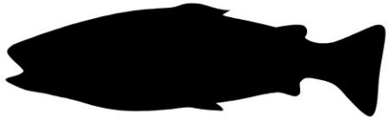


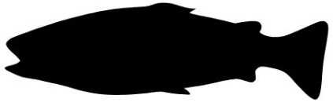


Capture-Recapture
N fish in the pond

Slide 9


Capture-Recapture
Day 1: Catch $n_{1}$ fish and tag them

Slide 10

Capture-Recapture
Day 2: Catch $n_{2}$ fish, $m$ of which are tagged

Slide 11

Capture-Recapture
Estimate the total catch of fish with:
$$\hat{N}=\frac{n_{1}n_{2}}{m}$$
Assume: recapture sample is a probability sample
Self-reports are analogous to the capture sample
Dockside intercept is analogous to recapture sample
We want to estimate total of a characteristic, not the total units in the population

Slide 12
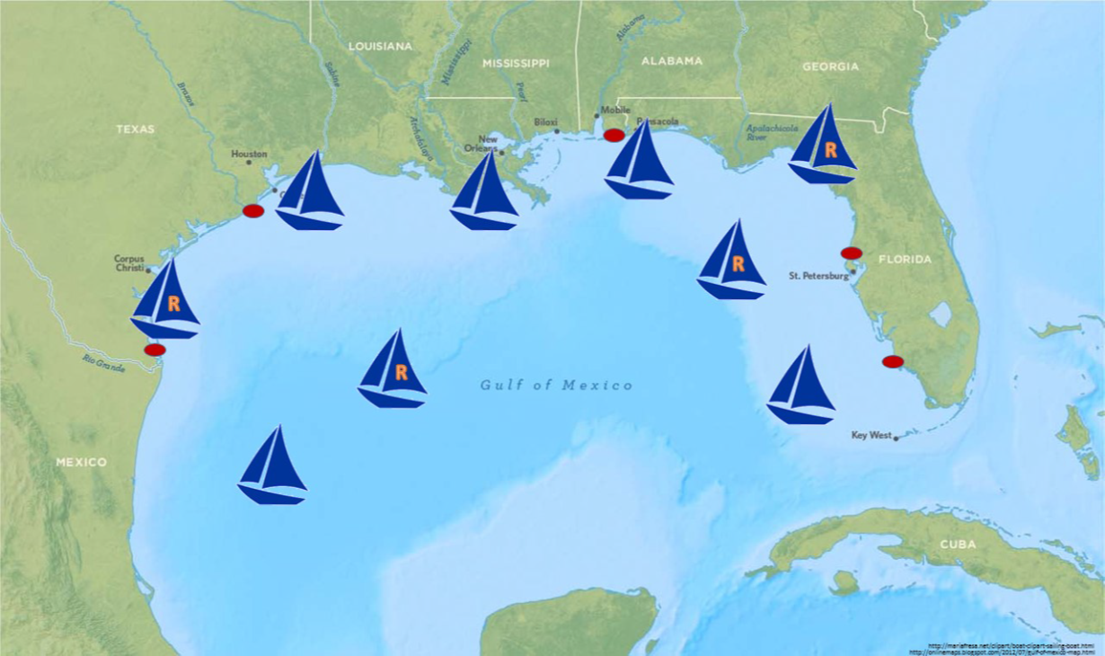

Slide 13

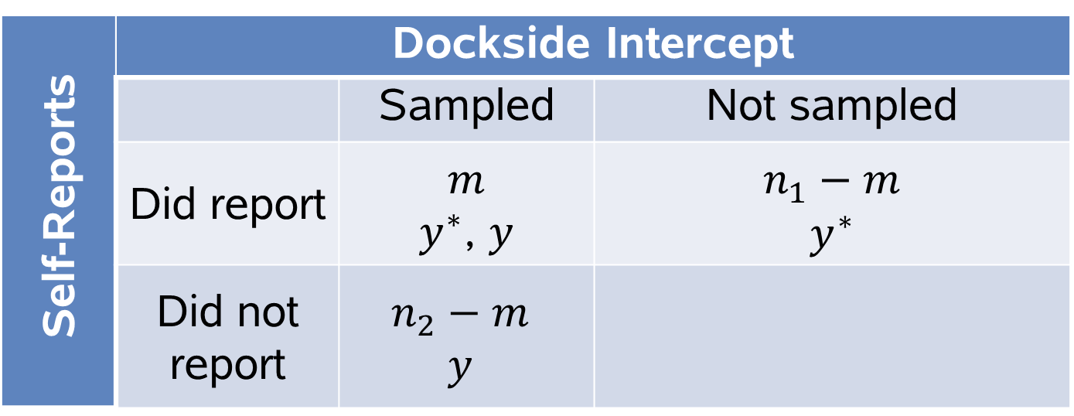


Sampling Setup
Self-Reports | Dockside Intercept
 |  | Sampled | Not sampled
 | Did report | $$m$$ $y^{∗}$, $y$ | $$n_{1}−m$$ $$y^{∗}$$
 | Did not report | $$n_{2}−m$$ $$y$$
$$n_{1}$$
$$n_{2}$$
$$\hat{N}$$

Slide 14

Estimator
Liu et al (2017):
${\hat{t}}_{y2}=t_{y^{∗}}+\frac{n_{1}}{{\hat{n}}_{1}}({\hat{t}}_{y}−{\hat{t}}_{y^{∗}}$)
$t_{y^{∗}}=$ total reported catch
${\hat{n}}_{1}=$ $estimated number of reports$
${\hat{t}}_{y}=$ estimated total catch from intercept sample
${\hat{t}}_{y^{∗}}=$estimated total reported catch from intercept sample

Slide 15
Matching Errors
Estimation requires linking trips between the samples, but this is difficult due to:
Captains may report well after a trip ends
Device/Measurement error
Timing of end of a trip and time of interview will be different in both samples, cannot identify multiple trips in same day
Self-reports consist of device reported data and captain reported data

Slide 16
Matching Error Types
Type 1: False-positive (biases estimators downward)
Link a sampled trip to a reported trip
That trip did not actually report
Type 2: Mismatch (not much of a concern)
Link a sampled trip to a reported trip
That trip did actually report, but linked to wrong reporting trip
Type 3: False-negative (biases estimators upward)
Fail to link a sampled trip to a reported trip
That trip did actually report

Slide 17
Record Linkage
The quality of the estimators depends on accurate linking
Due to non-sampling errors, matching trips is difficult
Implement Record Linkage
Fellegi and Sunter (1969), Bell et al (1994)

Slide 18

Record Linkage
Call x and y the two values observed for the $k^{th}$ linking variable
The linking score is:
$$S_{k}=\log\left(\frac{P\left(x,y | M=1\right)}{P\left(x,y | M=0\right)}\right)$$
$$=log\left(P\left(y | x,M=1\right)\right)−log(P\left(y\right))$$
where $M$ is an indicator of a match

Slide 19
Record Linkage
The linking score is simplified based on the amount of agreement or disagreement between x and y (Bell et al 1994)
Estimate pieces of linking score conditional on a match by holding other linking variables constant
Assuming independence, sum the scores for each linking variable to obtain a score for each potential link

Slide 20
Example
Data from 2 years of an electronic reporting experiment in the Gulf of Mexico (2016 – 2017)
In 2016: 1,628 intercepts, 5,976 self-reports
In 2017: 1,484 intercepts, 6,277 self-reports
Use Boat ID number as blocking variable

Slide 21
Augmenting GPS Data
GPS position reported for each self-reported trip
Over 2.5 million GPS reports to date
Predict Return Time, Return Location
See Ryan McShane in 40.105 at 11:30 for specifics

Slide 22
Additional Linking Variables
Intercept File (Recorded by Interviewer) | Report File (Reported by Captain of Observed from Device Signal)
Date of Interview | Date of Trip Return (Device)
Interview Site Number | Predicted Return Site (Device)
Number of Fish Harvested per Angler | Number of Fish Harvested for Entire Boat (Captain)
Number of Fish Discarded per Angler | Number of Fish Discarded for Entire Boat (Captain)
Number of Different Species Caught | Number of Different Species Reported (Captain)
Number of Anglers | Number of Anglers (Captain)

Slide 23
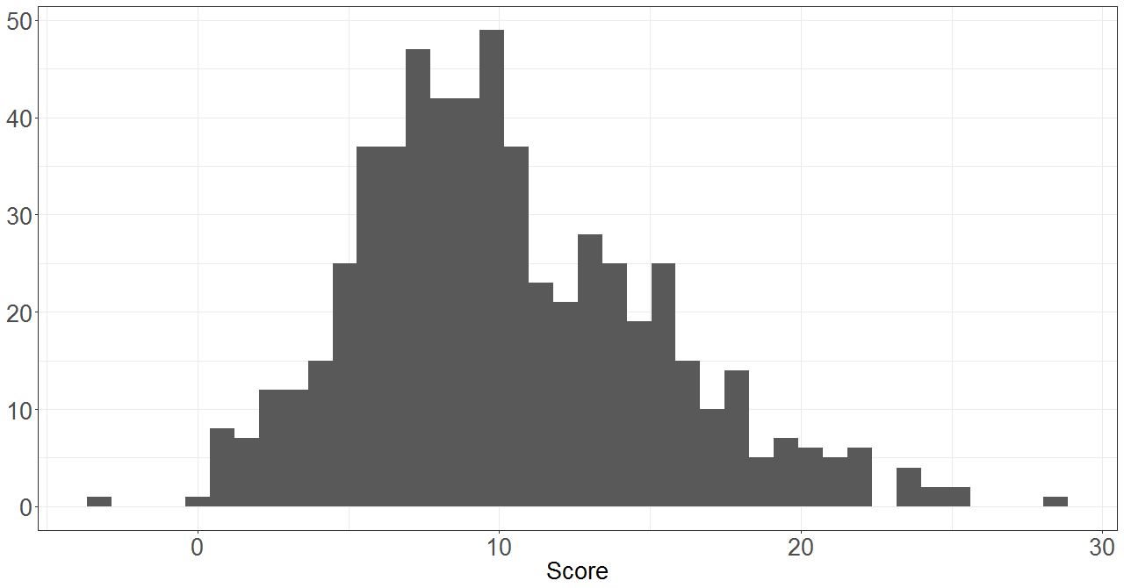
Score Distribution

Slide 24
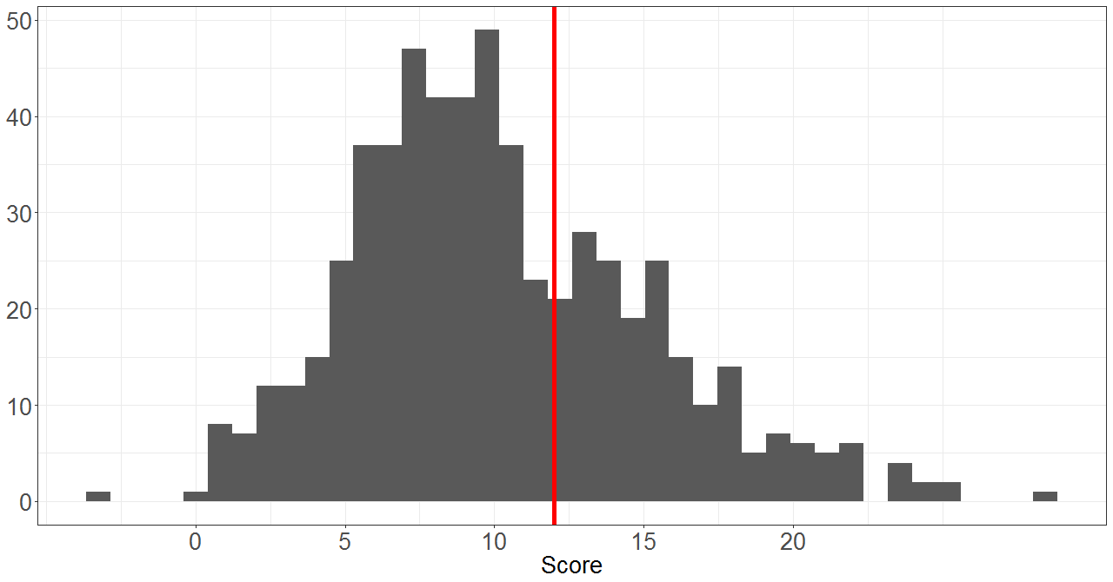
Score Distribution

Slide 25
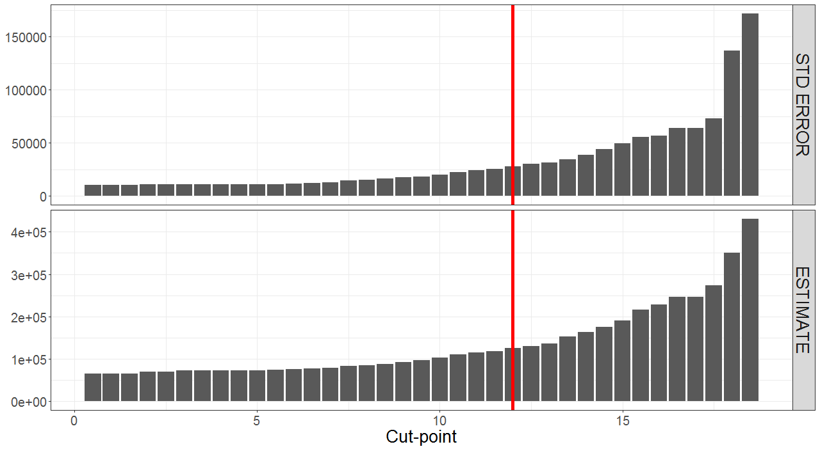

Slide 26
Estimates - Red Snapper Harvest 2017
For AL and FL
NOAA : 13.9% PSE
Record Linkage : 22.2% PSE (cut-point = 12, 86 matches)

Slide 27
Current and Future Work
Compare other metrics to determine cut-point
Estimate matching error
R package for estimation: blendR (Williams, 2018)
Many extensions

Slide 28
References
Bell, R. M., Keesey, J., & Richards, T. (1994). The Urge to Merge: Linking Vital Statistics Records and Medicaid Claims. Medical Care, 32(10), 1004-1018.
Breidt, J. F., Opsomer, J. D., & Huang, C. (2018). Model-Assisted Survey Estimation with Imperfectly Matched Auxiliary Data. In V. Kreinovich, S. Sriboonchitta, & N. Chakpitak (Eds.), Predictive Econometrics and Big Data (Vol. 753, pp. 21-35). Springer, Cham.
Fellegi, I. P., & Sunter, A. B. (1969). A Theory for Record Linkage. Journal of the American Statistical Association, 64(328), 1183-1210.
Liu, B., Stokes, L., Topping, T., & Stunz, G. (2017). Estimation of a Total from a Population of Unknown Size and Application to Estimating Recreational Red Snapper Catch in Texas. Journal of Survey Statistics and Methodology, 5(3), 350-317.
Newcombe, H. B., Kennedy, J. M., Axford, S. J., and James, A. P. (1959). Automatic Linkage of Vital Records. Science, 130(3381):954–959.
Tarnecki, J. H. and Patterson, W. F. (2015). Changes in Red Snapper Diet and Trophic Ecology Following the Deepwater Horizon Oil Spill. Marine and Coastal Fisheries, 7(1):135–147.
The National Academies of Sciences, Engineering, and Medicine. 2016. Review of the Marine Recreational Information Program (MRIP). Washington, DC: The National Academies Press. doi: 10.17226/24640
Williams, B. (2018). Combining a Probability and a Non-Probability Sample in a Capture-Recapture Setting. Journal of Open Source Software, 3(28), 886, https://doi.org/10.21105/joss.00886.

Slide 29
Thank you!

