Slide 1
How Non-Ignorable is the Selection Bias in Non-Probability Samples? An Illustration of New Measures using a Large Genetic Study on Facebook
Brady T. West¹
Phil Boonstra²
Roderick J.A. Little^{1,2}
Jingwei Hu¹
Fernanda Alvarado-Leiton¹
¹Survey Research Center, Institute for Social Research, University of Michigan-Ann Arbor
²Department of Biostatistics, School of Public Health, University of Michigan-Ann Arbor

Slide 2
Problem Statement
“Big Data” are everywhere (and inexpensive), but often arise from non-probability samples that lack a statistical basis for population inference
We therefore need to use model-based approaches to make inference based on non-probability samples (Elliott and Valliant, 2017)
Existing indicators of sample representativeness, such as the R-indicator (Schouten et al. 2009), depend only on response propensity, and are agnostic about the survey variables of interest
The H₁ indicator (Sarndal and Lundstrom 2010) is based on the variables of interest, but assumes an ignorable selection mechanism
No good tools exist for gauging the amount of non-ignorable selection bias in a descriptive estimate that arises from non-probability sampling (Nishimura et al. 2016); we aim to develop such tools with this work

Slide 3
Current Work in the Nonresponse Context
We build on the pioneering work of Don Rubin, who first considered the notion of the ignorability of a missing data mechanism
Andridge and Little (2009, 2011, 2018) propose the use of proxy pattern-mixture models to address non-ignorable nonresponse bias arising from survey nonresponse, and present positive results
West and Little (2013) applied similar models to the problem of auxiliary variables measured with error in nonresponse adjustment
We seek to apply these methods to the empirical assessment of non-ignorable selection bias that arises from non-probability sampling

Slide 4

Approach for Continuous Variables
Suppose that we have data on a non-probability sample, including a continuous variable of interest Y and covariates of interest Z
Aggregate population information, via administrative records or some other source, is also available for the covariates Z
We wish to develop the best predictor of Y from Z; for example, this could be the linear predictor of Y from a regression of Y on Z
We call this “best” predictor of Y an auxiliary proxy for Y, and denote the auxiliary proxy by X (where X is scaled to have the same variance as Y); is the mean of X for the population
$$\overline{X}$$

Slide 5
Approach for Continuous Variables, cont’d
Our proposed index of non-ignorable selection bias is based on maximum likelihood estimates of the parameters for a normal pattern-mixture model:
Note that the probability of inclusion in the non-probability sample (S = 1) is allowed to depend on both X* (rescaled X) and Y through φ
If φ = 0, then selection is entirely ignorable, depending on X* only
If φ = 1, then selection is entirely non-ignorable, depending on Y only
There is no information in the data about φ, which can be varied in a sensitivity analysis

Slide 6

Approach for Continuous Variables, cont’d
Andridge and Little (2011) show that the ML estimate of the mean of Y, given φ, is the following (note that rescaling of X is incorporated):
Note that is the correlation of X and Y in the non-probability sample
Given this result, we propose a measure of unadjusted bias (MUB), which can be rescaled by the observed standard deviation of Y to form a simpler standardized measure of unadjusted bias (SMUB):
$$r_{XY}^{\left(1\right)}$$

Slide 7
Using the Proposed Index
Note that the proposed index is simple: it only depends on φ; means, standard deviations, and correlations from the observed non-probability sample; and the population mean for X
We propose an intermediate choice of φ = 0.5 for computing the index, and then forming an “interval” (or range of plausible values) for the selection bias by using the extreme cases of φ:
and

Slide 8
Additional Remarks on the Proposed Index
SMUB(1) will become quite unstable when X is not a good predictor of Y; in this case, bias cannot be reliably estimated
SMUB(0.5) is related to the Bias Effect Size proposed by Biemer and Peytchev at the 2011 Nonresponse Workshop
We show that this has a model-based justification, and we use the full bias expression in the numerator, rather than the difference between Rs and NRs
We have also implemented a fully Bayesian approach to computing the index that incorporates uncertainty about all of the input parameters (but requires microdata for non-selected cases)
The proposed interval is a recommendation for practice, but we have an R function available for the Bayesian approach given the necessary microdata

Slide 9
Approach for Binary Variables
Following Andridge and Little (2009, 2018), suppose that a binary variable Y arises from a latent variable U that follows a normal distribution; we form X from a probit regression of Y on Z
Then, following a similar approach based on the pattern mixture model for U and X, we can form indices of selection bias based on the observed respondent proportion and the ML estimate of the mean of Y
We can then define MSB (the measure of selection bias; no need for standardization) for proportions (details available upon request), along with MSB(0), MSB(0.5), and MSB(1) indices for forming intervals
We can also apply a fully Bayesian approach for forming credible intervals for MSB (if we are given microdata on the non-selected cases)

Slide 10
Motivating Example: NSFG Smartphone Users
We treat data from 16 quarters (2012-2016) of the National Survey of Family Growth (NSFG) as a hypothetical population
We then consider smartphone users in this “population” as our hypothetical non-probability sample, simulating the selection process; see Couper et al. (2018) for details
Our Y variables were variables of interest to NSFG data users
We considered both continuous and binary Y variables, to assess how robust the SMUB measures were to assumptions about normality
Our Z variables included those where pop. aggregates may be available:
age, race/ethnicity, marital status, education, household income, region of the U.S. (based on definitions from the U.S. Census Bureau), current employment status, and presence of children under the age of 16 in the household
We regressed Y on Z for smartphone users to form our linear predictor X

Slide 11
Evaluation
We computed our proposed indices (SMUB and MSB) and intervals for each of several Y variables, for males and females separately
We were also able to compute the standardized true estimated bias (STEB) for each of our estimates, given the hypothetical “population” and the knowledge of true means and SDs for this population
We also considered the FMI as a competing index, given some of the results in Nishimura et al. (2016)
We assessed how often our proposed interval covered the STEB, and the correlations of our indices with the STEB values

Slide 12
Results: Proposed Interval (SMUB)
The proposed interval covers the actual STEB in 9/12 cases where the correlation of X with Y in the non-probability sample was above 0.4 (good proxies)
The proposed interval only covered the STEB in 5/16 cases where the correlation was less than 0.4
The proposed interval becomes much wider when the correlation becomes smaller!

Slide 13
Results: Correlation of SMUB(0.5) with STEB
This plot shows a strong correlation (0.65) of the SMUB(0.5) values with the actual STEB (true bias) values
Note that the dashed green line reflects perfect correlation
We see an even stronger correlation (0.86) when focusing on variables with correlations (rho) greater than 0.4 in the non-probability sample
The FMI had a small negative correlation: not a useful measure (Nishimura et al. 2016)

Slide 14
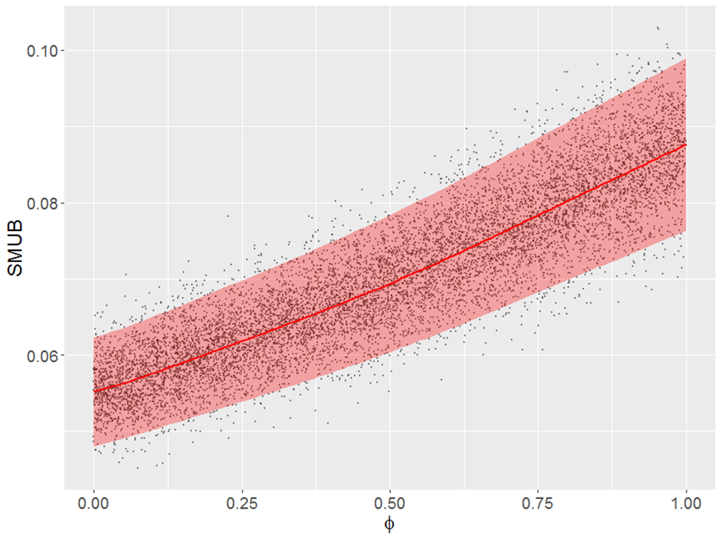
Results: Bayesian Approach
This plot is automatically generated when running our nisb_bayes() function in R for a given set of variables
This plot shows draws of SMUB given draws of the φ parameter, and includes predicted values of SMUB as a function of phi, and 95% confidence bands
The variable of interest is number of months worked in the past year, for females: STEB = 0.069
Note that a choice of φ = 0.5 results in draws of SMUB that closely reflect the true bias (for THIS variable)
The proposed interval, allowing for uncertainty, also covers the true bias in this case; the Bayesian approach had better coverage for smaller correlations

Slide 15
Applying the Binary Approach
When computing the MSB indices and their corresponding intervals for the 16 proportions based on the binary variables in this motivating illustration, the following results emerged:
The proposed intervals were significantly less wide than the SMUB intervals (regardless of the correlation), reflecting the sensitivity of the MSB index (derived from the probit model) to the discrete nature of the binary variables
10 of the 16 estimated bias values were covered by the proposed intervals, representing an improvement over the SMUB approach (only 8 out of 16)
Simulation results for the MSB indices (in progress!) are quite promising, and suggest similar improvements over the SMUB index for binary variables

Slide 16
Application: Genes for Good (GfG)
University of Michigan study that uses a Facebook app to recruit volunteers age 18+ living in the U.S. for participation in a genetic study
→ http://genesforgood.sph.umich.edu
Volunteers answer periodic survey questions about health via the app, and provide saliva samples via mail for genetic testing
More than 77,000 volunteers to date; a non-probability sample!
We focus on 1,829 volunteers age 50+ in the present application, their coded genotype values on ~223,000 single nucleotide polymorphisms (SNPs), selected socio-demographics, and survey measures of health

Slide 17
Polygenic Scores (PGSs)
A.K.A. genetic risk scores, PGSs aggregate genetic information from several hundred thousand (or more) SNPs capturing genetic variants (Belsky and Israel 2014)
Computed based on a linear combination of estimated coefficients from bivariate regressions of selected phenotypes p (e.g., BMI) on each individual SNP in genome-wide association studies (GWAS), and the actual coded SNP values g for a given individual i:
We focus on PGSs for various phenotypes that represent important risk factors for developing cancer (our Y variables of interest), such as BMI, lifetime smoking, diabetes, education, etc.
Essentially, the PGSs are important Z variables used to compute X!

Slide 18
The Health and Retirement Study (HRS) Data
The HRS is a longitudinal panel study that surveys a nationally representative probability sample of 20,000 people age 50+ in the U.S. every two years (http://hrsonline.isr.umich.edu)
The HRS began collecting biomarker data from sampled members in 2006, and has now genotyped DNA samples from more than 20,000 consenting respondents through 2012
Not all sampled individuals were genotyped; weighted analyses suggest that this ~50% subsample is representative of the full HRS
We focus on 12,154 genotyped individuals (non-Hispanic) with PGSs and survey variables computed using the exact same approach as GfG; this yields is our benchmark population information

Slide 19
Application: SMUB and MSB Results
Using GfG data, we regressed seven phenotypes (2 continuous, 5 binary) on the PGSs for each phenotype and other socio-demographics
Elastic net penalties were applied when fitting the models to the continuous GfG data to identify the most important predictors (and form X)
The estimated coefficients were used to compute the same X values in the HRS “population”, enabling the SMUB and MSB calculations
NOTE: All indices x 1000!

Slide 20
Application: Summary of Results
Across the seven variables, all three index values have high correlations with the STEB / estimated bias:
SMUB(0) / MSB(0): 0.815
SMUB(0.5) / MSB(0.5): 0.770
SMUB(1) / MSB(1): 0.863
Implications: The non-probability sampling mechanism used for Genes for Good may be producing a biased sample in terms of these risk factors (and especially the proportions based on the binary variables, e.g., ever smoker)
The proposed intervals once again generally perform well, especially when allowing for sampling variance in the GfG estimates
If microdata were available on all cases NOT sampled for Genes for Good, we could apply the Bayesian approach to adjust the estimates accordingly
The performance was still strong, despite some smaller correlations!

Slide 21
Conclusions
We have proposed simple model-based indices of potential non-ignorable selection bias for descriptive estimates based on non-probability samples
The indices are easy to compute and only require aggregate information on relevant covariates (correlation > 0.4? Or > 0.3?) for the target population
The proposed indices perform quite well when based on moderately informative auxiliary information
We have written R functions enabling all SMUB and MSB computations reported in this presentation; these functions are available here: https://github.com/bradytwest/IndicesOfNISB
Future work (in progress) needs to develop similar indices for regression coefficients and other multivariate quantities

Slide 22
Acknowledgements / Thank You!
This work was supported by an R21 grant from NIH (PI: West; NIH Grant No. 1R21HD090366-01A1)
Thanks to Mick Couper for letting us play with the NSFG data!
The National Survey of Family Growth (NSFG) is conducted by the Centers for Disease Control and Prevention's (CDC’s) National Center for Health Statistics (NCHS), under contract # 200-2010-33976 with University of Michigan’s Institute for Social Research with funding from several agencies of the U.S. Department of Health and Human Services, including CDC/NCHS, the National Institute of Child Health and Human Development (NICHD), the Office of Population Affairs (OPA), and others listed on the NSFG webpage (see http://www.cdc.gov/nchs/nsfg/). The views expressed here do not represent those of NCHS nor the other funding agencies.
Many thanks to Erin Ware and Anita Pandit for helping us to navigate the HRS and Genes for Good data (especially the genetic data)!
Thank you to David Weir and Goncalo Abecasis for letting us work with the HRS and Genes for Good data for this study!
Please direct any and all comments to Brady West (bwest@umich.edu)

Slide 23
References
Andridge R.R. and Little, R.J.A. (2009). Extensions of proxy pattern-mixture analysis for survey nonresponse [conference paper]. Proceedings of the 2009 Joint Statistical Meetings, Section on Survey Research Methods, 2468-2482.
Andridge, R.R. and Little, R.J. (2011). Proxy pattern-mixture analysis for survey nonresponse. Journal of Official Statistics, 27, 2, 153-180.
Andridge, R.R. and Little, R.J. (2018). Proxy pattern-mixture analysis for a binary variable subject to nonresponse. Submitted to Journal of Official Statistics, August 2018.
Belsky, D.W. and Israel S. (2014). Integrating genetics and social science: genetic risk scores. Biodemography Soc Biol, 60(2), 137-155.
Biemer, P. and Peytchev, A. (2011). A standardized indicator of survey nonresponse bias based on effect size. Paper presented at the International Workshop on Household Survey Nonresponse, Bilbao, Spain, September 5, 2011.
Couper, M.P., Gremel, G., Axinn, W.G., Guyer, H., Wagner, J., and West, B.T. (2018). New Options for National Population Surveys: The Implications of Internet and Smartphone Coverage. Social Science Research. DOI: https://doi.org/10.1016/j.ssresearch.2018.03.008.
Elliott, M. R., & Valliant, R. (2017). Inference for nonprobability samples. Statistical Science, 32(2), 249-264.
Nishimura, R., Wagner, J., and Elliott, M. (2016). Alternative indicators for the risk of non-response bias: A simulation study. International Statistical Review, 84(1), 43-62.
Särndal, C.-E., and S. Lundström (2010). Design for estimation: Identifying auxiliary vectors to reduce nonresponse bias. Survey Methodology, 36, 131–144.
Schouten, B., Cobben, F., and Bethlehem, J. (2009). Indicators for the Representativeness of Survey Response. Survey Methodology, 35(1), 101-113.
West B.T. and Little R.J.A. (2013). Nonresponse adjustment of survey estimates based on auxiliary variables subject to error. Journal of the Royal Statistical Society, Series C, 62(2), 213-231.

