Slide 1


A Full Spectrum Approach to Election Polling and Forecasting
BigSurv2018
Using Big Data for Electoral Research I
27 October 2018

Slide 2


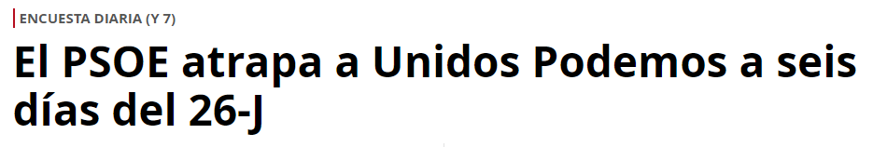
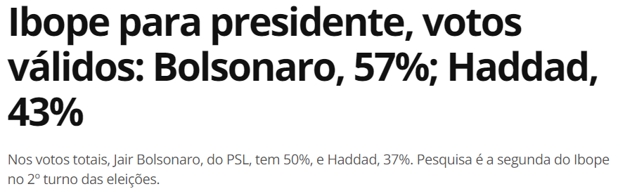



Election Research & Forecasting
A Full Spectrum Approach to Election Polling and Forecasting
Why do we track and try to forecast elections?
Elections matter…
Public opinion and analytic forecasting provides some truth in a sea of spin and ‘fake news’.

Slide 3



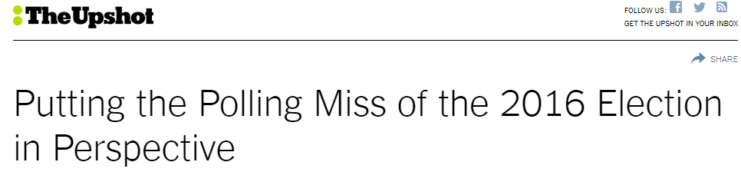
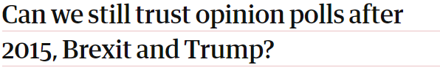
Lessons Learned
A Full Spectrum Approach to Election Polling and Forecasting
However, election polling experienced a bad year in 2016 missing the U.K. Brexit vote and the U.S. Presidential Election. Why?
  Polls were within the margin of error.
  Public and media not equipped to accurately evaluate odds and certainty.
  Virtually all conversation focused on a single method of election forecasting – public opinion polls.

Slide 4
Moving Toward a Best Practice in Election Forecasting
A Full Spectrum Approach to Election Polling and Forecasting
  Be transparent about the impact of assumptions on poll results.
  Go beyond polling to integrate other forms of inference into analysis.
  Holistic data fusion allows better insight into assumptions.
  Present all indicators to the public – including contrary ones – to accurately convey certainty.

Slide 5
Election Forecasting Tools
A Full Spectrum Approach to Election Polling and Forecasting
TRADITIONAL FORECASTING TOOLS
Public opinion polling
Expert ratings
Structural models
NEW TOOLS FOR ELECTION INSIGHT
Social media analytics
Machine assisted expert evaluation
Online behavioral data
Sensor / IoT data

Slide 6
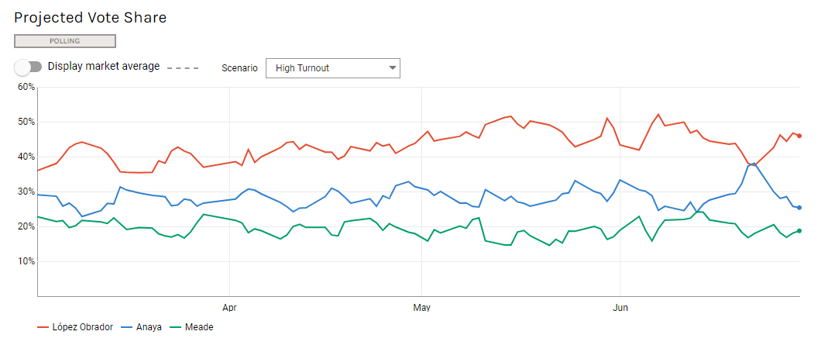
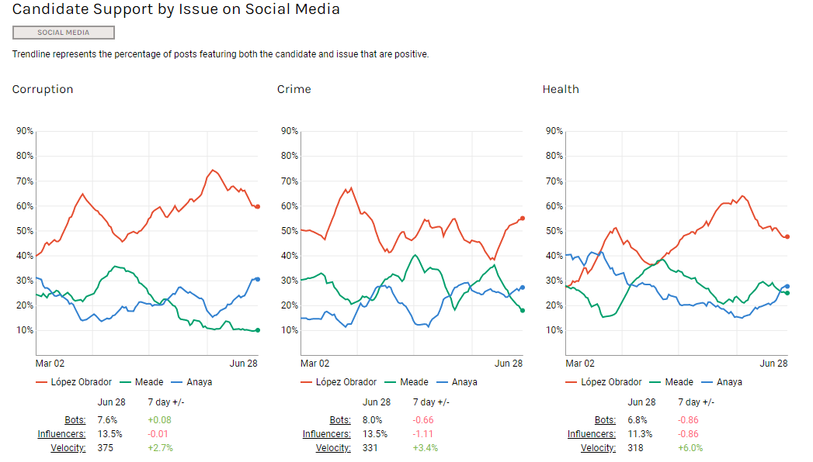
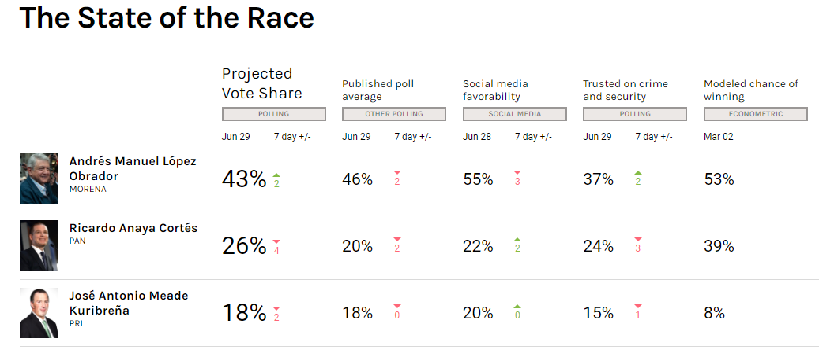
Ipsos Work in the 2018 Mexican Election
A Full Spectrum Approach to Election Polling and Forecasting
Daily telephone public opinion tracking
Dashboard with integrated data fusion
Sentiment tracking on social media

Slide 7
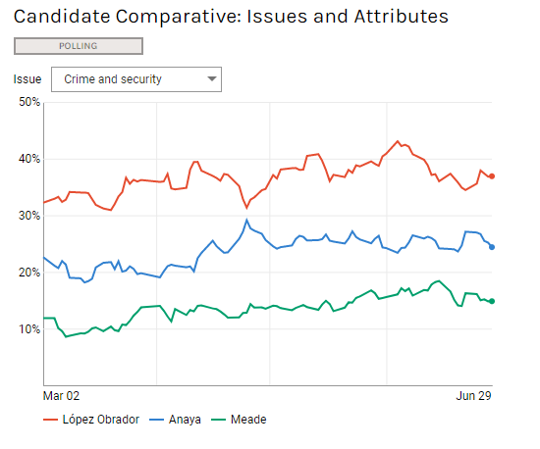
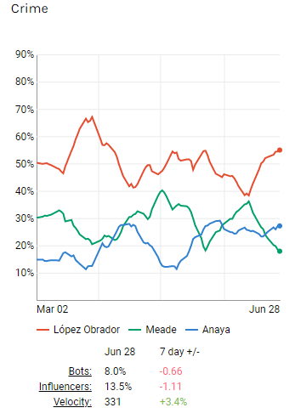
Social Media as an Indicator
A Full Spectrum Approach to Election Polling and Forecasting
Social media in Mexico performed well to explain shifts in public conversation.
Sentiment analysis of social media post identified each candidate’s share of support both overall and on specific political issues.

Slide 8
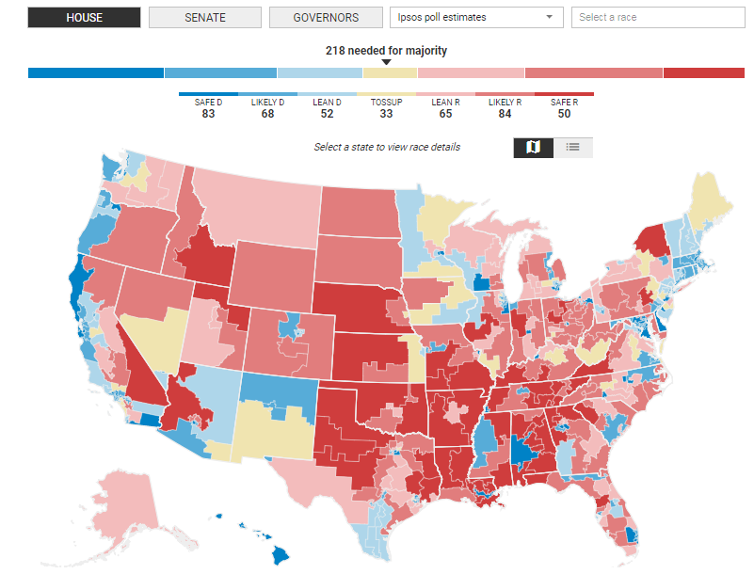
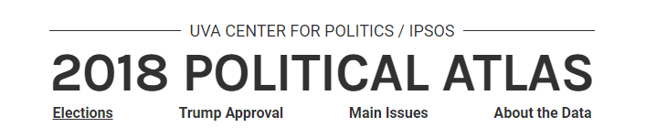
Ipsos in the 2018 U.S. Midterm Election
A Full Spectrum Approach to Election Polling and Forecasting

Slide 9
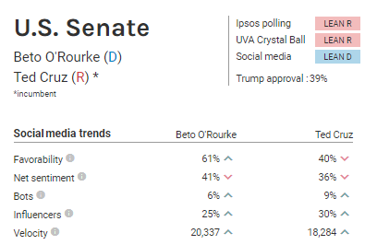
Competitive social media strength
A Full Spectrum Approach to Election Polling and Forecasting
All social media conversation around candidate is collected.
Posts with positive tone are identified.
Proportion of all positive posts specific to candidate flagged as candidate “vote” share on social media.
Indicates relative strength on social media.

Slide 10
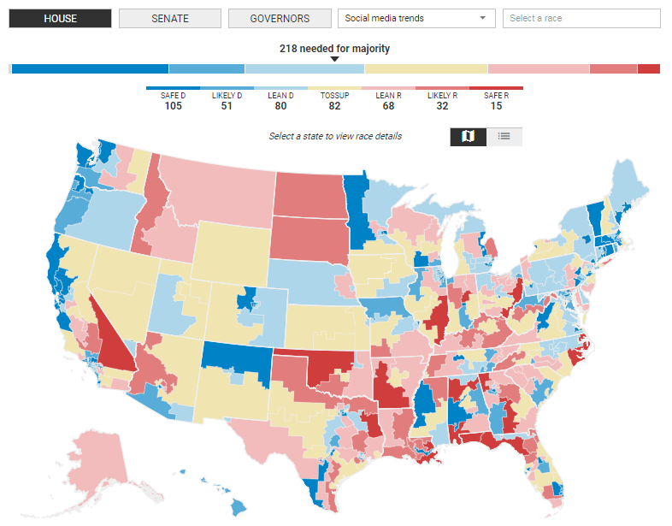
Social-based political leaning district modeling
A Full Spectrum Approach to Election Polling and Forecasting
Created a database of Democratic and Republican elected officials.
Categorize all social media posts as Democratic or Republican leaning by tone and vocabulary usage.
Provides indication of the political persuasion of the district in real time.

Slide 11
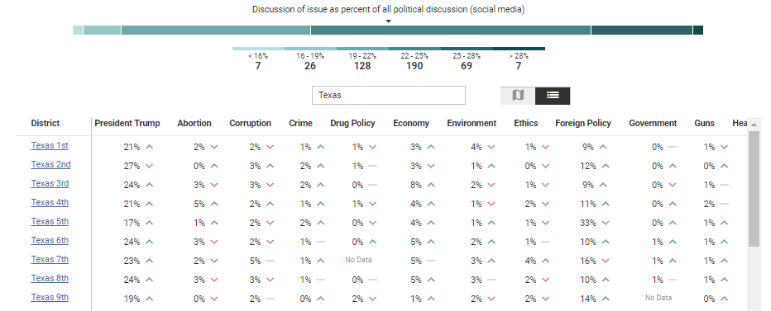
Tracking main topics on social media
A Full Spectrum Approach to Election Polling and Forecasting
Tracking structured from public opinion data.
Social media conversation is categorized into politically important issues.
Allows real-time tracking at the local level of the issues residents are discussing.

Slide 12
Methodology: Sources & Tools
A Full Spectrum Approach to Election Polling and Forecasting
Sentiment Analysis
  Deep learning using the Keras library or FastText
  System to detect negative vs. positive sentiment using social media training data containing negative and positive emojis. This approach is based on the DeepMoji system.
Political Leaning Detection
  Uses the FastText text classifier
  Using posts by incumbent congressmen and posts from subreddits with a political affiliation, we trained a model to tell posts by Democrats from posts by Republicans, and then applied that model to general social media discussion.

Slide 13
Additional Insight Tools Under Development
A Full Spectrum Approach to Election Polling and Forecasting
Google trend data to enhance public opinion modeling.
Tracking activist activity as a proxy for campaign and get-out-the-vote strength.
Sentiment analysis of published news as a proxy for campaign efficacy.
Structural forecast model overlays.

Slide 14

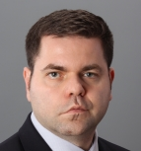
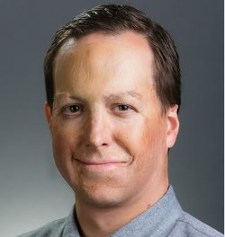
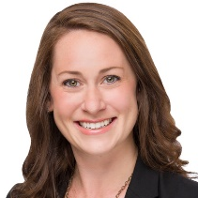
Thanks
Clifford Young
President, Ipsos
Mark Polyak
SVP, Ipsos
Chris Jackson
VP, Ipsos
Mallory Newall
Director, Ipsos
Clifford.Young@ipsos.com
Mark.Polyak@ipsos.com
Chris.Jackson@ipsos.com
Mallory.Newall@ipsos.com

