Slide 1
Measuring young people’s physical activity using accelerometers in the UK Millennium Cohort Study
Emily Gilbert, Lisa Calderwood
Centre for Longitudinal Studies, University College London

Slide 2
Measuring physical activity
Physical activity levels are strongly associated with many other outcomes – obesity, cardio-vascular health, well-being etc.
Typically measured by self-reporting BUT:
Social desirability
Recall bias
Intensity of exercise is subjective

Slide 3
Self-report vs objective measure
% of people doing recommended amount of physical activity
Health Survey for England (2008)

Slide 4
The Millennium Cohort Study
Follows the lives of over 19,000 young people in the UK born in 2000/01
Surveyed at key development stages of life:
9 months, 3, 5, 7, 11, 14 and 17
Multiple types of data collection
Age 14 Survey: interviews plus saliva collection, physical measurements, cognitive assessments, time use diaries and activity monitors)
Obesity is a major research area for MCS
Age 7 Survey included activity monitors

Slide 5
Potential problems
Incorporating an accelerometry study into a face-to-face survey
Managing the high volume devices throughout fieldwork
Will 14 year-olds wear them?

Slide 6
Device placement
Young people were asked to wear the activity monitor on two randomly-selected days, one a weekday and one a weekend day (time use diary for same two days).
Interviewers explained the task to young people during the household visit, told them which two days had been selected, and left them with written information.
Text message and email reminders were sent to young people and parents the day before each selected day.
Young people were asked to post the monitor back in pre-paid envelope after the second day.

Slide 7
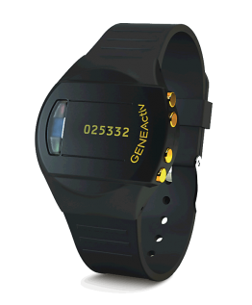

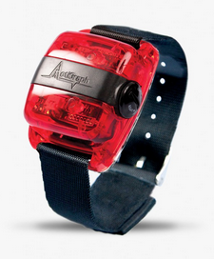

Piloted devices
Triaxial accelerometers
Allow various recording frequencies
Sufficient data capacity
Robust and waterproof
No respondent feedback

Slide 8
Depth interviews
Depth interviews with 14 year olds and parents
I’d want to know if it has a tracker in it… you never know, there could be… or a hidden camera! I’d feel uncomfortable…

Slide 9
Depth interviews
James, who identified the three most important things in his life as football, football and football, was sure he wouldn’t be able to wear the accelerometer in football matches.

Slide 10
Piloting
Two pilots (Feb 2014, July 2014)
Placement protocol
Respondent reactions
Device returns
Office admin
Compliance

Slide 11
Reactions
 | Comfortable
 | Uncomfortable Bulky / too big / indiscrete Ugly

Slide 12
Reactions
I did not wear it in the shower because of the risk of getting water damaged or electrocuted
I had to remove it in PE. I removed it during my dance lesson as it was rubbing and got in the way…
To have my spray tan done
In PE

Slide 13
Decisions
GENEActiv
Respondent feedback was more positive
Compliance was higher
Office procedures were manageable

Slide 14
Compliance and return - mainstage
 | %
Agree to wear | 80% (of eligible)
Return rate | 72% (of those who agreed)
Compliance | % of returned devices
0 days | 16%
1 day | 11%
2 days | 63%

Slide 15
Conclusions
Response, return and compliance rates were comparable to other studies.
Objective physical activity data collected for over 4,900 14-year olds.
The development work undertaken prior to the survey was the key to the success of this data collection.

Slide 16
Lessons learned
Costly!
Devices (GENEActiv - £120)
Interview time (explaining the task – 5 minutes)
Device management – fieldwork agency costs
Staff time
Planning
Protocol development
Technical issues
Complex data management

Slide 17
Accelerometry vs self-reports
Interestingly, our CMs report less physical activity than the activity monitors show.

Slide 18
Accelerometry vs self-reports
Minutes of physical activity

Slide 19
Resources
Working paper: Gilbert, E, Conolly, A, Tietz, S, Calderwood, L, Rose, N (2017) 'Measuring young people's physical activity using accelerometers in the UK Millennium Cohort Study' CLS working paper 2017/15. London: Centre for Longitudinal Studies
van Kuppeveldt, D.E., Heywood, J., Hamer, M. Sabia, S. Fitzsimons, E., van Hees, V. (2018) ‘Segmenting accelerometer data from daily life with unsupervised machine learning’: bioRxiv 263046: https://doi.org/10.1101/263046
Data available via the UKDS: www.ukdataservice.ac.uk

Slide 20
Thank you!
emily.gilbert@ucl.ac.uk

