Slide 1
Using Enrollment Records to Guide Categorization of Health Insurance Coverage Type Post-ACA
Joanne Pascale, US Census Bureau
Kathleen Call, State Health Access Data Assistance Center
Angela Fertig, Medica Research Institute
BigSurv Conference
Barcelona
October 25-27, 2018
Any views expressed are those of the authors and not necessarily those of the U.S. Census Bureau

Slide 2
Before 2014 Health Reform: Insurance Type Classifications
1. Private
Employer-sponsored insurance (ESI)
Non-group purchased on the individual market
2. Public
a. Medicaid (for low income)
b. Medicare (for 65+)
c. Military

Slide 3
Post-Health Reform: Marketplace in the Mix
1. Private
Employer-sponsored insurance (ESI)
Non-group purchased on the individual market
Outside the marketplace
On the marketplace
2. Public
a. Medicaid (for low income)
b. Medicare (for 65+)
c. Military

Slide 4
Measuring Health Insurance Got More Complicated Post-ACA
1. Private
Employer-sponsored insurance (ESI)
Non-group purchased on the individual market
Outside the marketplace
On the marketplace
2. Public
a. Medicaid (for low income)
b. Medicare (for 65+)
c. Military

Slide 5
Ambiguity Between Marketplace and Medicaid/Public Coverage
The term ‘marketplace’ has a dual meaning:
Portal for shopping for coverage (e.g.: healthcare.gov)
The coverage itself
Marketplace and public available on the portal
broad spectrum from fully-subsidized public to fully-unsubsidized private
Private/public blurry line:
Some marketplace coverage has $0 premium
Some Medicaid requires enrollees to pay part of premium

Slide 6
Post-ACA Landscape Saddled Survey Questions with Ambiguity
What is the coverage called?
“Marketplace” could mean public (e.g., if they got their Medicaid from the portal) or private/marketplace
Did you get coverage on the marketplace?
“Yes” could mean public or marketplace
“No” does not mean they don’t have marketplace coverage; they could have got it from a broker
Is there a monthly premium?
Is the premium subsidized?
“Yes” to either could mean private or public

Slide 7
Upshot
Due to this ambiguity, in many cases:
no one question identifies coverage type
some patterns of response across several questions could define multiple types of coverage
➔ Need an algorithm for harnessing survey data to classify coverage type

Slide 8
Supervised Machine Learning
Start with enrollment records from a private health plan that offers range of private and public coverage
Use records as sample in a survey that includes Current Population Survey health insurance module
Identify survey items useful as “features” (variables) in a classification scheme to categorize coverage type
Create an algorithm to classify coverage type
Calculate reporting accuracy metrics

Slide 9
Reverse Record Check Study (“CHIME”) Data Collection Methods
Sample: phone numbers of enrollees from private health insurance company records; random sample drawn from multiple strata:
Employer-sponsored insurance (ESI)
Non-group (direct purchase/outside marketplace)
Marketplace (unsubsidized and subsidized)
Public
15-minute phone survey conducted in Spring, 2015
Content: abbreviated CPS (demos, labor force, health insurance)
Data collected on all household members
Response rate = 22%
Health plan enrollment file sent post-data collection
Records matched to survey at person-level
Final person-level matched file n=1,989
Weighted data to health plan population totals

Slide 10
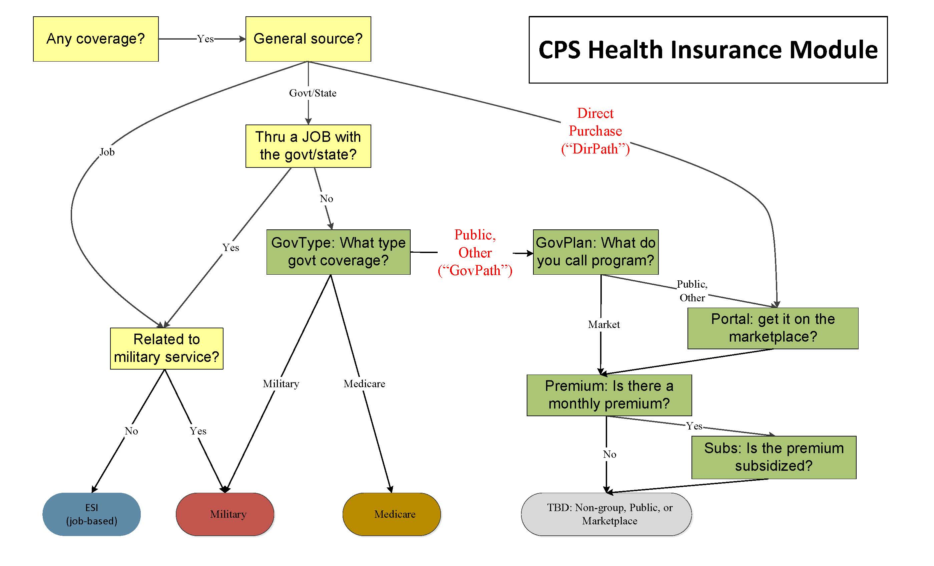

Slide 11
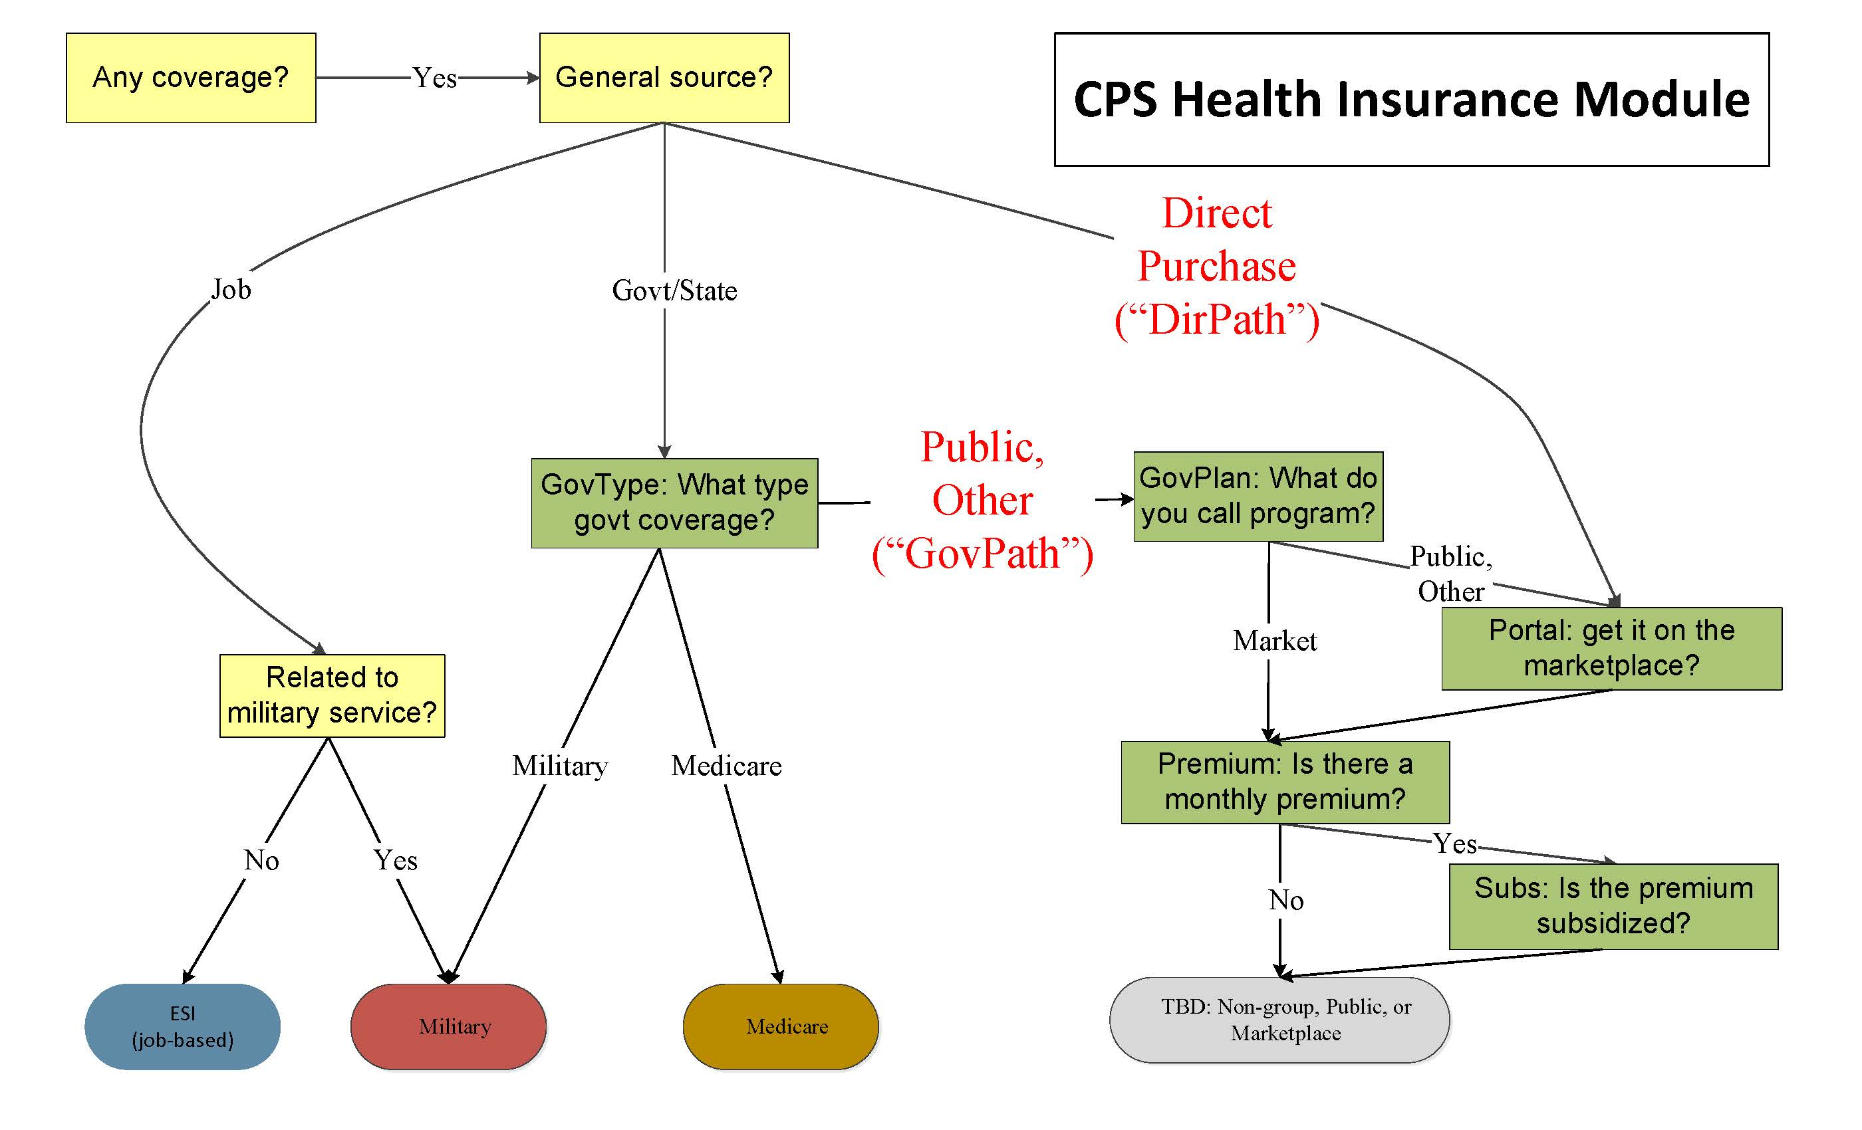

Slide 12
Creating “Permutations” of the Five Moving Parts
Collapse response categories from five key items:
GovType:
Public
Other/DK/Ref
GovPlan
Public
Market
Other/DK/Ref
Portal (Yes, No)
Premium (Yes, No)
Subsidy (Yes, No)
Create all possible permutations from the 5 items (n=150+ permutations)
Examine distribution of enrollment records within each permutation
Collapse permutations where:
Substantive answers are similar (e.g.: don’t know/refused) AND
Enrollment record distribution is similar across permutations

Slide 13
Data Reduction Example
Perm | Freq | GovType | GovPlan | Portal | Prem | Subs
A | 70 | Public | Medicaid | Yes | No | n/a
B | 22 | Public | Medicaid | No | No | n/a
C | 13 | Public | Medicaid | D/R | No | n/a

Slide 14
Data Reduction Example
Perm | Freq | GovType | GovPlan | Portal | Prem | Subs
A | 70 | Public | Medicaid | Yes | No | n/a
B | 22 | Public | Medicaid | No | No | n/a
C | 13 | Public | Medicaid | D/R | No | n/a

Slide 15
Data Reduction Example
Perm | Freq | GovType | GovPlan | Portal | Prem | Subs
A | 70 | Public | Medicaid | Yes | No | n/a
B | 22 | Public | Medicaid | No | No | n/a
C | 13 | Public | Medicaid | D/R | No | n/a
Perm | Freq | GovType | GovPlan | Portal | Prem | Subs
ABC | 103 | Public | Medicaid | Y,N,D/R | No | n/a

Slide 16
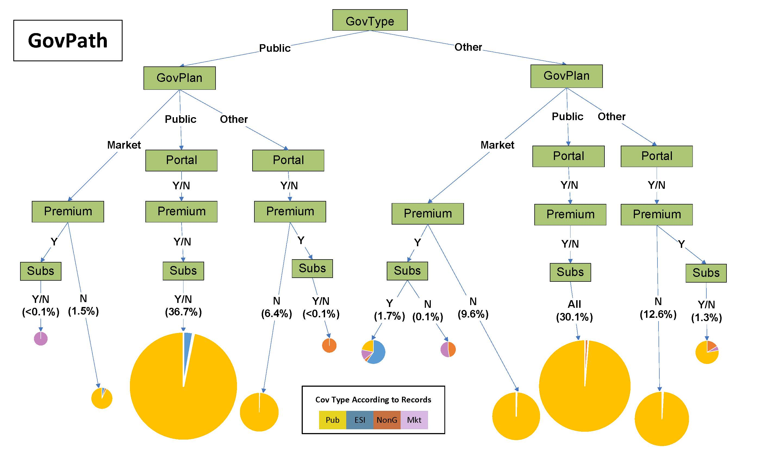

Slide 19
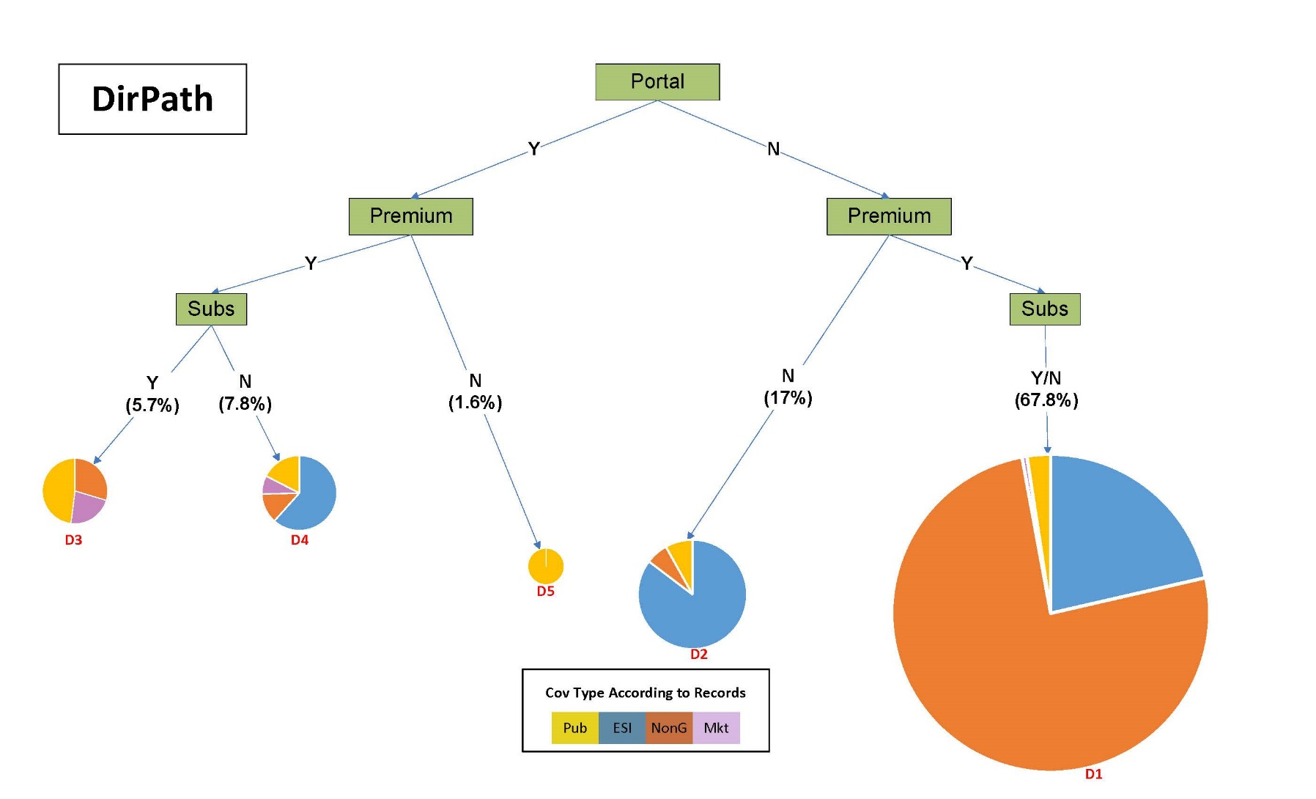

Slide 20
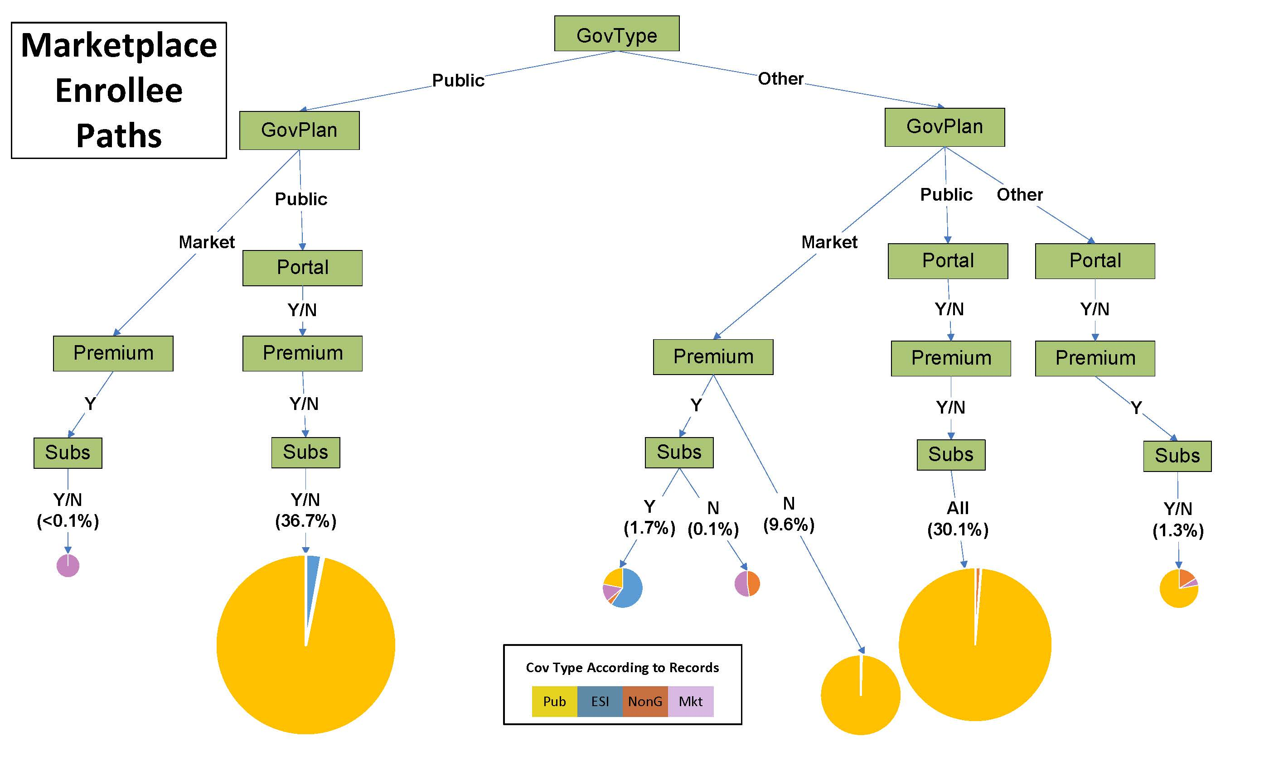

Slide 21
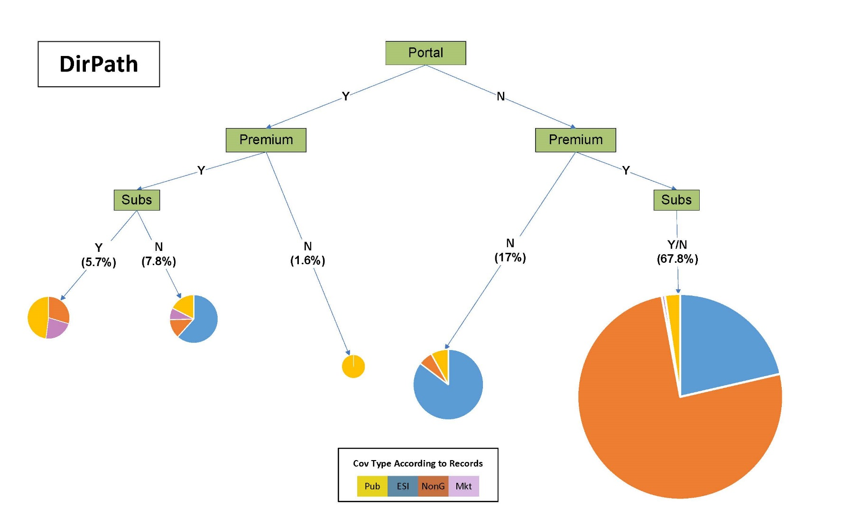

Slide 22
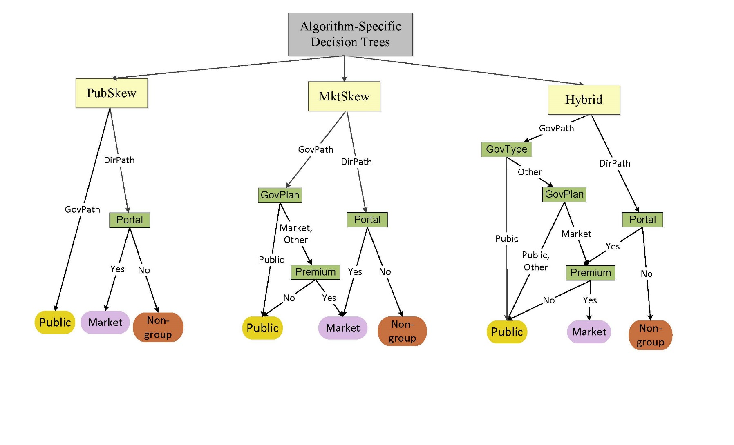

Slide 23
Results

Slide 24
Under-Reporting Trade-Offs

Slide 25
Effect of Algorithm Choice has Little Effect on Public Coverage

Slide 26
…but Marketplace Under-reporting is High Under PubSkew

Slide 27
Over-Reporting Trade-Offs

Slide 28
PubSkew and MktSkew get Higher Over-reporting of their Skew

Slide 29
Point Estimate versus Population Prevalence

Slide 30
Point Estimate versus Population Prevalence

Slide 31
Summary
Whereas:
Employer-Sponsored Insurance (ESI):
Reporting is highly accurate AND
Dominates the landscape of coverage
Marketplace
Reporting is very difficult to separate from public AND
Coverage is relatively rare
Algorithm choice has little effect on aggregated coverage types (private, public, insured) BUT
PubSkew results in exceptionally high under-reporting of marketplace, compared to MktSkew and Hybrid

Slide 32
Implications for Other Surveys
For respondents who report govt-related coverage, classifying them ALL as public means marketplace takes a big hit
Among those with govt-related coverage:
Examine other available data points on features of the coverage
Combine responses that lean away from public to identify those most likely to be marketplace enrollees

Slide 33
Thank you!
Contact Information:
Joanne Pascale
Joanne.Pascale@census.gov

Slide 34
Premium and Subsidy Verbatim Questions
Is there a monthly premium for this plan?
READ IF NECESSARY: A monthly premium is a fixed amount of money people pay each month to have health coverage. It does not include copays or other expenses such as prescription costs.
Yes
Is the cost of the premium subsidized based on family income?
READ IF NECESSARY: A monthly premium is a fixed amount of money people pay each month to have health coverage. It does not include copays or other expenses such as prescription costs.
READ IF NECESSARY: Subsidized health coverage is insurance with a reduced premium. Low and middle income families are eligible to receive tax credits that allow them to pay lower premiums for insurance bought through healthcare exchanges or marketplaces.

Slide 35
Under-Reporting

Slide 36
Over-Reporting

Slide 37
Point Estimate versus Population Prevalence

Slide 38
General Source of Coverage Reported by Strata
General Source Reported in Survey | Coverage Type According to Enrollment Records
 | Non-group | Market | Market/Unsub | Market/Subs | Medicaid
ESI | 17% | 10% | 22% | 5% | 5%
Direct purchase | 78% | 40% | 45% | 39% | 2%
Govt/State | 6% | 42% | 27% | 48% | 83%
Other | 4% | 8% | 8% | 9% | 12%
Medicare | 2% | 3% | 0% | 5% | 3%
Military | 0% | 0% | 0% | 0% | 1%
Uninsured | 1% | 1% | 0% | 2% | 5%
Notes:
Table 8

Slide 39
Marketplace, Premium and Subsidy Reporting by Strata
Data Reported in Survey |  | Coverage Type According to Enrollment Records
 |  | Non-group | Market/ Unsub | Market/ Subs | Medicaid
Marketplace | Yes | 9% | 89% | 87% | 64%
 | No | 89% | 11% | 9% | 22%
 | D/R | 2% | 0% | 4% | 14%
Premium | Yes | 97% | 95% | 95% | 12%
 | No | 2% | 5% | 6% | 87%
 | D/R | 2% | 0% | 0% | 0%
Subsidy | Yes | 5% | 9% | 90% | 87%
 | No | 91% | 86% | 9% | 14%
 | D/R | 4% | 6% | 1% | 0%
Notes:
Table 10. Among those Where General Source of Coverage was Reported as Direct or Government/State

