Slide 1
The Future Is Now: How Surveys Can Harness Social Media to Address 21st Century Challenges
Amelia Burke-Garcia, MA, PhD
Brad Edwards, MBA
Ting Yan, PhD
October 26, 2018

Slide 2

“The survey and polling business is in crisis … response rates have been falling for more than 30 years… Even high-quality face-to-face surveys rarely reach a 70% response rate these days.”
― Tourangeau, 2017

Slide 3
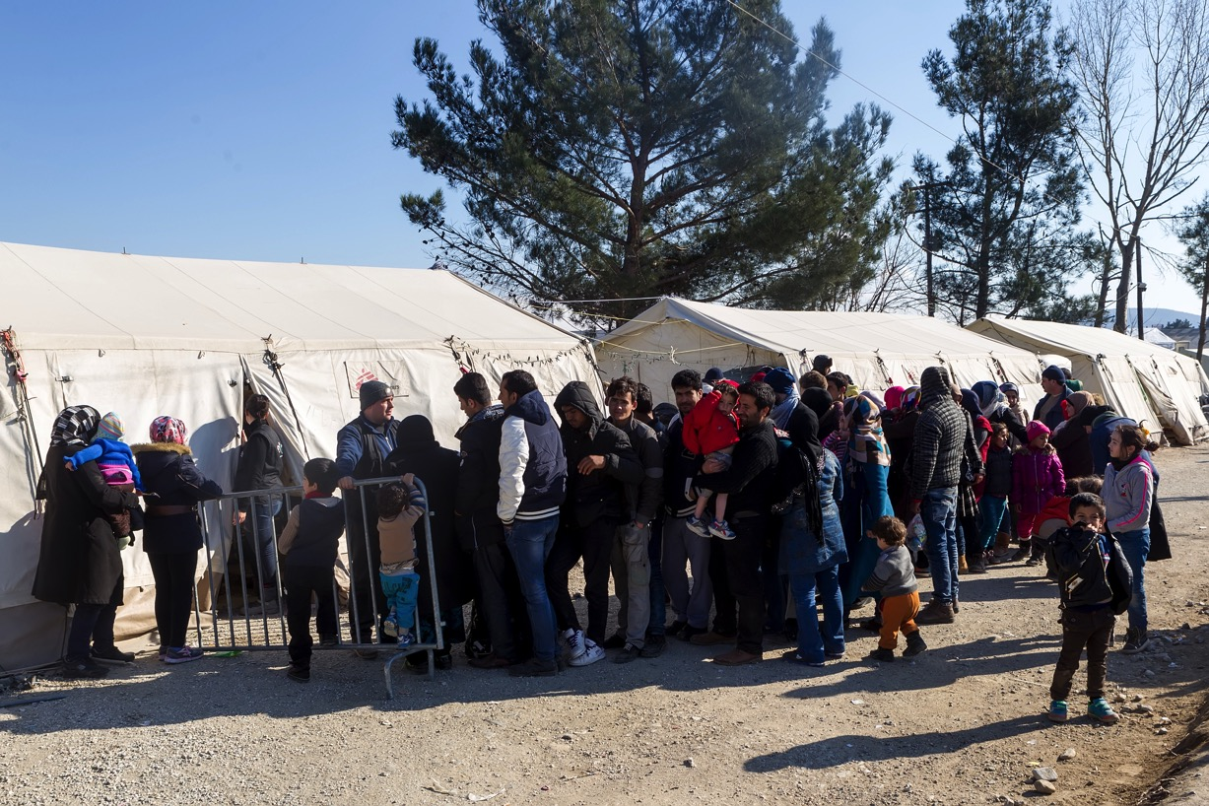
Challenges Survey Research Face Today
“One person was displaced every two seconds in 2017,
with developing countries most affected.”
― UNHCR, 2018
Mass migration
Population displacement
Declining trust in institutions
Ubiquity of mobile devices
Lower attention spans
Declining response rates
Data validity

Slide 4

“Foreign citizens made up 7.5% of persons living in
the EU Member States on 1 January 2017.”
― EuroStat, 2018

Slide 5
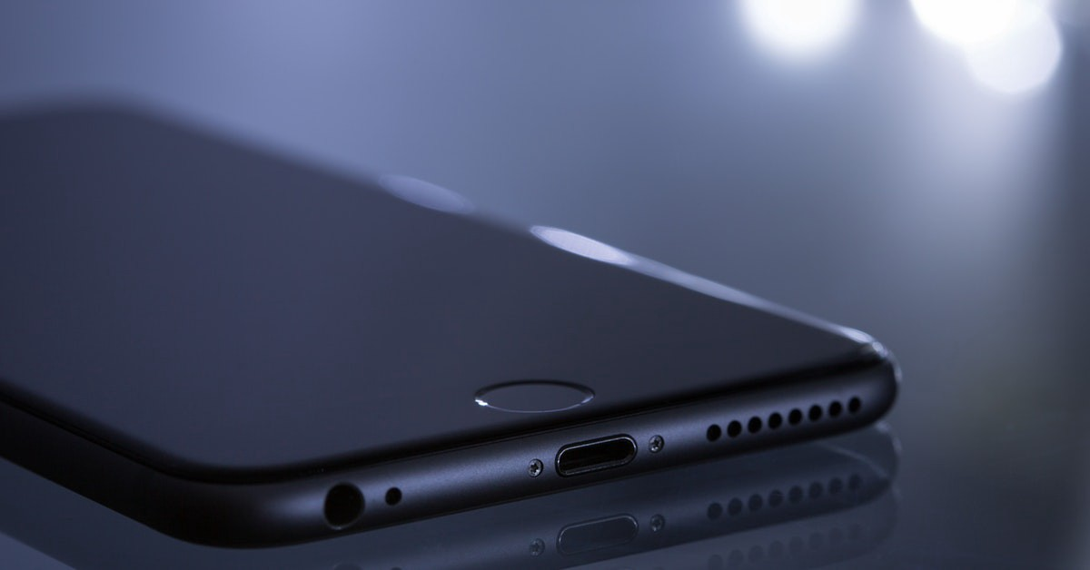
Challenges Survey Research Face Today
“One-in-five American adults are ‘smartphone-only’
internet users.”
― Pew Research Center, 2018
Mass migration
Population displacement
Declining trust in institutions
Ubiquity of mobile devices
Lower attention spans
Declining response rates
Data validity

Slide 6

Challenges Survey Research Face Today
Declining response rates
Data quality issues
“People now
generally lose
concentration
after eight seconds.”
― Microsoft, 2015

Slide 7

Challenges Survey Research Face Today
Mass migration
Population displacement
Declining trust in institutions
Ubiquity of mobile devices
Lower attention spans
Declining response rates
Data validity
“Only 18% of Americans today say they can trust the
government.”
― Pew Research Center, 2017

Slide 8

“83 percent of employed people spend more time working at the workplace than at home.”
― American Time Use Survey, 2018

Slide 9

The whole world
is getting hard
to survey.

Slide 10
“The change in the nature of the new types of data, their availability, the way in which they are collected, and disseminated are fundamental. The change constitutes a paradigm shift for survey research.”
― APPOR, 2015

Slide 11
A new survey world
“that uses multiple data sources, multiple modes,
and multiple frames.”
― Lyberg & Stukel

Slide 12
To A Broader Conceptualization of Social Media
“The context of who, what, and where we are, not just the explicit message (text or images) we communicate.”

Slide 13
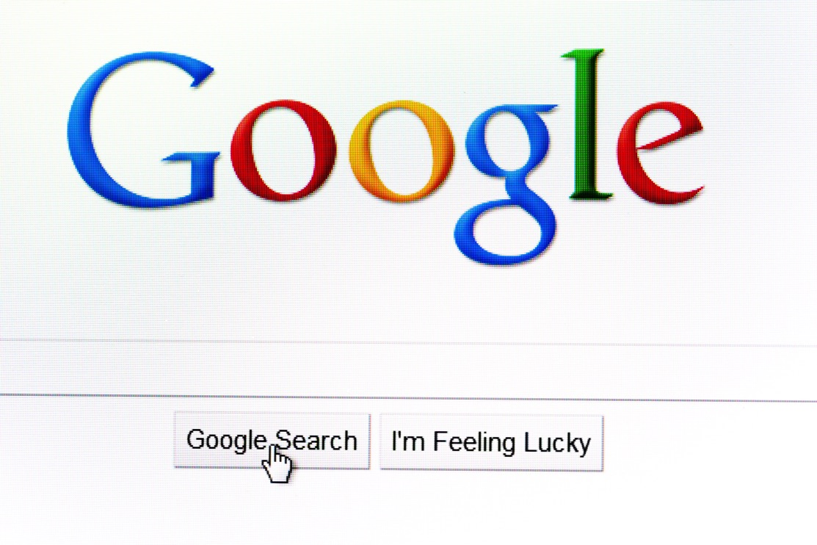
“There are more than 3,000,000 Google searches – every minute.”

Slide 14
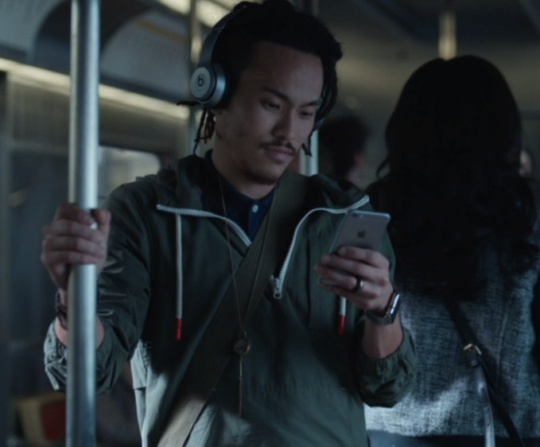
“There are more than 2 billion monthly active Apple device users – globally.”

Slide 15
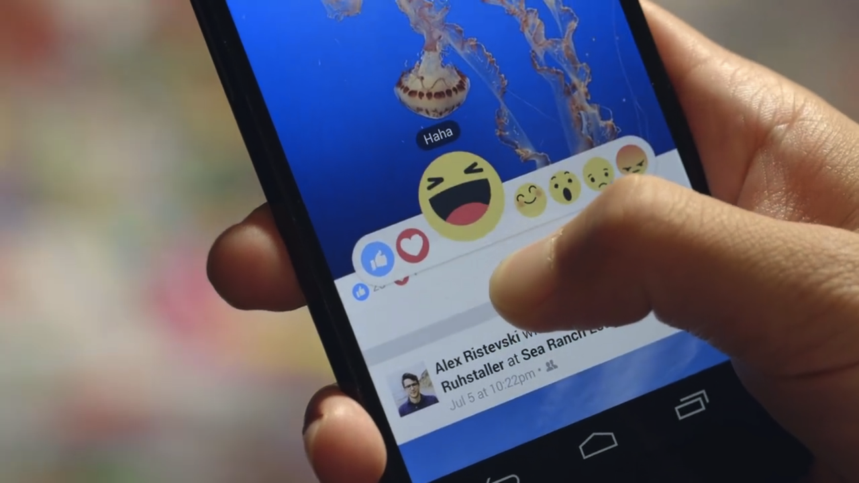
“There are more than 2.2 billion people on Facebook – globally.”

Slide 16

“There are more than 300 million monthly active Amazon users – globally.”

Slide 17
The Hard-to-Survey Framework
Sampling
Reaching
Persuading
Interviewing
Identifying

Slide 18
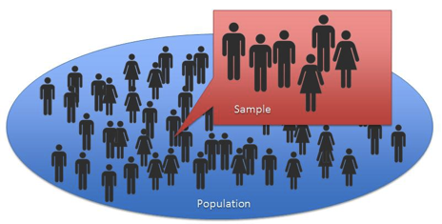
The Opportunities for… Sampling People
Venue-based, Time-Space sampling
  What is VBTS sampling?
  Translating for an online context
    Virtual events – how they work online?
    The importance of the group manager
Respondent-Driven Sampling
  Online groups
  Online influencer networks

Slide 19

The Opportunity for… Identifying People
Confirming characteristics
  Essential variables such as gender, age, and geographic locations
  Other variables, e.g., membership to certain types of groups, personal interests or passions
Lowers burden by not asking key questions via a screener
Data needs to be public

Slide 20

The Opportunities for… Reaching People
Paid social media advertising
  Promote the survey brand
  Serve direct link to web survey
  Ads can be easily developed
  Tailored to demographic and psychographic subgroups
  Designed to fit specific platforms
Tracing

Slide 21

The Opportunities for… Persuading People to Participate
Paid social media advertising
Online influencers
  The act of influencing requires a specific result: a change in thinking or behavior
  Layperson opinion leaders have the ability to share information with their readers
  They have the trust of their readers and followers

Slide 22

The Opportunities for… Interviewing People
Passive social media data mining
  Collect & analyze social data
  Which questions can be more easily answered
Active data collection
  Obtain needed services & ideas by soliciting contributions from a large group of people
  Has had dramatic impact on the speed and scale at which scientific research can be conducted

Slide 23
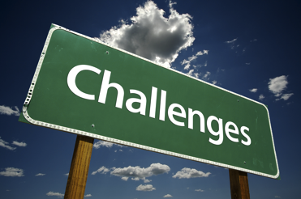
Outstanding Challenges
Platforms are rapidly changing
How populations use them is also changing, e.g., ad blockers
Inactive users/fake accounts/bots
Gaps in understanding & awareness amongst users
Transparency, privacy, consent, and appropriate use of the data
Tools to analyze data
Budget
Human error/misrepresentation
Hawthorne effect

Slide 24

Future Directions
Investment in pilot and feasibility studies
New frameworks for how to successfully integrate such data into survey research
New ways of thinking about error in survey research
Protocols for appropriately and successfully using social media

Slide 25
“We are all now connected by the Internet, like neurons in a giant brain.”
― Stephen Hawking

Slide 26

Thank you!
Amelia Burke-Garcia, MA, PhD
Director, Westat Center for Digital Strategy & Research
ameliaburke-garcia@westat.com

