Slide 1
Alternative Approaches for Measuring the Movement of Goods in the United States
Julie Parker
Bureau of Transportation Statistics
October 27, 2018

Slide 2
Commodity Flow Survey (CFS)
Component of the Economic Census
Every 5 years
Partnership: Bureau Transportation Statistics (BTS) and US Census Bureau
Shipper survey of ~100,000 establishments
Mining
Manufacturing
Wholesale Trade
Select Retail and Services
Notes:
A little background. Also, Auxiliary establishments are included such as warehouses and distribution centers.

Slide 3
CFS Data and Usage
Information collected:
Commodity
Value
Weight
Mode of Transportation
Destination
Temperature Control, HAZMAT, Exports
Data provide a comprehensive, multimodal picture of national freight flows for sampled industries.

Slide 4
CFS Process for Respondent
Questionnaire
Extract shipment data
Sample shipments
US Census Bureau
Industry Respondent
Census receives data
Enter data into online questionnaire
Find commodity codes
Notes:
They do this 4 times since reporting is quarterly for the 1 year.

Slide 5
CFS, Past & Present
Started in 1993
Many good changes since 1993:
Website
Optical character recognition
Electronic Questionnaire
Methodology
Notes:
Publish millions of rows of data

Slide 6
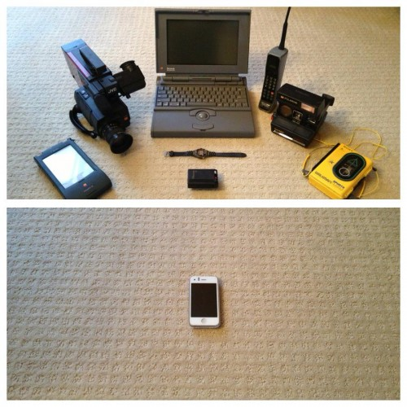
Technological Advances
1993
2017

Slide 7
AND,
Notes:
Computational power

Slide 8
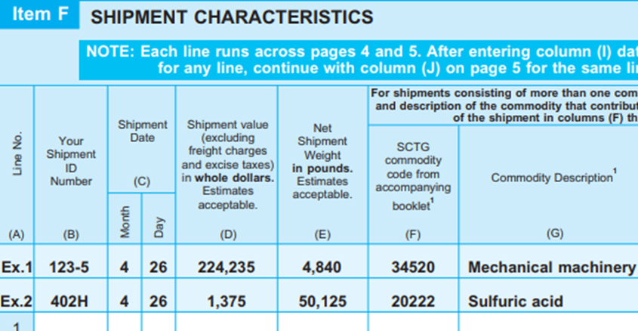
Room for Improvement
1993
2017
Notes:
Room for improvement especially with data collection.

Slide 9
Reduce Respondent Burden
Questionnaire
Extract shipment data
Sample shipments
US Census Bureau
Industry Respondent
Census receives data
Enter data into online questionnaire
Find commodity codes
Notes:
I’m going to talk about how these 2 items will reduce respondent burden.

Slide 10
Reduce Respondent Burden
Questionnaire
Extract shipment data
Sample shipments
US Census Bureau
Industry Respondent
Census receives data
Enter data into online questionnaire
Find commodity codes
Notes:
I’ll first talk about searching for commodities.

Slide 11
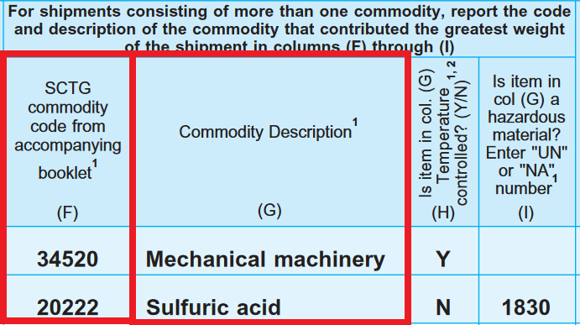
Standard Classification of Transported Goods (SCTG)
514 SCTG codes
Not used by Industries
Classification needed
Notes:
As you can see from the questionnaire, we ask for Standard Classification of Transported Goods (SCTG) and a description. Respondents essentially take that description and match it to 1 of 514 SCTG code. What also makes this more painful is that these codes are not used by industry. But, we need some kind of classification method to produce estimates.

Slide 12
Standard Classification of Transported Goods (SCTG)
514 SCTG codes
Not used by Industries
Classification needed
Notes:
1 sec - Use a segue to next slide.

Slide 13
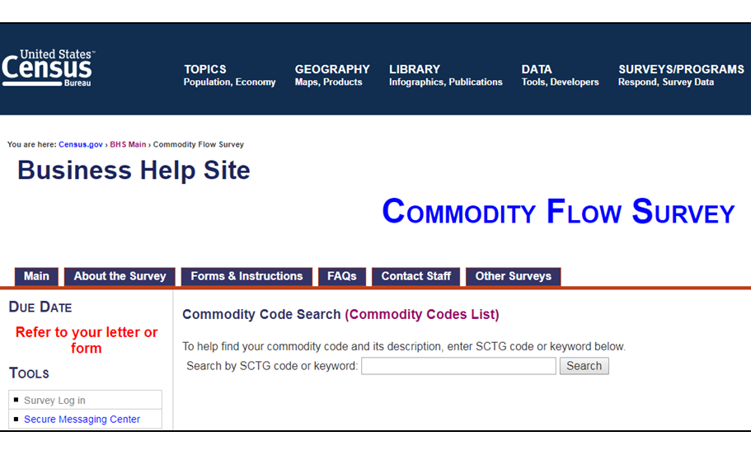
SCTG Resources
Census Business Help Site – Search Tool
Notes:
Here are some SCTG resources – PDF and online search tool (was made ad hoc). Use the pig/hog example.

Slide 14
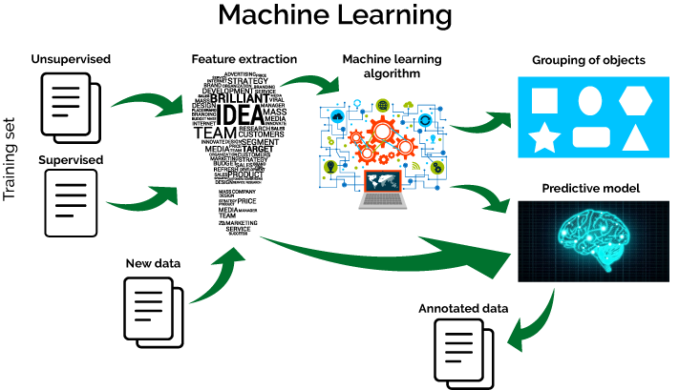
Objective: Text Classification
Create a Machine Learning Model
Assign SCTG code to shipment records
Notes:
Semi-supervised – because uses some unlabeled data (doesn’t have SCTG); classifier model

Slide 15
SCTG Machine Learning Model
Training Data: 360,000 from 500,000 shipments
6.4 million shipments from 2017 CFS
Machine Learning / Classification Algorithms: Natural Language Processing (Bag-of-Words), Logistic Regression (logit) Model, Grid Search CV
Features: 31 Variables, 514 SCTG Labels
Current model: SCTG code, Shipment Description, Industry code
Notes:
Consider all variables that benefit the algorithm

Slide 16
SCTG ML Model Results
Model Performance: 76%
“Truth” is respondent’s reported SCTG
Model is doing a better job!
Easing Respondent Burden in 2022 CFS:
2022 CFS, respondents save 50,000+ hours, $2.1 million in respondent lookup costs
Ongoing: more cleaning, relabeling, scraping new product descriptions, creating better process

Slide 17
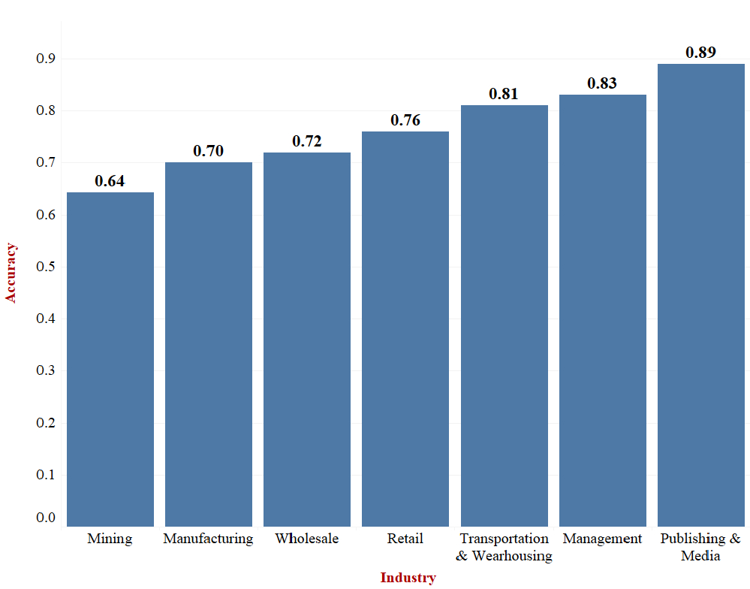
Industry Results
MANUFACTURING
Accuracy varies by industry
Notes:
We need to looks at this from an industry-level since that’s how we sample. As you can see, accuracy varies by industry. For example, manufacturing can match to 70% of the descriptions for that industry. Similar to the model performance, these estimates are effected by respondents’ reported SCTG being the truth deck.

Slide 18
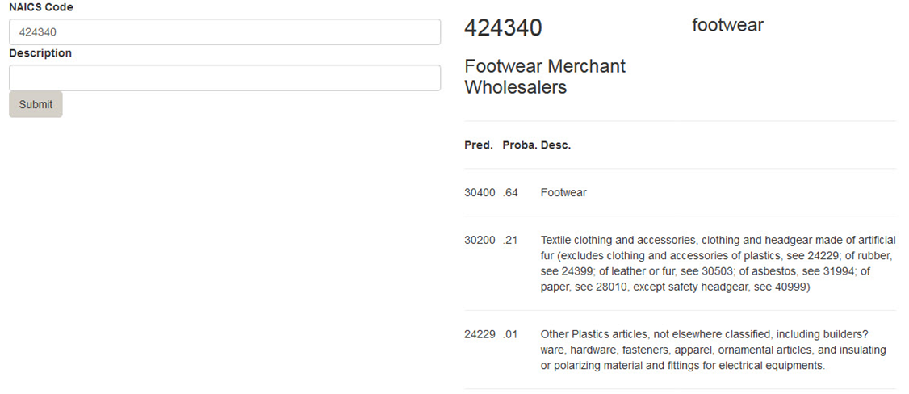
Added bonus, 2017 Edit tool
Look up potential SCTG codes for a given industry/description combination
Notes:
CFS analyst team uses it as an aid, to look up potential SCTG codes for a given NAICS/description combination

Slide 19
Reduce Respondent Burden
Questionnaire
Extract shipment data
Sample shipments
US Census Bureau
Industry Respondent
Census receives data
Enter data into online questionnaire
Find commodity codes
Notes:
Line separates Census/Respondent. It’s very difficult for businesses to find these commodities codes.

Slide 20
Provide Data from Internal Systems
Targeting Large Companies/Enterprises
3 Approaches:
BTS Research
Company-Led
CFS Team Initiated

Slide 21
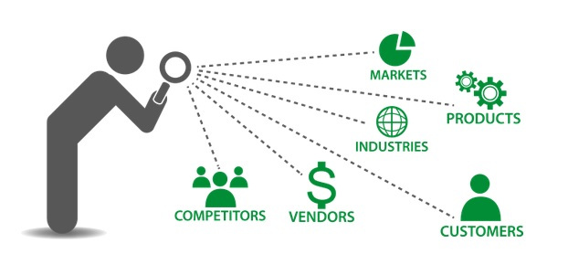
Approach 1: BTS Research
What’s Industry doing?
Outreach, attend their conferences
How’s data managed?
Are they providing data to someone else?
Supply Chain Intelligence

Slide 22
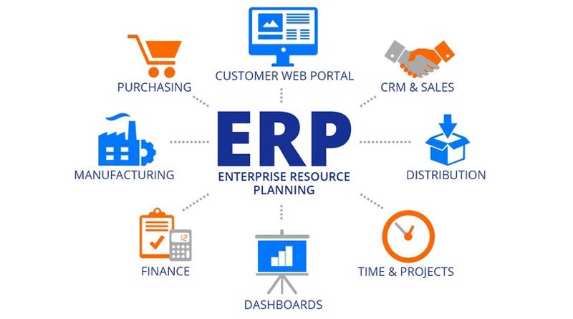
Establishment Software System
Enterprise resource planning (ERP)
Business process management software
Integrates all facets of an operation single database, application and user interface
How are these data different from what we currently get?
Notes:
It’s an integrated management system (talk about value and mode) used by large establishments – especially enterprises. There are many vendors – Oracle, SAP, Microsoft, etc.

Slide 23
Transforming Freight Flow Data Collection
Using business-to-business (B2B) data to improve CFS use as time series enabling more frequent updates and interim period reporting
ERP system
Recruiting case studies
Grocery store chain
Paper company
Notes:
This example is 1 of 3 projects that was awarded.

Slide 24
Approach 2: Company-Led
CURRENTLY: Reporting is one location at a time
Separate user names and passwords
RECENTLY: Companies are looking to reduce their burden.
Data dumps
Set up internal system
‘Click a button’
Notes:
Companies know there’s a better way. Click a button and the companies data (for multi-establishments) are sent to the government.

Slide 25
Approach 3: CFS Team Initiated
Site visit to understand how company pulls data
Nonresponse follow-up
Understand reporting issues
2022 CFS, ‘set up their system’

Slide 26
Questions and Comments
Julie.Parker@dot.gov
(202) 366-6373
Special thanks to:
Joy Sharp
James Hinckley
Mehdi Hashemipour
Christian Moscardi

Slide 27
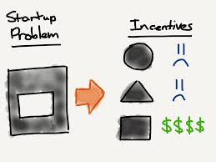
Lastly,
Notes:
Will respondents provide more data, more often, if burden is reduced? Other incentives needed? Mandatory reporting is very helpful but how far will it take us?

