Slide 1
Experiences in FBI’s NCS-X NIBRS Estimation Project
RTI International
Dan Liao
Marcus Berzofsky
Ian Thomas
Lance Couzens
Bureau of Justice Statistics
Alexia Cooper
The 1st Conference on Big Data Meets Survey Science (BigSurv18)

Slide 2
Acknowledgements
The authors would like to thank Bureau of Justice Statistics (BJS) for sponsoring this research. However, we would like to note that the views expressed in this paper are those of the authors only and do not reflect the views or position of BJS or the Department of Justice.

Slide 3
Data Quality Issues in Big Data
The “big data” revolution is is not the size or quantity of these data that is revolutionary. The revolution centers on the increased availability of new types of data which have not previously been available (Connelly, et al., 2016).
  Social Media
  Electronic Banking / Electronic Medical Records
  Administrative Records
No matter what type of data is being analyzed, questions to ask are:
  Whether the data has the proper quality that fits the statistical use?
  If errors were found, how to address these errors?
This presentation will share our experiences in a statistical project that aims to address data quality and completeness issues in the US crime administrative data.

Slide 4
Background Information on Administrative Crime Statistics
Administrative data sources of crime statistics in the US are collected from local law enforcement agencies (LEAs) by FBI’s Uniform Crime Reporting (UCR) Program.
UCR SRS (Summary Reporting System):
  collects monthly counts of crimes and arrests on main offenses from LEAs across the country since 1929
  is the only administrative data source which can provide information at a national, state and local level about the amount of crime (by type) occurring in the United States

Slide 5

National Incident-Based Reporting System (NIBRS)
UCR NIBRS (National Incident-Based Reporting System)
  a more comprehensive reporting system with detailed information on each incident, initiated in1990s
  In 2016, NIBRS agencies reported 5,237,106 incidents involving 6,101,034 offenses with 6,437,018 victims*.
  The FBI has decided to sunset the SRS program requiring all agencies to report using NIBRS by 2021. NIBRS will become national standard for crime reporting.
*Information from https://www.fbi.gov/news/stories/2016-nibrs-data-released

Slide 6

An Overview of the NCS-X NIBRS Estimation Project
The National Crime Statistics Exchange (NCS-X) is a collaborative program designed to generate nationally-representative incident-based data on crimes reported to LEAs.
The NCS-X NIBRS estimation project is an on-going two-phase project
  The first phase: develop statistical procedures to address data quality and completeness issues and create estimation procedures for generating reliable and accurate national crime indicators.
  The second phase: create a prototype system that can produce analytic products, including national estimates of key crime indicators.

Slide 7
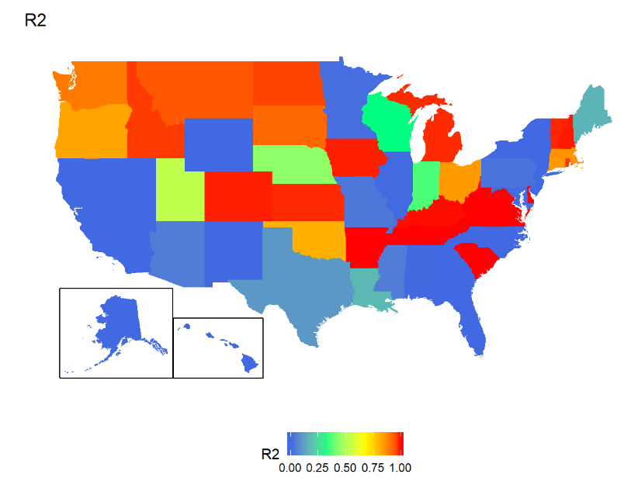
Coverage Ratio of the 2016 NIBRS Data by State
R2=$\frac{\# of the Crimes Reported to the 2016 SRS from NIBRS Reporters in the State }{\# of All the Crimes Reported to the 2016 SRS in the State}$

Slide 8
Representativeness of the NIBRS Data to Generate National Estimates
Approximately 6,900 of the around 18,000 LEAs in the United States report crimes through the NIBRS system.
The current NIBRS data is considered to be non-representative of the nation.
  The crime rates among the NIBRS reporters are appreciably lower than NIBRS non-reporters (McCormack, Pattavina and Tracy, 2017).
  The noncoverage bias on NIBRS estimates of violent crime is unignorable (Addington, 2008).

Slide 9
Address Representative Issues Through a Supplementary Probability Sample and Statistical Weighting
NCS-X Sample Agencies
  In 2012, NCS-X initiative selected 400 specific agencies via a probability sampling scheme to transition from SRS to NIBRS.
  Large agencies with 750+ sworn officers were all selected into this sample.
  The UCR SRS data were used in the development of the sampling design.
  To date, around 50 agencies have completed their transition.
Statistical Weighting
  With more agencies transitioned to NIBRS including the NCS-X sample agencies, statistical weighting procedures are in planning to compensate for nonreporting agencies.
    Weighting: Nonprobability Sample + Probability Sample
    The feasibility of producing national estimates with the NIBRS data will be assessed.

Slide 10
Missing Data in NIBRS
Missing Data in NIBRS
Missing Entire Incident
Rejected by the State Program
Missing Value in a Variable
Logic Skips
Truly Missing
Rejected by FBI
LEA’s Failure to Submit

Slide 11
Data Segments in the NIBRS Data
Agency #
Arrestee #
Offender #
Victim #
Incident #
Property
Offense
Administrative

Slide 12
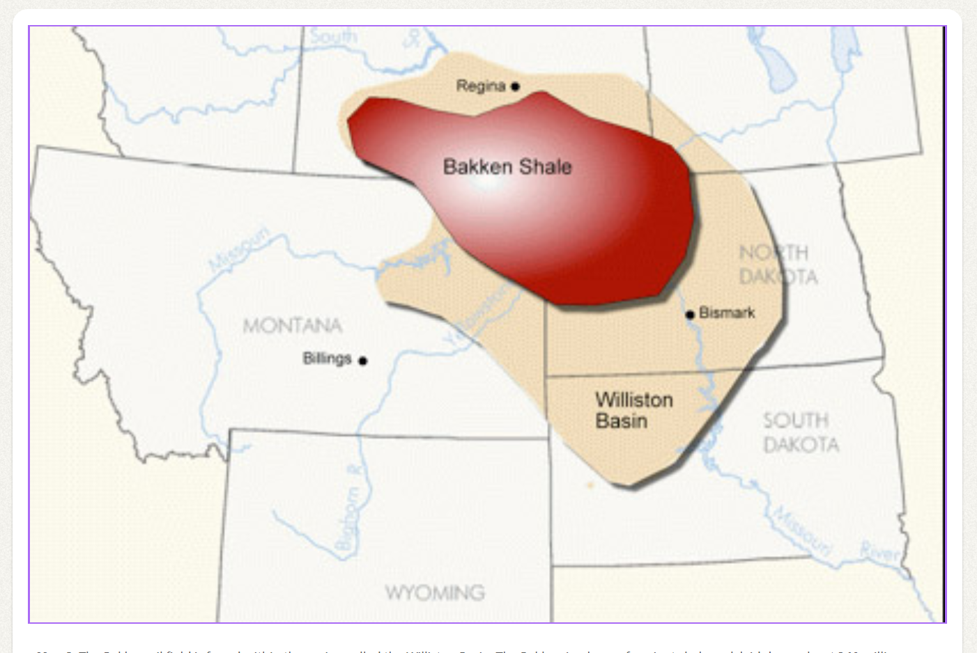
Pilot Study: Crime in the Bakken Region (2006-2012)
*Picture from: https://www.ndstudies.gov/gr8/content/unit-iv-modern-north-dakota-1921-present/lesson-1-changing-landscapes/topic-5-energy/section-3-oil
The purpose of this study is to use the NIBRS data to examine how crimes reported to the police have changed in the Williston Basin/Bakken region as oil and natural gas production increased.

Slide 13
Multiple Data Sources
Main Data File: NIBRS
    Montana, South Dakota and North Dakota are 100% reporters to NIBRS (no coverage error).
Auxiliary Data
  UCR’s SRS Data: monthly crime counts by violent and property victimizations
  UCR’s LEOKA (Law Enforcement Officers Killed and Assaulted): characteristics of each agency (e.g. number of officers)
  BJS’s LEAIC (LEA Identifiers Crosswalk) file: agency type
  Annual Population Estimates from the US Census: these estimates are available for all counties in the Bakken region in the period of interest and are disaggregated by sex and age groups

Slide 14
Decomposition of Data Missingness
NIBRS data is missing in a hierarchical structure
  Item nonresponse at victim/incident level (e.g. weapon, injury, victim and offender relationship)
  Unit nonresponse at agency level
    some agencies do not report to NIBRS in the entire year
    some agencies report to NIBRS in a partial year (i.e. Partial Reporters)
 | Jan | Feb | Mar | Apr | May | Jun | Jul | Aug | Sep | Oct | Nov | Dec
Agency1 | √ | √ | √ | √ | √ | √ | √ | √ | √ | √ | √ | √
Agency2 | √ |  |  | √ |  |  |  |  | √ | √ | √ | √
Agency3 | √ | √ | √
Agency4

Slide 15
Hot Deck Imputation for Hierarchical Data
First Step: Imputation at Victim Level
    item missingness in three variables: a) presence of weapon, b) injury sustained, and c) victim-offender relationship
  Identify useful matching variables among the NIBRS data and other auxiliary data via a series of statistical analyses
  hot deck imputation using the matching variables
Second Step: Imputation at Monthly-agency Level
    Unit missingness due to nonresponse at the agency level
  hot deck imputation using matching variables to identify donor pool for each missing agency
  the entire record of the selected donor is used to impute the missing agency

Slide 16
Imputation Procedure for Data with a Hierarchical Structure
County level
A.1
Inc. 1
…Inc. N
A. 2
Inc.1..N
Annual County Level
Monthly Agency Level
Incident Level
Vic. 1
Vic. 2
Victim Level
A. 3

Slide 17
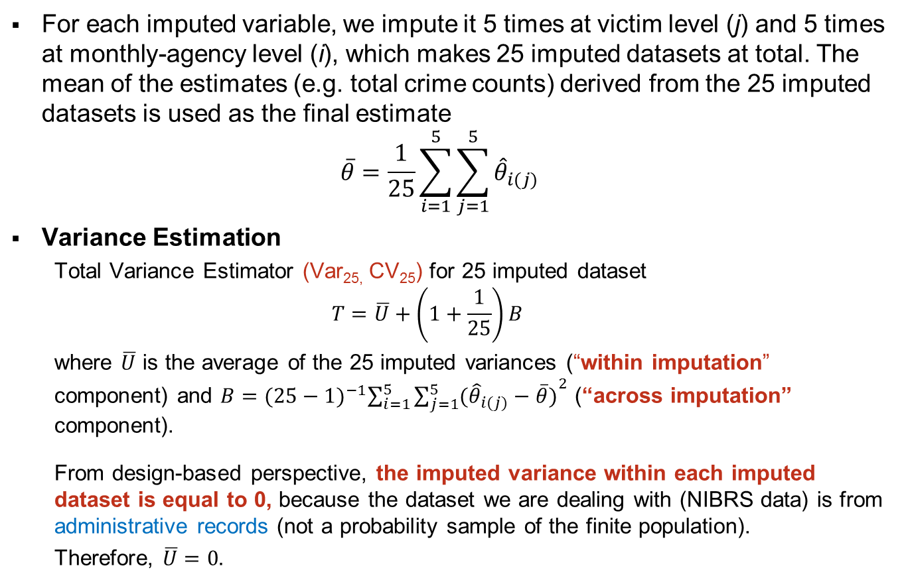
Multiple Imputation
For each imputed variable, we impute it 5 times at victim level (j) and 5 times at monthly-agency level (i), which makes 25 imputed datasets at total. The mean of the estimates (e.g. total crime counts) derived from the 25 imputed datasets is used as the final estimate
  $$\overline{θ}=\frac{1}{25}\sum_{i=1}^{5}{\sum_{j=1}^{5}{{\hat{θ}}_{i(j)}}}$$
Variance Estimation
    Total Variance Estimator (Var_{25,} CV₂₅) for 25 imputed dataset
    $$T=\overline{U}+\left(1+\frac{1}{25}\right)B$$
    where $\overline{U}$ is the average of the 25 imputed variances (“within imputation” component) and $B={(25−1)}^{−1}\sum_{i=1}^{5}{{\sum_{j=1}^{5}{({\hat{θ}}_{i(j)}−\overline{θ})}}^{2}}$ (“across imputation” component).
    From design-based perspective, the imputed variance within each imputed dataset is equal to 0, because the dataset we are dealing with (NIBRS data) is from administrative records (not a probability sample of the finite population).
    Therefore, $\overline{U}=0.$

Slide 18
Presence of Weapons in Violent Crime Victimizations

Slide 19
Summary
The NIBRS data has the great potential to change the landscape of crime research in the US. It becomes a pressing need to address the data quality issues of the NIBRS data before using it for statistical purposes.
Techniques from survey research are widely incorporated in multiple aspects of this project to address data quality issues in this data, including sampling, weighting, imputation techniques.
The Bakken study is a small step taken to address missing data problem in NIBRS. With more information provide by FBI and BJS, we will revise the current imputation strategy and will compare the performance of different imputation methods on addressing missing data problem in this hierarchical data.

Slide 20
Discussions
The sources for the administrative data are usually decentralized (e.g. each LEA submits data separately)
  Data quality needs to be assessed within and across LEAs.
  Coverage error is related to agencies of different sizes. Participation of the large agencies is important to enable the production of national estimates.
The data structure of the administrative data can be much more complex than survey data. Missing data can occur at multiple levels/segments and need be decomposed before applying imputation techniques.
Timeliness and Accessibility
  Automate procedures that can address the data quality errors and test the adjustment results are required to make timely statistics.
  When using auxiliary data sources, their data quality, timeliness and accessibility need to be considered.

Slide 21
More Information
Dan Liao
Research Statistician
301.816.4615
dliao@rti.org

