Slide 1
Residential Scene Classification for Geo-Sampling in Low and Middle Income Countries (LMICs)
Rob Chew, Safaa Amer, Jamie Cajka, Kasey Jones,
Justine Allpress, Mark Bruhn, Jenn Unangst
BigSurv18 - Oct 26th 2018

Slide 2
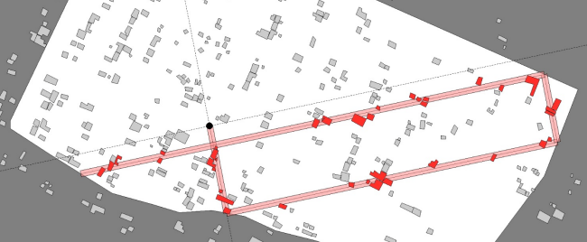
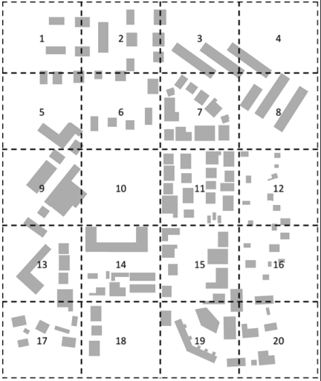
Sampling in Low and Middle Income Countries
Sample design in LMICs is difficult due to:
Lack of complete sampling frame
Outdated census
Inaccurate population estimates
Find ways to implement probability-based sampling, avoid selection bias
Move away from random walks and sampling without a listing/re-listing exercise
Represent full population across different geographic locations, urban/rural, poverty levels, gender, age
Above: Random Walk sampling
Right: Geo-sampling

Slide 3
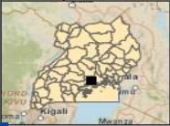
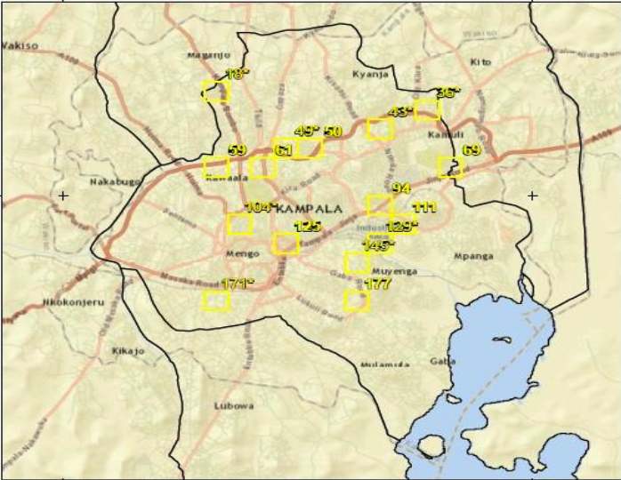
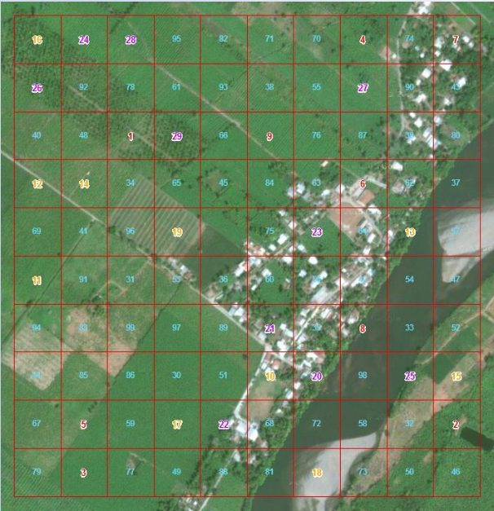
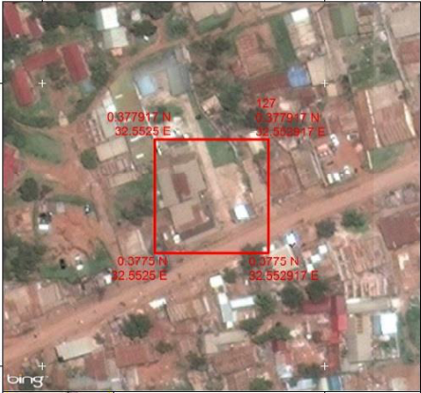
What is Geo-sampling?
A complex sampling design supported by Geographic Information Systems
Barriers: Multi-stage Sampling Design
Step 1: Stratify by Region and Poverty Level to select states/counties
Step 2: Stratify by Urban/Rural to select Districts with Probability Proportional to Size
Step 3: Select primary grid units (PGUs) with Probability Proportional to Size
Step 4: Select secondary grid units (SGUs) and interview all households within the SSU
Step 5: Select respondent within households – adult age 15 to 64
Select States
Select Districts
Select PGUs
Select SGUs

Slide 4
Can we improve SGU selection?
Many SGUs are sparsely populated; costly to send interviewers to grids without households
During selection, cells without residential dwellings are excluded
Currently, human coders examine thousands of SGU images and classify them as either containing a residential dwelling or not
To further reduce the level of effort and cost of Geo-sampling, we developed a machine learning model that predicts whether an SGU grid contains residential dwellings

Slide 5
Benefits of Approach
Reduction in manual resources and calendar time needed for labelling images on future Geo-sampling projects
Simplifies sample weighting
Increases the precision of calculating the probability of selection and avoids assumptions about the population distribution

Slide 6
Data
High-resolution aerial images from two states in Nigeria and one state in Guatemala
720 x 720 px
Google, Bing, ESRI
Two datasets
Nigeria
~5.3k images
63% non-residential
37% residential
Guatemala
~1.5k images
67% non-residential
33% residential
Data split into Training (85%) and Validation (15%), stratified to preserve class balance
Residential
Non-Residential

Slide 7


Methodology
Object Recognition
Determining what an image is
E.g. “Is this a cat?”
Object Detection
Determining the number and location of objects in an image
E.g. “How many cats are in this image? Where are the cats?”

Slide 8
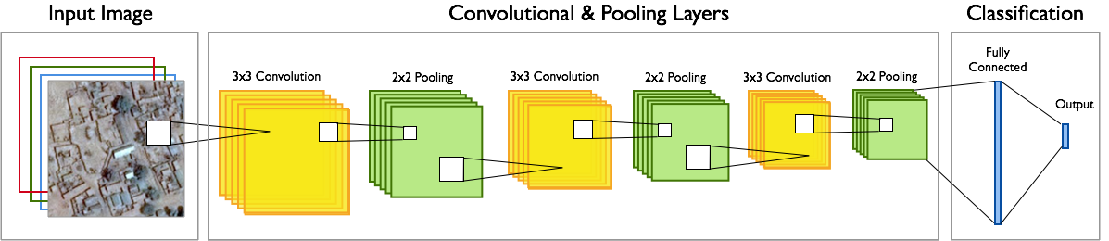
Methodology – Image Recognition
Modern image-based machine learning relies heavily on the use of neural networks
There are three major neural network layers that all models we assessed used:
Convolution: A map of how well a feature(s) occur in an image
Pooling: Shrinking the amount of information we are processing
Activation: A function converting values to a given range

Slide 9
Methodology – Transfer Learning
Transfer Learning: Leveraging the power of a pre-trained model to solve a new problem
Models trained on large data sets in one domain sometimes find good local minima that transfer well to a new problem domain.
Benefits:
Reduced training time
Often, good accuracy
Minimal additional coding
Examples:
VGG16
Xception
Inception
ResNet50
Notes:
ImageNet: ImageNet is an image dataset organized according to the WordNet hierarchy. Each meaningful concept in WordNet, possibly described by multiple words or word phrases, is called a "synonym set" or "synset". There are more than 100,000 synsets in WordNet, majority of them are nouns (80,000+). In ImageNet, we aim to provide on average 1000 images to illustrate each synset. Images of each concept are quality-controlled and human-annotated. In its completion, we hope ImageNet will offer tens of millions of cleanly sorted images for most of the concepts in the WordNet hierarchy.
VGG16 is a convolutional neural network. Achieved ~93% Top-5 test accuracy in ImageNet. (14 million + images belonging to 1000 classes

Slide 10
Benchmarks
Human Benchmark
Could this process be a replacement / reduction for human coding?
To create naïve benchmark, we calculated the raw agreement between two independent coders, prior to adjudication.
Instead of comparing the disagreement between a modeled prediction and a coder, comparing the disagreement between two coders.
OSM+ESA
Modeling on aerial images is unnecessary if residential information is already captured in existing datasets.
OpenStreetMaps (OSM): Large open geospatial database with crowdsourced annotations of roads and buildings for areas worldwide.
European Space Agency (ESA): open land cover data set used to study the effects of climate change.
Created models based on these curated features for comparison.
Notes:
The SGCs were individually evaluated by coders to determine if they contained one or more residential buildings within the image (add example residential and non-residential grid images). This process was completed using a GUI tool developed within ArcGIS for applying a residential or non-residential label to each of the grid cells. The data was labelled by two independent coders, with a senior GIS analyst acting an adjudicator to settle disputed labels and to ensure consistency and accuracy in selection.
To provide a naïve human-level benchmark for this task, we computed the raw agreement (Carletta 1996) between our two independent coders , prior to adjudication. The raw agreement for two coders can be calculated by the following:
$$Raw Agreement = \frac{1}{N} \sum_{i=1}^{C}{n_{ii}}$$
where $N$ is the total number of images that are jointly labelled by the two coders and $n_{ij}$ is the number of cases assigned as $i$ by Coder 1 and $j$ by Coder 2 for categories $i,j$ = 1,...,$C$.
Though other measures of inter-rater reliability have been developed to correct for when coder agreement occurs by chance (Cohn 1960, Landis & Koch 1977), the raw agreement most closely mirrors the commonly used “model accuracy” evaluation metric, where instead of comparing the difference in labels between two humans, we compare the difference between a gold-standard human label and a model prediction. Additionally, since the raw agreement does not penalize for chance agreement, it is a more difficult benchmark to exceed than the other inter-reliability metrics considered. Of the 5,350 Nigeria images, coders disagreed on labels for 482 grids, resulting in a raw agreement of 91.0%. Of the 1,500 Guatemala images, coders disagreed on 44 grids, resulting in a raw agreement of 97.1%.
==============
To ensure that the methods could be reproduced in new countries, we only considered data sources that were both open source / freely available and had a global scope.
We assessed the OSM+ESM data set on seven different classifiers (decision trees, gradient boosting trees, AdaBoost, random forest, logistic regression, support vector machines, and k-nearest neighbors) using the scikit-learn package in Python (Pedregosa et al. 2011). The models were run for both Nigeria and Guatemala using the same training and test splits as the deep CNN models for comparability.

Slide 11
Findings
Dataset | Nigeria | Guatemala
Baseline CNN | 88.9% | 93.3%
VGG16 | 93.4% | 96.4%
InceptionV3 | 93.6% | 95.6%
VGG16 + InceptionV3 Ensemble | 94.5% | 96.4%
Decision Tree | 80.3% | 93.8%
Gradient Boosting Trees | 80.3% | 93.8%
AdaBoost | 80.6% | 92.9%
Random Forest | 80.1% | 93.8%
Logistic Regression | 80.6% | 93.8%
Support Vector Machines | 79.9% | 93.8%
K-Nearest Neighbors | 75.6% | 92.4%
Human Benchmark* | 91.0% | 97.1%
Trained directly from images
Trained from crowdsourced administrative database
* Raw agreement across two independent coders
Notes:
One possible explanation for the difference in performance for the GIS feature models between Nigeria and Guatemala may be due to the completeness of the OpenStreetMaps (OSM) database between the two countries. Lending some evidence toward this notion, a recent study on road network completeness in OSM (Barrington-Leigh & Millard-Ball 2017) found that Nigeria had a lower estimated fraction of roads captured (36%) than Guatemala (47%). Additionally, our PGUs in Nigeria may be the types of areas to be less likely to have good coverage in OSM . While using a GIS feature model may become more reliable as developing countries get better coverage, the models trained on satellite images have not suffered from this limitation.

Slide 12
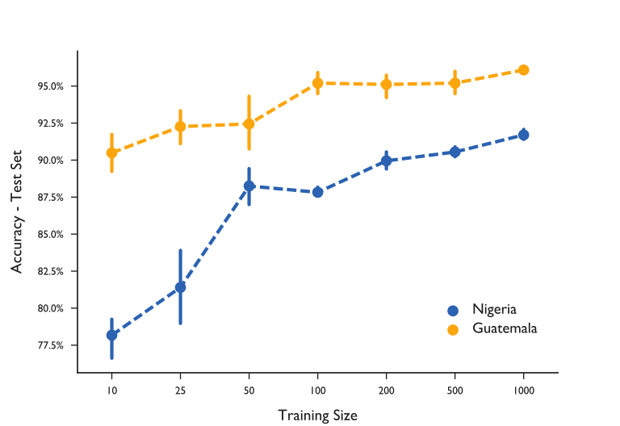
Learning Curves
Operationalizing in new countries requires re-training on images from the new countries.
Created learning curves to test how sensitive model performance is to training size
Notes:
Operationalizing this method in new countries will require re-training the models with images from the new countries. To better understand the expected data annotation burden, we created learning curves to test how sensitive model performance is to training size (Amari et al. 1992). Figure XX shows the test set accuracy and 95% confidence intervals for training set sizes at 10, 25, 50, 100, 250, 500, and 1000 images. Five randomly sampled training sets were created and trained for each set size, stratified to preserve the class ratios seen in the original training sets. The five trained models for each training set size were then run on the corresponding countries complete validation set to determine accuracy metrics. Though results are only presented for the pre-trained VGG16 model, the learning curves showed similar trends for InceptionV3.
As expected with smaller training sizes, there is a lower average and larger variance in the accuracy for both Nigeria and Guatemala. Average accuracy increases as training size increases, from 78.2% (n=10) to 91.7% (n=1000) in Nigeria and 90.5% (n=10) to 96.1% (n=1000) in Guatemala. Though neither sets of models at these sample sizes exceed the human-level benchmarks, they do approach the baseline with modest amounts of training data. This finding both supports the robustness of transfer learning and the more practical case for portability to new areas.

Slide 13
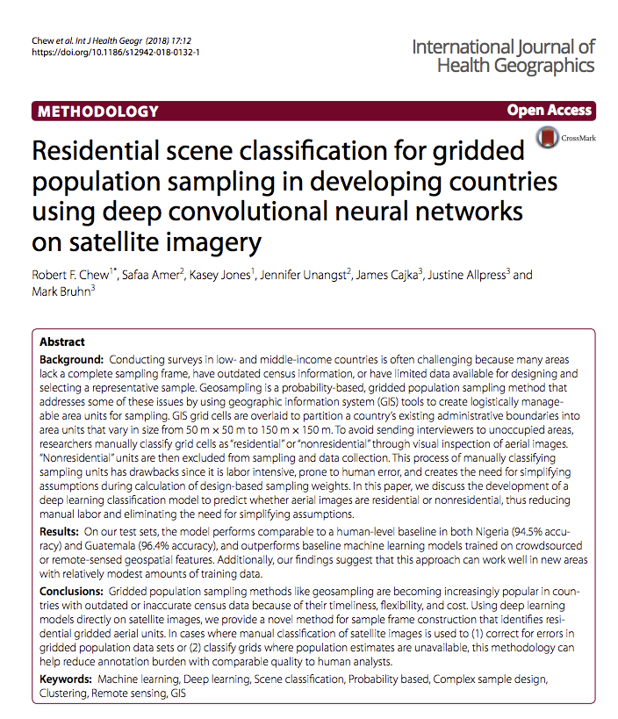
Questions?
Rob Chew
Research Data Scientist
rchew@rti.org

