Slide 1
SowiDataNet
Counteracting the Growing Disparity of the Data Landscape
in the Social and Economic Sciences in Germany
Monika Linne, Data Archive for the Social Sciences
GESIS – Leibniz Institute for the Social Sciences

Slide 2
Time Frame: 01.04.2014 – 31.03.2017
Research data network for the Social and Economic Sciences:
a new infrastructure for archiving and distribution of quantitative research data of the social and economic sciences
Funded by

Slide 3
Project Partners
Project lead
Main Focus on Infrastructure
Ideal combination of research and infrastructure expertise from the Social and Economic Siences: Essential prerequisite for the implementation of a community driven repository
Main Focus on Research
German Institute for Economic Research

Slide 4
Current Situation
Fissured data landscape in Germany:
Decentralized and unstandardized preparation of data documentation
Scattered data archiving in different organizations, repositories, research data centers
No central search and archiving portal
Dissemination over several independent data portals, research data centers
Data search is extensive and cumbersome, data is very hard to find, efficient re-analysis is hampered
Researchers are reluctant to data sharing
Funders more and more demand for data publication

Slide 5
How can SowiDataNet counteract?
Comprehensive requirements analysis
Community driven implementation of a convenient documentation tool
Low barriers enhance the acceptance of SowiDataNet
Good instructions for data providers
Contact person (curator) for questions
Customized/ local usage for scientific organizations with corporate design
Establish a data sharing mentality in Germany
Reduce reluctance of data sharing
→ SowiDataNet is open to all researchers and scientific organizations from the Social and Economic Sciences

Slide 6
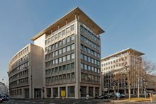
Where does the data come from?
Organizations without own research data infrastructure
Organizations with own research data infrastructure
Research data centers
Individual researchers
Bringing Social and Economic Research Data Together

Slide 7
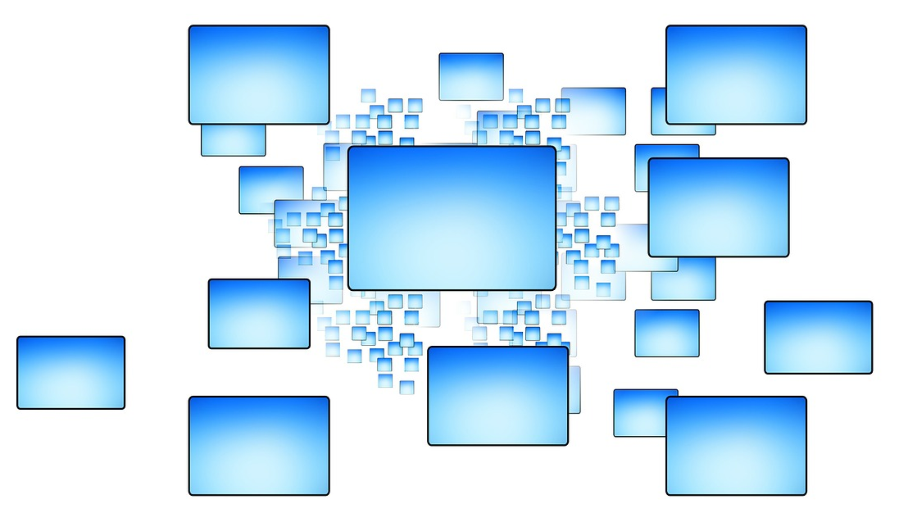
Purpose and Features of SowiDataNet
Organizations without archiving tools can use SDN for data documentation
Autonomous documentation of quantitative research data from individual researchers
Implementation of a web-based infrastructure for research data
Interface-based usage of SDN on institutional websites (customized view)
Central search portal
Bringing together research data from different sources and data providers
Referencing data held in other organizations and research data centers

Slide 8
Purpose and Features of SowiDataNet
Modular system (future extension by other disciplines possible)
Data access by direct download or linking to institutional data base
Implementation of a web-based infrastructure for research data
Following metadata standards (DublinCore, DataCite)
Bitstream Preservation
Data Review
Integrating Social Media (discussion forums, notification features, rating options)
DOI Registration
Notes:
Data Review carried out manually, by a ‘curator’.
The review contains technical controls for file formats, data readability, and is checked for viruses. Furthermore, integrity of data and documentation, completeness, data quality, intellectual property and legal aspects are clarified and verified.

Slide 9
Implementation of prototype:
Building on recent datorium developments
http://portal.sowidatanet.de:9191/xmlui/

Slide 10
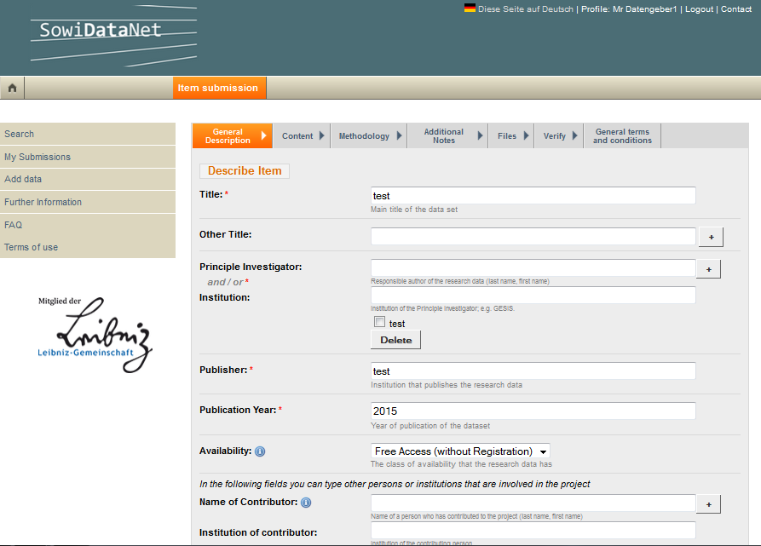

Slide 11
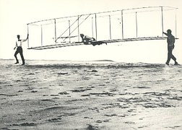
Currently…
…we are testing.
Several test persons from different Organizations (heterogeneous group of users)
Tests with big and heterogeneous data sets
Consolidation of the results
Discussion of results
Adjustment of prototype

Slide 12
Questions
Comments
Feedback

