Slide 1
Cooperation of an archive and an NSI to add value to detailed non-anonymised microdata
The Slovenian good practice
Sebastian Kočar (Slovene Social Science Data Archives)
5th Conference of the European Survey Research Association – ESRA 2013
Ljubljana, Slovenia
July 2013

Slide 2
The current state of art – issues and solutions
The issues and the solutions
Statistical Office of the Republic of Slovenia (SORS) collects a great amount of data
in theory, registered researchers can access all their official statistics microdata
the distributed microdata, available in the safe room or by the remote access, are not ready for analysis immediately
no structured metadata are made available to researchers
Social Science Data Archives (ADP) can add value to those detailed non-anonymised microdata in cooperation with SORS

Slide 3
An overview of our cooperation in the past
Cooperation
has been going on since the establishment of the Slovenian Social Science Data Archives (ADP)
ADP has been distributing anonymised SORS microdata (selection of variables, samples) and structured metadata
Labour Force Survey, Household Budget Survey, Time Budget Survey, Crime Victim Survey, Census 2002
less intense cooperation between 2002 and 2011, no newly distributed SORS microdata
partnership of both organizations in the project since May 2011

Slide 4
DwB as an initiative for increasing the cooperation
Cooperation
the main goal of the project is to improve the research environment, access to detailed official statistics microdata in Europe
we recognized the need to concentrate on improving the research environment, access and quality of access to (detailed) official statistics microdata, on the national level
the products of our work inside of separate work packages could be used in modified form to achieve cooperation goals easier
without close cooperation with SORS departments, finishing WP5 tasks efficiently would be almost impossible for ADP

Slide 5
The purpose and the aim of our cooperation – ADP‘s POV
Cooperation
one of Social Science Data Archives‘ missions is to provide quality microdata and metadata to different groups of data users: under-graduate students, postgraduate students, young researchers at faculties, research organizations, registered researchers
by distributing mostly Public Use Files on our webpage, we can‘t concentrate on the needs of experts in the social sciences field, namely registered researchers and research institutes
ADP can also help SORS with its experience and expertise in the field - researchers can benefit in the long term

Slide 6
Forms of cooperation
Forms of cooperation
microdata: intensive work on deindividualized microdata, ready to be used immediately for statistical analysis using preferred software
microdata: preparing PUF files, later distributed by ADP
metadata: analysis of possible automatic harvesting
metadata: preparing structured metadata for researchers
metadata: counseling on inclusion of DDI standard to SORS procedures
activities to promote official statistics microdata scientific use, workshops for students

Slide 7
Preparing deindividualized microdata – what we do
Forms of cooperation
preparing deinvidualized microdata in the safe room environment, the same access conditions as for other registered researchers
SPSS is used, SPSS syntax is written
variable and value labels, missing values are added to the dataset; additional logical control is made, unneeded variables are deleted, variables in databases are connected to codebooks used
by using SPSS syntax prepared, microdata can be exported in any desired format, readable by variety of software used by researchers

Slide 8
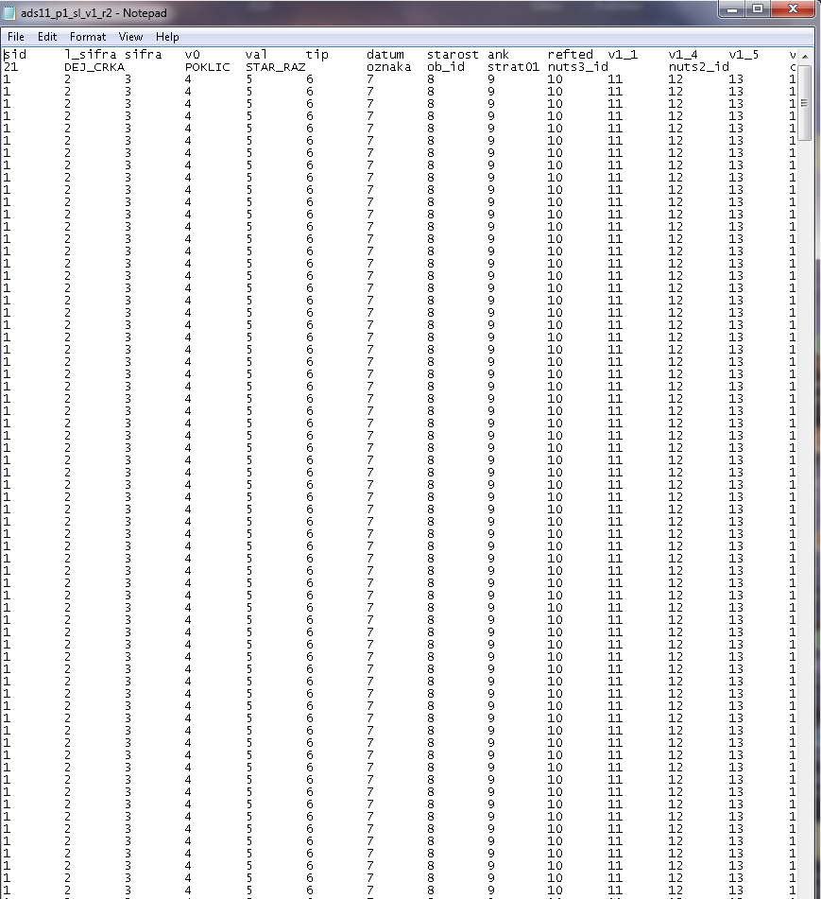
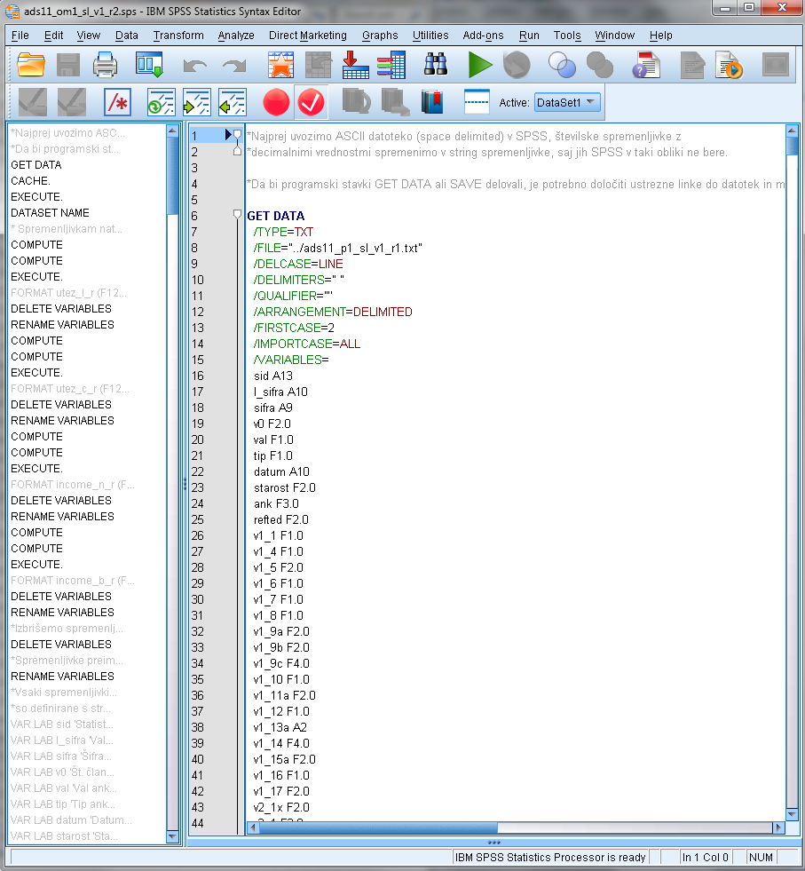
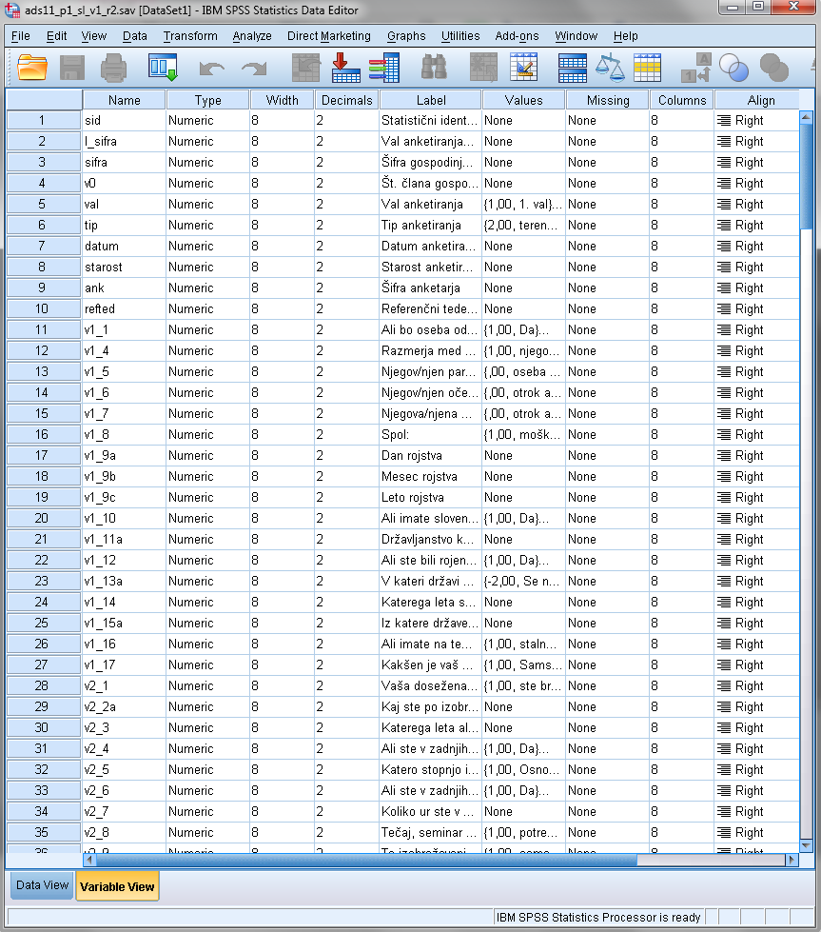
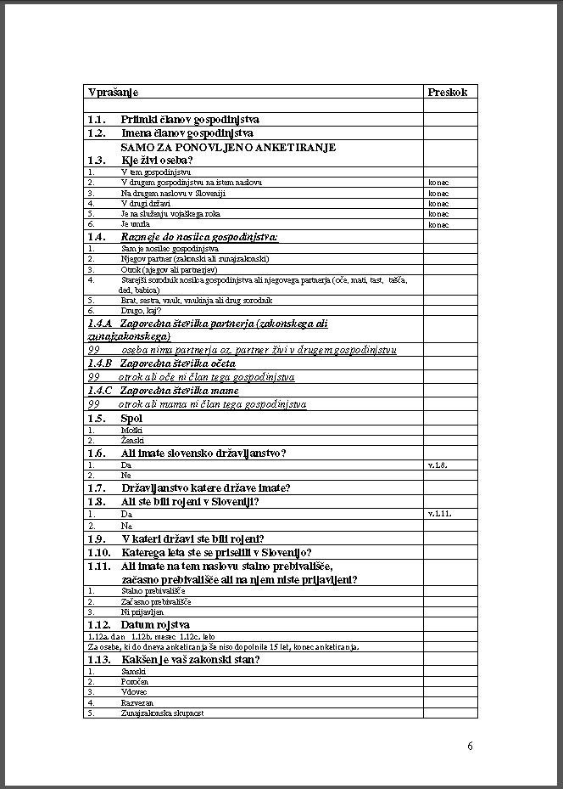
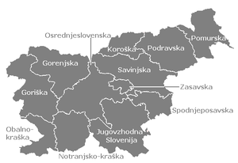
Preparing deindividualized microdata – how we do it
Forms of cooperation
+
=

Slide 9
Preparing Public Use Files – the purpose of it
Forms of cooperation
no new SORS microdata have been in the last years distributed by ADP, the newest ones on our webpage are Census 2002 microdata
one of our target groups, undergraduate students, is not familiar with SORS microdata (can’t access them in the detailed form), so they are not aware of the advantages of using them
the majority of researchers would benefit from a simpler access to moderately anonymized microdata
the developed anonymization procedure keeps as much statistical information intact as possible, data are of sufficient quality to be used for advanced level of research

Slide 10
Preparing Public Use Files – how we do it
Forms of cooperation
in cooperation with SORS Sector for General Methodology and Standards
anonymisation procedure which follows Eurostat LFS anonymisation criteria (in SPSS)
calculating individual and global risk (R! – sdcMicro)
calculating strata allocation, based on individual risk averages by strata (R! – bethel)
stratified sampling, based on the inclusion probability of a certain case (R! – sampling – samplecube)
sample weights recalculation

Slide 11
Preparing Public Use Files – evaluation of methods
Forms of cooperation
additionally, the comparison of anonymisation methods, software and technics to improve the anonymisation process in terms of complexity and time used, is in progress
as the responsible employees at the Slovenian NSI don‘t have much time to concentrate on preparing PUF, we would like to optimize the process and keep the quality of PUF data
comparison of methods and technics used by open-source software
data reduction techniques, data perturbation techniques, sampling, generating synthetic microdata
R! - sdcMicro package (bethel and sampling), The Cornell Anonymization Toolkit, $μ$-ARGUS, open-source synthetic data generator

Slide 12
METADATA - metadata harvesting from SORS systems
Forms of cooperation
the analysis of SORS metadata systems and other possible metadata sources was made
METIS metadata standard had been introduced in the past, but the remains of the system couldn‘t be used for automatic harvesting of sufficient metadata
some bits and pieces of metadata could be, on the other hand, harvested from some databases, applications, e-versions of documentation (quality reports, methodological explanations, databases, questionnaires etc.)
since all this is saved in different systems, several employees from different SORS departments should consequently be involved in the metadata preparation process – automatic harvesting of all metadata researchers need is not possible

Slide 13
METADATA – metadata standard counceling
Forms of cooperation
SORS is working on improvements of its microdata and metadata documentation systems
Social Science Data Archives have extensive experience with DDI standard
in the process of analyzing the possibilities of (semi)automatic metadata harvesting, ADP and SORS got some useful information, applicable for working on both documentation projects in the future
internal presentation on the ADP processes of long term preservation and metadata standard used was given
ADP counsels and advices SORS work groups on metadata standards

Slide 14
METADATA – structured metadata for researchers
Forms of cooperation
DDI standard is used
study descriptions are being prepared, ADP DDI extended scheme is used – including methodological, file description, data description, publication, other material etc. metadata fields
all the required/useful documentation is made available to researchers in one place (codebooks, questionnaires, publications, syntaxes, methodological explanations etc.)
metadata is being harvested from SORS and EUROSTAT documentation and websites, also by contacting separate SORS departments, responsible for conducting a survey

Slide 15
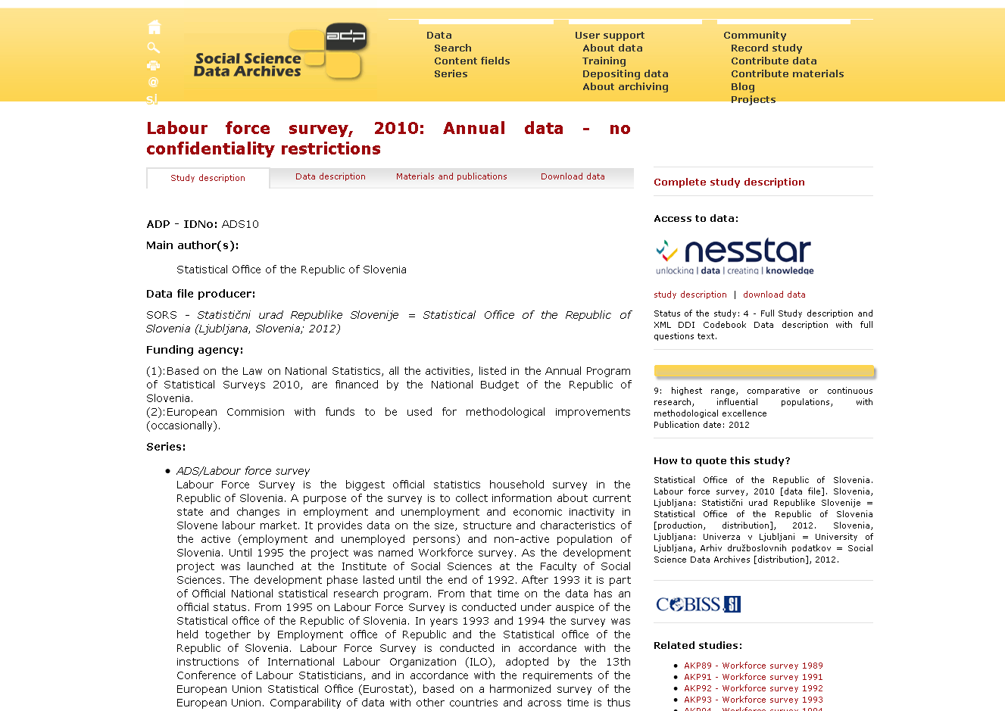
Availability of prepared metadata – ADP website
Forms of cooperation

Slide 16
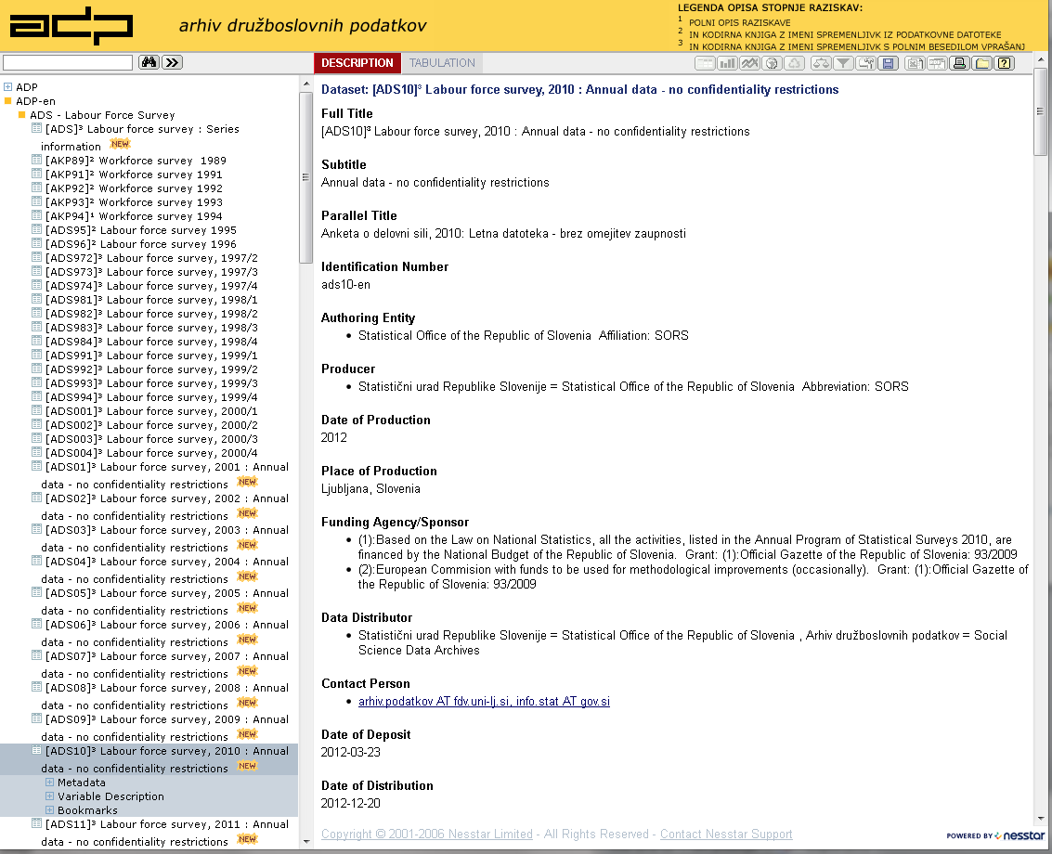
Availability of prepared metadata – Nesstar
Forms of cooperation

Slide 17
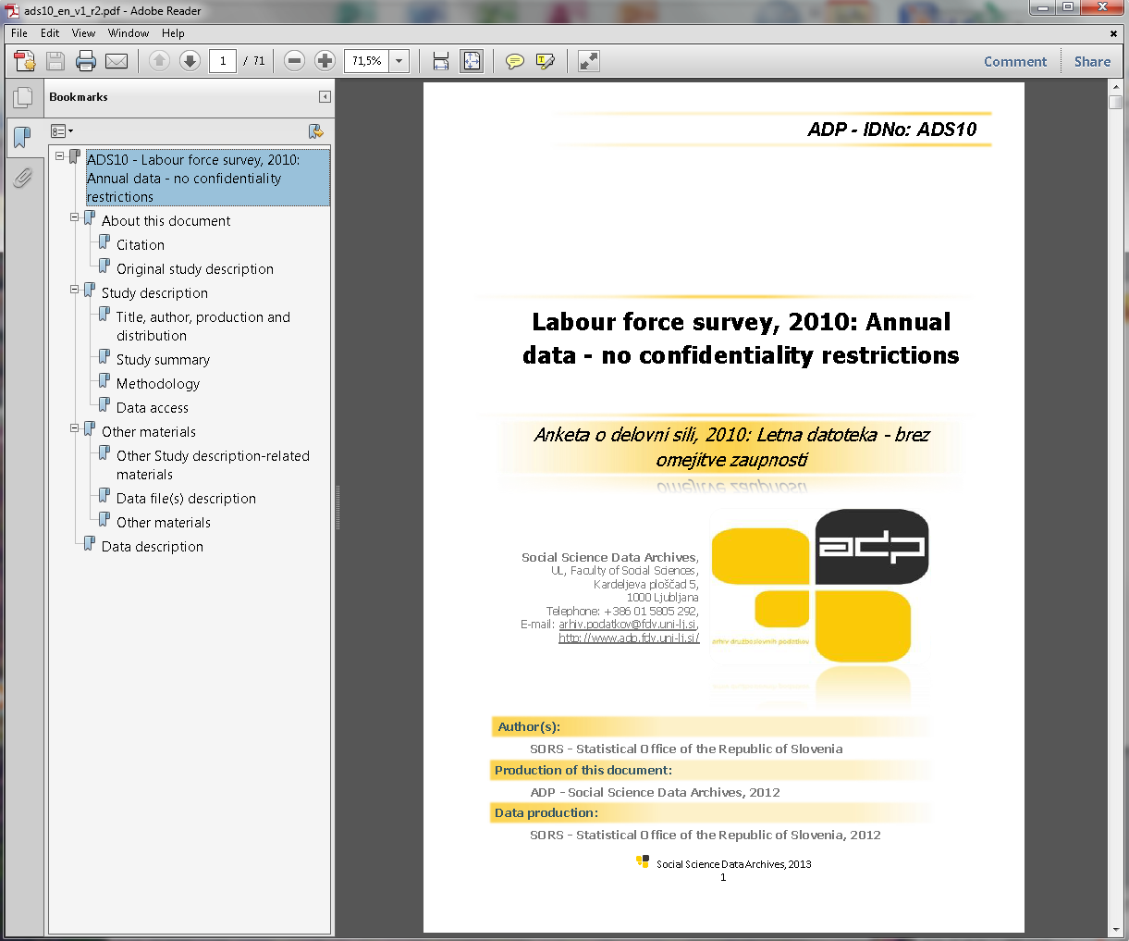
Availability of prepared metadata – safe room, remote access
Forms of cooperation

Slide 18
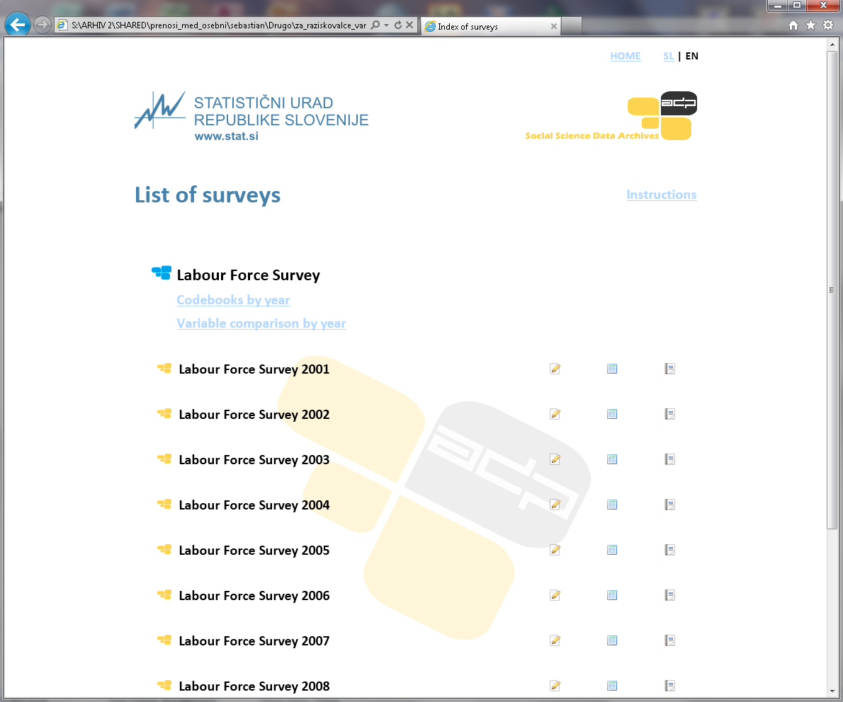
Availability of prepared metadata – html browsing document
Forms of cooperation

Slide 19
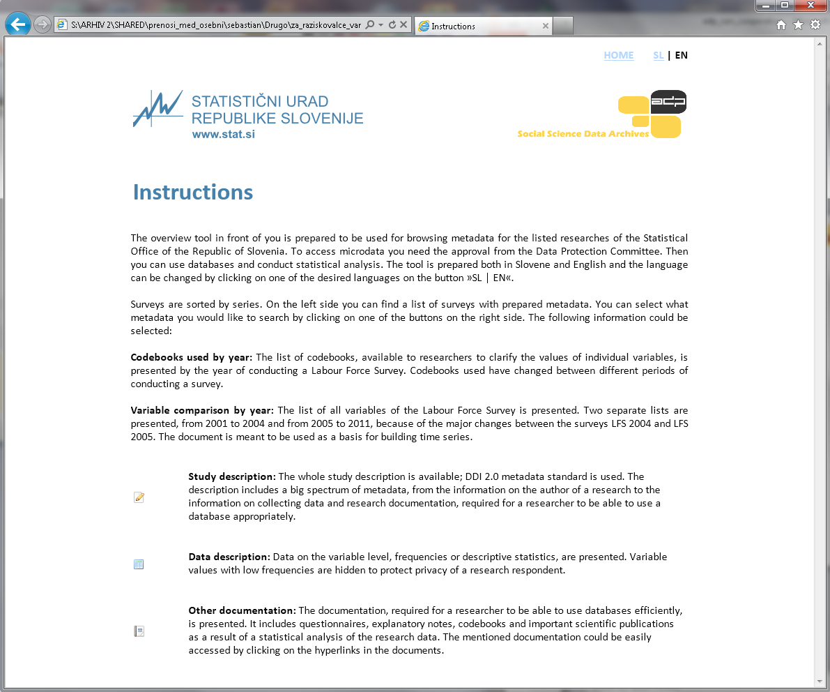
Availability of prepared metadata – html browsing document
Forms of cooperation

Slide 20
Promotional activities – channels used
Forms of cooperation
national conferences (Multiconference Information Society 2012, Statistical Days 2012, Joint Conference of Slovenian Sociological Association and ESA Working Group 2012)
international conferences (IASSIST 2013, ESRA 2013, Applied Statistics 2013)
ADP and Faculty of Social Sciences websites
ADP social network sites (FB, Twitter), blog
SORS website, to be renovated and the part about microdata access improved (ADP presented the researchers‘ point of view and suggested solutions)
mailing lists (Slovenian Research Agency, SORS microdata users)
national workshops for students and researchers

Slide 21
Results of the national cooperation
Results and future challenges
Labour Force Survey 2001-2011 detailed deindividualized microdata, structured metadata, survey documentation gathered; available in the safe room or by the remote access
Register data on public expenditures to support pensioners
Labour Force Survey 2010 Public Use File
html browsing document
metadata system, analysis, harvesting, counseling, development
becoming familiar with organizational policies, procedures, work specifics; working with different SORS departments; developing procedures, low input-high output model of cooperation

Slide 22
Challenges of the future
Results and future challenges
preparing microdata and metadata of selected surveys, register data (including PUF)
decision based on researchers‘ needs, importance, practicability and applicability of data, availability of SORS employees (Register Census 2011, EU SILC, CIS f.e.)
continuation of work done (updates in a series)
harvesting metadata from upgraded metadata and microdata documentation systems
organizing workshops for students (LFS workshop in Autumn 2013)
addressing researchers needs (what, where, how, in what form)

Slide 23
Thank you for your attention!
Sebastian Kočar (Slovene Social Science Data Archives)
5th Conference of the European Survey Research Association – ESRA 2013
Ljubljana, Slovenia
July 2013

